Slide 1
Review on the comments of “WLAN/5G interworking report Proposed Way Forward(11-21/0438r0)”
Date: 2021-03-15
Authors:

Slide 2
Abstract
At the March 10 meeting, “WG/5G Interworking Report Proposed Way Forward(21/0438r0)” was presented by Robert Stacey, Intel.
This contribution provides review and clarification on four comments from the document (11-21-0438r0).

Slide 3
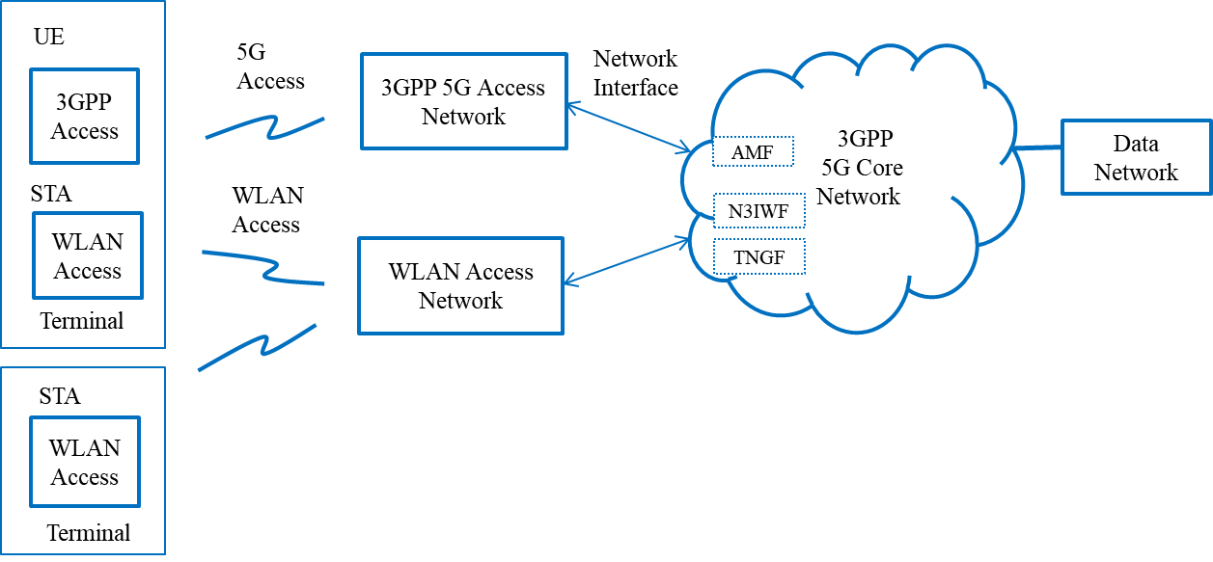
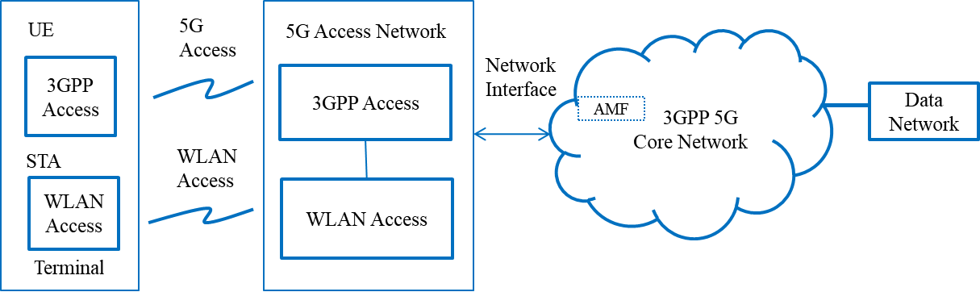
Comment #1: Tightly coupled and loosely coupled interworking model
  3GPP Rel 15/16 does not define tightly coupled & loosely coupled interworking model shown in Figure 2 & 3. Figure 3 shows TNGF as part of loosely coupled model, however TNGF requires tight integration with WLAN over Ta, but N3IWF does not.
  Review : Terms “Tightly coupled and Loosely coupled interworking are not specified in 3GPP standard. However, RAN level and core network level interworking are conceptually specified. RAN level and core network level interworking are referred to Tightly coupled and Loosely coupled interworking in this technical report. In Loosely coupled interworking(Fig. 3), UE terminal can be connected to N3IWF or TNGF (means untrusted or trusted case), and STA terminal can be connected to N3IWF via WLAN access network. From the view of 3GPP domain, TGNF interworking is recognized as Tightly coupled interworking. Thus, TNGF interworking view in Fig. 3 seems to be different and confused from the view of 3GPP domain.
Fig.2 Tightly coupled interworking reference model between 5G core network and WLAN
Fig. 3 Loosely coupled interworking reference model between 5G core network and WLAN

Slide 4
Comment #1: Proposal to harmonize 3GPP interworking view
  The current title “Tightly coupled interworking reference model between 5G core network and WLAN in Fig. 2 is proposed to be changed into“5G and WLAN access convergence model”, which means a tight integration in the function of UE and 5G access network. A term “Tight integration” is used in RAN convergence paper from WBA. This model is a typical 3GPP system deployment using WLAN as wireless data path.
  The current title “Loosely coupled interworking reference model between 5G core network and WLAN in Fig. 3 is proposed to be changed into “Interworking model between 5G core network and WLAN”, which supports two types of terminals UE and STA, and untrusted and trusted interworking. If these agreed, the related content of technical report will be updated.
Fig.2 5G and WLAN access convergence model
Fig. 3 Interworking model between 5G core network and WLAN

Slide 5
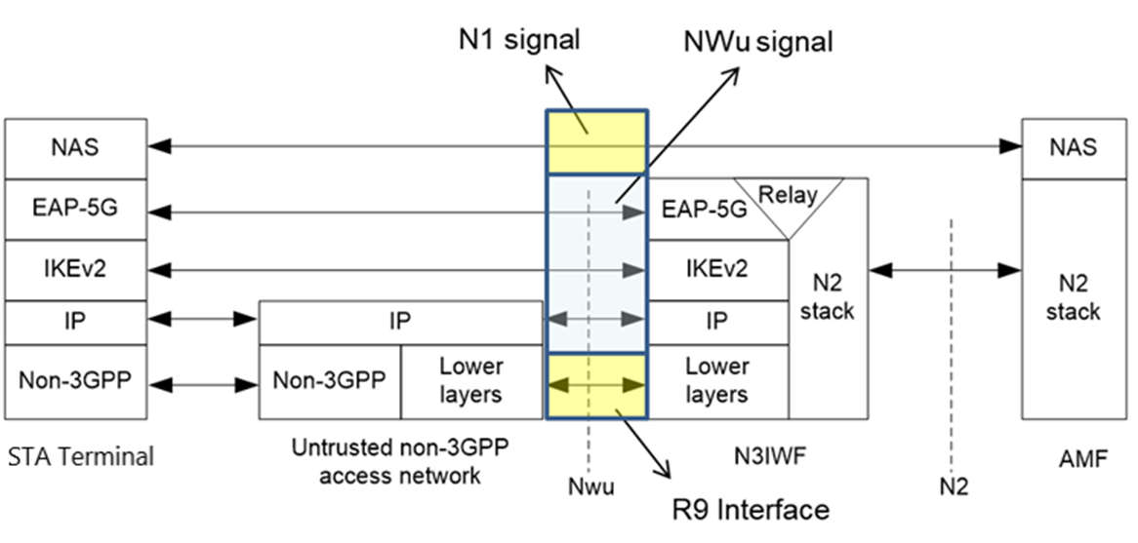
Comment #2: Section 4.2 STA terminal
  Section 4.2: “A STA terminal shall initially support registration and authentication to establish a connection between a STA terminal and N3IWF” is inaccurate. Registration and auth are not done to establish connection with N3IWF.
  Review: According to IEEE 802.11 standard, station (STA) is defined as a logical entity that is a singly addressable instance of a medium access control (MAC) and physical layer (PHY) interface to the wireless medium (WM). In this report, STA terminal has functions of terminal interface (TEI) and terminal control (TEC), which is described in section 3.2 WLAN interworking functional model in 5G system.
  Section 4.2 describes a control function of STA terminal: STA terminal shall support registration and authentication function to interwork with 5G core network.
Fig.6 Control plane between a STA terminal and N3IWF (3GPP TS 23.501)

Slide 6
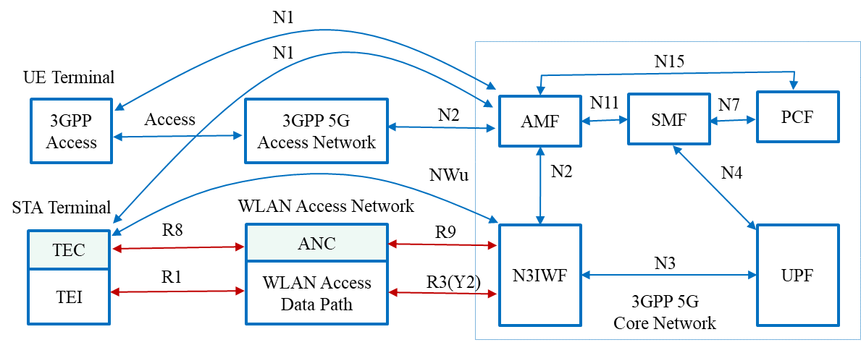
Comment #3: Section 6.1 STA terminal
  Section 6.1: “NAS signaling to AMF and packet session control to SMF are specified in 3GPP specifications and can be implemented in STA TEC and WLAN ANC.” is inaccurate. WLAN access network does not implement NAS signaling and packet session related control.
  Review: In this report , STA terminal has functions of terminal interface (TEI) and terminal control (TEC) as shown in Fig.4.
  Section 6.1 describes a control function of STA terminal : STA terminal shall support NAS signaling to interwork with 5G core network.
Fig.4 Untrusted WLAN interworking reference model with 5G core network

Slide 7
Comment 4: Section 7 STA terminal
  Section 7: “The STA TEC and WLAN ANC should contain the function for NAS signaling, ATSSS and QoS management functions, and should follow the guidance of the 3GPP specifications.” is inaccurate. NAS Signaling and ATSSS are not supported by WLAN access network.
  Review: In this report , STA terminal has functions of terminal interface (TEI) and terminal control (TEC) as shown in Fig.4.
  Section 7 describes a control function of STA terminal: STA terminal shall support NAS signaling and ATSSS functions to interwork with 5G core network.
Fig.4 Untrusted WLAN interworking reference model with 5G core network

Slide 8
Summary
Comment #1: Tightly coupled and loosely coupled interworking model(Fig. 2 and 3)
  To harmonize 3GPP interworking view to WLAN, terms “Tightly coupled interworking and Loosely interworking” are deleted.
  The title of Fig. 2 is proposed to be changed into “5G and WLAN access convergence model” in section 3.1.
  The title of Fig. 3 is proposed to be changed into “Interworking model between 5G core network and WLAN” in section 3.1.
  If the proposal to change is agreed, the related content of technical report will be updated in section 3.1.
Comment #2, #3, #4: Section 4.2, 6.1 and 7.0 STA terminal related functions
  In this report , STA terminal in WLAN domain has functions of terminal interface (TEI) and terminal control (TEC), which is described in section 3.2 WLAN interworking functional model in 5G system.
  The comments #2, #3 and #4 are related to functional requirements of STA terminal
  - STA terminal shall support registration and authentication function to interwork with 5G core network.
  - STA terminal shall support NAS signaling to interwork with 5G core network.
  - STA terminal shall support NAS signaling and ATSSS functions to interwork with 5G core network.

