Slide 1
Multi-Band WiFi Fusion for WLAN Sensing
Date: 2021-03-23
Authors:
Name | Affiliation | Address | Phone | Email
Pu (Perry) Wang | Mitsubishi Electric Research Laboratories (MERL) | 201 Broadway, Cambridge, MA 02139, USA | 617-621-7567 | pwang@merl.com
Jianyuan Yu
Toshiaki Koike-Akino
Ye Wang
Philip V. Orlik
Notes:
September 2012

Slide 2

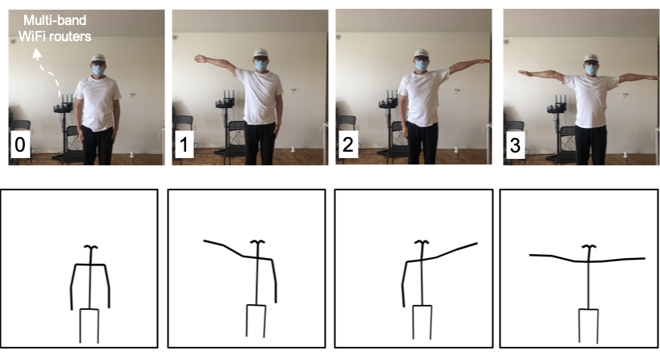
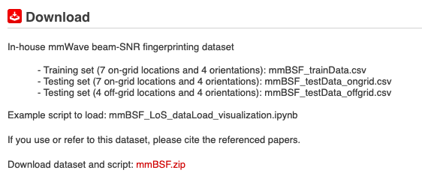
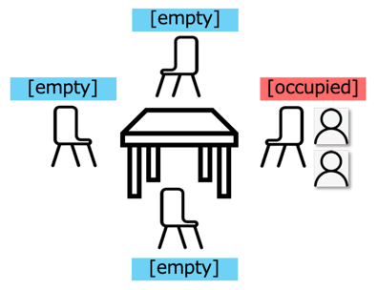
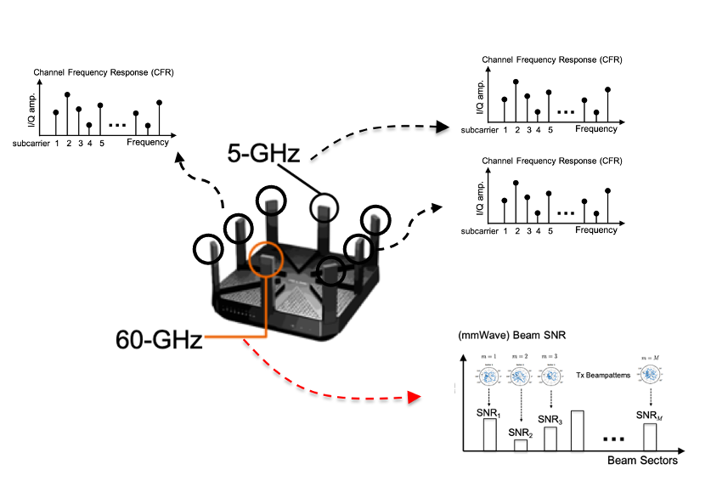
Abstract
This contribution is a continuation of
  20/1074r1 WLAN Localization and Sensing With Mid-Grained Channel Measurements
  20/1741r1 Feasibility study of human pose and occupancy classification using mmWave WiFi beam attributes
  which used mid-grained beam measurements (e.g., beam SNRs) at 60 GHz, immediately available during mmWave beam training phase, for WLAN sensing.
Occupancy Sensing
Open dataset for WiFi beam measurements (60 GHz)
Pose Recognition
https://www.merl.com/demos/mmBSF
This contribution reports multi-band WiFi fusion between
  Fine-grained CSI at sub-7 GHz (2.4 GHz and 5 GHz)
  Mid-grained beam measurements (e.g., beam SNRs) at 60-GHz
  Particularly, we aim to promote the use of fused WiFi channel measurements/results from different frequency bands for WLAN sensing.
Multi-band WiFi fusion for WLAN Sensing

Slide 3
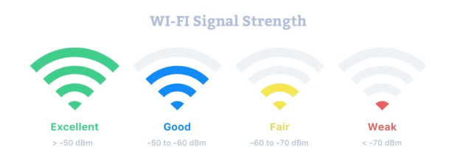
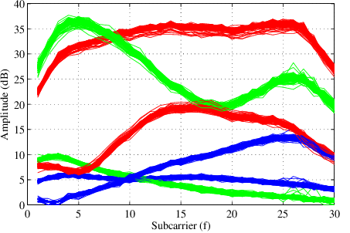
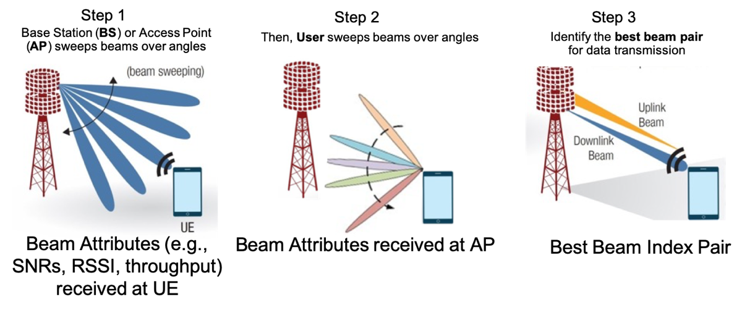
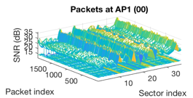
WiFi Channel Measurements
RSSI
WLAN sensing may consider the following WiFi channel measurements
  Coarse-grained RSSI (received signal strength indicator)
    In the unit of dBm, easy to access, coarse channel information
  Fine-grained CSI (channel state information) at sub-7 GHz
    Complex amplitudes at freq.-domain OFDM subcarriers (802.11g/n/ac at 2.4 & 5 GHz)
    WiFi CSI can be accessible from commercial WiFi devices in earlier 2010s
    The CSI-based fingerprinting outperforms the RSSI-based fingerprinting
    (DeepFi’16, PhaseFi’17, BiLoc’18, CSI-Net’19, Person-in-WiFi’19)
  Super-grained CSI at 45+ GHz (e.g., 60 GHz)
    Complex amplitudes at freq.-domain OFDM subcarriers (802.11ad/ay at 60 GHz)
    Not easy to access using commercial WiFi devices
    Super-resolution in delay profile with huge overhead (access, storage, processing)
  Mid-grained (mmWave) beam measurement (e.g., beam SNRs)
    Data collection and exchange (between AP and User) are already defined in 802.11ad/ay standards during beam training (therefore, minimal additional overhead)
    Spatial-domain channel measurements at mmWave bands, weighted by beamforming patterns
Picture source: https://www.netspotapp.com
CSI sequences for 2 Tx & 3 Rx
Picture sources: [7]
Reuse of WiFi channel beam measurement during (mmWave) beam training for WLAN Sensing
*Similar to the CSI beamforming feedback matrix (21/0357r0) but in mmWave bands and no significant changes to PHY is required

Slide 4
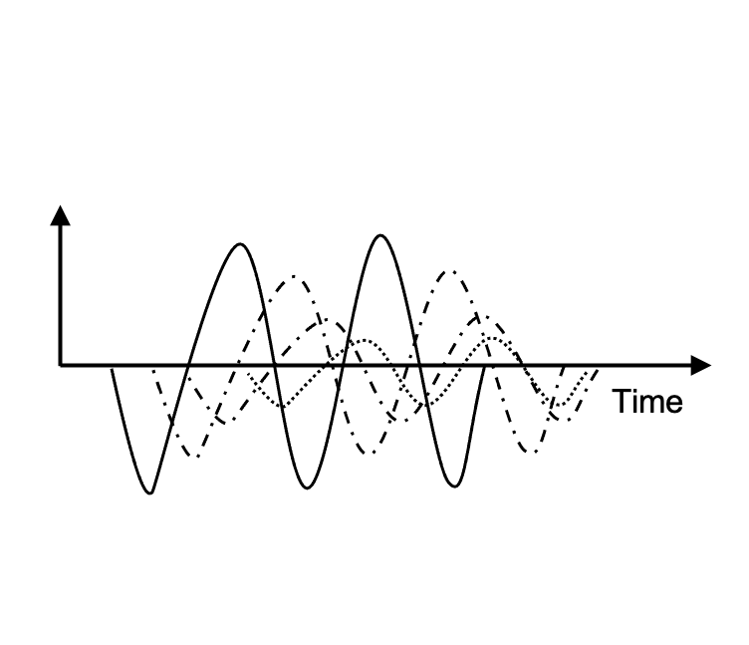
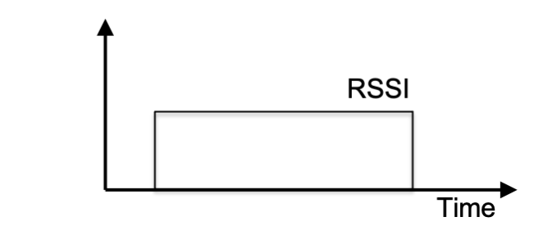
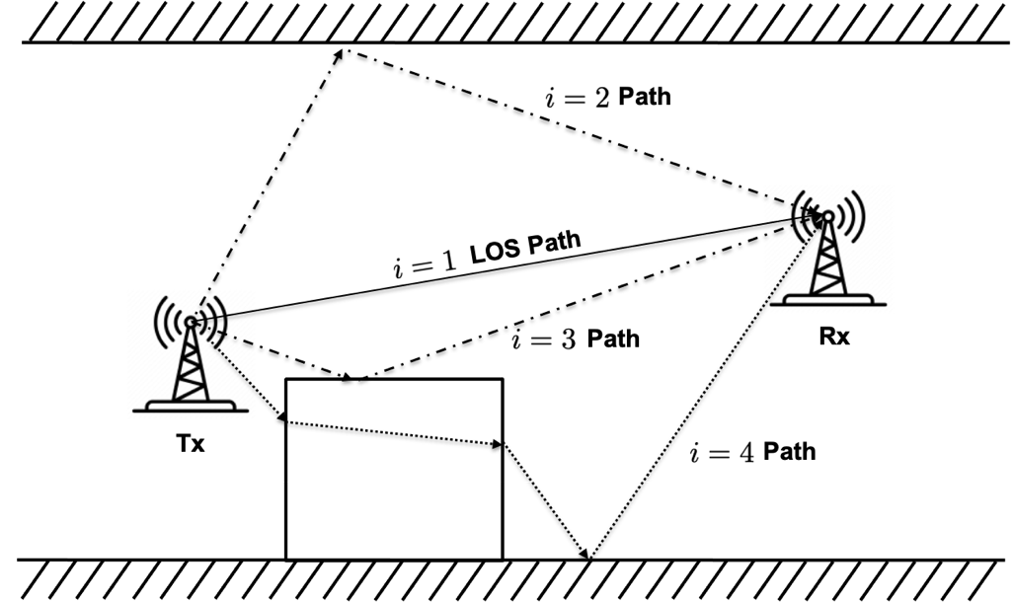
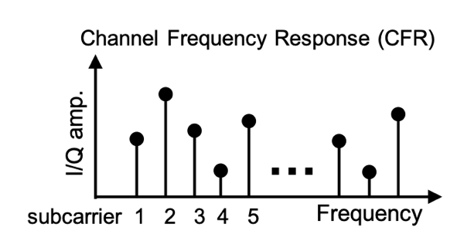
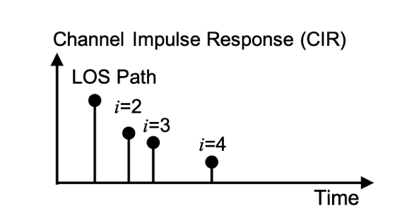
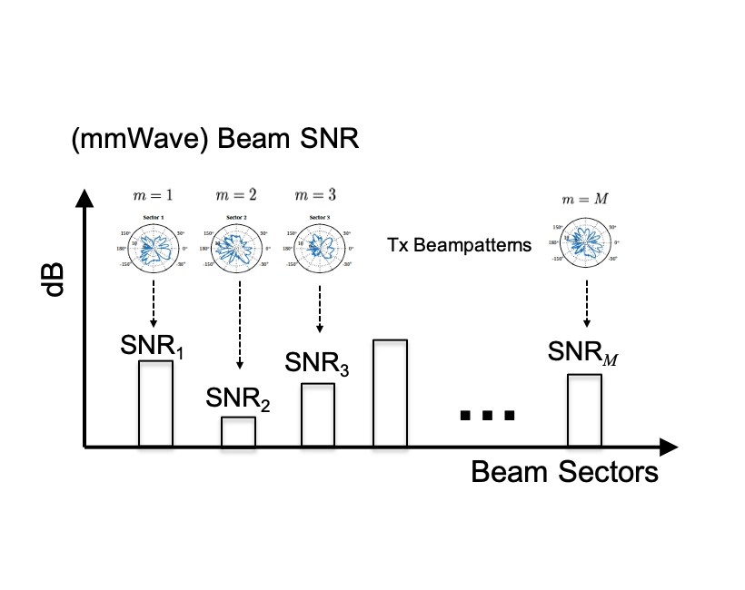
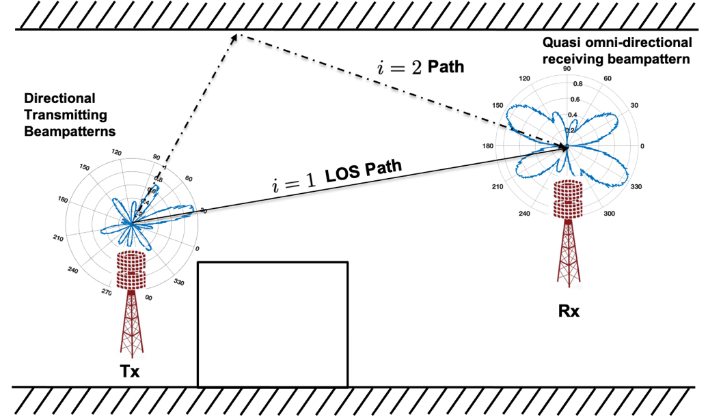
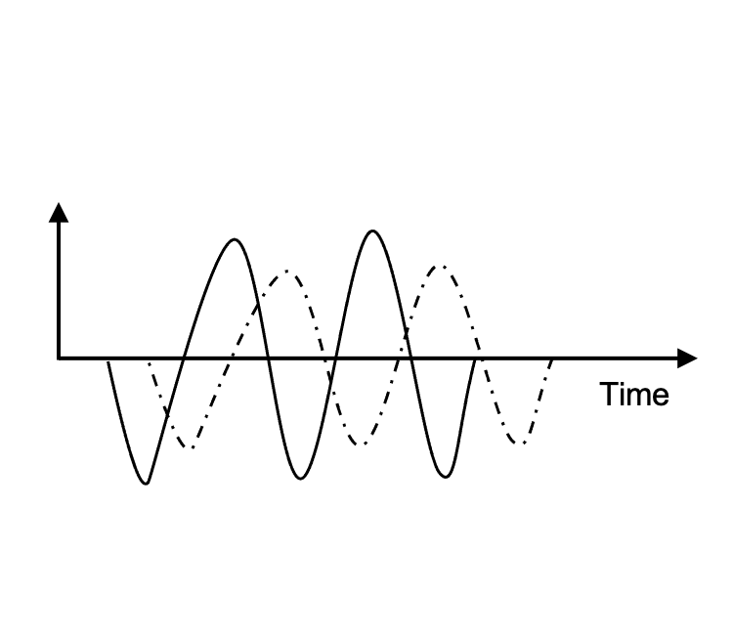
Multi-Band WiFi Fusion: Measurements (I)
We consider two complementary WiFi channel measurements for WLAN Sensing
  Fine-grained CSI: Complex amplitudes at freq.-domain OFDM subcarriers (802.11g/n/ac at sub-7 GHz)
coarse-grained RSSI
fine-grained CSI (CFR)
Delay profile (CIR)
Multipath propagation at sub-7 GHz
Echo signals at sub-7 GHz
Channel Measurements at sub-7 GHz
  Mid-grained beam measurements: Spatial-domain channel measurements at mmWave bands, weighted by beampatterns
mid-grained beam measurements
Echo signals at 45+ GHz
Channel measurements at 45+ GHz
(during beam training)
Multipath propagation at 45+ GHz
Pictures copyright@MERL

Slide 5
Multi-Band WiFi Fusion: Measurements (II)
We propose to fuse 1) Fine-grained CSI at sub-6 GHz from multiple spatial streams and 2) Mid-grained beam measurements (e.g., beam SNRs) at the mmWave band of 60 GHz
CSI at sub-7 GHz | Beam Measurements at 60 GHz
frequency-domain CFR; delay-domain CIR | spatial-domain link quality over beamforming patterns
sensitive to both subtle & large motions | sensitive to only large motions/distinct patterns (*if the coarse beampatterns at commercial devices)
cover large areas (pass through walls) | cover small areas (blocked by obstacles)
richer multipath | sparse propagation paths (with cluster/group structures)
Limited number of antennas with omnidirectional beampatterns | Phased array with directional beampatterns
inconsistent measurements (channel fading, sensitive to environmental dynamics – pet, movable home appliances) | more repeatable (even in the presence of disturbance)
high dimension (no. subcarriers x no. antennas) | medium/low dimension (no. of beampatterns)

Slide 6
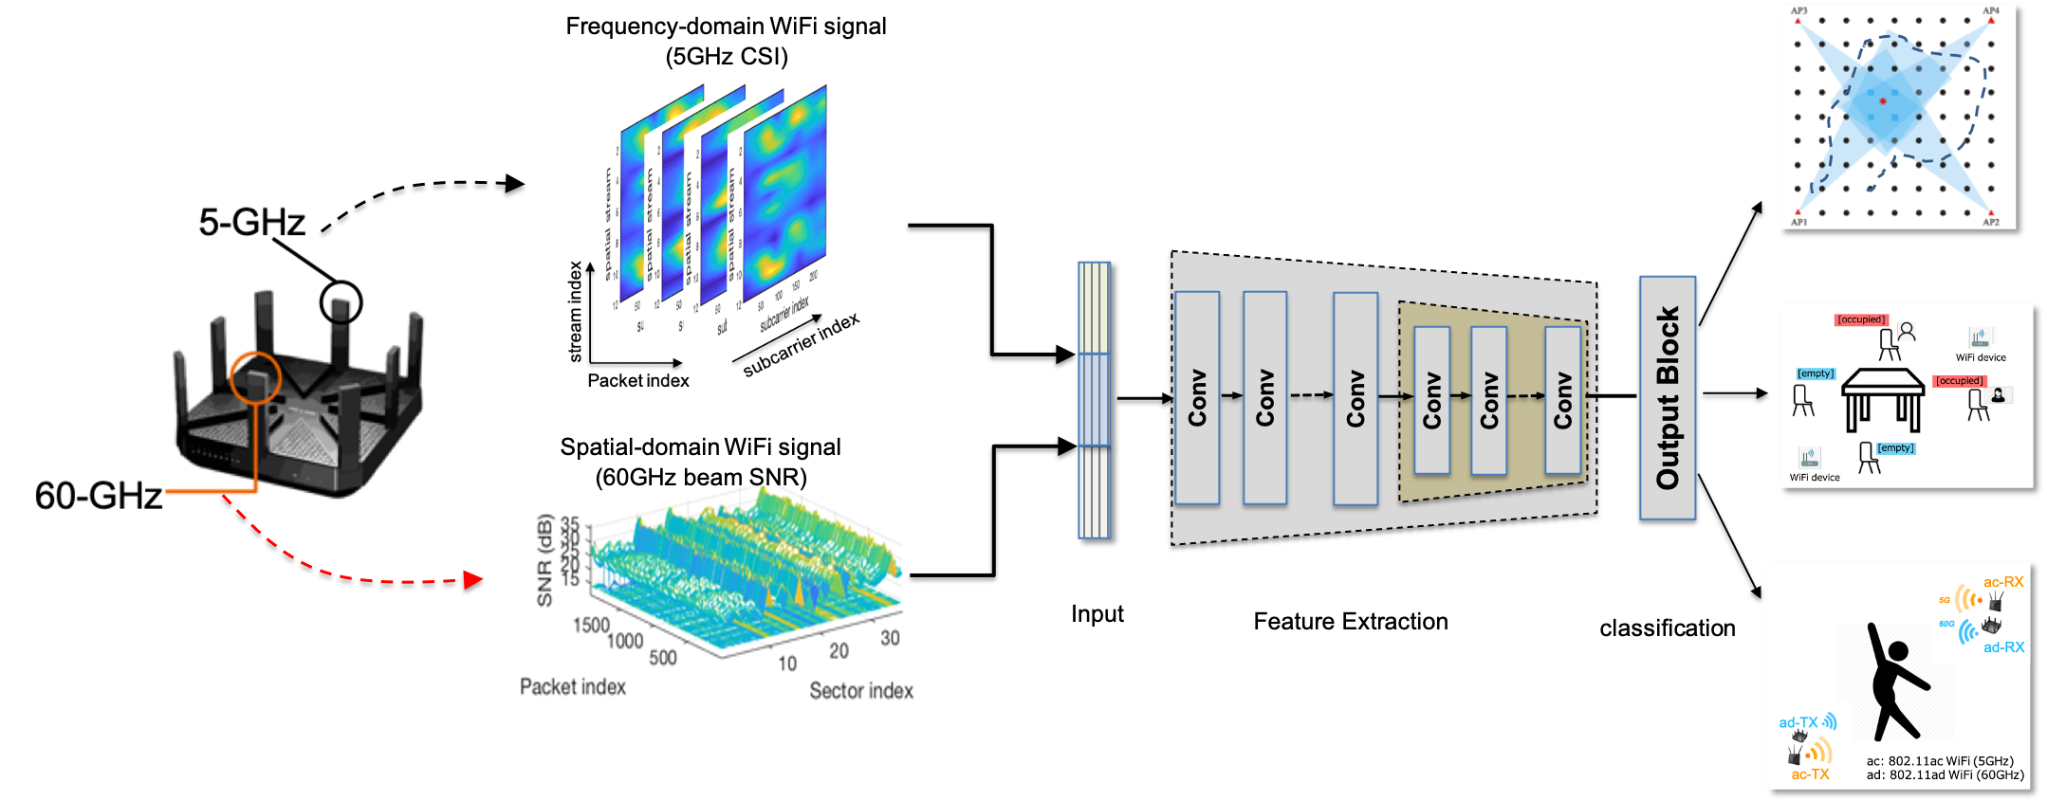
Multi-Band WiFi Fusion (I): Input Fusion/Concatenation
A simple way to combine the two measurements is to concatenate them together before being fed into a neural network or signal processing method for multi-task WLAN sensing applications.
Indoor Localization
(with-device)
Occupancy Sensing
(device-free)
Pose Recognition
(device-free)
Input Fusion/Concatenation
Pictures copyright@MERL

Slide 7
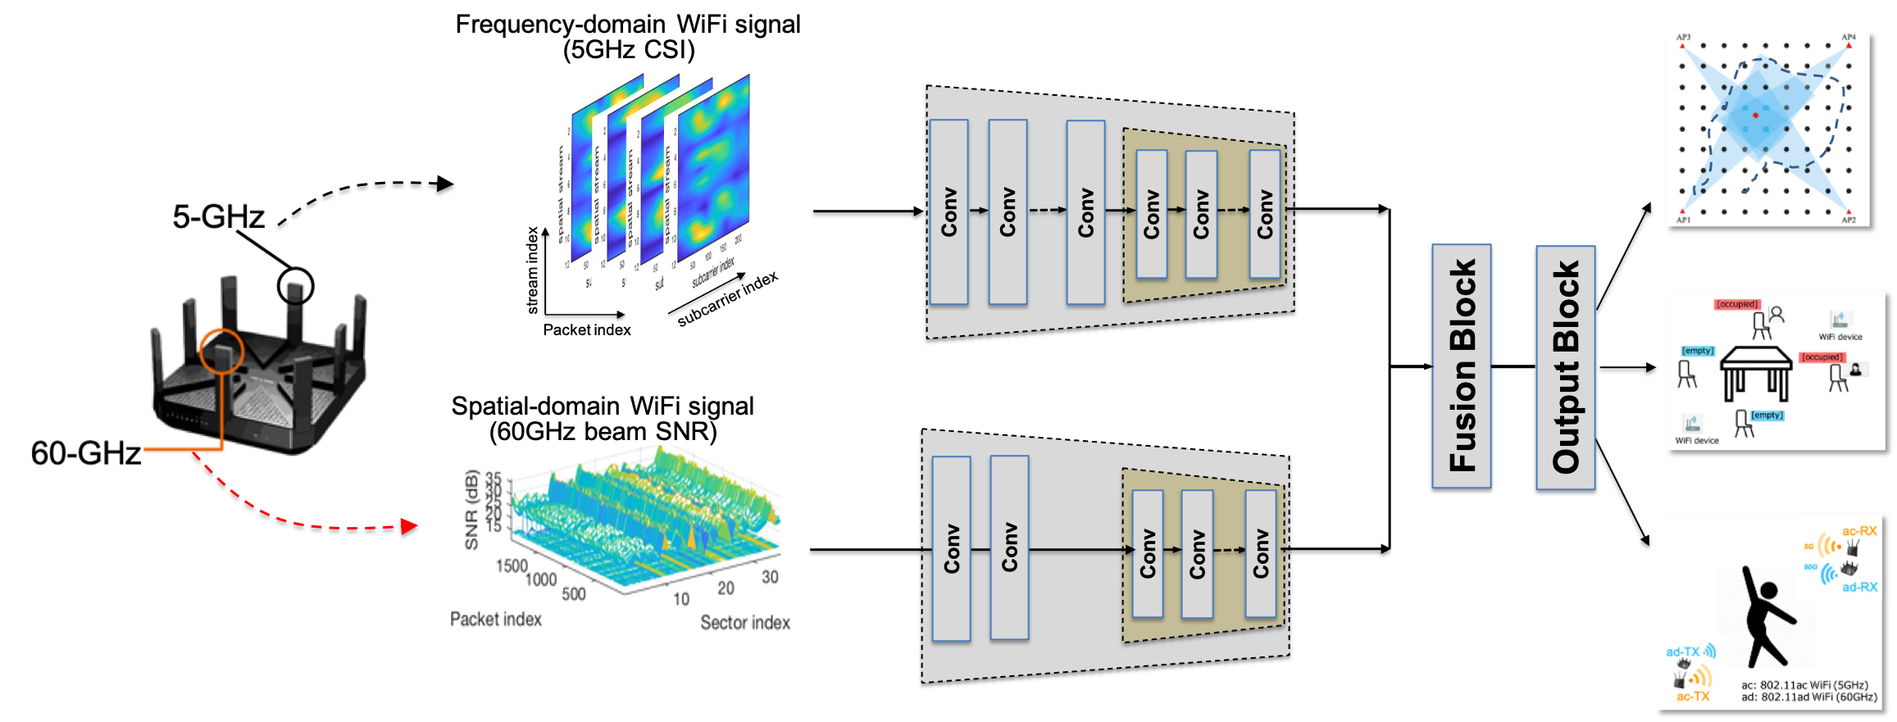
Multi-Band WiFi Fusion (II): Feature Fusion
Another popular choice is to use separate encoders for individual feature extraction and fuse the features in the latent space (final outputs of the two encoders), followed by a classifier network.
Feature Fusion (in smaller latent/compressed dimension)
Pictures copyright@MERL

Slide 8
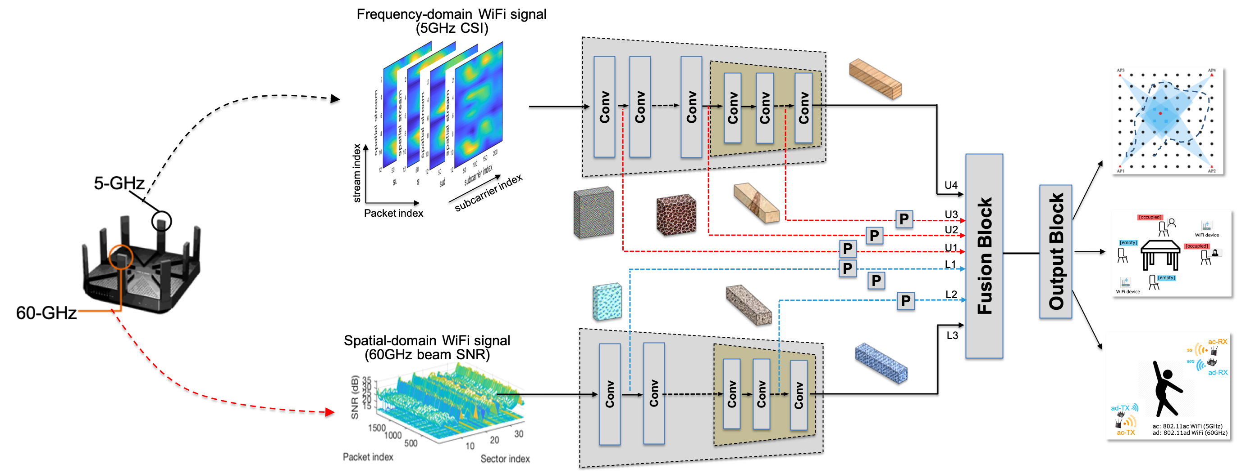
Multi-Band WiFi Fusion (III): Feature Permutation
It is known that the two considered measurements are with different granularity levels.
No consideration of feature granularity correspondence.
We further consider a feature permutation-based multi-band WiFi fusion.
Feature Fusion with Granularity Correspondence
Pictures copyright@MERL

Slide 9
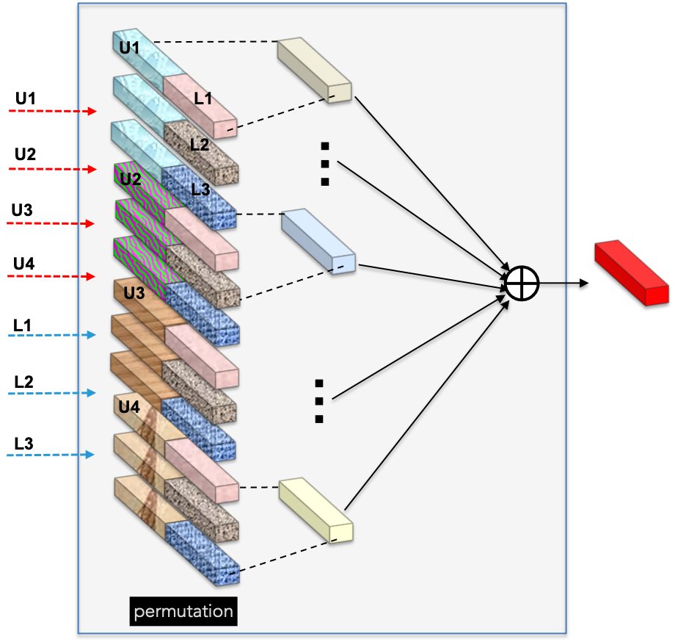
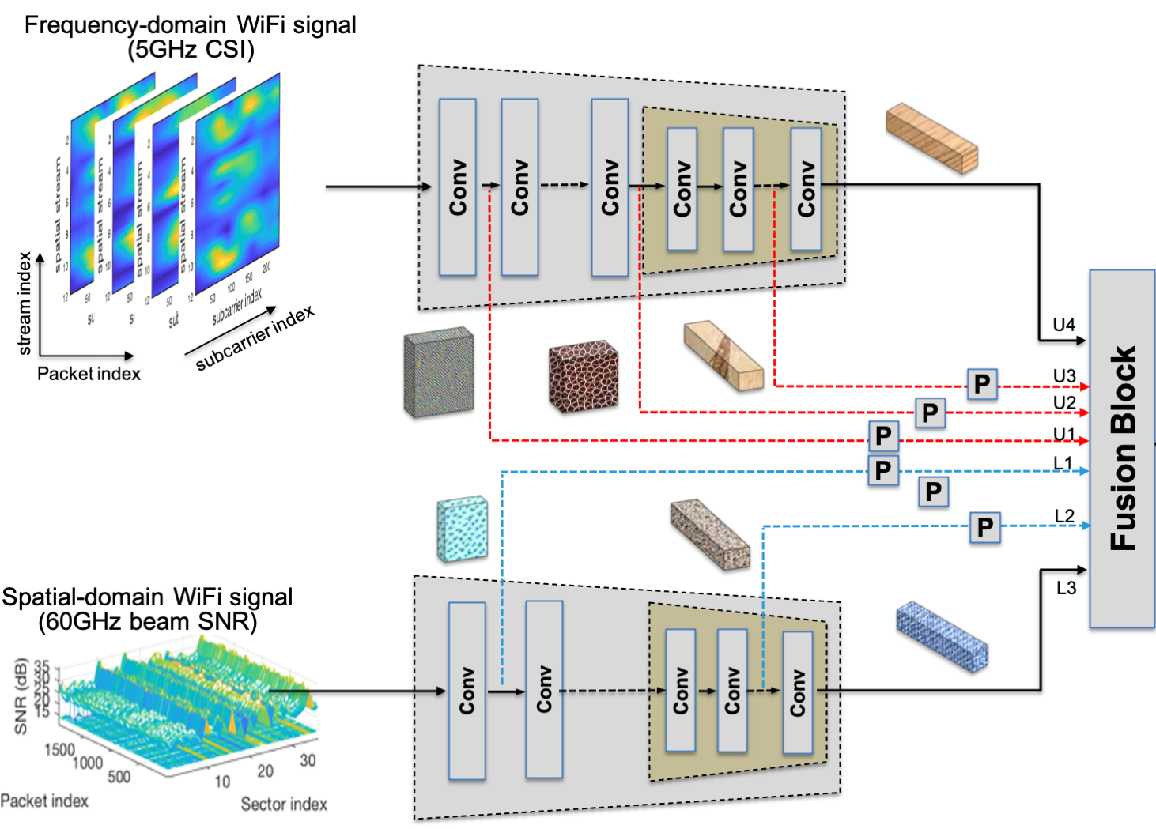
Multi-Band WiFi Fusion (III): Feature Permutation
The first stage is to permute the collected features at some selected layers from both encoders for CSI and beam SNR.
The second stage is to combine the permuted fused features to a single fused feature.
Feature Permutation
Pictures copyright@MERL

Slide 10
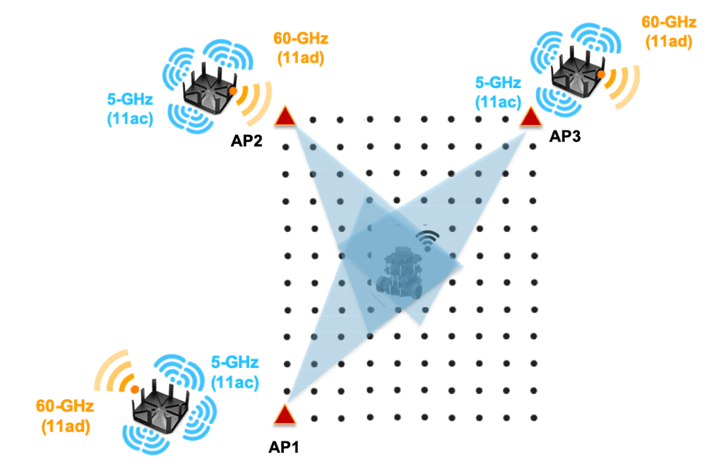
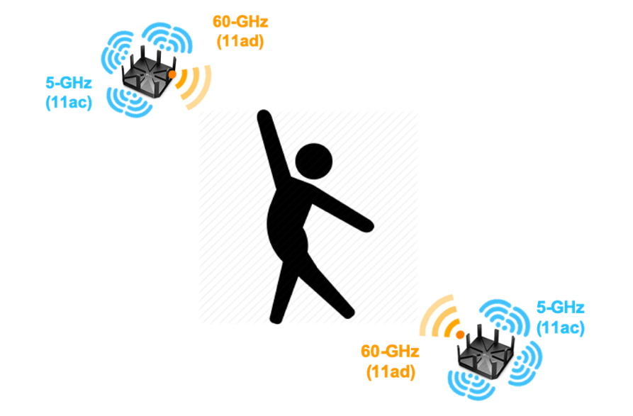
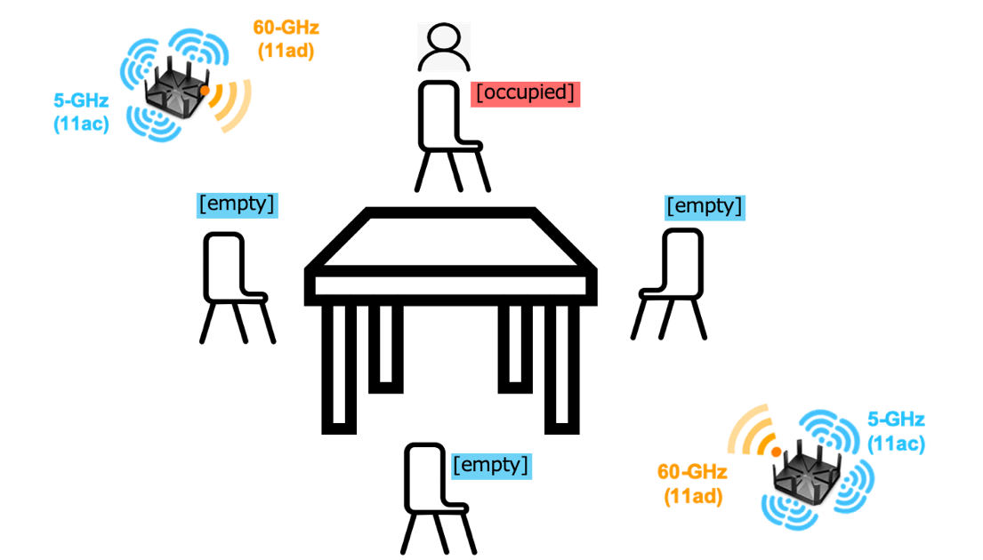
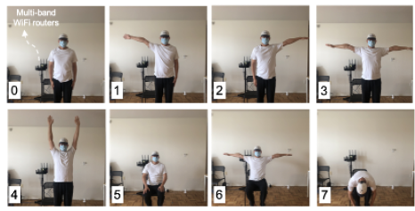
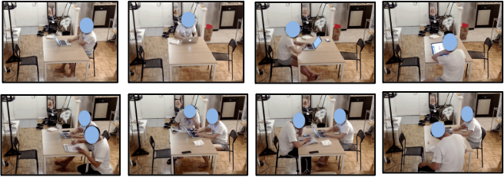
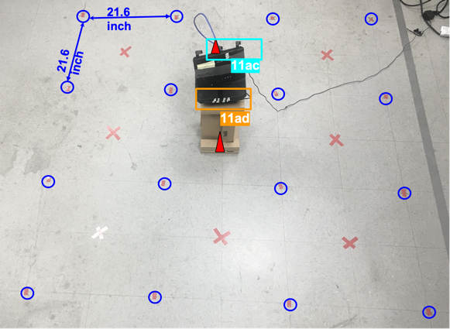
Multi-Task WLAN Sensing

Slide 11
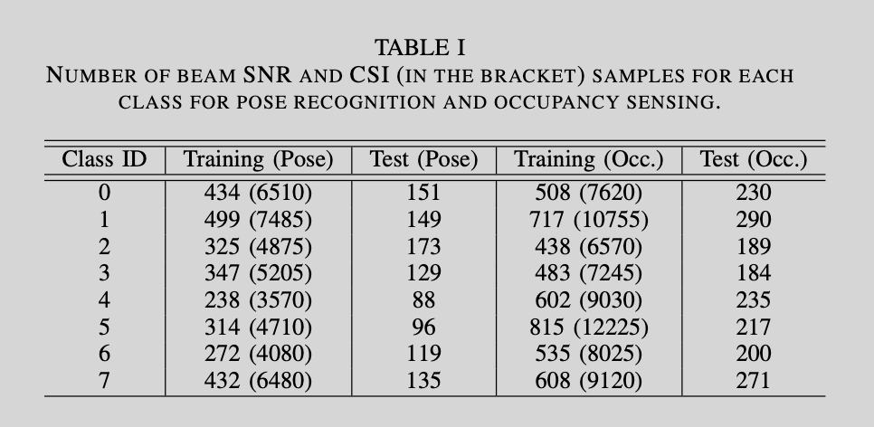
Testbed & Dataset
CSI from 802.11ac devices: We used ASUS RT-AC86U routers with 3 external and 1 internal antennas to extract the CSI measurements at 5 GHz and modified its firmware using the nexmon CSI Extractor Tool of [11].
Beam SNR from 802.11ad devices: We use TP-Link Talon AD7200 routers to collect beam SNRs at 60 GHz. This router implements Qualcomm QCA9500 transceiver that supports a single stream communication in 60 GHz range using analog beamforming over 32-element planar array [8-10]
For each sensing task, multiple (~7) independent data sessions for performance evaluation*
* As opposed to evaluation based on random splitting of a single-data-session data.

Slide 12
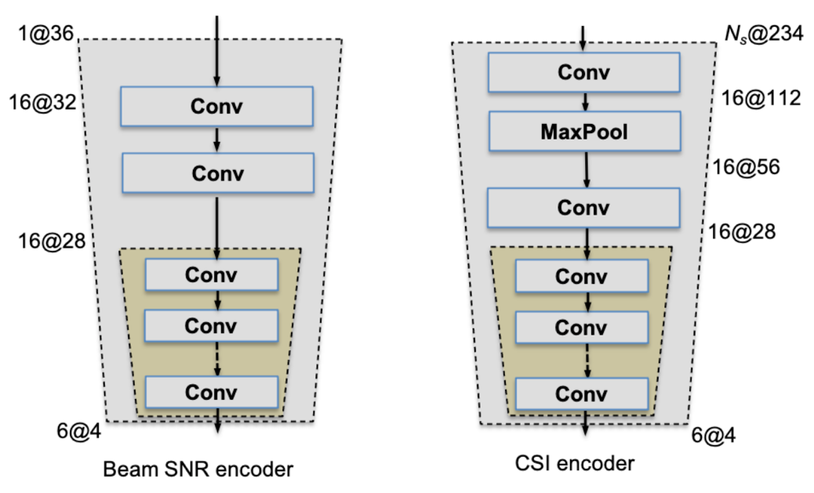
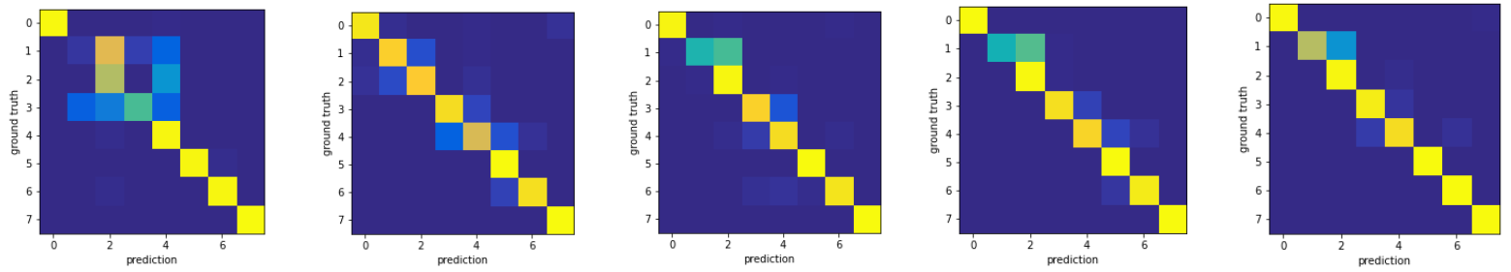
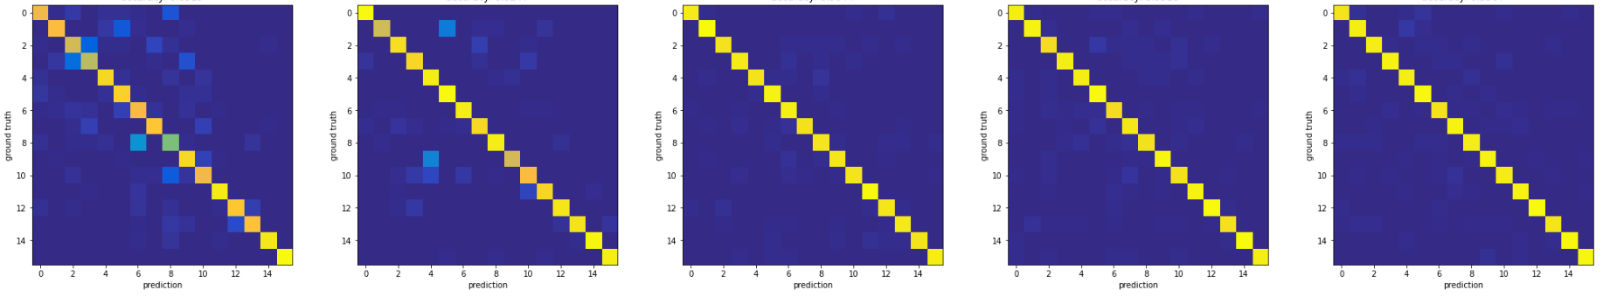
Results (I): Confusion Matrix
Compressed both WiFi channel measurements into a dimension of 24
The compressed fused measurement can be considered as a type of sensing measurement results from one or more STAs
Pose Recognition (8 poses)
CSI-only
Beam SNR-only
IF: input fusion
FF: input fusion
FP: feature permutation
Indoor localization (4 x 4 grids)
CSI-only
Beam SNR-only
IF: input fusion
FF: input fusion
FP: feature permutation

Slide 13
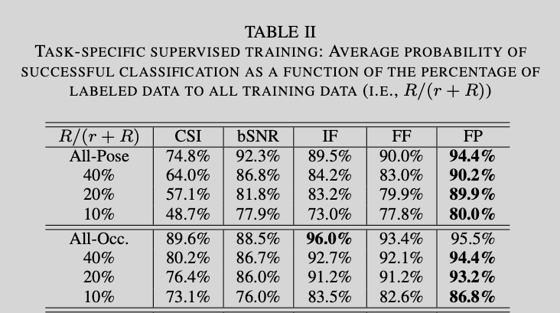
Results (II): Impact of The Number of Labeled Samples

Slide 14
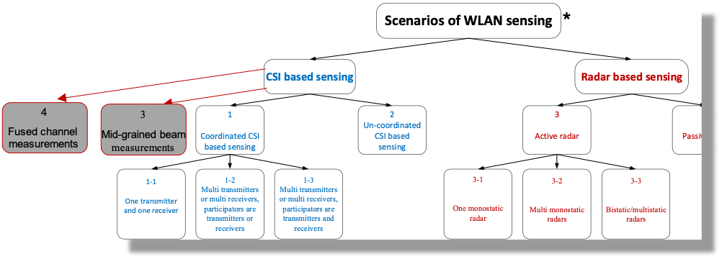
The Role of Fused Measurements/Results
(Related document 20/0147r3)
Motion 15 (Related document 20/1851r4):
  A sensing session is composed of one or more of the following phases: setup phase, measurement phase, reporting phase, and termination phase.
    In the setup phase, a sensing session is established, and operational parameters associated with the sensing session are determined and may be exchanged between STAs.
    In the measurement phase, sensing measurements are performed.
    In the reporting phase, sensing measurement results are reported.
    In the termination phase, STAs stop performing measurements and terminate the sensing session.
Sensing measurement: the measurement of the area of interest
  raw CSI, raw RSSI, received radar signal, etc,
  mid-grained beam measurements at mmWave bands
  fused multi-band WiFi measurements/features at STA.
Sensing (measurement) result:
  compressed CSI, range-Doppler map, range-time map, etc.,
  fused multi-band WiFi result (from multiple sensing STAs)

Slide 15
Conclusions
Robustness: Multi-band WiFi fusion can enhance the capability of sensing receivers and processors with existing WiFi standards-compliant channel measurements (no significant PHY modifications is required).
Small dimension/overhead: Multi-band WiFi fusion can significant reduce the overhead from each sensing responder/receiver/processor by sharing the fused sensing features in a much smaller dimension, as opposed to the raw CSI or beam measurements.
What’s Next: Multi-band WiFi fusion can further relax the requirement of extensive labeled training data, an issue in the post-deployment of WLAN sensing devices (will be introduced in a subsequent contribution).

Slide 16
References
[1] IEEE 802.11-19/1769r1, CSI-based Wi-Fi Sensing: Results and Standardization Challenges,
[2] IEEE 802.11-19/1626r1, 802.11 sensing: Applications, feasibility, standardization,
[3] Wi-Fi sensing in 60GHz band, IEEE 802.11-19/1551r1
[4] Wi-Fi sensing, IEEE 802.11-19/1164
[5] Wi-Fi sensing: cooperation and standard support, IEEE 802.11-19/1416
[6] M. Kotaru, K. Joshi, D. Bharadia, S. Katti, “Spotfi: Decimeter Level Localization using WiFi”,
[7] X. Wang, L. Gao, S. Mao and S. Pandey, "DeepFi: Deep learning for indoor fingerprinting using channel state information," WCNC, New Orleans, LA, 2015, pp. 1666-1671
[8] D. Steinmetzer, D. Wegemer, M. Schulz, J. Widmer, and M. Hollick, ‘‘Compressive millimeter-wave sector selection in off-the-shelf IEEE 802.11ad devices,’’ in Proc. 13th Int. Conf. Emerg. Netw. EXperiments Technol., Nov. 2017
[9] D. Steinmetzer D. Wegemer and M. Hollick Talon Tools: The Framework for Practical IEEE 802.11ad Research 2018 [online] Available: https://seemoo.de/talon-tools/
[10] M. Schulz D. Wegemer and M. Hollick, “Nexmon: The C-Based Firmware Patching Framework”, 2017
[11] F. Gringoli, M. Schulz, J. Link, and M. Hollick, “Free your CSI: A channel state information extraction platform for modern Wi-Fi chipsets,” in Proceedings of the 13th International Workshop on Wireless Network Testbeds, Experimental Evaluation and Characterization, 2019, pp. 21–28.
[12] IEEE 802.11-20/1074r1, WLAN Localization and Sensing With Mid-Grained Channel Measurements
[13] IEEE 802.11-20/1741r1, Feasibility study of human pose and occupancy classification using mmWave WiFi beam attributes
[14] M. Pajovic, P. Wang, T. Koike-Akino, H. Sun and P. V. Orlik, “Fingerprinting-based indoor localization with commercial mmWave WiFi—Part I: RSS and beam indices" GLOBECOM 2019, pp. 1-6, Dec. 2019.
[15] P. Wang, M. Pajovic, T. Koike-Akino, H. Sun and P. V. Orlik, “Fingerprinting-based indoor localization with commercial mmWave WiFi—Part II: Spatial beam SNRs" GLOBECOM 2019, pp. 1-6 Dec. 2019.
[16] T. Koike-Akino, P. Wang, M. Pajovic, H. Sun and P. V. Orlik, “Fingerprinting-based indoor localization with commercial mmWave WiFi: A Deep Learning Approach”, IEEE Access, Vol. 8, pp. 84879-84892, 2020.
[17] J. Yu, P. Wang , T. Koike-Akino, Y. Wang, and P. V. Orlik, “Human Pose and Seat Occupancy Classification with Commercial mmWave WiFi”, GLOBECOM Workshop on JSAC, December, 2020.

Slide 17
Straw Poll 1
Do you agree that the mid-grained beam measurements (e.g., beam SNRs) at 60 GHz as one type of sensing measurements for WLAN Sensing?
Yes:
No:
Abstain:
Pu (Perry) Wang, MERL

Slide 18
Straw Poll 2
Do you agree that the fused WiFi measurements across multiple operating frequency bands as a valid type of sensing measurements or sensing results?
Yes:
No:
Abstain:
Pu (Perry) Wang, MERL

