Slide 1
Enhanced UORA
Date: 2021-03-12
Authors:
Name | Affiliation | Address | Phone | Email
Yanyi Ding | Panasonic Corporation |  |  | yanyi.ding@sg.panasonic.com
Rojan Chitrakar
Yoshio Urabe
Rajat Pushkarna

Slide 2
Background
The efficiency of UORA is low. In the highest-efficiency case, the RU acceptance rate is 37%. [1]
This contribution proposes an enhanced UORA (e-UORA) mechanism to reduce the collision rate and improve the success probability.

Slide 3
Collision in UORA
In 11ax, UORA allows non-AP HE STAs that wins the contention to randomly select random access RU (RA-RU) assigned by an AP in a trigger frame.
Non-AP HE STAs can only transmit on the first spatial stream in RA-RUs.
i.e., UL MU-MIMO is not supported in RA-RUs.
If more than one non-AP HE STAs select a same RA-RU, collision happens.
Trigger frame
(random access)
Frequency
(AID 0) RU 1
(AID 0) RU 2
…
(AID 2045) RU 3
RU1 Collision
RU 2 Empty
…
HE TB PPDU from STA 3 (RU 3)
STA1
Multi-STA BlockAck
STA 1, STA 2:
associated STAs qualified to contend for RA-RUs.
STA 3:
unassociated STA qualified to contend for RA-RUs.
STA2
STA3
SIFS
SIFS
Time

Slide 4
Enhanced UORA
In e-UORA, UL MU-MIMO is enabled in RA-RUs. (Whether e-UORA is enabled may be indicated in the trigger frame.)
Non-AP STAs that wins the contention may randomly select a single spatial stream in the randomly selected RA-RU to transmit.
The range of eligible spatial streams is limited by the number of HE/EHT-LTF symbols indicated in the trigger frame.
The receiver AP performs decoding on all eligible spatial streams on RA-RUs of TB PPDU.
For STAs supporting UL MU-MIMO and UORA, e-UORA is a simple enhancement to realize.

Slide 5
Enhanced UORA
Example of e-UORA
The number of EHT-LTF symbols indicated in the trigger frame is ‘2’.
i.e., the range of eligible spatial streams in RA-RU is SS1~SS2.
Trigger frame
(random access)
Frequency
(AID 0) RU 1
(AID 0) RU 2
…
(AID 2045) RU 3
EHT TB PPDU from STA1 and STA2 (RU 1)
RU 2 Empty
…
EHT TB PPDU from STA 3 (RU 3)
STA1, selects SS1
Multi-STA BlockAck
STA2, selects SS2
STA3, selects SS1
SIFS
SIFS
Time
In this example, the collision that could have happened in RU 1 is avoided.

Slide 6
Discussion on RU Size Concern
There is restriction on size of MU-MIMO enabled RU.
In 11ax, the minimal size of MU-MIMO enabled RU is 106-tones.
In 11be D0.3, the minimal size of MU-MIMO enabled RU is 242-tones.
The restriction on size of MU-MIMO enabled RU was proposed by [2]. Considerations on throughput of DL MU-MIMO within OFDMA was discussed:
DL MU-MIMO in small-size RU causes large overhead of HE-SIG-B symbols.
For UORA, there is no HE-SIG-B or only one EHT-SIG symbol in TB PPDU.
The considerations on throughput of MU-MIMO within OFDMA does not exist in e-UORA.

Slide 7
Simulation Setup
Common setup
Mechanism: UORA/ e-UORA
Number of STAs: [ 2, 4, 6, 8, 10, 12, 14, 16 ]
Number and size of RA-RUs: 8, 26-tone RU
Range of eligible SS in RA-RUs: [ 2, 4 ] (assume all supported by STAs)
Each STA has one packet to transmit.
Iterations: 1000
UORA setup
EOCWmin = 2
BSS radius = 15 m
Active STAs are randomly located in the BSS.

Slide 8
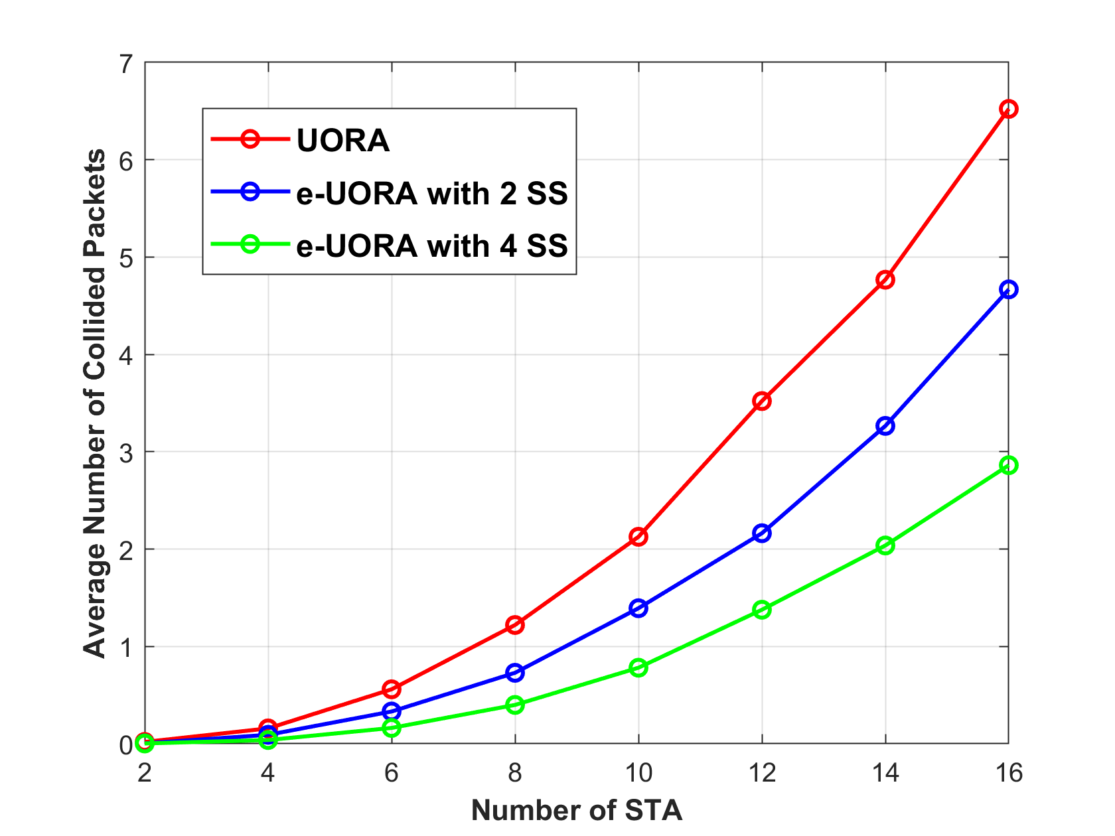
Simulation Result
Nru = 8
At the point of Nru=Nsta, compared with UORA (1.2), the number of collided packets may be reduced by:
~40% when 2 SS is applied in e-UORA (0.72).
~67% when 4 SS is applied in e-UORA (0.39).
The decrease of collided packets is more obvious with increasing number of active STAs.
1.2
0.72
0.39
Note:
Average number of collided packets is the number of collided packets per iteration.

Slide 9
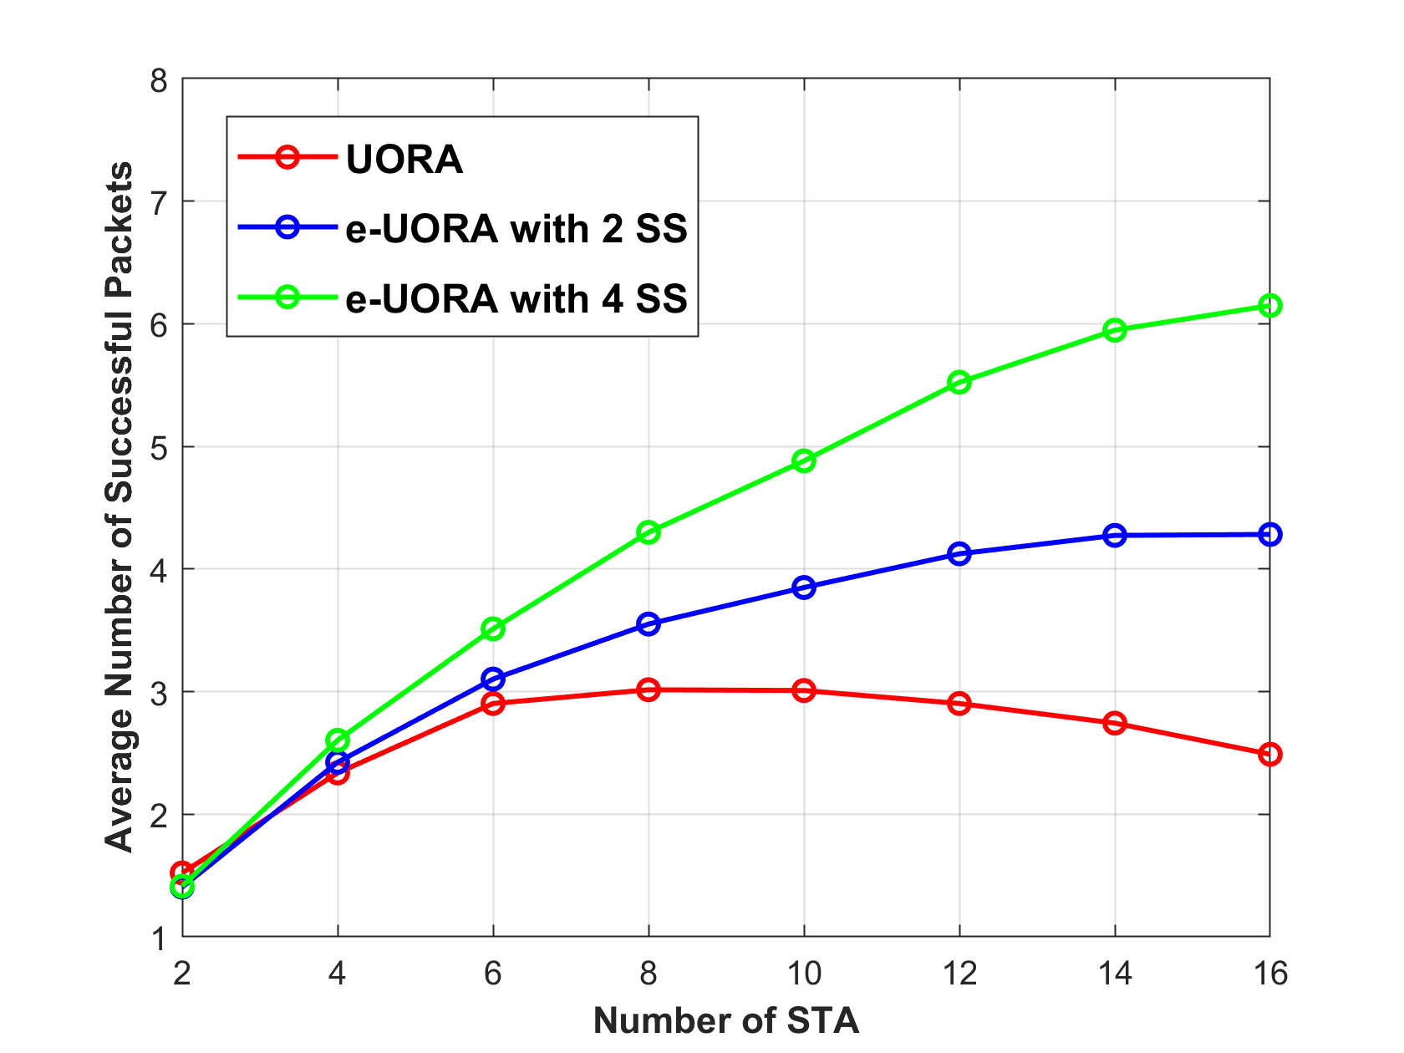
Simulation Result
Nru = 8
Under the same SNR, the maximal average number of successful packets can be up to:
3 in UORA.
4.2 in e-UORA with Nss = 2.
6.1 in e-UORA with Nss = 4.
It is still possible for a STA to transmit successfully in UL MU-MIMO within RA-RU, even without scheduling and power control.
6.1
4.2
3
Note:
D-NLOS Channel with actual timing, without power control.
‘Successful packets’ means a packet being transmitted successfully and decoded correctly.
Average number of successful packets is the number of successful packets per iteration.

Slide 10
Conclusion
In this contribution, we propose the enhanced UORA to reduce the collision rate and improve the efficiency.
STAs that wins contention may randomly select a single spatial stream on the randomly selected RA-RU to transmit.
The range of eligible spatial streams is limited by the number of HE/EHT-LTF symbols indicated in the trigger frame.
No extra signaling is needed for the range of eligible spatial streams in the Trigger frame.
Other signaling is TBD.
No extra complexity added.

Slide 11
Reference
Draft P802.11ax_D8.0
11-15-0832-00-00ax-performance-evaluation-of-su-mu-mimo-in-ofdma

Slide 12
SP#1
Do you support that EHT allows UL MU-MIMO to be enabled in RA-RUs and relaxes the restriction on size of UL MU-MIMO enabled RU for RA-RUs?
Only applicable to EHT TB PPDU.
Only single SS per STA is allowed.
The new minimal size of UL MU-MIMO enabled RA-RU is TBD.
This is for R1.
Y/N/A:

Slide 13
SP#2
Do you support that EHT allows non-AP STAs that wins UORA contention to randomly select an eligible spatial stream in the randomly selected RA-RU to transmit?
The range of eligible spatial streams is limited by the number of HE/EHT-LTF symbols indicated in the trigger frame.
This is for R1.
Y/N/A:

