Slide 1
Discussion on LC optimized mode coexistence with other 11bb PHYs
Date: 2021-03-08
Authors:

Slide 2
Abstract
This presentation discusses what is needed for the LC optimized mode PHY to coexist with the LC common mode and LC HE mode PHYs.

Slide 3
LC PHY modes may be used in overlapping spectrum
LC PHY has 3 modes:
  LC common mode (mandatory) – based on OFDM (11a) PHY
  LC HE mode (optional) – based on HE (11ax) PHY
  LC optimized mode (optional) – based on ITU G.9991/G.9960 PHY
Per P802.11bb D0.3 subclause 32.3.1, these modes may be used in the same optical spectrum:
  LC common-mode is transmitted in the wavelength range between 800 and 1000 nm
  LC HE mode is transmitted in the wavelength range between 800 and 1000 nm
  LC optimized mode is transmitted between 380 nm and 1000 nm

Slide 4
LC common mode and LC HE mode rely on CCA to detect medium busy
P802.11bb D0.3 subclause 32.3.2.3.6 (CCA) states, “This shall be the same as in section 17.3.6”
  OFDM PHY CCA requirements are in 802.11 subclause 17.3.10.6 (CCA requirements)
P802.11bb D0.3 subclause 32.3.3.3.20 (Receiver specification) states, “This section shall be the same as section 27.3.20.”
  HE PHY CCA requirements are in P802.11ax D8.0 subclause 27.3.20.6 (CCA sensitivity)

Slide 5
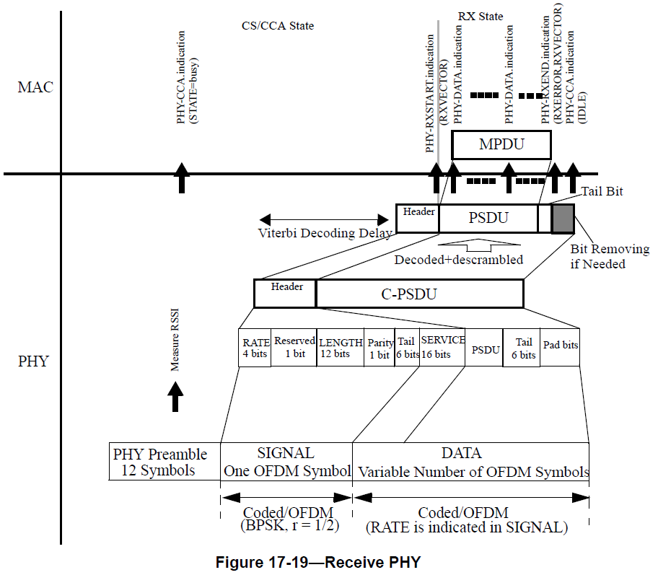
CS/CCA (carrier sense/clear channel assessment)
CS/CCA relies on the legacy preamble
  “Legacy” means compatible with Clause 17 or 18 receivers; see 802.11 subclause 19.1.4 (PPDU formats for HT PHY)
OFDM and HE PPDUs all begin with the same (legacy) preamble
  802.11 subclause 17.3.10.6 (CCA requirements): “CS/CCA detect time is based on finding the short sequences in the preamble”
  In HE PHY, the legacy preamble fields are Non-HT Short Training field (L-STF), L-LTF (Non-HT Long Training field) and L-SIG (Non-HT SIGNAL field) of the legacy preamble

Slide 6
Legacy preamble role in (CS/CCA) mechanism
Legacy preamble is used to detect a valid 802.11 PPDU and to determine its length
  802.11 subclause 19.3.9.2 (HT-mixed format preamble): The non-HT portion of the HT-mixed format preamble enables detection of the PPDU and acquisition of carrier frequency and timing by both HT STAs and STAs that are compliant with Clause 17 or Clause 18. The non-HT portion of the HT-mixed format preamble contains the SIGNAL field (L-SIG) defined in Clause 17 and is thus decodable by STAs compliant with Clause 17 and Clause 18 as well as HT STAs.
  802.11 subclause 27.3.11.5 (L-SIG): The L-SIG field is used to communicate rate and length information. The structure of the L-SIG field is defined in Figure 17-5 (SIGNAL field bit assignment).
Other STAs determine the medium busy time from the PPDU length
Using the same legacy preamble enables all STAs to identify when the medium is occupied, even if the PPDU was sent by a STA operating with a different PHY

Slide 7
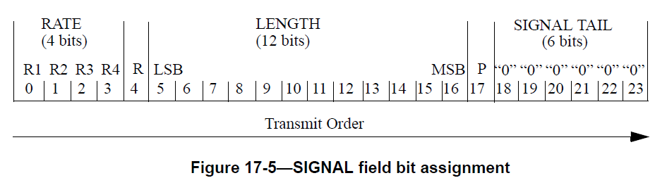
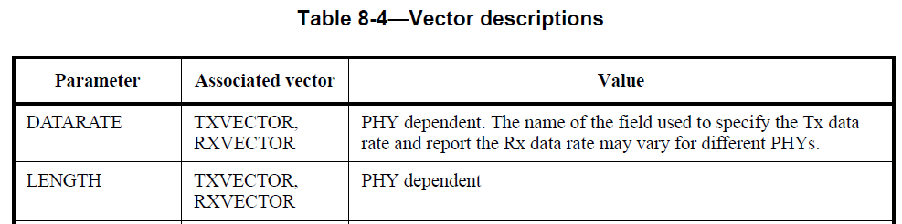
Determining PPDU length
PPDU length is determined from RATE and LENGTH subfields in SIGNAL field of the legacy preamble
  SIGNAL field contains the RATE and the LENGTH fields of the TXVECTOR. The RATE field conveys information about the type of modulation and the coding rate as used in the rest of the PPDU. (REVmd D8.0 17.3.4.1 General, SIGNAL field)
  RATE and LENGTH are PHY dependent, i.e. specified in the clause for each PHY (REVmd D8.0 8.3.4.4 (Vector descriptions))

Slide 8
PHY dependent SIGNAL field
SIGNAL field for Clause 17 OFDM PHY
  The encoding of the SIGNAL single OFDM symbol shall be performed with BPSK modulation of the subcarriers and using convolutional coding at R = 1/2. (REVmd D8.0 17.3.4.1 General, SIGNAL field)
  RATE defined in Table 17-6 (REVmd D8.0 17.3.4.2 RATE field)
  LENGTH is an unsigned 12-bit integer that indicates the number of octets in the PSDU (REVmd D8.0 17.3.4.3 (PHY LENGTH field))
L-SIG field for Clause 27 HE PHY
  Structure and position same as Clause 17 SIGNAL field
  Encoding, RATE and LENGTH compatible with Clause 17 SIGNAL field
  Specified in P802.11ax D8.0 subclauses 27.3.6.4 (Construction of L-SIG) and subclause 27.3.11.5 (L-SIG)

Slide 9
Assessment
LC optimized PHY needs to support CS/CCA for common mode PHY, 11ax PHY, and LC optimized PHY to coexist in the same or overlapping spectrum
Requirements for CS/CCA to work on STAs that don’t support LC optimized mode:
  All PHY PPDUs must start with the 802.11 legacy preamble (to detect valid PPDUs)
  One option is to prepend the current LC optimized PPDU with the 802.11 legacy preamble, but the subcarrier spacing of the legacy preamble is different from that of the LC optimized PHY
  802.11 assumes all PHYs use the same clock rate (to correctly decode the legacy preamble and calculate the medium busy time from the PPDU length to calculate medium busy time from PPDU length)
  But LC optimized PHY has a different carrier spacing and clock rate
    Clock rate for LC optimized PHY is specified in ITU G.9960 Cor. 1 09/19

Slide 10
Comparison of subcarrier spacings
Subcarrier spacings
  LC HE mode: 78.125 kHz for HE PHY, from 802.11ax Table 27-12 (Timing-related constants)
  LC common mode: 312.5 kHz, i.e., 4x78.125 kHz, from 802.11 Table 17-5 (Timing-related parameters)
  LC optimized mode: 195.3125 kHz, from P802.11bb D0.3 Table 3 (OFDM Parameters of LC optimized mode)
    Corresponds to k=8 in ITU G.9960 Table 7-67: subcarrier spacing is 24.4140625 kHz x k, where k is 1, 2, 4, 8, 16, 32, 64
The subcarrier spacings are more closely related than they might seem:
  If k=4, then 78.125/(24.4140625*4) = 4/5 exactly (i.e., 0.80000…)

Slide 11
Adapting the LC optimized PHY clock rate
Proposal A: set LC optimized PHY rate to 80% of ITU PHY rate
  All subcarrier spacings become integer multiples of 78.125 kHz (LC HE mode subcarrier spacing), which facilitates implementation
    LC optimized PHY subcarrier spacing 195.3125x0.08 = 156.25 kHz = 2x78.125 kHz
    LC common mode PHY subcarrier spacing is 4x78.125 kHz
  LC optimized mode modulation bandwidths change from 50, 100, 200 MHz to 40, 80, 160 MHz, i.e., exact match with LC HE mode bandwidths. This facilitates filtering.
  Still supporting ITU tone mapping, constellation mapping, etc.
  Achievable bit rate is, of course, reduced by 20%

Slide 12
Keeping the LC optimized PHY clock rate
Proposal B: Use fractional PLL to operate all PHYs with native clock rates
  Clocks are divided by factor N before PLL
  CM PHY is clocked as 20 MHz
    = 200 MHz /10 LCO base rate
    = 160 MHz / 8 HE base rate
  Native bit rates are maintained
  Same principle is used for HE vs. CM rate
  Bandwidth varies while packet is transmitted

Slide 13
Summary
Coexistence of LC PHY modes requires LC optimized mode to be consistent with 802.11 CS/CCA
  LC optimized mode PPDU must start with the 802.11 legacy preamble
  Clock rate must be aligned with 802.11
    A: Set LC optimized mode clock rate to 80% of ITU clock rate
    B: Keep native clock rates of all PHYs and use fractional PLL
How to move forward? Contributions welcome!

Slide 14
References
P802.11-REVmd D5.0
P802.11ax D8.0
P802.11bb D0.3
ITU G.9960 Corrigendum 1 (09/19)

