Slide 1
Comments on LC HE PHY light interface
Date: 2021-03-08
Authors:

Slide 2
Abstract
This document provides comments on P802.11bb D0.3 text concerning the light interface for the LC HE PHY.

Slide 3
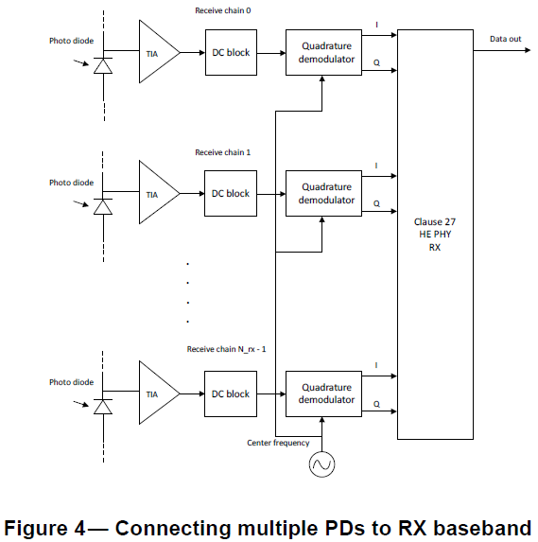
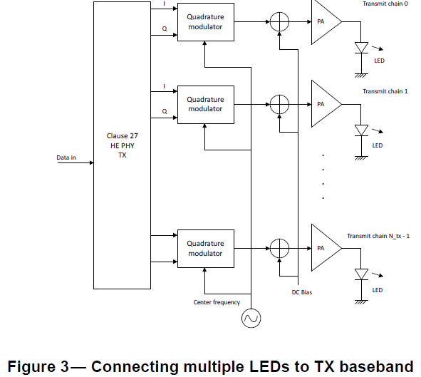
HE light interface
Subclauses of P802.11bb D0.3 32.3.3.3.23 (Light Interface) state:
  “The light interface shall be an extension of the light interface described in 32.3.2.3.8 Light Interface to multiple TX and RX streams”
  “Figure 3 shows multiple LEDs connected to the TX baseband and Figure 4 shows multiple PDs connected to the RX baseband.”
  “The LEDs may all operate at the same wavelength or at different wavelengths.”

Slide 4
Comments on HE light interface in D0.3
Page 23 line 11: extension to multiple TX and RX streams should not be mandated. There is no reason why multiple LEDs (or even one LED) have to be used for the HE light interface to work.
Page 23 line 11: the term “TX and RX streams” is not defined
Page 23 line 16: baseband generation and processing of “streams” on different wavelengths is not defined
Figures 3 and 4 and their parent Figure 1 are examples of specific implementations
Proposal:
Simplify and clearly state that figure is an example. See next slide for details.

Slide 5
Proposed changes to D0.3
Changes to 32.3.3.3.23 Light Interface
Change subclause 32.3.3.3.23 title to “Light interface” to align with 32.3.2.3.8
Delete page 23 line 10 through page 24 line 4 (all subclauses and text in 32.3.3.3.23 Light Interface) and replace with “The HE light interface is described in 32.3.2.3.8 (Light interface).”
Changes to 32.3.2.3.8 Light interface
32.3.2.3.8 Light interface Page 18 line 12: Change sentence to “Figure 1 illustrates shows an example of how a light emitting diode (LED) can be is connected to the TX OFDM PHY and a photo diode (PD) to the RX OFDM PHY. The actual structure of the transmitter and receiver is implementation dependent. For example, multiple LEDs or PDs may be used.
Page 18 line 15 (Figure 1): Change PA/LED and PD/TIA blocks to simple OFE blocks or append the following text to the paragraph starting on line 12: “Also, other light emitting and light collecting devices may be used.” Change “Clause 17 OFDM PHY” to “CM PHY”, two times.

Slide 6
References
P802.11bb D0.3

