Slide 1
DirectVoteLive Test Meeting Lessons
Date: 2021-03-04
Authors:

Slide 2
Abstract
A DirectVoteLive virtual test meeting was run to validate the 802.11 voter database.
The goal was for all Voters/Potential Voters would sign-in and vote on 3 motions:
Motion 1:
I am able to provide a vote in the DirectVote tool.
Motion 2:
I plan to attend the 802.11 WG Opening Plenary Meeting Monday March 8, 2021 at 14:00 UTC (9:00 am ET).
Motion 3:
I plan to attend the 802.11 WG Closing Plenary Meeting Tuesday March 16, 2021 at 13:00 UTC (9am ET)

Slide 3
Participation Report
Attendance: 314 of 486 attendees invited participated.

Slide 4
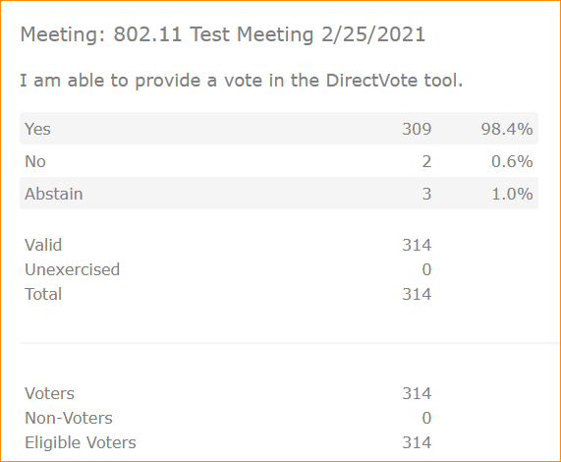
Motion 1

Slide 5
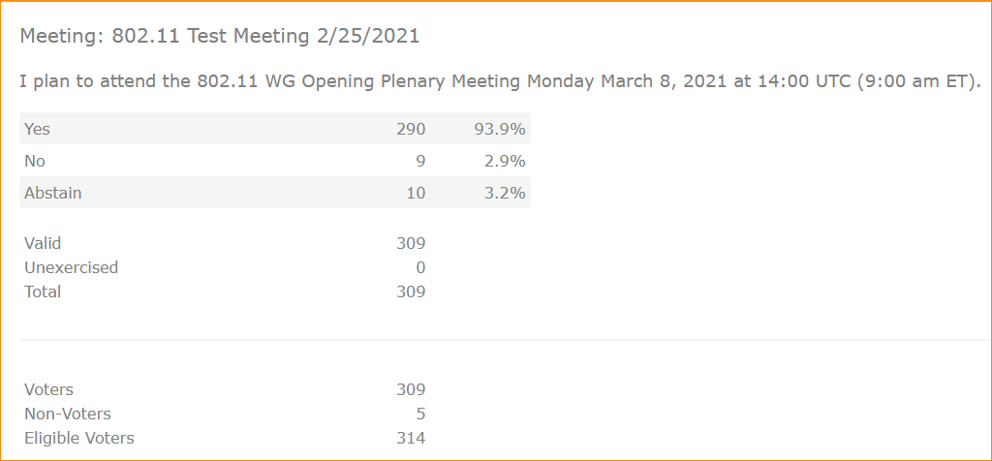
Motion 2

Slide 6
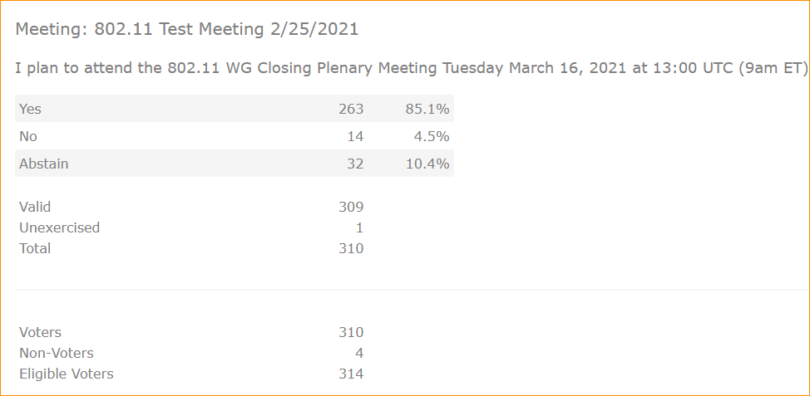
Motion 3

Slide 7
WARNINGS -
Use the link that was sent to you to be able to use the IEEE SSO to get into the tool at the right place.
Do not forward your mail to colleagues as it will not work for them.
The Email was sent to your 802.11 Voter email address of record. That may or may not be the email you get your listserv emails from.
Your DirectVoteLive and myProject email address (your IEEE Account Primary address) must be the same, or you will not be able to login. Case Sensitive

Slide 8
What we learned.
802.11 Voter Database has not consistently been updated when voters change email addresses.
The IEEE Account Main Email address and the DirectVoteLive Email address must match exactly.
Email address is case sensitive.
The User must use the invite link, even after logging in, must reuse the link as refreshing will take you to a DirectVoteLive login page that is not associated with IEEE and the SSO process.

Slide 9
References

