Slide 1
Considerations of sensing negotiation
Date: 2021-03-05
Authors:
Name | Affiliations | Address | Phone | Email
Cheng Chen | Intel |  |  | cheng.chen@intel.com
Claudio da Silva |  |  |  | claudio.da.silva@intel.com
Bahareh Sadeghi |  |  |  | bahareh.sadeghi@intel.com
Carlos Cordeiro |  |  |  | carlos.cordeiro@intel.com
Notes:
September 2012

Slide 2
Abstract
In [1], we presented an overview of the framework of the sensing protocol, including discovery, setup, measurement, reporting, and termination.
Discovery is generally done before a sensing session where STAs exchange sensing related capabilities, for example, during associations.
A sensing session is composed of one ore more of the following phases: setup phase, measurement phase, reporting phase, and termination phase.
In the setup phase, a sensing session is established, and operational parameters associated with the sensing session are determined and exchanged between STAs.
In the setup phase, in order to exchange and agree on the operational parameters of the sensing session, there may be a need for the sensing initiator and responder to perform negotiation.
In this contribution, we provide some considerations on sensing negotiation.

Slide 3
Consideration 1: Is negotiation needed between the initiator and responder(s)?
The primary objective for the setup phase is to exchange operational parameters associated with the sensing session among STAs that will participate in it.
For example, these parameters may include
Identification of the roles of sensing transmitter and sensing receiver
Scheduling information of sensing periods/windows
Channel bandwidth and number of antennas
Type of sensing measurement result [2]
…
Providing a negotiation process for the initiator and responder(s) to agree on the set of sensing parameters before the actual sensing measurement will significantly facilitate the sensing procedure in many scenarios.
For example, in Coordinated/ Active CSI-based sensing scenarios [2][3][4].
However, in some scenarios where the set of sensing parameters is pre-determined, the initiator could simply advertise the parameters without further negotiations.

Slide 4
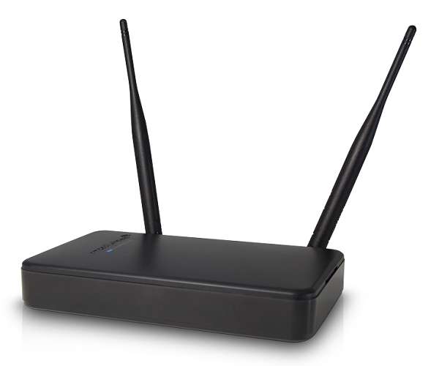
Sensing without negotiation
Examples of scenarios that do not require negotiations are:
1. Passive/Opportunistic sensing: There is no dedicated sensing transmitters or sensing PPDU transmissions. A STA relies on receiving and measuring existing frames transmitted by other STAs in an opportunistic manner.
2. Single-STA sensing: Only one STA participates in the sensing session so there is no need to exchange parameters with other STAs. For example, monostatic radar.
3. Pre-determined sensing: The initiator advertises the schedule of a pre-determined sensing session and any interesting STAs could simply join the session.
For example, an AP can advertise the schedule of a pre-determined sensing session in its Beacon frames during which it will transmits sensing PPDUs. Any STAs that are interesting could simply join the sensing session at the advertised time and perform sensing by receiving the sensing PPDUs.
Target
AP advertises a predetermined
sensing session in its Beacon.
STA3
AP
Beacon
Sensing PPDU
STA2
Echo
Sensing PPDU
STA1
STA1
STA1
STA1 overhears the transmission
from STA3 to STA2 to perform
sensing.
STA1 transmits and receives
the echo signal to perform sensing.
STA2
Sensing PPDU

Slide 5
Sensing with negotiation
In scenarios where negotiation is required, we will need to define a negotiation process for the initiator and responder to agree on a set of operational parameters associated with the upcoming sensing session.
The sensing initiator initiates the negotiation by sending a particular request frame, say, Sensing Request frame, to the responder.
The Sensing Request frame includes all relative information necessary to perform sensing measurement in the sensing session.
After receiving the Sensing Request frame, the responder is expected to respond with a Sensing Response frame to indicate
Its willingness to participate in the sensing session
Could define a Status Indication field to describe the detailed outcome.
Whether it agrees to the set of operational parameters indicated in the received Sensing Request frame
If not, it may suggest an alternative set of operational parameters.
Sensing Initiator
Sensing Responder
Sensing Request
ACK
Note: The ACK may not be necessary depending
on how we define the Sensing Request/Response
frame.
Sensing Response
ACK

Slide 6
Consideration 2: AP and non-AP STA initiator
11bf needs to support both scenarios where an AP or a non-AP STA acts as a sensing initiator.
Sensing negotiation may be different in these two scenarios.
If the sensing initiator is an AP
It has the information of all other STAs in the BSS, and therefore can choose sensing transmitters and sensing receivers based on its own knowledge.
It can provide services including scheduling, protection, synchronization etc.
If the sensing initiator is a non-AP STA, it needs to first initiate negotiation with the AP
If somehow the non-AP STA already discovers some other non-AP STAs in the BSS through some means, it can indicate their identities and the intention to invite them in the negotiation with the AP.
However, if the non-AP STA wants the other non-AP STAs to participate in the sensing session but does not have the knowledge of them, it needs to indicate its intention in the negotiation with the AP and request the AP to invite other non-AP STAs to participate in the sensing session.
In both cases, the non-AP STA initiator can negotiate other sensing parameters, but will likely rely on the AP to provide services including scheduling, protection, synchronization etc.
Negotiation
AP
AP
STA2
STA2
Negotiation
Negotiation
STA1
STA1

Slide 7
Consideration 3: Negotiation with multiple responders
For multiple responders, sensing initiator needs to negotiate with all of them.
The sensing initiator could perform negotiation with each of them individually and separately.
This would lead to larger overhead and is not a scalable solution.
Alternatively, depending on the MU capabilities, what if the sensing initiator performs negotiation with all responders simultaneously at one shot?
This option may be feasible if the sensing initiator is an AP STA.
It also depends on how we design the negotiation process and how we design the Sensing Request frame
For example, if we define the Sensing Request frame as a Management/Action frame, this might not be possible. But if we define the Sensing Request frame as a Control frame, say, a variant of Trigger frame, then it is possible to design simultaneous responses.
However, some negotiated parameters may take time for the responders to decide whether to agree or not, so immediate response following a Control-type negotiation frame may not be realistic.
Unless if the initiator has already advertised its intended sensing parameters in advance, we may design a simplified binary negotiation procedure where the responders simply respond with “Yes” or “No”.
Sensing Initiator
Sensing Initiator
Sensing Initiator
Sensing Request
To Responder 1
Sensing Request
To Responder 2
Sensing Request
To Responder 1-2
Sensing Request
To Responder 1-2
?
?
Sensing Responder 1
Sensing
Response
Sensing Responder 1
Sensing Response
Sensing Responder 1
CTS/CTS-to-self
Sensing Responder 2
Sensing
Response
Sensing Responder 2
Sensing Responder 2
Sensing Response
CTS/CTS-to-self

Slide 8
Conclusions
In this contribution we presented some considerations on sensing negotiation process.
We propose the sensing negotiation should be an optional process within the sensing setup phase.
We talked about several technical points of sensing negotiation, including the overall flow, AP/non-AP STA initiator, negotiation with multiple responders etc.

Slide 9
SP1
Do you agree with the following?
11bf shall define an optional negotiation process in the sensing setup phase for the sensing initiator and sensing responder(s) to exchange and agree on operational parameters associated with the sensing session.

Slide 10
References
[1] DCN 1851r1, Overview of Wi-Fi Sensing Protocol
[2] DCN 0147r2, Definitions and scenarios of the WLAN sensing-follow ups
[3] DCN 1960r1, Analysis of the functionality of sensing
[4] DCN 0145r4, Collaborative WLAN Sensing – follow ups

