Slide 1
Diversity Enhancement for DUP Mode
Date: 2021-03-03
Authors:
Name | Affiliation | Address | Phone | Email
Ali Tuğberk Doğukan | Vestel & Koç University |  |  | adogukan18@ku.edu.tr
Başak Ak Özbakış |  |  |  | basak.ozbakis@vestel.com.tr
Ertuğrul Başar |  |  |  | ebasar@ku.edu.tr

Slide 2
Introduction
DUP mode, which duplicates the coded and modulated data symbols in the frequency domain, is accepted for range extension in the 6 GHz band [1].
DUP mode is only used with MCS0+DCM and bandwidth 80/160/320 MHz.
MCS14 (BPSK + ½ rate coding + DCM + DUP) is only applicable to Nss = 1 [Motion 137, #SP250, [2] and [3]].
PAPR reduction scheme is proposed for DUP mode in [4]. However, additional diversity scheme is TBD.
This contribution proposes a diversity enhancing technique called coordinate interleaving to improve the performance of DUP mode.
Coordinate interleaving transmits the imaginary and real parts of data symbols over different subcarriers.
A similar diversity enhancing method called ‘constellation rotation and cyclic Q delay’ is used in DVB-T2 standard [5].

Slide 3
Revisiting DUP Mode
In DUP mode, DCM signal is duplicated in frequency domain with PAPR reduction scheme [4].
$x$: pre-DCM modulated symbols
$x_{DCM}$: symbols obtained by performing DCM on $x$
$x=\left[x_{L} x_{U}\right]$
$x_{L}$ and $x_{U}$ are the lower and upper half of $x$, respectively.
$x_{L,DCM}$: symbols obtained by performing DCM on $x_{L}$
$x_{U,DCM}$: symbols obtained by performing DCM on $x_{U}$

Slide 4
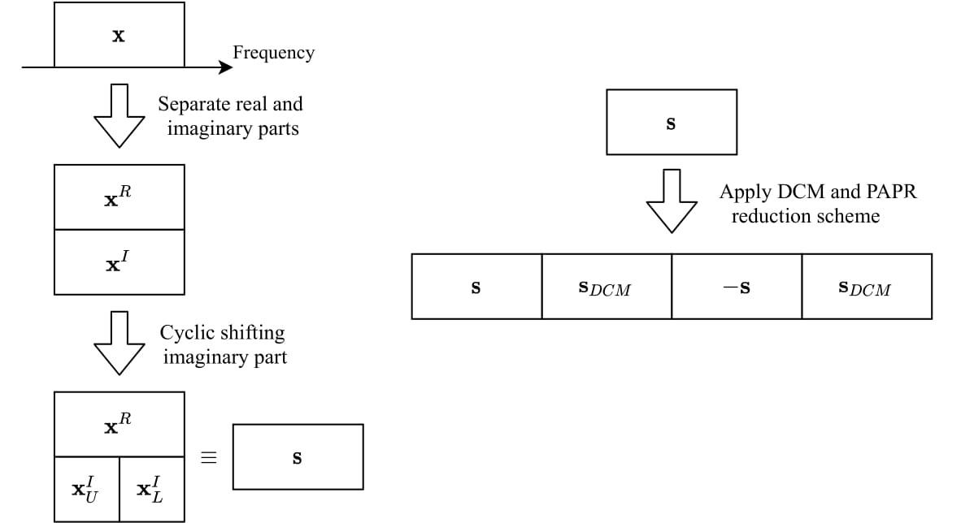
Proposed Method
$x=x^{R}+jx^{I}$
$x^{I}$ is cyclically shifted by $c$ elements.
In order to have imaginary and real parts, rotated BPSK can be used.
$x^{I}=\left[x_{L}^{I} x_{U}^{I}\right]$, $x_{L}^{I}$ is the lower half of $x^{I}$ and $x_{U}^{I}$ is the upper half of $x^{I}$.
After obtaining $s$, DUP mode can be used with the PAPR reduction scheme in [4].
The real parts of $x$ and $s$ are the same, however; the imaginary part of $s$ is the cylically shifted version of $x$.

Slide 5
Comparison
Imaginary part is cyclically shifted by $c=245$ elements.
DUP mode $→$ $x_{1}$ is transmitted over 4 subcarriers with the indices $1$, $491$, $981$, and $1471$.
Proposed method $→$ $x_{1}$ is transmitted over 8 subcarriers with the indices $1$, $246$, $491$, $736$, $981$, $1226$, $1471$, and $1716$.

Slide 6
Simulation Assumptions
Simulation setup
80, 160, and 320MHz
Channel Model B and D
Payload: 1000B
LMMSE channel estimation
MMSE equalizer
Ideal timing/frequency/phase
Quasi-static fading channel
$c=N_{SD}/2$

Slide 7
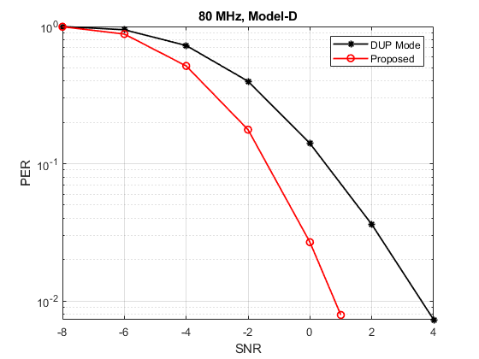
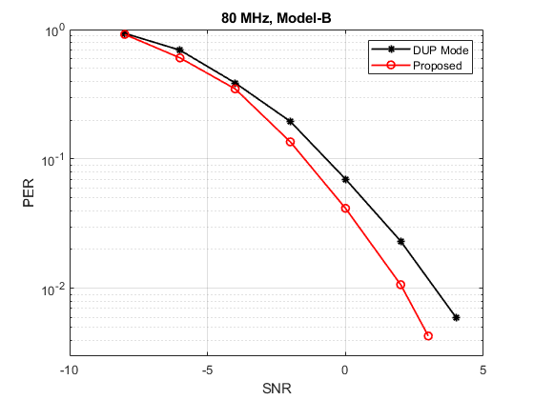
80 MHz

Slide 8
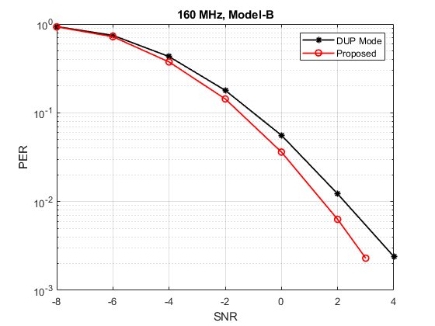
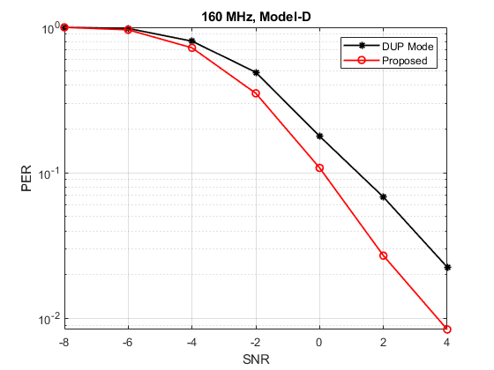
160 MHz

Slide 9
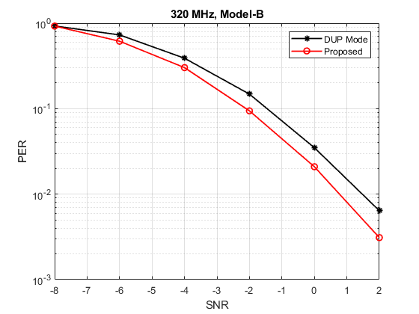
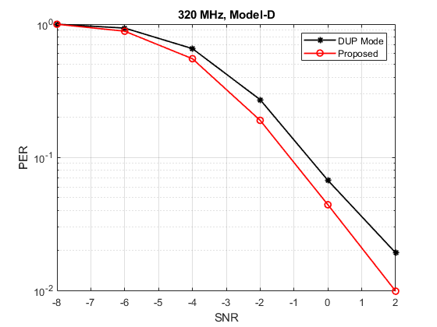
320 MHz

Slide 10
Summary
We propose a diversity enhancing technique for DUP mode to further increase the transmission range and improve the error performance.
Compatible with the PAPR reduction scheme [2].
The proposed method theoretically doubles the diversity order of DUP mode.
The proposed method improves the error performance of DUP mode DCM. Hence, the communication range is further extended.

Slide 11
Reference
[1] Ron Porat, IEEE 802.11-20/965r4, 6 GHz LPI Range Extension.
[2] TGbe, “Compendium of motions related to the contents of the TGbe specification framework document,” 20/1755r11, November 2020.
[3] Jianhan Liu (MediaTek), “On TBD MCSs,” 20/1377r1, October 2020.
[4] Ron Porat, et al, IEEE 802.11-20/1191r1, DUP mode PAPR reduction.
[5] “Frame structure channel coding and modulation for a second generation digital terrestrial television broadcasting system(DVB-T2),” ETSI EN 302 755 V1.1.1, Sep. 2009.

Slide 12
SP
Do you agree to add the proposed diversity enhancing method with MCS14 (DUP mode DCM) to the 11be SFD?
Y/N/A

