Slide 1
Dicussion on HE or EHT variant differentiation of a trigger frame
Date: 2021-03-03
Authors:
Name | Affiliations | Address | Phone | email
Ross Jian Yu | Huawei |  |  | ross.yujian@huawei.com
Ming Gan | Huawei |  |  | ming.gan@huawei.com
Mengshi Hu | Huawei |  |  | humengshi@Huawei.com

Slide 2
Background
  The following motions or SP have passed regarding trigger frame:
  In R1, an 1-bit HE/EHT indication in the common part of the Trigger frame is used to indicate to the EHT STA whether to transmit an HE or EHT TB PPDU within the primary 160 MHz.
  Use B54 (the first bit) of UL HE-SIG-A2 Reserved field to carry this HE/EHT indication.
  NOTE – The EHT STA shall not transmit an HE TB PPDU on the secondary 160 MHz.
  [Motion 150, #SP384, [92] and [316]][#M19]
  If the Special User Info field is not present in the Trigger frame, then the User Info field is the HE format and the EHT STA transmits an HE TB PPDU.
  In R1, if the Special User Info field is present in the Trigger frame, the User Info field is the EHT Format and the EHT STA transmits an EHT TB PPDU.
  [Motion 150, #SP369, [92] and [322]][#M21]
  B39 in a User Info field addressed to an EHT STA within a Trigger frame is the Primary/Secondary 160 (PS160) subfield.
  • NOTE – The PS160 subfield, along with B7-B0 of the RU Allocation subfield, specify the RU/MRU.
  [Motion 150, #SP380, [92] and [324][#M25]
  Do you support using B55 of the Common Info Field to indicate the presence of the Spacial User Info Field in the Trigger Frame?
  • B55 is set to 1 to indicate that there is no Special User Info field in the Trigger frame.
  • B55 is set to 0 to indicate that the Special User Info field is present in the Trigger frame.
  Straw poll #393 [#SP393]

Slide 3
Goal of the proposal
  Goal of this proposal is to enable R1 (non-AP) EHT STAs to participate in an A-PPDU solicited by an R2 EHT AP.
  This proposal talks about how a R1 EHT STA differentiates HE or EHT variant, or we can say, how to decide whether to transmit HE TB PPDU or EHT TB PPDU, when receiving a trigger frame.
  The proposal does not change what is sent in the Trigger Frame.

Slide 4
HE or EHT differentiation discussion
A-PPDU is not supported in R1. Hence, in the PDT (21/0259r3), it is said
  If the BaselineMACFeaturesOnly capability is 1 then an EHT AP shall not transmit a Trigger frame that solicits both an HE TB PPDU and an EHT TB PPDU.(#M2 )
In this case, there is some redundancy or dependency of several bits from the AP side:
  B54 in common field: HE/EHT P160
  B55 in common field: presence of special user field
There are some comments to state the dependency of the two bits for R1, which is reasonable from the AP side..
At the STA side, as there are some dependency at the Tx side, several methods have been mentioned to decide HE or EHT variant, or we can say to decide HE or EHT TB PPDU.

Slide 5
HE or EHT – Method 1
Several methods include:
  Method 1: rely on B55 in common field: presence of special User field
  Method 2: rely ONLY on B54 in common field: HE/EHT P160
  Method 3: rely on BOTH B54 in common field and B39 in User field (PS160 for EHT variant and reserved for HE variant)
We will talk about each method and show why Method 3 should be applied.
Method 1: B55=0, special User field is present, then User field is EHT variant; B55=1, special User field is not present, then User field is HE variant.
Issue of method 1: enables an R1 non-AP STA to participate in the EHT portion of the A-PPDU but not the HE portion of the A-PPDU.

Slide 6
HE or EHT – Method 1 (cont’d)
Discussion: later in R2, a R2 AP sends a trigger frame which solicits both HE TB PPDU and EHT TB PPDU, the UL BW is set to 3 (160MHz), UL BW Extension is set to 2 (320MHz-1), the AP will set B55=0. In this case, a R1 EHT STA (which is also an HE STA) will think all User fields are EHT variant, and hence this EHT STA cannot be solicited to transmit HE TB PPDU within A-PPDU, even worse than an old HE STA, which can participate in A-PPDU.
UL BW is set to 3 (160MHz),
UL BW Extension is set to 2 (320MHz-1),
Trigger frame
EHT TB PPDU
Special user field is present, transmit EHT
S160
Trigger frame
HE TB PPDU
Special user field is present, transmit EHT
P160
B54=1, HE/EHT P160 = HE
B55=0, special User field is present

Slide 7
HE or EHT – Method 2
Method 2: B54=0, EHT PPDU in P160, then User field is EHT variant; B55=1, HE PPDU in P160, then User field is HE variant.
Issue of method 2: enables an R1 non-AP STA to participate in the HE portion of the A-PPDU but not the EHT portion of the A-PPDU.
Discussion: although in R1, we restrict AP to send trigger to solicit A-PPDU. Whilst we don’t want to exclude the possibility where a R1 STA could later transmit EHT PPDU within A-PPDU, solicited by a R2 AP in R2 stage. The transmission could be transparent to a R1 STA.

Slide 8
HE or EHT – Method 2 (cont’d)
For example, later in R2, the UL BW is set to 3 (160MHz), UL BW Extension is set to 2 (320MHz-1), then a R2 AP could solicit HE PPDU in P160 and EHT PPDU in S160 with B54=1 indicating HE TB PPDU in P160, and B55=0, the special User field is present.
In this case, a R1 EHT STA will think all User fields are HE variant, and hence this EHT STA cannot be solicited to transmit EHT TB PPDU.
UL BW is set to 3 (160MHz),
UL BW Extension is set to 2 (320MHz-1),
Trigger frame
EHT TB PPDU
S160
PS160=P160, transmit HE
Trigger frame
HE TB PPDU
P160
HE/EHT P160=HE, transmit HE
B54=1, HE/EHT P160 = HE
B55=0, special User field is present

Slide 9
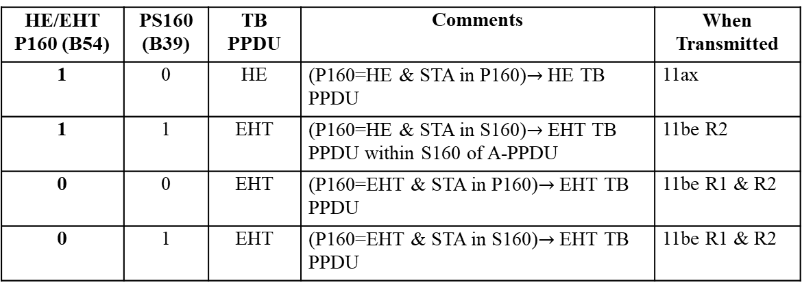
HE or EHT – Method 3
Method 3: rely on both B54 in common field and B39 in User field (PS160 for EHT variant and reserved for HE variant)
Rewriting method 3 in a simple way:
  B54 of common field = 1, B39 of a User field = 0, then HE variant;
  Otherwise, EHT variant.
HE/EHT P160 (B54) | PS160 (B39) | TB PPDU | Comments | When Transmitted
1 | 0 | HE | (P160=HE & STA in P160)$→$HE TB PPDU | 11ax
1 | 1 | EHT | (P160=HE & STA in S160)$→$EHT TB PPDU within S160 of A-PPDU | 11be R2
0 | 0 | EHT | (P160=EHT & STA in P160)$→$EHT TB PPDU | 11be R1 & R2
0 | 1 | EHT | (P160=EHT & STA in S160)$→$EHT TB PPDU | 11be R1 & R2

Slide 10
HE or EHT – Method 3 (cont’d)
Same example as before: later in R2, the UL BW is set to 3 (160MHz), UL BW Extension is set to 2 (320MHz-1), then a R2 AP could solicit HE PPDU in P160 and EHT PPDU in S160 with B54=1 indicating HE TB PPDU in P160, and B55=0, the special User field is present.
Method 3 enables a R1 EHT STA to transmit either HE TB or EHT TB PPDU depending on a R2 AP’s schedule.
UL BW is set to 3 (160MHz),
UL BW Extension is set to 2 (320MHz-1),
Trigger frame
EHT TB PPDU
S160
PS160=S160, transmit EHT
Trigger frame
HE TB PPDU
HE/EHT P160=HE,
PS160=P160, transmit HE
P160
B54=1, HE/EHT P160 = HE
B55=0, special User field is present
Slide 12

Slide 11
HE or EHT – Method 3 (cont’d)
With method 3, examples of EHT R1 STA behavior in R1 stage:
UL BW is set to 3 (160MHz),
UL BW Extension is set to 2 (320MHz-1),
Trigger frame
EHT TB PPDU
S160
PS160=S160, transmit EHT
EHT TB only case
Trigger frame
EHT TB PPDU
HE/EHT P160=EHT,
PS160=P160, transmit EHT
P160
B54=0, HE/EHT P160 = EHT
B55=0, special User field is present
UL BW is set to 3 (160MHz),
HE TB only case
Trigger frame
HE TB PPDU
HE/EHT P160=HE,
PS160=P160, transmit HE
P160
B54=1, HE/EHT P160 = HE
B55=1, special User field is not present

Slide 12
HE or EHT Method 3 (cont’d)
Even later, we find some potential interoperability issue in R2 regarding method 3, we can still disallow a R2 AP to solicit EHT TB PPDU or HE TB PPDU from a R1 EHT STA by restricting the AP’s behavior. But we should not prevent this from happening in R1 stage by wrongly describe the STA’s behavior regarding HE or EHT differentiation.
In this proposal, no additional bits are proposed, method 3 only relies on the existing bits in the trigger frame.

Slide 13
Straw Poll #1
Do you agree with the following?
  An EHT non-AP STA will use the HE/EHT P160 subfield (B54) of the Common Info Field and the PS160 subfield (B39) of the User Info Field to determine whether to transmit an HE or an EHT TB PPDU.
    If the HE/EHT P160 subfield (B54) of the Common Info Field is set to 1 and the PS160 subfield (B39) of the User Info Field is set to 0, then the EHT non-AP STA will transmit an HE TB PPDU, otherwise it will transmit an EHT TB PPDU.
  Y
  N
  A

Slide 14
References
[1] https://mentor.ieee.org/802.11/dcn/20/11-20-1935-19-00be-compendium-of-straw-polls-and-potential-changes-to-the-specification-framework-document-part-2.docx
[2] https://mentor.ieee.org/802.11/dcn/21/11-21-0259-03-00be-pdt-trigger-frame-for-eht.docx

