Slide 1
Wi-Fi Sensing Parameters
Date: 2021-03-03
Authors:

Slide 2
Abstract
[1] proposes determining the sensing transmission parameters during the negotiation phase.
This contribution will go over adjustable sensing transmission parameters affecting sensing performance and suggests the possibility of having predefined sensing transmission parameters for popular use-cases [2] to shorten the negotiation phase.

Slide 3
PPDU of the PHY Amendments
802.11 Version | Modulation Format | Frequency | Bandwidths
802.11p | OFDM only | 5.9 GHz | 5, 10, 20 MHz
802.11n | OFDM only | 2.4/5 GHz | 20, 40 MHz
802.11ax | OFDMA | 2.4/5/6 GHz | 20, 40, 80, 160 MHz
802.11ay | OFDM, single carrier | 60 GHz | 2, 4, 6, 8 GHz
802.11be | OFDMA | 2.4/5/6 GHz | 20, 40, 80, 160, 240, 320 MHz

Slide 4
Adjustable parameters affecting sensing performance
Periodicity/ Pulse Repetition Frequency
Bandwidth
Frequency Band
Number of Antenna
Power

Slide 5
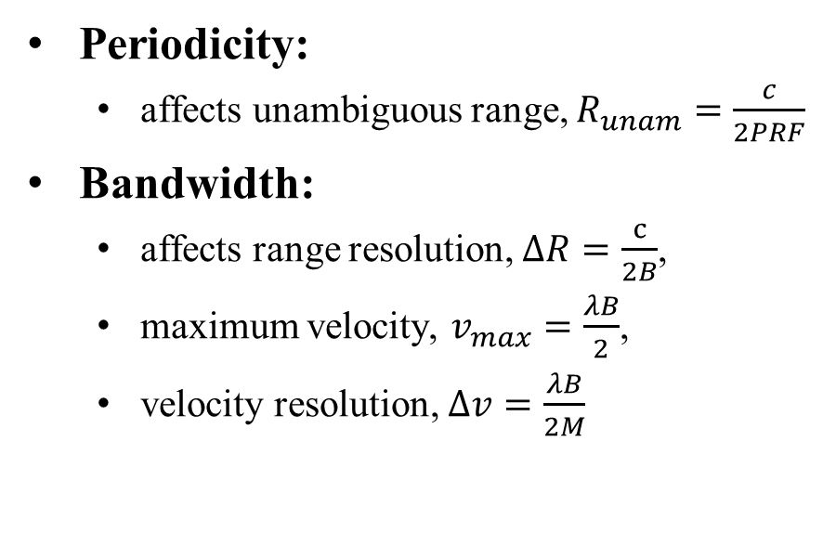
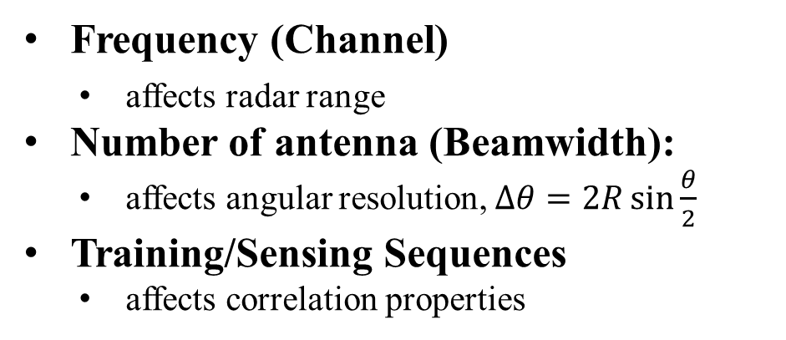
Radar-Based Sensing
Radar-based sensing can be further divided to correlation-based approach of pulsed radar [3] and the approach mentioned in [4].
Periodicity:
  affects unambiguous range, $R_{unam}=\frac{c}{2PRF}$
Bandwidth:
  affects range resolution, $ΔR=\frac{c}{2B}$,
  maximum velocity, $v_{max}=\frac{λB}{2}$,
  velocity resolution, $Δv=\frac{λB}{2M}$
Frequency (Channel)
  affects radar range
Number of antenna (Beamwidth):
  affects angular resolution, $Δθ=2R\sin{\frac{θ}{2}}$
Training/Sensing Sequences
  affects correlation properties

Slide 6
CSI-Based Sensing [5]
Periodicity
  Rate of the measurements
Bandwidth
  Amount of data collected per measurement
Frequency (Channel)
  Sensitivity of measurements to motion size
Number of Antenna (Beamwidth)
  Determines the area being sensed per measurement

Slide 7
Sensing Transmission Parameter Selection
There is a wide range of choices for sensing transmission parameters, and many possible combinations.
In a multi-sensing application scenario, tailoring sensing transmissions for each application and transmitting multiple sensing transmissions will increase network load, computational complexity, and negotiation stage duration (if there are back and forths).
Possible Solutions:
  It may be beneficial to have suggest sensing parameters which are suitable for multiple applications.
  It may be beneficial to suggest specific signal designs for specific applications for devices which have limited capability (secondarily sensing devices).

Slide 8
SP1
Do you agree with the following:
The following parameters shall be determined (or specified) in the negotiation phase of a sensing session
  Periodicity (the rate of transmission of sensing transmissions)
  Bandwidth
  Number of antennas
  Power

Slide 9
References
[1] 11-20-1851-01-00bf-overview-of-wi-fi-sensing-protocol
[2] 11-20-1712-02-00bf-wifi-sensing-use-cases
[3] H. J. Li and Y. W. Kiang, “10 – Radar and inverse scattering,” in The Electrical Engineering Handbook, W.K. CHEN, Ed. Burlington: Academic Press, 2005, pp. 671–690.
[4] C. Sturm, E. Pancera, T. Zwick and W. Wiesbeck, "A novel approach to OFDM radar processing," 2009 IEEE Radar Conference, Pasadena, CA, USA, 2009, pp. 1-4.
[5] Zheng Yang, Zimu Zhou, and Yunhao Liu. 2013. From RSSI to CSI: Indoor localization via channel response. ACM Comput. Surv. 46, 2, Article 25 (November 2013), 32 pages.

