Slide 1
Wi-Fi Sensing Parameters
Date: 2021-03-03
Authors:

Slide 2
Abstract
[1] proposes determining the sensing transmission parameters during the negotiation phase.
This contribution will go over adjustable sensing transmission parameters affecting sensing performance and suggests the possibility of having predefined sensing transmission parameters for popular use-cases [2] to shorten the negotiation phase.

Slide 3
PPDU of the PHY Amendments
802.11 Version | Modulation Format | Frequency | Bandwidths
802.11p | OFDM only | 5.9 GHz | 5, 10, 20 MHz
802.11n | OFDM only | 2.4/5 GHz | 20, 40 MHz
802.11ax | OFDMA | 2.4/5/6 GHz | 20, 40, 80, 160 MHz
802.11ay | OFDM, single carrier | 60 GHz | 2, 4, 6, 8 GHz
802.11be | OFDMA | 2.4/5/6 GHz | 20, 40, 80, 160, 240, 320 MHz

Slide 4
Adjustable parameters affecting sensing performance
Periodicity/ Pulse Repetition Frequency
Bandwidth
Frequency (Channel)
Sub-carrier Spacing
Training/Sensing Sequences
Number of Antenna (Beamwidth)
…

Slide 5
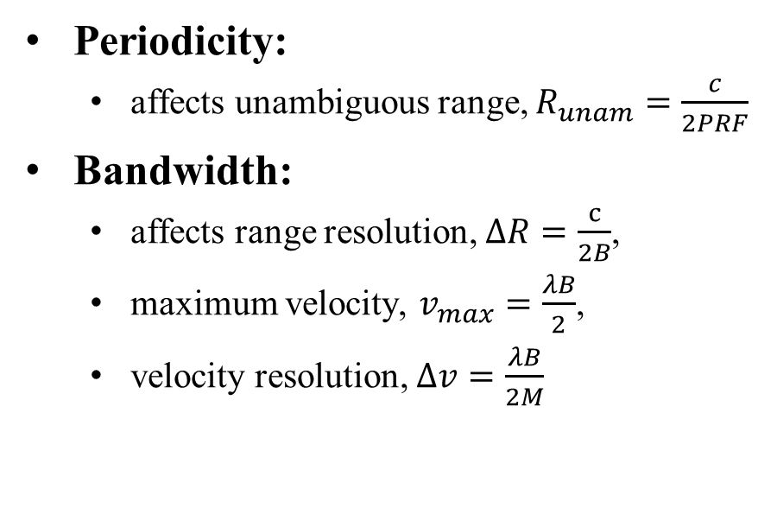
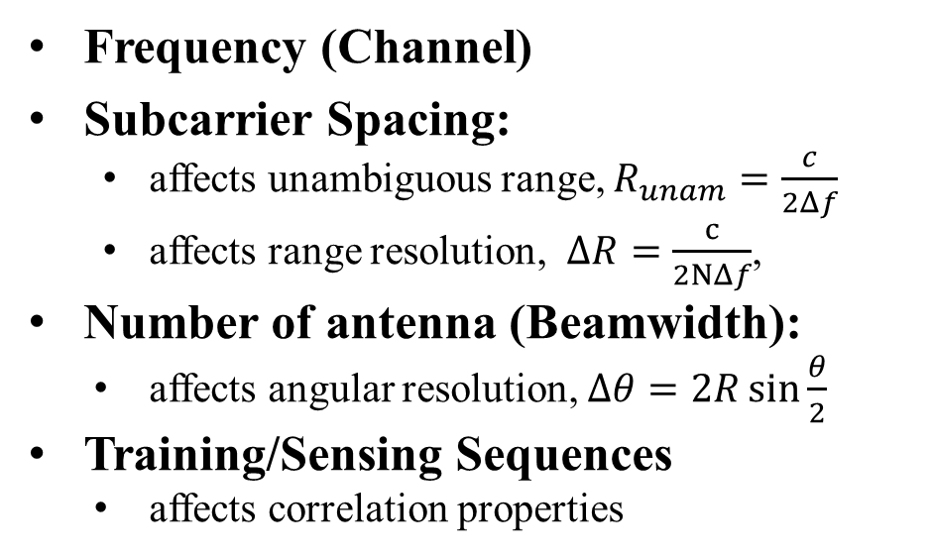
Radar-Based Sensing
Radar-based sensing can be further divided to correlation-based approach of pulsed radar [3] and the approach mentioned in [4].
Periodicity:
  affects unambiguous range, $R_{unam}=\frac{c}{2PRF}$
Bandwidth:
  affects range resolution, $ΔR=\frac{c}{2B}$,
  maximum velocity, $v_{max}=\frac{λB}{2}$,
  velocity resolution, $Δv=\frac{λB}{2M}$
Frequency (Channel)
Subcarrier Spacing:
  affects unambiguous range, $R_{unam}=\frac{c}{2Δf}$
  affects range resolution, $ΔR=\frac{c}{2NΔf}$,
Number of antenna (Beamwidth):
  affects angular resolution, $Δθ=2R\sin{\frac{θ}{2}}$
Training/Sensing Sequences
  affects correlation properties

Slide 6
CSI-Based Sensing [5]
Periodicity
  Rate of the measurements
Bandwidth
  Amount of data collected per measurement
Frequency (Channel)
  Sensitivity of measurements to motion size
Sub-carrier Spacing
  Quality of data for each measurement
Number of Antenna (Beamwidth)
  Determines the area being sensed per measurement

Slide 7
Sensing Transmission Parameter Selection
There is a wide range of choices for sensing transmission parameters, and many possible combinations.
In a multi-sensing application scenario, tailoring sensing transmissions for each application and transmitting multiple sensing transmissions will increase network load, computational complexity, and negotiation stage duration (if there are back and forths).
Possible Solutions:
  It may be beneficial to have suggest signal designs which are suitable for multiple applications.
  It may be beneficial to suggest specific signal designs for specific applications for devices which have limited capability (secondary sensing devices).

Slide 8
SP1
Do you agree with the following:
The adjustable sensing parameters are
  Periodicity
  Bandwidth
  Frequency
  Channel
  Subcarrier spacing
  Training/sensing sequence
  Number of antennas

Slide 9
SP2
Do you think it will be beneficial to have some preset sensing parameters for specific use-cases/use-case types?

Slide 10
References
[1] 11-20-1851-01-00bf-overview-of-wi-fi-sensing-protocol
[2] 11-20-1712-02-00bf-wifi-sensing-use-cases
[3] H. J. Li and Y. W. Kiang, “10 – Radar and inverse scattering,” in The Electrical Engineering Handbook, W.K. CHEN, Ed. Burlington: Academic Press, 2005, pp. 671–690.
[4] C. Sturm, E. Pancera, T. Zwick and W. Wiesbeck, "A novel approach to OFDM radar processing," 2009 IEEE Radar Conference, Pasadena, CA, USA, 2009, pp. 1-4.
[5] Zheng Yang, Zimu Zhou, and Yunhao Liu. 2013. From RSSI to CSI: Indoor localization via channel response. ACM Comput. Surv. 46, 2, Article 25 (November 2013), 32 pages.

