Slide 1
GCR NRFP acknowledgment follow-up
Date: 2021-03-03
Authors:
Name | Affiliations | Address | Email
Boyce Bo Yang | Huawei | Nanjing, China | yangbo59@huawei.com
Chenhe Ji |  | Nanjing, China | jichenhe@huawei.com

Slide 2
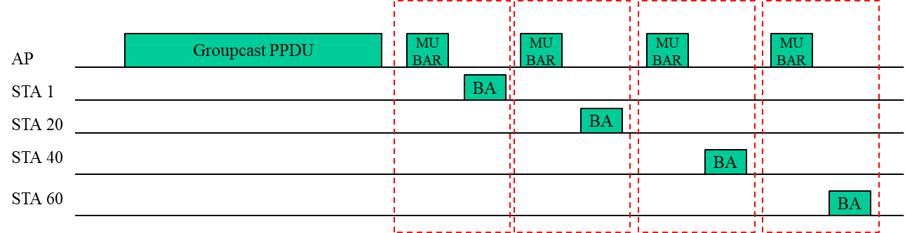
Recall GCR NFRP feedbacks[1]
  For a typical implementation of 40MHz BW, there are up to 18 RUs. 4 MU-BAR Triggers are needed to solicit BAs from each group transmission, if there are 60 recipients.
  Note that, if the MCS is selected properly, most of the packets (90% or more) can be received by the recipients correctly.
  In case of multicast transmission, most recipients can decode the multicast A-MSDU correctly and only a few recipients would have decoding errors, so
    The BA bitmaps from 90% of STAs are all 1s, which is only 1 bit info.

Slide 3
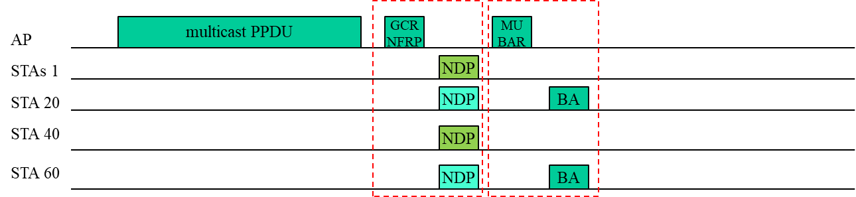
Recall GCR NFRP feedbacks[1] (2)
  NDP feedback is able to carry 1 bit info for many STAs
  An AP can send a GCR NFRP Trigger frame after a multicast data frame
    A STA that decodes all MSDUs correctly would send a response on NDP_TONE_SET_0
    A STA that has at least one errors would send a response on NDP_TONE_SET_1
  By GCR NFRP, the AP would know which STAs receive all MSDUs and which STA has at least one errors. Since the AP only need to solicit BAs from a very small fraction of recipients, BA signaling overhead can be reduced(by 50% of signaling in this example. Refer to backup page for more data).

Slide 4
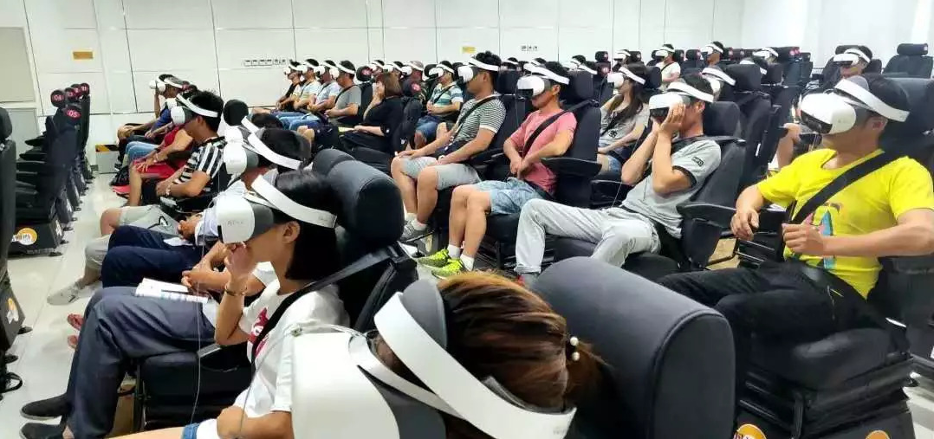
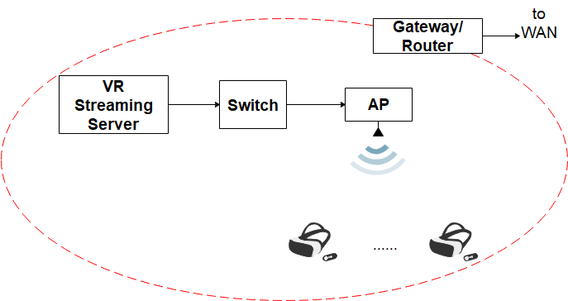
Use cases - VR training/education
local subnet
VR training in a driving school[2]
Scenario:
VR training and VR education are emerging in many areas: colleges, vocational training, popular science shows etc.
In implementation, APs and VR helmets would be chosen deliberately, and those devices supporting multicast features would be more competitive
Topology:
VR streaming servers are usually within a local subnet and the VR streams would not across the gateway or any router.
VR streams are downlink, from the VR server to multiple VR helmets.

Slide 5
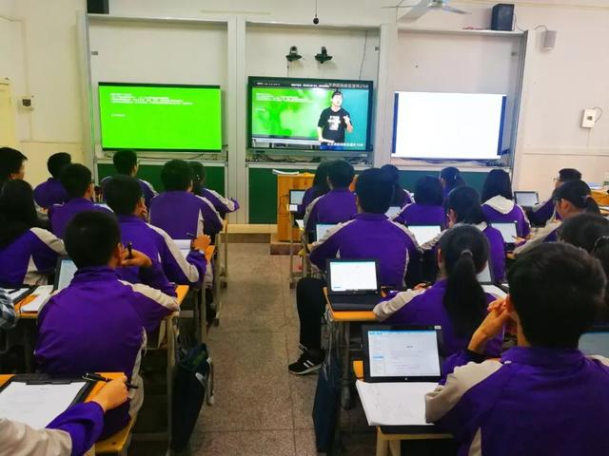
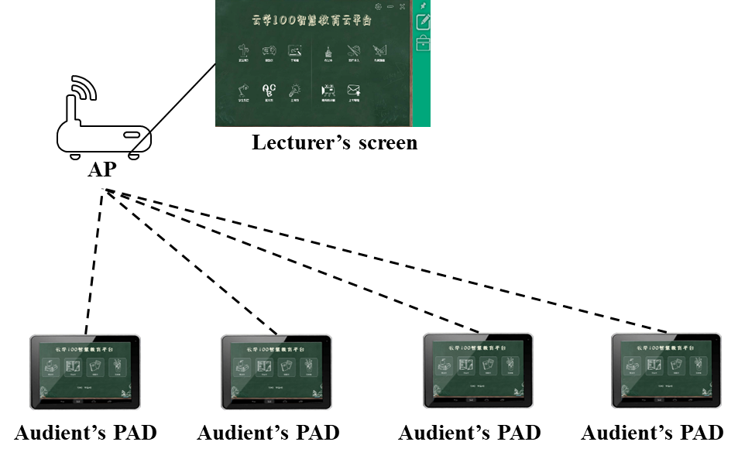
Use cases – Intelligent screen
Iscreen: screen sharing and interaction[3]
Scenario:
Intelligent screens are very popular in multimedia classrooms/meeting room now: Each audient would have a pad screen in front of him or her and the screen is synchronized to the lecturer’s screen. So the audients don’t have to peer at the projector’s screen from the back rows.
Topology:
The devices (AP, PAD and PC) in those scenarios are usually chosen deliberately
The traffic stream is transmitted in a local subnet(screen sharing, interactions). An AP multicast live stream to audient’s PAD.

Slide 6
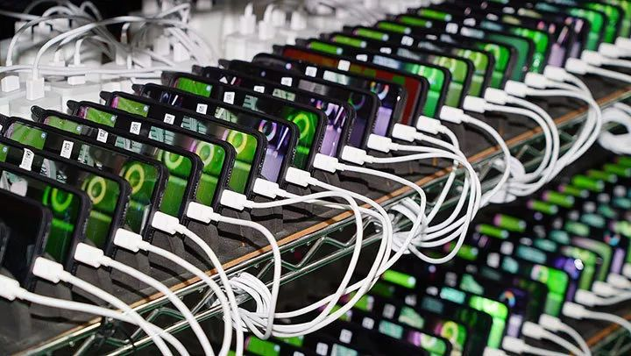
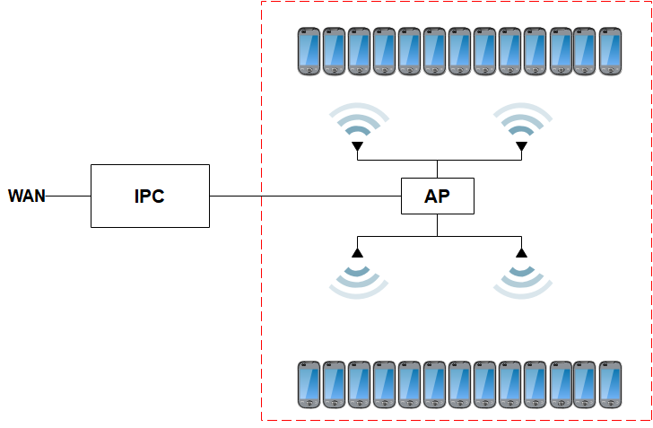
Use cases – Industry manufacture
Mobile phone testing and OS loading
Scenario:
In a mobile phone factory, hundreds of phones would be put in a test chamber for pre-delivery test.
In this stage, the operating system of each phone would be updated from factory version to consumer version.
To download such a big file, multicast is much more efficient than unicast.
Topology
An IPC is connected to an AP with cable directly.
Mobile phones are put closely to each other in a chamber
Test software or OS files are multicast from IPC to mobile phones

Slide 7
Discussion on GCR NFRP acknowledgment
  Use cases:
  It’s not so common at home that an AP multicast to many clients. However, there are a lot of application scenarios in enterprise and industry WLAN, where multicast transmissions usually occur within a local subnet(avoiding IP routing problems in WAN routers).
  The gains of NFRP based feedbacks is getting higher as the number of recipients getting larger (refer to [1] for more details).
  Supportive of basic NFRP:
  In many cases, the clients can be selected on purpose to support multicast features. So it less critical whether a feature is supported by the majority of WLAN devices on market.
  Some vendors have already support NFRP, which proofs that NFRP is doable in technique.
  Introducing GCR NFRP acknowledgment would add values to devices that support basic NFRP and have no negative effect to devices that do not support basic NFRP.

Slide 8
Summary
We give some use cases of multicast transmission that have many recipients in real deployment
In those cases, multicast streams are usually limited to local area network and the devices can be selected on purpose.
GCR NFRP would help reduce feedback overheads in those use cases.

Slide 9
Straw Poll
Do you agree to introduce a NDP feedback based acknowledgment mechanism for multicast in 11bc
Note: this NDP feedback based acknowledgment mechanism is optional
Y/N/A

Slide 10
Reference
[1] IEEE 802.11-15/1261r2
[2] https://www.sohu.com/a/250956802_526149
[3] https://kknews.cc/zh-my/education/4beo2yq.html

Slide 11
Backup

Slide 12
Evaluation on BA feedback overheads
Simulation setup
BW: 40MHz
Num of STAs with decoding errors: <=18
MCS for Trigger/BA: 4
Observations:
As shown in the figures, the gain is significant if there are more than 40 recipients
(us）
MF = 1
(us）
MF = 0
Number of Recipients
Number of Recipients

Slide 13
Changes to the spec is minor
Use one of the reserved values in Feedback Type field to indicate a GRC acknowledgement request
Response procedure is very similar to the basic TB-NFRP
User info of NFRP variant Trigger
Starting AID
Reserved
Feedback Type
Reserved
UL Target Receive Power
Multiplexing Flag
Bits:
12
9
4
7
7
1
Table 9-31k—Feedback Type subfield encoding
Table 9-31k—Feedback Type subfield encoding
Value | Description
0 | Resource request
1 | GCR acknowledgement request
2-15 | Reserved
Value | Description
0 | Resource request
1-15 | Reserved

