Slide 1
Threshold Based Sensing Measurement
Date: 2021-05-10
Authors:
Name | Affiliation | Address | Phone | Email
Mengshi Hu | Huawei Technologies Co. Ltd | F3, Huawei Base, Shenzhen, China |  | humengshi@Huawei.com
Yingxiang Sun |  |  |  | sunyingxiang@Huawei.com
Chenchen Liu
Rui Du
Meihong Zhang
Danny Kai Pin Tan
Jason Yuchen Guo

Slide 2
Abstract
On the basis of [1], a potential procedure of threshold based sensing measurement (TBSM) is proposed in this contribution.
No need for a sensing receiver to feed back the CSI all the times.
The CSI can be fed back by a sensing receiver when the CSI variation becomes large.
A threshold can be added to describe whether the CSI variation is large enough.
The feedback overhead can be reduced.

Slide 3



Background of WLAN Sensing
Sensing based on channel sounding
Explicit feedback
Implicit feedback
Channel variation sometimes plays an important role
Some typical use cases:
Regularity
Some use cases like intruder detection may need a regular CSI feedback.
Most of the feedbacks over a period may be highly correlated.
Note:
Sensing transmitter: a STA that transmits PPDUs used for sensing measurements in a sensing session
Sensing receiver: a STA that receives PPDUs sent by a sensing transmitter and performs sensing measurements in a sensing session
An example of configuration [1]
Intruder detection
Fall detection
Gesture recognition

Slide 4
Threshold Based Sensing Measurement (TBSM)
The TBSM procedure allows a STA to determine the sensing measurement from other STAs. Referring to [2]-[4], it could be composed of the following four phases:
Setup phase: The sensing transmitter and the sensing receivers that participate the TBSM are determined.
Measurement phase: CSI measurements are performed.
Reporting phase: If the CSI variation meets the feedback threshold criterion, the sensing receivers will send Feedback response showing the CSI variation is large, then the feedback will be triggered and be sent to the sensing transmitter.
Termination phase: The sensing session is terminated.
Note:
1. Feedback thresholds configuration could be performed in the setup phase or measurement phase.
2. The comparison between the current measured CSI and the previous measured CSI could be performed in the measurement phase or feedback phase. 3. The same goes for the comparison between the CSI variation and the feedback threshold.

Slide 5
Measurement phase
CSI measurement
The sensing transmitter regularly sends NDPAs and NDPs to the sensing receivers
The sensing receivers perform CSI measurements after receiving the NDPs sent by the sensing transmitter.

Slide 6
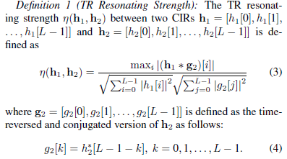
Reporting phase (1/3)
Feedback criterion
The feedback criterion could be Δ_{CSI} ≥ Δ_{CSI_th}, depending on the measurement that quantitatively evaluates Δ_{CSI}, where the CSI variation Δ_{CSI} is the difference between the current CSI and the previous CSI, Δ_{CSI_th} is the threshold of CSI variation.
For example, Δ_{CSI} could be evaluated by time-reversal resonating strength (TRRS) [5]. The TRRS is more robust compared to conventional correlation coefficients, since it takes the maximum value of the correlation coefficients.

Slide 7
Reporting phase (2/3)
Feedback request and feedback trigger
The sensing transmitter regularly sends feedback requests to the sensing receivers. The sensing receivers that meet the feedback criterion will send the feedback response to indicate they will perform a further feedback. Then the sensing transmitter will further trigger these sensing receivers.
The current measured CSI is compared with the previous measured CSI.
Some other information can be stored depending on need, e.g., the final result (referred to the final information that need to know, such as range, velocity, angle, and etc.), the compressed CSI (might be the compressed beamforming feedback matrix or the compressed matrix by other compressing methods), and etc.
The sensing receiver can feed back the NDP, CSI, compressed CSI, or the final result.

Slide 8
Reporting phase (3/3)
The sensing transmitter will perform one of the following operations depending on the feedback sent from the sensing receivers:
If the feedback is NDP, the sensing transmitter performs sensing measurement if needed.
If the feedback is the final result of sensing, no further computing is needed.
If the feedback is the CSI, the sensing transmitter performs some subsequent computing based on the CSI if needed.
If the feedback is the compressed CSI, the sensing transmitter reconstructs the CSI and then performs some subsequent computing based on the reconstructed CSI if needed.

Slide 9
Overhead Analysis (1/2)
Benefits (compared with the traditional procedure only using Procedure B):
If there is no need for CSI feedback at sensing receivers, only Procedure A is required.
If some sensing receivers need to feed back the CSI, both Procedure A and Procedure B are required, but Overhead B can be reduced because of Procedure A (Only a part of the sensing receivers need to feed back in procedure B. Thus more resources can be allocated to those receivers).
Example: if x% of the sensing receivers need to feed back the CSI, Overhead B can be reduced to around x% compared with the traditional procedure only using Procedure B (without Procedure A).
Because Overhead B is often far greater than Overhead A, it usually has a significant gain to utilize Overhead A to remove (1-x%) Overhead B.
Procedure A
Overhead A (small)
Procedure B
Overhead B (large)

Slide 10
Overhead Analysis (2/2)
Scenario (20MHz, 9 Sensing Receiver, HE PPDU format, supporting OFDMA, 16-QAM with coding rate 1/2)
Feedback request in Procedure A (if a trigger format is used)
Needed bits for trigger frames: Around (2+2+6+6+8+4+9*5) Octets = 584 bits (on the basis of Basic Trigger, 9 receivers)
Overhead of PPDU: Around dozens of microseconds
Feedback response in Procedure A
Overhead of PPDU: Around dozens of microseconds
Feedback trigger in Procedure B (if a trigger format is used)
Overhead of PPDU: Around dozens of microseconds
Feedback in Procedure B
If the CSI feedback needs 10000 bits, 10000 bits/29.3 Mbps = 341 μs (1 sensing receiver, 29.3 Mbps for a 242-tone RU)
If the CSI feedback needs 10000 bits, 10000 bits/12.8 Mbps = 781 μs (2 sensing receiver, 12.8 Mbps for a 106-tone RU)
If the CSI feedback needs 10000 bits, 10000 bits/3 Mbps = 3333 μs (9 sensing receiver, 3 Mbps for a 26-tone RU)
In the above scenario, the overhead can be significantly reduced from thousands of microseconds to hundreds of microseconds (because the number of the receivers needed to feed back in Procedure B reduces). Even if the CSI feedback does not need so many bits (e.g. 3000 bits), the proposed procedure is still beneficial.
In non-OFDMA cases, the benefit is also obvious.

Slide 11
Summary
To reduce overhead, potential procedures of Threshold Based Sensing Measurement (TBSM) was discussed.
No need for a sensing receiver to feed back the CSI all the times.
The CSI can be fed back by a sensing receiver when the CSI variation becomes large.
A threshold can be added to describe whether the CSI variation is large enough.
The feedback overhead can be reduced.

Slide 12
References
[1] 11-20-1120-01-SENS-follow-ups-on-channel-measurement-procedure-for-wlan-sensing.
[2] 11-21-0147-03-00bf-Definitions-and-scenarios-of-the-WLAN-sensing-follow-ups.
[3] 11-20-1851-04-00bf-Overview-of-Wi-Fi-sensing-protocol.
[4] 11-21-0370-00-00bf-considerations-of-sensing-negotiation.
[5] Z. Wu, Y. Han, Y. Chen and K. J. R. Liu, A Time-Reversal Paradigm for Indoor Positioning System,
in IEEE Transactions on Vehicular Technology, vol. 64, no. 4, pp. 1331-1339, April 2015.

Slide 13
Straw Poll
Do you agree that the 11bf amendment defines an optional threshold based measurement and reporting procedure in which
The difference between the current measured CSI and the previous measured CSI is quantified. The difference is referred to as CSI variation.
A threshold value to be used by the sensing receiver in the threshold based procedure is defined.
By comparing the CSI variation with the threshold, the sensing receiver can send a feedback resulting from the large CSI variation to the sensing transmitter.
Whether the threshold is predefined, or defined by the sensing receiver, transmitter, initiator or responder is TBD.
The threshold based procedure is not always required (Procedure A in 21/0351r5 is not always required).

Slide 14
Motion
Move to add the following to 11bf SFD:
The 11bf amendment defines an optional threshold based measurement and reporting procedure in which
The difference between the current measured CSI and the previous measured CSI is quantified. The difference is referred to as CSI variation.
A threshold value to be used by the sensing receiver in the threshold based procedure is defined.
By comparing the CSI variation with the threshold, the sensing receiver can send a feedback resulting from the large CSI variation to the sensing transmitter.
Whether the threshold is predefined, or defined by the sensing receiver, transmitter, initiator or responder is TBD.
The threshold based procedure is not always required (Procedure A in 21/0351r5 is not always required).
  Move: Second:
  Result:
  Note： Related document 21/0351r5

Slide 15
Response (1/2)
Q1: I see that there could be a cost in terms of memory requirements needed. I believe it could be a capability and that this could be an optional feature.
A1: The memory that would be taken by the CSI matrix could be calculated according to the 9.4.1.27 CSI Report field in IEEE P802.11-REVme/D0.0, March 2021.
The size of CSI matrix for each carrier is (2×Nb×Nc×Nr) bits
The size of the CSI Report field is Nr8+Ns(3+2NbNcNr) bits
Nb: is the number of bits determined by the Coefficients Size field of the MIMO Control field (Indicates the number of bits in the representation of the real and imaginary parts of each element in the matrix)
Nc: is the number of columns in a CSI matrix determined by the Nc index field of the MIMO Control field
Nr: is the number of rows in a CSI matrix determined by the Nr Index field of the MIMO Control field
Ng： of carriers grouped into one
Ns： is the number of subcarriers sent
The evaluation results are summarized in the following table (HT version):
BW | Ng | Ns | Nb | Nc | Nr | Size (bit)
20MHz | 1 | 56 | 8 | 4 | 4 | 14336
20MHz | 2 | 30 | 8 | 4 | 4 | 7680
20MHz | 4 | 16 | 8 | 4 | 4 | 4096
40MHz | 1 | 114 | 8 | 4 | 4 | 29184
40MHz | 2 | 58 | 8 | 4 | 4 | 14848
40MHz | 4 | 30 | 8 | 4 | 4 | 30720

Slide 16
Response (2/2)
Q2: Do you suggest having actual formulas in the specification? Usually we don’t have these details in the specification.
A2: I suggest having actual formulas in the specification, so that we can evaluate the CSI variation under the same criterion. Otherwise, when having the same CSI variation, receiver A will have a feedback, and receiver B will have not have a feedback. Nevertheless, we can have further discussions for the details.

Slide 17
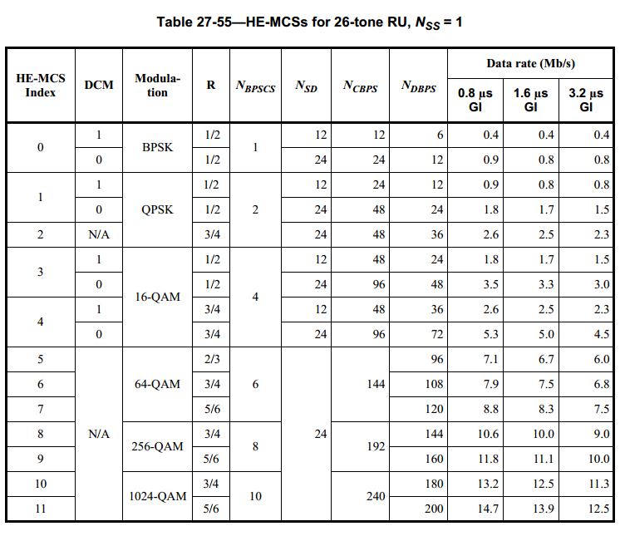
Appendix (1/3)

Slide 18
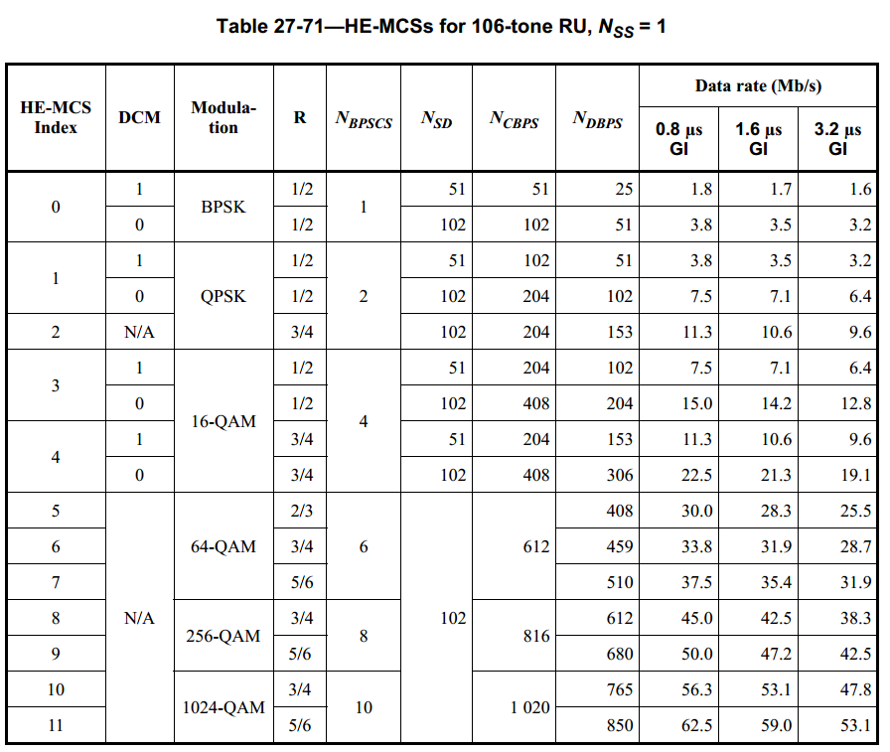
Appendix (2/3)

Slide 19
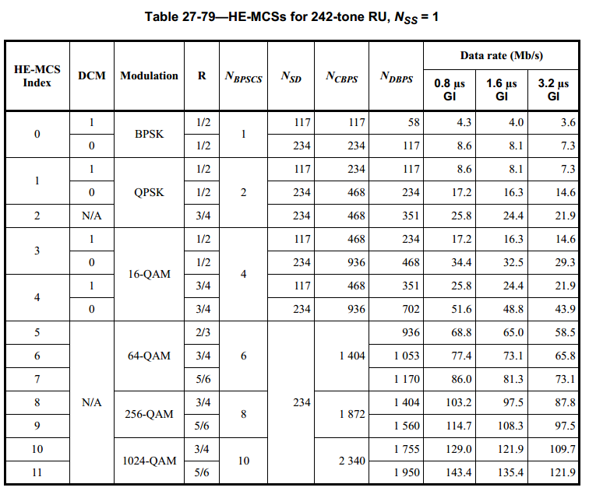
Appendix (3/3)

