Slide 1
Compressed Supported MCS and Nss Set Field
Date: 2021-03-10
Authors:
Name | Affiliations | Address | Phone | email
Steve Shellhammer | Qualcomm |  |  | shellhammer@ieee.org
Bin Tian |  |  |  | btian@qti.qualcomm.com
Youhan Kim |  |  |  | youhank@qti.qualcomm.com
Rui Cao | NXP |  |  | rui.cao_2@nxp.com
Liwen Chu |  |  |  | liwen.chu@nxp.com

Slide 2
Feedback Received
Received feedback on two areas when presented earlier
For 320 MHz STAs include the fields for 80, 160 and 320 MHz and not just 160 and 320 MHz
Modify the design to treat 20 MHz-Only STAs different than 80 MHz STAs, so that the 80 MHz STAs cannot signal that they only support MCS 0-7, versus the mandatory MCS 0-9
Updates have been made to consider the feedback received

Slide 3
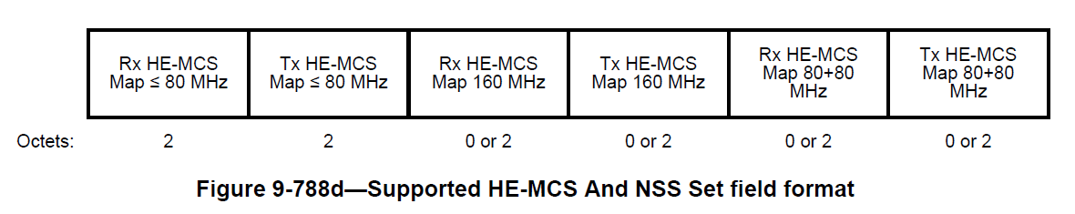
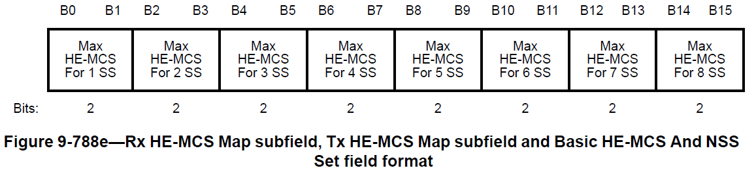
Background
The 802.11ax Supported MCS and Nss Set Field requires up to 12 Octets
If we use a similar format in 802.11be we will require 12 octets in 802.11be for R1 and when we extent to 16 spatial streams in R2 we will require an additional 12 octets, for a total of 24 octets in 802.11be

Slide 4
Compressed Supported MCS and Nss Set Field
We will show an alternative format which requires at most 7 octets for EHT R1 & R2
We will provide a few illustrations showing the difference between the approach used in 802.11ax and the approach proposed here

Slide 5

HE Encoding Approach
MCS 10-11
MCS 8-9
MCS 0-7
None
 | 1 SS | 2 SS | 3 SS | 4 SS | 5 SS | 6 SS | 7 SS | 8 SS
Legend
Signaled in HE Supported MCS and Nss Set Field
Each column is encoded using 2 bits
  Indicates the max MCS supported for each number of spatial streams, from 1 to 8
  This requires $2×8=16$ bits = 2 octets, for each BW and for both TX and RX

Slide 6
Proposed EHT Encoding Approach
MCS 12-13
MCS 10-11
MCS 8-9
MCS 0-7
 | 0 SS | 1 SS | 2 SS | 3 SS | 4 SS | 5 SS | 6 SS | 7 SS | 8 SS | 9 SS | 10 SS | 11 SS | 12 SS | 13 SS | 14 SS | 15 SS | 16 SS
Legend
EHT Signaling Required
Propose encoding by row
  For each MCS set, specify the maximum Nss supported

Slide 7
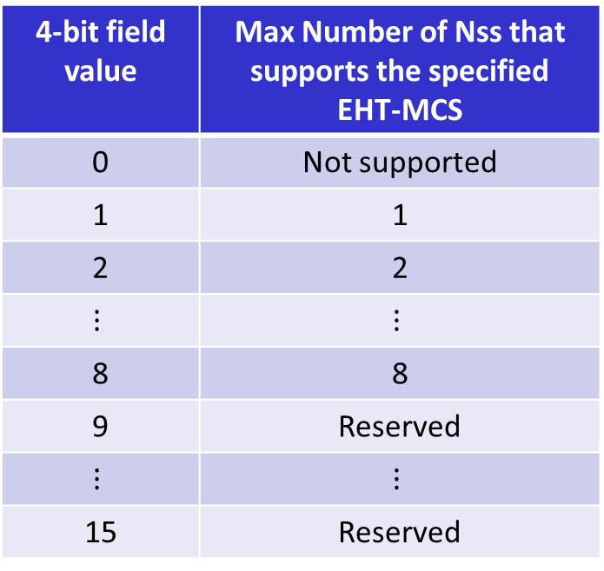
Row Encoding Proposal
4-bit field value | Max Number of Nss that supports the specified EHT-MCS
0 | Not supported
1 | 1
2 | 2
$$⋮$$ | $$⋮$$
8 | 8
9 | Reserved
$$⋮$$ | $$⋮$$
15 | Reserved
Each Row requires a 4-bit field
Can be extended to support 16 SS in R2

Slide 8
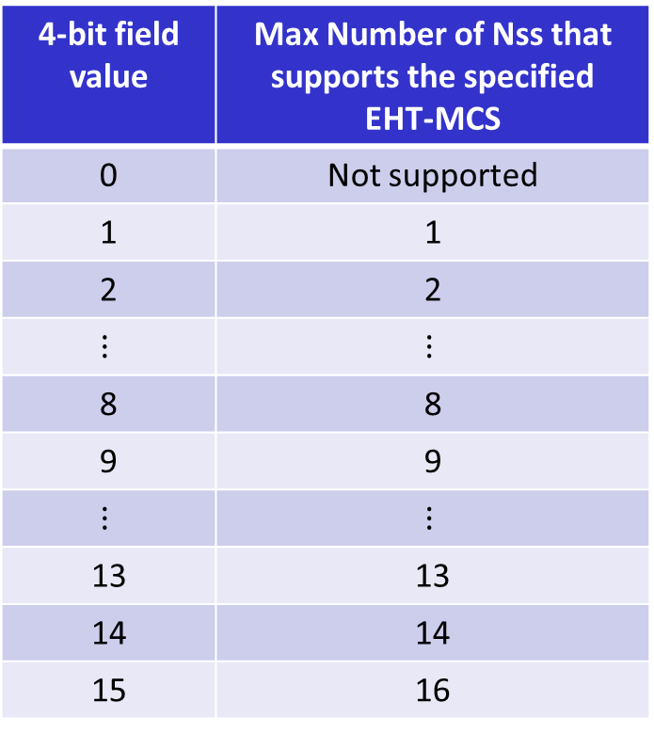
Extension to Support 16 SS in R2
In R2 we can update the table entries as such
4-bit field value | Max Number of Nss that supports the specified EHT-MCS
0 | Not supported
1 | 1
2 | 2
$$⋮$$ | $$⋮$$
8 | 8
9 | 9
$$⋮$$ | $$⋮$$
13 | 13
14 | 14
15 | 16
A STA that supports a given MCS for 15 spatial streams also supports it for 16 spatial streams

Slide 9
Option 1 – Separate Field for 20 MHz-Only STAs
Maximum Supported Bandwidth | Fields Transmitted | Octets Required
20 MHz-Only | EHT MCS Map (BW = 20 MHz) | 4
80 MHz | EHT MCS Map (BW = 80 MHz) | 3
160 MHz | EHT MCS Map (BW = 80 MHz) EHT MCS Map (BW = 160 MHz) | 6
320 MHz | EHT MCS Map (BW = 80 MHz) EHT MCS Map (BW = 160 MHz) EHT MCS Map (BW = 320 MHz) | 9
This Option prevents an 80 MHz STA from signaling that it only supports MCS 0-7, and not MCS 8-9

Slide 10
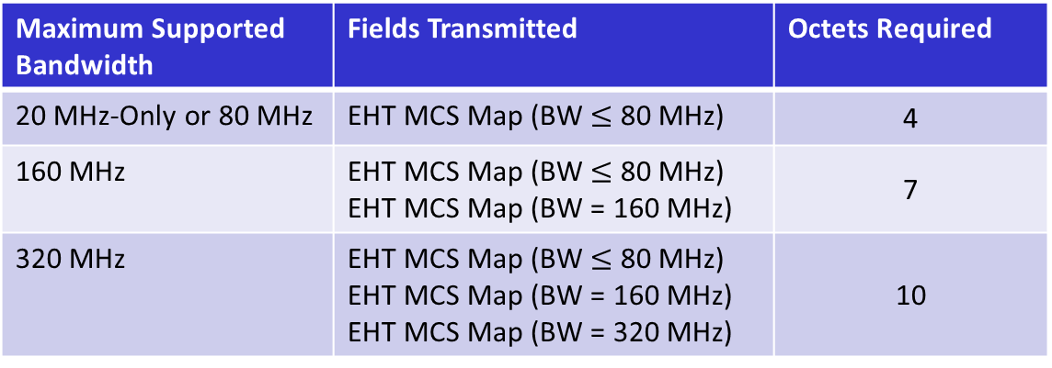
Option 2 – 20 MHz-Only STAs incorporated into BW $≤$ 80 MHz
Maximum Supported Bandwidth | Fields Transmitted | Octets Required
20 MHz-Only or 80 MHz | EHT MCS Map (BW $≤$ 80 MHz) | 4
160 MHz | EHT MCS Map (BW $≤$ 80 MHz) EHT MCS Map (BW = 160 MHz) | 7
320 MHz | EHT MCS Map (BW $≤$ 80 MHz) EHT MCS Map (BW = 160 MHz) EHT MCS Map (BW = 320 MHz) | 10
This Option does not prevent an 80 MHz STA from signaling that it only supports MCS 0-7, and not MCS 8-9

Slide 11
Detailed MCS Map Subfields
Three MCS Sets: MCS 0-9, MCS 10-11, MCS 12-13
Four MCS Sets: MCS 0-7, MCS 8-9, MCS 10-11, MCS 12-13

Slide 12
Basic EHT-MCS and Nss Set Field
We also believe this approach makes sense of the Basic EHT-MCS and Nss Set Field
We propose the following format for the Basic EHT-MCS and Nss Set Field
  Includes all four MCS Sets: MCS 0-7, MCS 8-9, MCS 10-11 and MCS 12-13

Slide 13
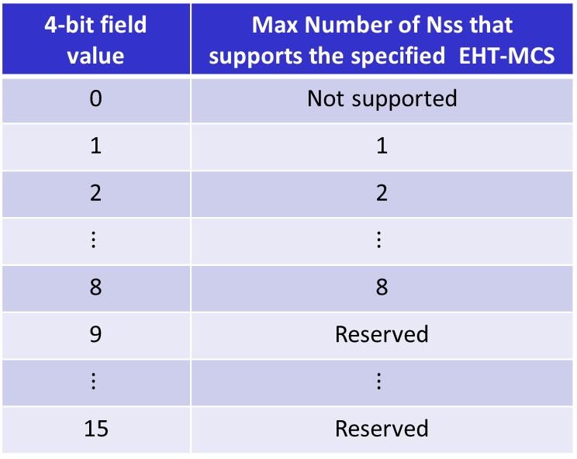
Straw Poll #1
For the Supported MCS and Nss Set field, do you agree to signal the maximum number of spatial streams supported for a given MCS set, using the table below?
  Note: This can be extended to support up to 16 spatial streams in R2
4-bit field value | Max Number of Nss that supports the specified EHT-MCS
0 | Not supported
1 | 1
2 | 2
$$⋮$$ | $$⋮$$
8 | 8
9 | Reserved
$$⋮$$ | $$⋮$$
15 | Reserved

Slide 14
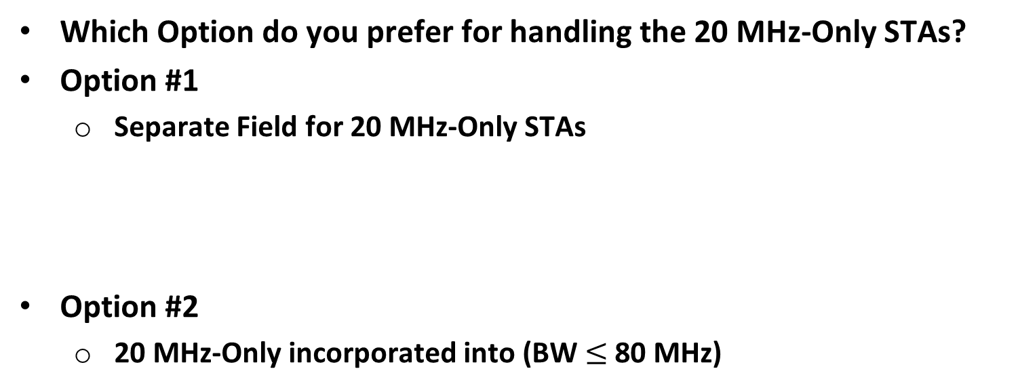
Straw Poll #2
Which Option do you prefer for handling the 20 MHz-Only STAs?
Option #1
  Separate Field for 20 MHz-Only STAs
Option #2
  20 MHz-Only incorporated into (BW $≤$ 80 MHz)

Slide 15
Straw Poll #3a (If Option 1 is Preferred)
Do you support the following Supported MCS and Nss Set Field and the EHT-MCS Map Subfield format?
Supported MCS and Nss Set Field
EHT-MCS Map Subfield Format (BW = 80/160/320 MHz)
EHT-MCS Map Subfield Format (BW = 20 MHz)

Slide 16
Straw Poll #3b (If Option 2 is Preferred)
Do you support the following Supported MCS and Nss Set Field and the EHT-MCS Map Subfield format?
Supported MCS and Nss Set Field
EHT-MCS Map Subfield Format (BW = 160/320 MHz)
EHT-MCS Map Subfield Format (BW $≤$ 80 MHz)

Slide 17
Straw Poll #4
Do you support the Basic EHT-MCS And MCS Set Field format show below?

