Slide 1
Compressed Supported MCS and Nss Set Field
Date: 2021-03-03
Authors:
Name | Affiliations | Address | Phone | email
Steve Shellhammer | Qualcomm |  |  | shellhammer@ieee.org
Bin Tian |  |  |  | btian@qti.qualcomm.com
Youhan Kim |  |  |  | youhank@qti.qualcomm.com
Rui Cao | NXP |  |  | rui.cao_2@nxp.com
Liwen Chu |  |  |  | liwen.chu@nxp.com

Slide 2
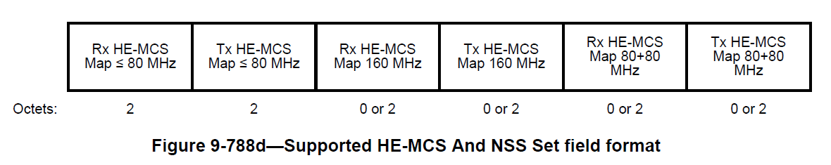
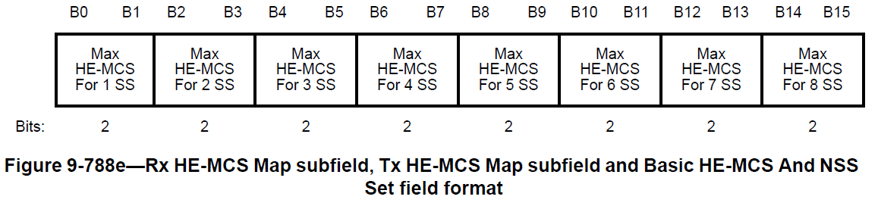
Background
The 802.11ax Supported MCS and Nss Set Field requires up to 12 Octets
If we use a similar format in 802.11be we will require 12 octets in 802.11be for R1 and when we extent to 16 spatial streams in R2 we will require an additional 12 octets, for a total of 24 octets in 802.11be

Slide 3
Compressed Supported MCS and Nss Set Field
We will show an alternative format which requires at most 7 octets for EHT R1 & R2
We will provide a few illustrations showing the difference between the approach used in 802.11ax and the approach proposed here

Slide 4
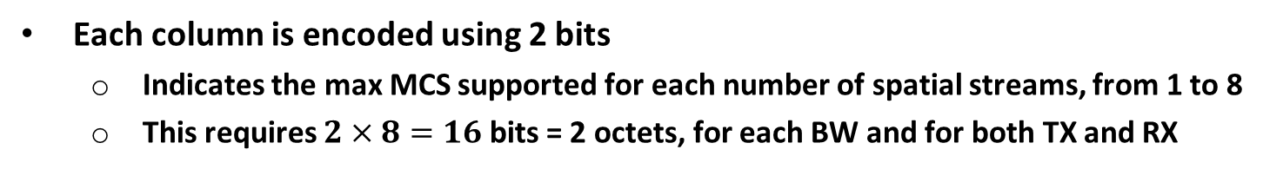
HE Encoding Approach
MCS 10-11
MCS 8-9
MCS 0-7
None
 | 1 SS | 2 SS | 3 SS | 4 SS | 5 SS | 6 SS | 7 SS | 8 SS
Legend
Signaled in HE Supported MCS and Nss Set Field
Each column is encoded using 2 bits
  Indicates the max MCS supported for each number of spatial streams, from 1 to 8
  This requires $2×8=16$ bits = 2 octets, for each BW and for both TX and RX

Slide 5
Proposed EHT Encoding Approach
MCS 12-13
MCS 10-11
MCS 8-9
MCS 0-7
 | 0 SS | 1 SS | 2 SS | 3 SS | 4 SS | 5 SS | 6 SS | 7 SS | 8 SS | 9 SS | 10 SS | 11 SS | 12 SS | 13 SS | 14 SS | 15 SS | 16 SS
Legend
EHT Signaling Required
Propose encoding by row
  For each MCS set, specify the maximum Nss supported

Slide 6
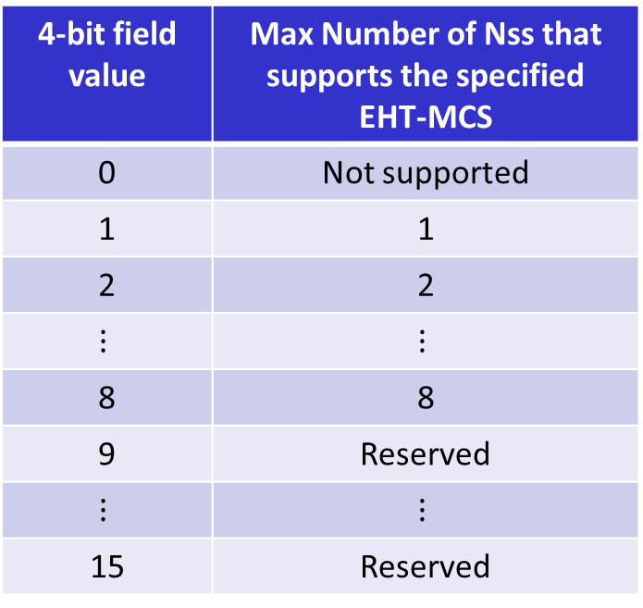
Row Encoding Proposal
4-bit field value | Max Number of Nss that supports the specified EHT-MCS
0 | Not supported
1 | 1
2 | 2
$$⋮$$ | $$⋮$$
8 | 8
9 | Reserved
$$⋮$$ | $$⋮$$
15 | Reserved
Each Row requires a 4-bit field
Can be extended to support 16 SS in R2

Slide 7
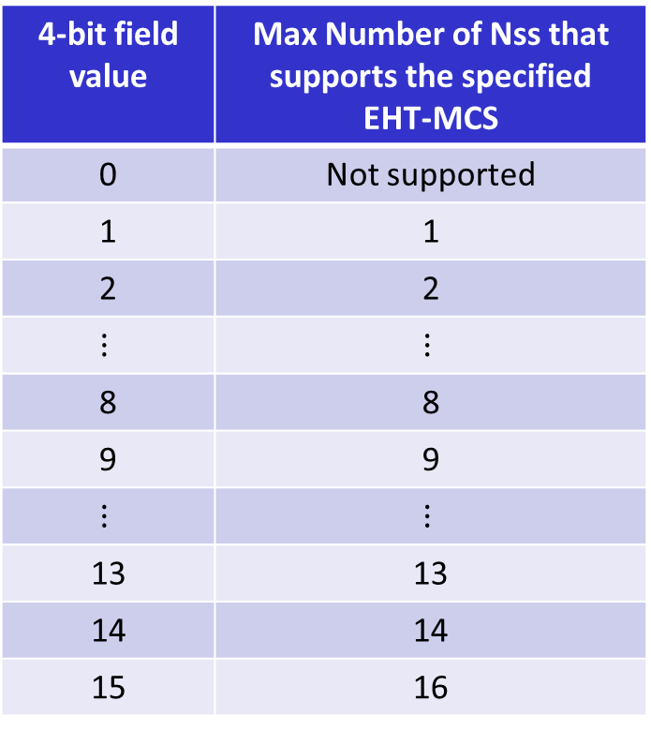
Extension to Support 16 SS in R2
In R2 we can update the table entries as such
4-bit field value | Max Number of Nss that supports the specified EHT-MCS
0 | Not supported
1 | 1
2 | 2
$$⋮$$ | $$⋮$$
8 | 8
9 | 9
$$⋮$$ | $$⋮$$
13 | 13
14 | 14
15 | 16
A STA that supports a given MCS for 15 spatial streams also supports it for 16 spatial streams

Slide 8

Proposal for BW $≤$ 80 MHz
4-bit field for each MCS row
Uses 4 Octets
Ready to expand to support 16 SS in R2

Slide 9
EHT 160 MHz
MCS 12-13
MCS 10-11
MCS 0-9
 | 0 SS | 1 SS | 2 SS | 3 SS | 4 SS | 5 SS | 6 SS | 7 SS | 8 SS | 9 SS | 10 SS | 11 SS | 12 SS | 13 SS | 14 SS | 15 SS | 16 SS
Legend
EHT Signaling Required
MCS 0-9 mandatory in 160 MHz
Only need three rows

Slide 10
Proposal for BW = 160 MHz
4-bit field for each MCS row
Uses 3 Octets
Ready to expand to support 16 SS in R2

Slide 11
EHT 320 MHz
MCS 12-13
MCS 10-11
MCS 0-9
 | 0 SS | 1 SS | 2 SS | 3 SS | 4 SS | 5 SS | 6 SS | 7 SS | 8 SS | 9 SS | 10 SS | 11 SS | 12 SS | 13 SS | 14 SS | 15 SS | 16 SS
Legend
EHT Signaling Required
MCS 0-9 mandatory in 320 MHz
Only need three rows

Slide 12
Proposal for BW = 320 MHz
4-bit field for each MCS row
Uses 3 Octets
Ready to expand to support 16 SS in R2

Slide 13
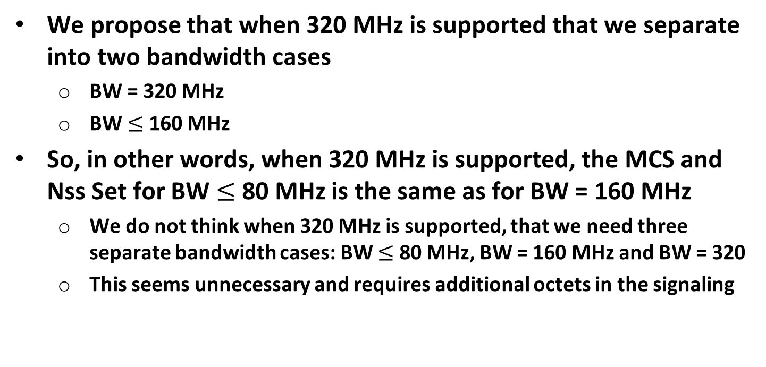
When 320 MHz Supported
We propose that when 320 MHz is supported that we separate into two bandwidth cases
  BW = 320 MHz
  BW $≤$ 160 MHz
So, in other words, when 320 MHz is supported, the MCS and Nss Set for BW $≤$ 80 MHz is the same as for BW = 160 MHz
  We do not think when 320 MHz is supported, that we need three separate bandwidth cases: BW $≤$ 80 MHz, BW = 160 MHz and BW = 320
  This seems unnecessary and requires additional octets in the signaling

Slide 14
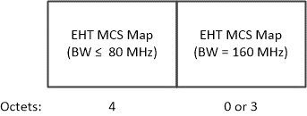
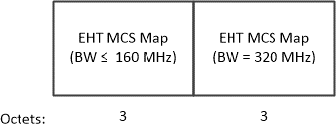
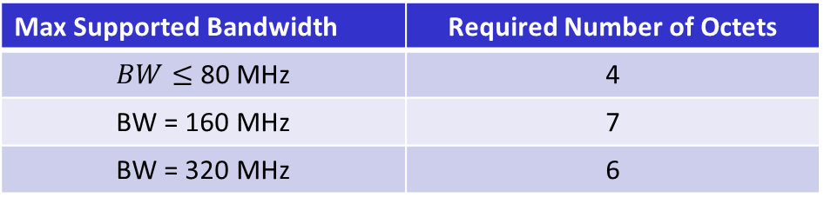
Compressed EHT MCS and Nss Set Field
If 320 MHz is not Supported
If 320 MHz is Supported
Max Supported Bandwidth | Required Number of Octets
$BW≤$ 80 MHz | 4
BW = 160 MHz | 7
BW = 320 MHz | 6

Slide 15
Basic EHT-MCS and Nss Set Field
We also believe this approach makes sense of the Basic EHT-MCS and Nss Set Field
We propose the following format for the Basic EHT-MCS and Nss Set Field

Slide 16
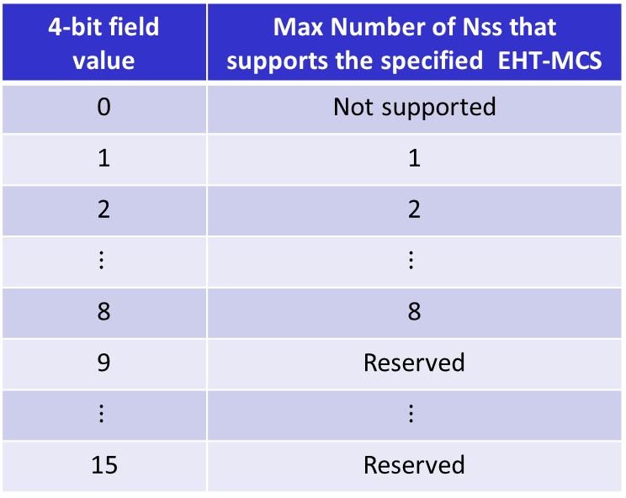
Straw Poll #1
For the Supported MCS and Nss Set field, do you agree to signal the maximum number of spatial streams supported for a given MCS set, using the table below?
  Note: This can be extended to support up to 16 spatial streams in R2
4-bit field value | Max Number of Nss that supports the specified EHT-MCS
0 | Not supported
1 | 1
2 | 2
$$⋮$$ | $$⋮$$
8 | 8
9 | Reserved
$$⋮$$ | $$⋮$$
15 | Reserved

Slide 17
Straw Poll #2
Do you agree the design of the EHT-MCS Map subfields in the figures below?

Slide 18
Straw Poll #3
Do you agree that when 320 MHz is not supported that the Supported MCS and Nss Set field signals the subfields shown in the figure below?

Slide 19
Straw Poll #4a
Do you agree that when 320 MHz is supported that the Supported MCS and Nss Set field signals the subfields shown in the figure below?

Slide 20
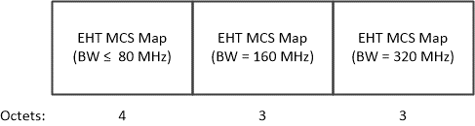
Straw Poll #4b
Do you agree that when 320 MHz is supported that the Supported MCS and Nss Set field signals the subfields shown in the figure below?

Slide 21
Straw Poll #5
Do you support a Compressed “Basic EHT-MCS And MCS Set Field” design as show below?

