Slide 1
PSR-based SR Normalization Discussion
Date: 2021-02-18
Authors:
Name | Affiliations | Address | Phone | email
Ross Jian Yu | Huawei |  |  | ross.yujian@huawei.com
Jason Yuchen Guo | Huawei
Yunbo Li | Huawei
Yan Chen | Huawei
Ming Gan | Huawei

Slide 2
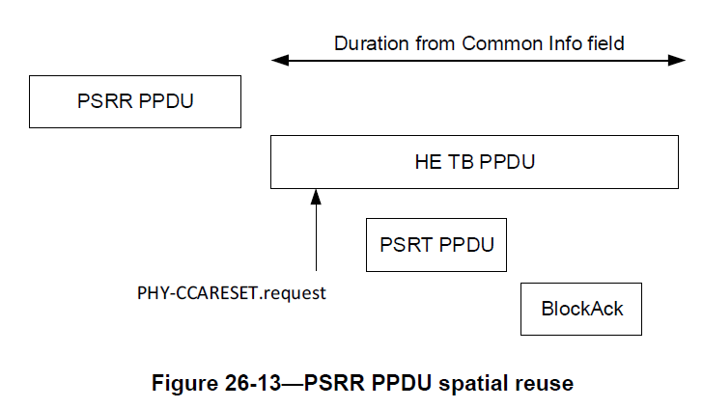
Recap – PSR-based SR in 11ax
PSR-based spatial reuse procedure in 11ax:
  PSRR (parameterized spatial reuse reception) PPDU contains a trigger frame
  The trigger frame and the HE-SIG-A field of HE TB PPDU contains parameters related with spatial reuse.
AP1
STA1
AP2
STA2

Slide 3
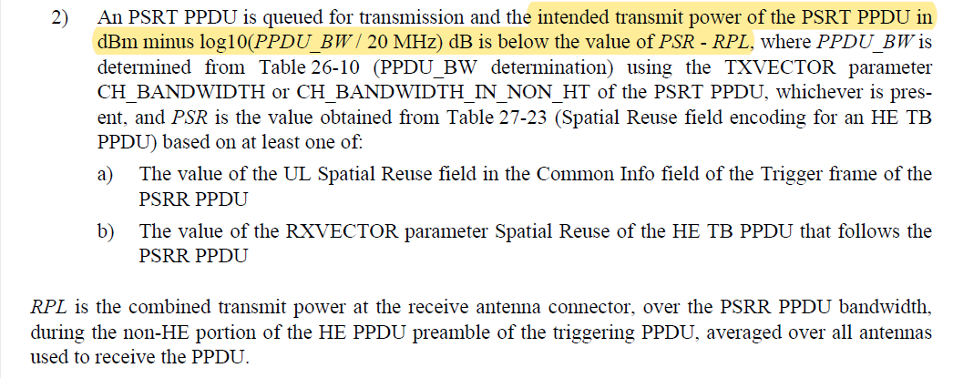
Recap – PSR-based SR in 11ax
How to set Tx power of PSRT PPDU values:

Slide 4
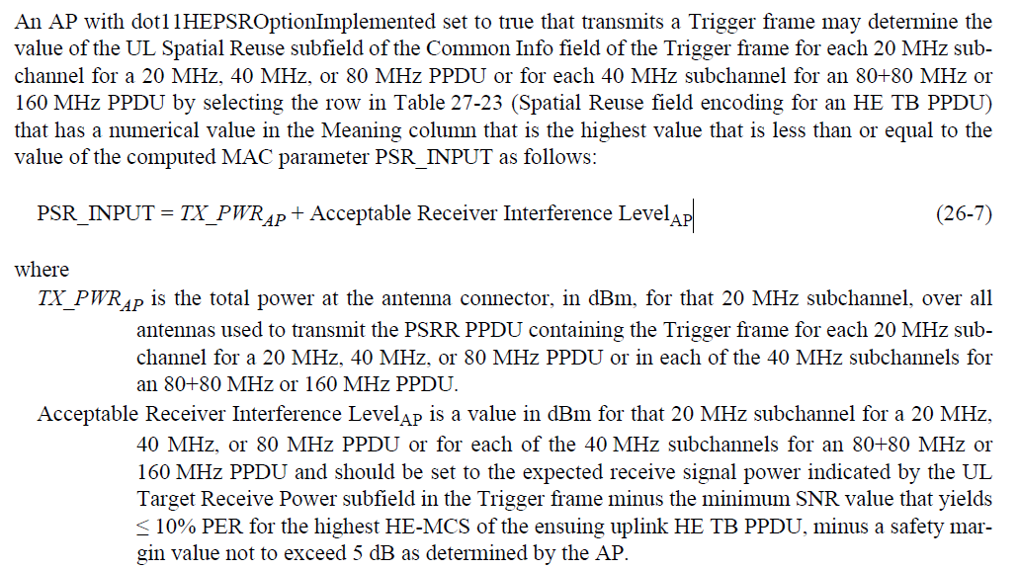
Recap – PSR-based SR in 11ax
How to set PSR values in trigger frame, which are also indicated in HE-SIG-A of the HE TB PPDU through spatial reuse 1-4 fields:

Slide 5
Normalization Issue Discussion
There are several parameters, the normalization is done as follows:
  TxPower_PSRT: always normalized to 20MHz by subtract log10(PSRT_PPDU_BW/20MHz)
  PSR value = TxPower_PSRR + Acceptable Rx interference: normalized to 20Mhz for BW<=80MHz; normalized to 40MHz for BW=160MHz
  RPL: received power of PSRR PPDU, over the whole PSRR PPDU BW, no normalization
The following condition in P802.11ax D8.0 is used to decides if the PSR transmission can be initiated or not:
  TxPower_PSRT (normalized to 20Mhz) is below PSR value (normalized to 20Mhz or 40MHz) – RPL (over the PSRR PPDU BW, no normalization)
There is an issue here and we need to resolve it in 11be and Revme (for 11ax).

Slide 6
Potential Solution 1 for 11ax
Potential solution 1 is that the normalization is still BW dependent. For example, for 11ax, the following condition is used:
  when BW<=80Mhz: TxPower_PSRT (normalized to 20Mhz) is below PSR value (normalized to 20Mhz) – RPL (normalized to 20MHz)
    RPL normalized to 20MHz is done by subtracting log10(PSRR_PPDU_BW/20MHz)
  When BW=160/80+80MHz: TxPower_PSRT (normalized to 40Mhz) is below PSR value (normalized to 40Mhz) – RPL (normalized to 40MHz) or equivalently
    When BW=160/80+80MHz: (TxPower_PSRT (normalized to 20Mhz) +3dB) is below PSR value (normalized to 40Mhz) – (RPL (normalized to 20MHz) + 3dB) or equivalently
    When BW=160/80+80MHz: TxPower_PSRT (normalized to 20Mhz) is below (PSR value (normalized to 40Mhz) – 6dB) – RPL (normalized to 20MHz)
      6dB is because TxPower_PSRR and Acceptable Rx interference each accounts for 3dB for the difference between 20MHz and 40MHz normalization

Slide 7
Potential Solution 1 for 11be
Potential solution 1 (BW dependent) for 11be is as follows:
  when BW<=40Mhz: TxPower_PSRT (normalized to 20Mhz) is below PSR value (normalized to 20Mhz) – RPL (normalized to 20MHz)
  When BW=80MHz: TxPower_PSRT (normalized to 40Mhz) is below PSR value (normalized to 40Mhz) – RPL (normalized to 40MHz)
    Or equivalently, when BW=80MHz: TxPower_PSRT (normalized to 20Mhz) is below (PSR value (normalized to 40Mhz) – 6dB) – RPL (normalized to 20MHz)
  When BW=160MHz: TxPower_PSRT (normalized to 80Mhz) is below PSR value (normalized to 80Mhz) – RPL (normalized to 80MHz)
    Or equivalently, when BW=160MHz: TxPower_PSRT (normalized to 20Mhz) is below (PSR value (normalized to 80Mhz) – 12dB) – RPL (normalized to 20MHz)
  When BW=320MHz: TxPower_PSRT (normalized to 160Mhz) is below PSR value (normalized to 160Mhz) – RPL (normalized to 160MHz)
    Or equivalently, when BW=320MHz: TxPower_PSRT (normalized to 20Mhz) is below (PSR value (normalized to 160Mhz) – 18dB) – RPL (normalized to 20MHz)
Need to account for different additional normalization gap (6dB/12dB/18dB) because of the normalization granularity difference of PSR value.

Slide 8
Potential Solution 2 for 11ax
Potential solution 2 is that the normalization is always per 20MHz, and assuming the PSR value is the same per 20MHz within the 40/80/160MHz range:
  Single condition for all cases, regardless of 11ax/11be: for all BW: TxPower_PSRT (normalized to 20Mhz) is below PSR value (normalized to 20Mhz) – RPL (normalized to 20MHz)
For 11ax, when BW=160MHz/80+80MHz,
  Spatial Reuse 4 field (as an example) applies to each 20MHz subchannel of the fourth 40 MHz subband of the 160 MHz operating band. If the STA operating channel width is 80+80 MHz, then this field is set to same value as the Spatial Reuse 2 field.

Slide 9
Potential Solution 2 for 11be
For 11be, when BW=80MHz,
  Spatial Reuse 1 field applies to each 20MHz subchannel of the first 40 MHz subband of the 80MHz operating band.
When BW=160MHz,
  Spatial Reuse 1 field applies to each 20MHz subchannel of the first 80 MHz subband of the 160MHz operating band.
When BW=320MHz,
  Spatial Reuse 1 field applies to each 20MHz subchannel of the first 160 MHz subband of the 320MHz operating band.
For potential solution 2, spatial reuse field always applies to a 20MHz subchannel, and normalized to 20MHz subchannel within a 40/80/160Mhz subband for both 11ax and 11be.
Single condition for all cases, regardless of 11ax/11be: for all BW: TxPower_PSRT (normalized to 20Mhz) is below PSR value (normalized to 20Mhz) – RPL (normalized to 20MHz)

Slide 10
Summary
The normalization issue regarding PSR based spatial reuse has been discussed.
Two potential solutions have been proposed:
  Potential solution 1: normalization is still BW dependent
    Need to account for different additional normalization gap (6dB/12dB/18dB) because of the normalization granularity difference of PSR value.
  Potential solution 2 is that the normalization is always per 20MHz
    Single condition for all cases, regardless of 11ax/11be
Potential solution 2 is preferred.
The plan is to modify 11be first and then modify 11ax part in Revme.

Slide 11
Straw Poll #1
Do you agree that:
  For TxPower_PSRT, PSR, RPL, the normalization is always per 20MHz regardless of the BW field of the EHT TB PPDU?
  when BW=80MHz,
    Spatial Reuse 1 field applies to each 20MHz subchannel of the first 40 MHz subband of the 80MHz operating band.
    Spatial Reuse 2 field applies to each 20MHz subchannel of the second 40 MHz subband of the 80MHz operating band.
  When BW=160MHz,
    Spatial Reuse 1 field applies to each 20MHz subchannel of the first 80 MHz subband of the 160MHz operating band.
    Spatial Reuse 2 field applies to each 20MHz subchannel of the second 80 MHz subband of the 160MHz operating band.
  When BW=320MHz,
    Spatial Reuse 1 field applies to each 20MHz subchannel of the first 160 MHz subband of the 320MHz operating band.
    Spatial Reuse 1 field applies to each 20MHz subchannel of the second 160 MHz subband of the 320MHz operating band.
  This is for R1, will bring a PDT for P802.11be D0.4

Slide 12
References
P802.11be D8.0
P802.11be D0.3

