Slide 1
Short frame in blindness issue of NSTR MLD
Date: 2021-01-26
Authors:
Name | Affiliations | Address | Phone | email
Jason Yuchen Guo | Huawei Technologies |  |  | guoyuchen@huawei.com
Yunbo Li
Guogang Huang
Ming Gan
Hongjia Su
Yiqing Li

Slide 2
Introduction
For a NSTR MLD, during the transmission of a STA (STA1) on one link, another STA (STA2) is not able to detect its medium state due to the interference from STA1, i.e., STA2 becomes blind [1-3].
AP1
Trigger
BA
A-MPDU
STA1
AP2
STA2
AP MLD
STA2 can not detect any packet during this blind duration
NSTR non-AP MLD

Slide 3
Introduction
In order to handle the blindness situation, it is agreed to bring some restriction to the channel access of STA-2. The following motion has passed:
Do you agree to add the following to 11be SFD R1: if during a transmission of a STA (STA-1) of a non-STR non-AP MLD, another STA (STA-2) of the same MLD cannot detect its medium state when required (due to STA-1’s UL transmission interference), STA-2 shall start a MediumSyncDelay timer at the end of STA-1's transmission, unless the STA-2 ended a transmission at the same time:
the MediumSyncDelay timer expires after a duration value that is either assigned by AP or a default value in spec or if at least either of the following events happens:
any received PPDU with a valid MPDU
a received PPDU whose corresponding RXVECTOR parameter TXOP_DURATION is not UNSPECIFIED
whichever happens first.
STA-2 shall perform CCA until the timer expires. Additional TBD exceptions may be considered.
Note: it is TBD whether STA-2 is required to start the MediumSyncDelay timer if the transmission of STA-1 is shorter than TBD duration

Slide 4
The short frame scenario
If the transmission of STA-1 is very short, do we still need to put the restriction on STA-2?
AP1
A-MPDU
RTS
BA
CTS
STA1
AP2
STA2
AP MLD
MediumSyncDelay timer needed or not?
NSTR non-AP MLD
AP1
No response
ACK
NFRP
QoS Null
RTS
NDP feedback
STA1
AP2
STA2
AP MLD
Short blindness duration
NSTR non-AP MLD

Slide 5
Analysis
Let’s assume the packet arrival on link 2 follows the Poisson distribution with the packet arrival rate equal to lambda, and then the interval of two consecutive packets (denoted by X) follows exponential distribution.
The cumulative distribution function (CDF) of X can be represented as
F(x) = 1- exp(- lambda * x).
We know that F(x) = Pr{X<=x}, which is the probability of at least one packet arrives during the duration of x. Coming back to the case of blindness, if x is the blindness duration, then the probability of missing a packet within the blindness duration is exactly F(x).
We compare two scenarios, a long frame scenario where the blindness duration is 2ms, and a short frame scenario where the blindness duration is 50us, and plot the probability of missing a packet within the blindness duration.

Slide 6
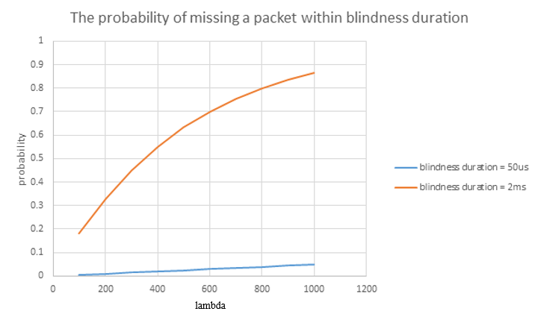
Analysis
It can be seen that the probabilities between the two scenarios are hugely different, and the probability of missing a packet during a short blindness duration of 50us is very low.
Hence, we propose that STA-2 is not required to start the MediumSyncDelay timer if the transmission of STA-1 is shorter than TBD duration

Slide 7
Conclusion
Considering that the probability of missing a packet during a short blindness duration is very low, we propose that the STA-2 is not required to start the MediumSyncDelay timer if the transmission of STA-1 is shorter than TBD duration

Slide 8
Straw Poll 1
Do you agree to add the following to the TGbe draft in R1?
If the transmission of a STA (STA-1) of a non-STR non-AP MLD is shorter than TBD duration, another STA (STA-2) of the same MLD is not required to start the MediumSyncDelay timer at the end of STA-1's transmission

Slide 9
References
[1] 11-20-1009-09-00be-multi-link-hidden-terminal-followup
[2] 11-20-0444-01-00be-mla-non-str-sta-edca-rules-after-self-interference
[3] 11-20-1263-02-00be-non-str-blindness-rules-discussion

