Slide 1
Protecting CH_BANDWIDTH_IN_NOT_HT (etc) in Service field
Date: 2021-05-22
Authors:

Slide 2
Situation
Indication for ≥320 MHz non-HT duplicate PPDUs in 6 GHz now uses bit 7 in the Service field
No protection was defined for that bit (no Parity, CRC, etc)
The number of bits allocated to protection should account for the number of bits needed for other purposes:
  E.g., self-contained static or dynamic preamble puncturing for non-HT duplicate PPDUs.

Slide 3
Using the FCS as a proxy for Service field protection is suboptimal
Some individuals propose that the “CRC” for the Service field can be the FCS for the MPDU contained in the Data field. On the other hand:
  The Service field is a PHY-to-PHY communications channel, and architecturally it should not depend on the correctness or otherwise of the MAC-to-MAC payload
  We don’t know how the Service field will evolve, but we cannot rule out that some use cases may operate without regard to the correctness of the contained MPDU.
    E.g., enabled improved PER by utilizing the diversity of the punctured duplicates of the Data field
  The side-effects of the weak parity chosen for the LSIG field are well known. Certainly we need to mandate additional or unavoidable RX checking: since these non-HT PPDUs are widely used for MAC protection, then weak implementations in third-party STAs hurt all transmissions.
  Additional RX processing can be either Parity/CRC in Service field; unavoidable RX processing might be conditioning further processing on a good MPDU.
  Adding a Parity/CRC now provides better and broader protection than adding it later when and if it becomes essential
  Using the FCS of the MPDU as Parity/CRC for the Service field is akin to defining an FCS of the MDPU that protects the whole MPDU except for the first few MPDU bits.
    But we would never propose that, because it’s an unnecessarily weak design
  The implementation cost of adding Parity/CRC on a few bits is utterly trivial, so if Parity/CRC provides any benefits at all then we should be adding it.

Slide 4
Signalling Preamble Puncturing
20, 40 MHz PPDU – N/A
80 MHz PPDU
  5 distinct values (1 unpunctured + 4 punctured values): i.e., 3 bits required
  Needed in both 5 GHz (where Service field should not be used) and 6 GHz
  Can use the same design for both 5 and 6 GHz using the Pad field (in an HESIGB-like design), and not needing any Service field bits (see sidebar)
160 MHz PPDU
  5 distinct values (1 unpunctured + 4 punctured values): i.e., 3 bits required
  Needed in both 5 GHz (where Service field should not be used) and 6 GHz
  Can use the same design for both 5 and 6 GHz using the Pad field (in an HESIGB-like design), and not needing any Service field bits (see sidebar)
320 MHz
  25 distinct values (1 unpunctured + 24 punctured values): i.e., 5 bits required
  Needed in 6 GHz only (where Service field can be used)

Slide 5
Sidebar: Proposed TX Bit Processing for 80/160 MHz PPDUs

Slide 6
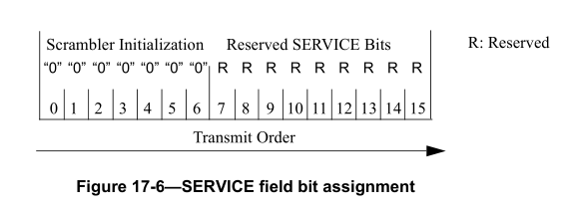
Feasible Design for Service field in 320 MHz PPDUs
Sample encoding
  1 extra bit for CH_BANDWIDTH_IN_NOT_HT (CBINH) parameter to define ≥320 MHz bandwidths (already defined)
  5 bits available for (self-identifying/dynamic) preamble puncturing
  1 Parity bit or 3 bits for CRC using x³ + x + 1
    CRC has a Hamming distance of 2, detects all 1-bit errors
  … which fits into 7 or 9 bits
Bit 2 of CBINH
Preamble puncturing indication
2R+ Parity or CRC

Slide 7
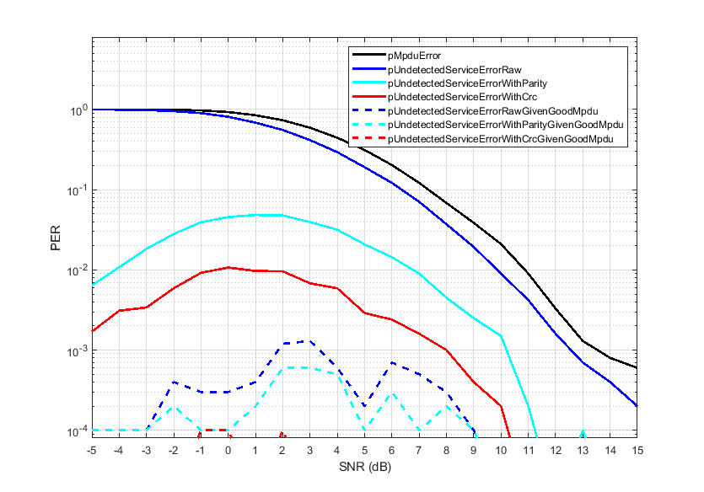
Performance Results
20B (RTS), 6 Mbps, 1TX x 1RX, ChB
Bad Service fields do occur, even with additional checks
If we choose simplicity. conditioning the use of the Service field on a good MPDU (blue dashed line) is very reliable
  Adding Parity (cyan dashed line) or especially a 3 bit CRC (red dashed line) helps further
If we choose architectural purity / future proofing, checking the Service field without regard to the MPDU via one Parity bit (solid cyan) is also a big improvement over no checking, and more so with a 3 bit CRC (solid red)
  But not as impactful as checking the MPDU

Slide 8
Strawpoll
Option A: No Parity or CRC to protect Service field
  Any future use of Service field should be conditional on a good MPDU (which is already implicit in today’s use of the Service field)
Option B: Add 1 bit Parity to Service field bit 15 that protects Service field bits 7-14
Option C: Add 3 bit CRC to Service field bits 13-15 that protects Service field bits 7-12
Y/N/A on each

Slide 9
Backup

Slide 10
Preamble Puncturing Modes
If needed, self-contained static or dynamic preamble puncturing signaling requires 3/3/5b for 80/160/320 MHz respectively:
Bandwidth (MHz) | Preamble puncturing modes | Count (New)
20 | N/A | 1 (0)
40 | N/A | 1 (0)
80 | YYYY; nYYY, YnYY, YYnY, YYYn | 5 (4)
160 | YYYYYYYY; nnYYYYYYY, YYnnYYYY, YYYYnnYY, YYYYYYnn | 5 (4)
320 | YYYYYYYYYYYYYYYY; nnnnYYYYYYYYYYYY, YYYYnnnnYYYYYYYY, YYYYYYYYnnnnYYYY, YYYYYYYYYYYYnnnn; nnYYYYYYYYYYYYYY, YYnnYYYYYYYYYYYY, YYYYnnYYYYYYYYYY, YYYYYYnnYYYYYYYY, YYYYYYYYnnYYYYYY, YYYYYYYYYYnnYYYY, YYYYYYYYYYYYnnYY, YYYYYYYYYYYYYYnn; nnnnnnYYYYYYYYYY, nnnnYYnnYYYYYYYY, nnnnYYYYnnYYYYYY, nnnnYYYYYYnnYYYY, nnnnYYYYYYYYnnYY, nnnnYYYYYYYYYYnn; nnYYYYYYYYYYnnnn, YYnnYYYYYYYYnnnn, YYYYnnYYYYYYnnnn, YYYYYYnnYYYYnnnn, YYYYYYYYnnYYnnnn, YYYYYYYYYYnnnnnn | 25 (25)
Total |  | 37 (33)

Slide 11
Design for 80/160 MHz PPDUs
Uncoded Pad bits with Tail
Non-HT (Mbps) | nPad (RTS, CF-End or PS-Poll @ 20B) | nPad (CTS @ 14B)
6 | 10 | 10
9 | 34 | 10
12 | 10 | 10
18 | 34 | 10
24 | 10 | 58
36 | 106 | 10
48 | 10 | 58
54 | 34 | 82
RTS, CF-End and PS-Poll are 20 octets; CTS is 14 octets
When transmitted in a non-HT PPDU, the number of uncoded Pad bits is always at least 10 bits (and assume NDPA can be padded to ensure this)
Can fit 3 bits of BW indication, Parity bit and a 6-bit Tail into 10 pad bits
  Akin to HESIGB/EHTSIG
Two ways to insert the new fields into the uncoded Pad field:
  Before the scrambler (for PAPR robustness)
  After the scrambler
Sample encoding
  Even Parity
  000 for unpunctured and (so no change for unpunctured PPDUs)
  001-100 for (self-identifying/dynamic) preamble puncturing
Data bits
Append Tail, Pad
Overwrite Pad with BW Info
Scramble
Overwrite Tail x2 with zeros
Encode + Puncture
Interleave

