Slide 1
HE and EHT PHY Capability Dependencies
Date: 2021-02-19
Authors:
Name | Affiliations | Address | Phone | email
Steve Shellhammer | Qualcomm |  |  | shellhammer@ieee.org
Bin Tian |  |  |  | btian@qti.qualcomm.com
Youhan Kim |  |  |  | youhank@qti.qualcomm.com

Slide 2
Background
During the PHY Ad Hoc review of R0 of the PHY Capabilities PDT it was pointed out that if we agree on some dependencies between a STA’s HE and EHT PHY Capabilities the EHT PHY Capabilities Table can be significantly simplified
Here we provide straw polls on those dependencies
For any straw poll that receives strong support the PDT will be simplified accordingly

Slide 3
SP1: Bandwidth Support
Do you agree that,
  There are no capability bits in the EHT Capabilities Information field to indicate support for 40, 80 or 160 MHz channel width
  Support for 40, 80 or 160 MHz channel width is the same for HE PPDUs and EHT PPDU in an EHT STA, and is indicated by the HE Capabilities Information field
  An EHT STA supporting 320 MHz channel width in the 6 GHz shall support 160 MHz channel width for HE and EHT PPDUs

Slide 4
SP2: Device Class
Do you agree that,
  There is no capability bit in the EHT PHY Capabilities Information field to indicate Device Class
  An EHT STA supports the same Device class in HE and EHT TB PPDUs?

Slide 5
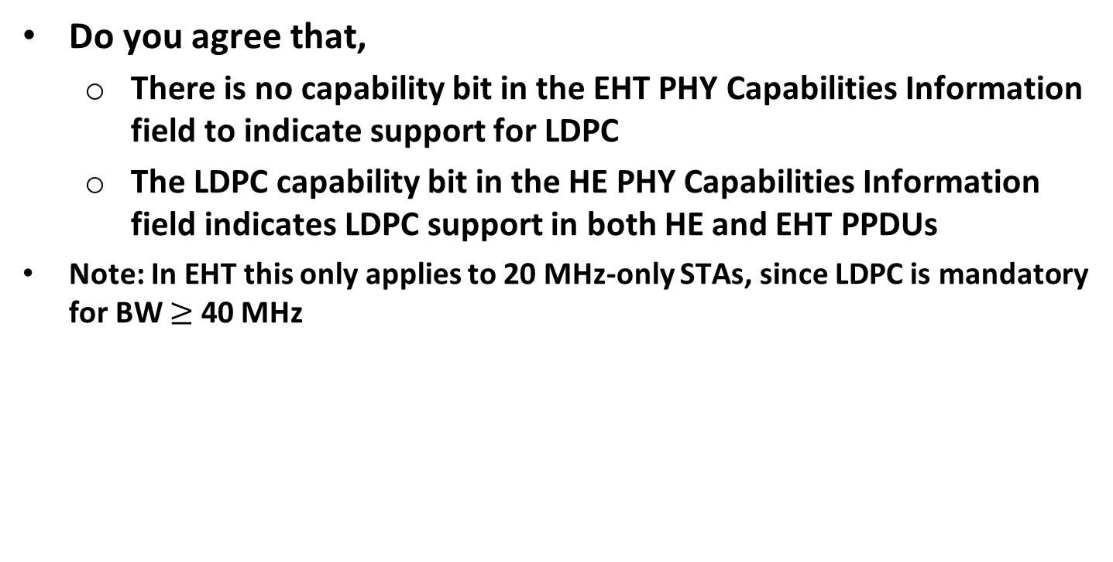
SP3: LDPC Support
Do you agree that,
  There is no capability bit in the EHT PHY Capabilities Information field to indicate support for LDPC
  The LDPC capability bit in the HE PHY Capabilities Information field indicates LDPC support in both HE and EHT PPDUs
Note: In EHT this only applies to 20 MHz-only STAs, since LDPC is mandatory for BW $≥$ 40 MHz

