Slide 1
Legacy addressing in MLO
Date: 2021-01-28
Authors:
Name | Company | Address | Phone | Email
Rojan Chitrakar | Panasonic Corporation |  |  | rojan.chitrakar@sg.panasonic.com
Yanyi Ding
Rajat Pushkarna
Yoshio Urabe

Slide 2
Overview
An MLD contains an MLD MAC Address and multiple STA MAC Addresses (one for each affiliated STA). [2]
The TA/RA of frames transmitted over-the-air shall be a STA MAC Address. [2]
An MLD MAC Address singly identifies an MLD. [2]
Legacy STA
Using MLD MAC address to identify a peer MLD is fine for MLDs or EHT STAs that understand the concept of MLD MAC Address. However, legacy STAs do not understand MLD MAC Address and will have issues when communicating with MLDs especially over peer-to-peer links. [3]

Slide 3
Background
[4], [5] provide good background information about Address Resolution Protocol (ARP), Neighbor Discovery Protocol (NDP) and Proxy ARP. ARP/NDP is used to discover a device’s MAC Address when its IP address is known.
If the AP supports Proxy ARP feature, the AP can respond to ARP Request / Neighbor Solicitation messages on behalf of associated STAs and thus helps to significantly reduce broadcast traffic in its BSS.
Illustration of how ARP/ND works without Proxy ARP

Slide 4
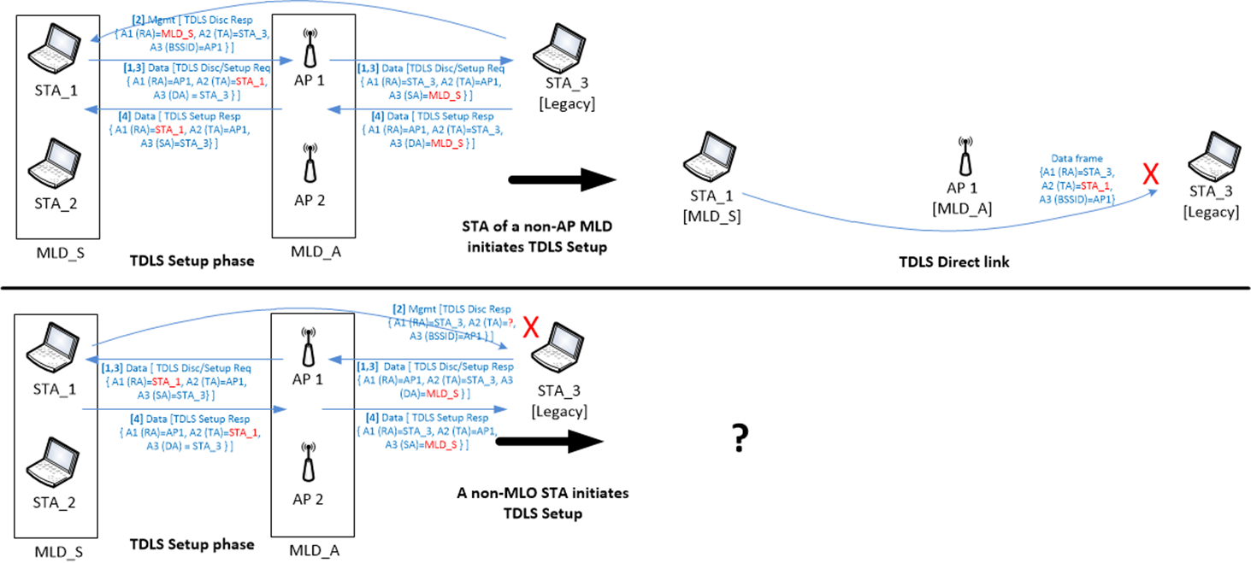
Addressing issues in TDLS
  [3] discusses the addressing issues in TDLS discovery/setup between an MLD and a legacy STA
Assumes MLD MAC Address (MLD_S) is set as the TDLS Initiator STA during TDLS Discovery/Setup causing frames on direct link to fail if TA is set as STA MAC Address.
[3] Proposes:
Setting the TA field to the non-AP MLD’s MAC address for frames sent directly to a TDLS peer STA.
Using MLD MAC Addresses in the Link Identifier element.
Using the MLD MAC address during the TPK handshake.
Also implies that RA may be set as MLD MAC Address
Assumes MLD MAC Address (MLD_S) is set as TDLS Responder STA in TDLS Discovery Request causing TDLS Discovery Response frame to fail if TA set as STA MAC Address.
However, even with the proposed method, the TDLS Setup will fail if the Legacy STA sets the TDLS Responder STA (in TDLS Discovery Request) to STA MAC Address (e.g., STA_1) and the MLD responds with the TA set as MLD MAC Address (MLD_S).

Slide 5
Discussion
It is not clear which MAC Address will be returned by an MLD in response to an ARP/ND request. Is it MLD MAC Address, or one of the STA MAC Addresses?
Using MLD MAC Address to identify an MLD may create confusions for legacy STAs:
AP2’s resolved MAC Address (AP-MLD-M) is different from AP2’s BSSID.
Non-AP MLD’s resolved MAC Address (STA-MLD-M) is different from the MAC Address used in the TA/RA field of OTA frames transmitted/received by the non-AP MLD.

Slide 6
Proposal
For a legacy STA associated with an AP (AP2) affiliated with an AP MLD:
  The AP MLD is identified* by the MAC Address of the AP2 (i.e., the BSSID of link 2). E.g., AP2-M.
  A non-AP MLD that is associated with the AP MLD and that has affiliated STA (STA2) associated with the AP2, is identified with the MAC Address of the STA2 (STA2-M)
  A non-AP MLD that is associated with the AP MLD and does not have any affiliated STAs associated with AP2 may be identified with its MLD MAC Address or with the MAC Address of any of the affiliated STAs.
Note: Identified here means the MLD’s IP address is mapped to that MAC Address and all over-the-air frames the MLD and the legacy STA use the MAC Address in the address fields.

Slide 7
Proposal
For an MLD, or for a device in the DS, a peer MLD is always identified by its MLD MAC Address. (Same as D0.3)
When relaying Data frames from an associated non-AP MLD to a legacy STA, an AP MLD shall use the MAC Address of the relevant affiliated STA of the non-AP MLD in the Source Address (A3) field (instead of its MLD MAC Address).
When communicating over the air with a legacy STA, an MLD shall use the MAC Address of its relevant affiliated STA in all applicable address fields (instead of its MLD MAC Address):
  E.g., in the TDLS Initiator STA field in TDLS Discovery/Setup frames.

Slide 8
Solution - Using Proxy ARP
Since an AP MLD has records of the MAC Addresses of all associated devices, the proposal can be easily achieved using Proxy ARP service.
The AP MLD shall maintain a Hardware Addresses* to Internet Address mapping for each associated station (non-AP MLD or non-AP STA), and shall update the mapping when the Internet Address of the associated non-AP MLD changes. When the IPv4 address being resolved in an ARP request or the IPv6 being resolved in a Neighbor Solicitation message, is used by a station currently associated with the AP MLD, the proxy ARP service shall respond on behalf of the station to the ARP request or the ARP probe or the Neighbor Solicitation message.
*The Hardware Addresses of an MLD may be its MLD MAC Address or the MAC Address of one of its affiliated STAs.

Slide 9
Solution - Using Proxy ARP (IPv4)
When an AP MLD receives an ARP request from one associated station or from the DS with a target IP address that corresponds to a second associated non-AP MLD, the AP MLD shall:
  insert the second non-AP MLD’s MLD MAC address as the Sender’s MAC Address in the ARP response packet if the associated station is a non-AP MLD or the request is from the DS.
  insert the MAC address of the affiliated STA of the second non-AP MLD that operates on the link in which the request was received, as the Sender’s MAC Address in the ARP response packet if the associated station is not an MLD.

Slide 10
Solution - Using Proxy ARP (IPv6)
When an AP MLD receives a Neighbor Solicitation message from one associated station or from the DS with a target IP address that corresponds to a second associated non-AP MLD, the AP MLD shall:
  insert the second non-AP MLD’s MLD MAC address as the Sender’s MAC Address in the Neighbor Advertisement Message if the associated station is a non-AP MLD or the request is from the DS.
  insert the MAC address of the affiliated STA of the second non-AP MLD that operates on the link in which the request was received, as the Sender’s MAC Address in the Neighbor Advertisement Message if the associated station is not an MLD.

Slide 11
Solution - Using Proxy ARP
Example 1: Resolving non-AP MLD1’s IP Address

Slide 12
Solution – Further Considerations
b0 (Individual/Group bit) may be used to differentiate MLD MAC Address
When the requesting station is a non-AP MLD, the AP MLD sets the Individual/Group bit (b0) of the Sender’s MAC address to differentiate between the STA MAC Address and the MLD MAC address of an associated non-AP MLD:
  b0 is set to 0 to indicate STA MAC Address
  b0 is set to 1 to indicate MLD MAC Address
  Note: If the b0 bit is set to 1 in a resolved MAC Address, the receiving MLD is informed that the target device is an MLD; else it is a legacy STA. The MLD needs to recover the original MLD MAC Address by setting b0 bit to 0.
Due to the broadcast frame reduction effect [5], we also propose that implementation of the proxy ARP service shall be mandatory for an AP MLD that supports legacy association. All the APs affiliated with the AP MLD shall set the Proxy ARP field to 1 in the Extended Capabilities element.
Notes:
Note: b0 (Individual/Group bit) is also used to indicate “bandwidth signaling TA” in certain control frames; but is not used in Data and Management frames.

Slide 13
Example 2: Non-AP MLD initiated TDLS setup with legacy STA
AP MLD provides the STA MAC Address as the hardware address. b0 = 0 informs that this is not an MLD MAC Address
STA4-M is used as the TDLS Initiator since the peer-STA is known to be non-MLD.
AP sets SA as the STA MAC Address
RA is correctly set as the STA MAC Address
Notes:
This example solves the first address mismatch issue raised by [3]

Slide 14
Example 3: Legacy STA initiated TDLS setup with non-AP MLD
AP MLD provides the STA MAC Address as the hardware address.
STA4-M is used as the TDLS Responder.
AP sets SA as the STA MAC Address
RA/TA correctly set as the STA MAC Address
Notes:
This example solves the second address mismatch issue raised by [3]

Slide 15
Conclusion
In this contribution, we discussed the MLO addressing issues from a legacy STA’s perspectives.
We proposed modifying the Proxy ARP services in AP MLD such that:
  For a legacy STA, an MLD’s IP address is mapped to one of its affiliated STA’s MAC Address.
  AP MLD helps to differentiate whether a resolved MAC Address is a STA MAC Address or an MLD MAC address (e.g., using the b0 (Individual/Group bit)).
  We showed that the address mismatch issues raised in [3] may be solved without requiring the RA/TA to be set as MLD MAC Addresses.

Slide 16
References
IEEE 802.11-20/1935r13 – compendium-of-straw-polls-and-potential-changes-to-the-specification-framework-document-part-2
Draft P802.11be_D0.3
IEEE 802.11-20/1692r2 – tdls-handling-in-mlo
IEEE 802.11-20/1750r0 – proxy-arp-service-in-mlo
IEEE 802.11-15/1015-01 – proxy-arp-in-802-11ax

Slide 17
Straw Poll 1
Do you support the following proxy ARP service in R1?
  When an AP MLD receives an ARP request from one associated station or from the DS with a target IP address that corresponds to a second associated non-AP MLD, the AP MLD shall:
    insert the second non-AP MLD’s MLD MAC address as the Sender’s MAC Address in the ARP response packet if the associated station is a non-AP MLD or the request is from the DS.
    insert the MAC address of the affiliated STA of the second non-AP MLD that operates on the link in which the request was received, as the Sender’s MAC Address in the ARP response packet if the associated station is not an MLD.
  Y/N/A

Slide 18
Straw Poll 2
Do you support the following proxy ARP service in R1?
  When an AP MLD receives a Neighbor Solicitation message from one associated station or from the DS with a target IP address that corresponds to a second associated non-AP MLD, the AP MLD shall:
    insert the second non-AP MLD’s MLD MAC address as the Sender’s MAC Address in the Neighbor Advertisement Message if the associated station is a non-AP MLD or the request is from the DS.
    insert the MAC address of the affiliated STA of the second non-AP MLD that operates on the link in which the request was received, as the Sender’s MAC Address in the Neighbor Advertisement Message if the associated station is not an MLD.
  Y/N/A

Slide 19
Straw Poll 3
Do you support the following proxy ARP service in R1?
  When a requesting station is an associated non-AP MLD, the AP MLD shall set the Individual/Group bit (b0) of the Sender’s MAC address in an ARP response packet or a Neighbor Advertisement Message to differentiate between the MAC Address of an affiliated STA and the MLD MAC address of the second non-AP MLD:
    b0 is set to 0 to indicate STA MAC Address
    b0 is set to 1 to indicate MLD MAC Address
  Note: If the b0 bit is set to 1 in a resolved MAC Address, the receiving MLD is informed that the target device is an MLD; else it is a legacy STA. The MLD needs to recover the original MLD MAC Address by setting b0 bit to 0.
  Y/N/A

Slide 20
Straw Poll 4
Do you support the following proxy ARP service in R1?
  Implementation of the proxy ARP service shall be mandatory for an AP MLD that supports legacy association. All the APs affiliated with the AP MLD shall set the Proxy ARP field to 1 in the Extended Capabilities element.
  Y/N/A

Slide 21
Straw Poll 5
Do you support the following AP MLD behavior in R1?
  When relaying Data frames from an associated non-AP MLD to an associated legacy STA, an AP MLD shall use the MAC Address of the relevant affiliated STA of the non-AP MLD in the Source Address (A3) field (instead of the non-AP MLD’s MLD MAC Address).
  Y/N/A

Slide 22
Straw Poll 6
Do you support the following AP MLD behavior in R1?
  When communicating over the air with a legacy STA, an MLD shall use the MAC Address of its relevant affiliated STA in all applicable address fields (instead of the non-AP MLD’s MLD MAC Address):
    Note: applicable address fields may be the TDLS Initiator STA field in TDLS Discovery/Setup frames, the TA/RA fields in all frames.
  Y/N/A

Slide 23
Annex I
21/240 suggest the following:
  If the TDLS responder is a non-AP MLD, then the TDLS responder STA Address field contained in the Link Identifier element of the TDLS Discovery Response frame or TDLS Setup Response frame shall be set to the MAC address of the non-AP MLD.
  If a legacy STA initiates TDLS Discovery/Setup using the STA MAC Address of an affiliated STA as the TDLS Responder STA Address, the above rule will cause the legacy STA to reject the corresponding TDLS Response frame due to the mismatch in the TDLS Responder STA Address.
Mismatch in the TDLS Responder STA Address

