Slide 1
Simplified EHT PPE Thresholds Field
Date: 2021-02-05
Authors:
Name | Affiliations | Address | Phone | email
Mengshi Hu | Huawei |  |  | humengshi@huawei.com
Ross Jian Yu | Huawei |  |  | ross.yujian@huawei.com
Ming Gan | Huawei |  |  | ming.gan@huawei.com
Oded Redlich | Huawei |  |  | oded.redlich@huawei.com
Shimi Shilo | Huawei |  |  | Shimi.Shilo@huawei.com

Slide 2
EHT PPE Thresholds Field (1/2)
In [1] we have proposed two options for the design of EHT PPE Thresholds field.
  Option 1: Add PPET20 subfields
  Option 2: Still use PPET16/8 subfields to indicate 16/8/0 μs, and indicate a scope for 20 μs
In the following slides, we further reduce the overhead by simplifying the NSS subfield and RU Index Bitmask subfield.
 | NSTS | RU Index Bitmask | PPE Thresholds Info | PPE Pad
Bits | 3 | 4 | 3 per each | 0-7
PPET16 NSS1 RUx | PPET8 NSS1 RUx | … | PPET16 NSSn RUm | PPET8 NSSn RUm | …
PPE Thresholds field in 11ax

Slide 3
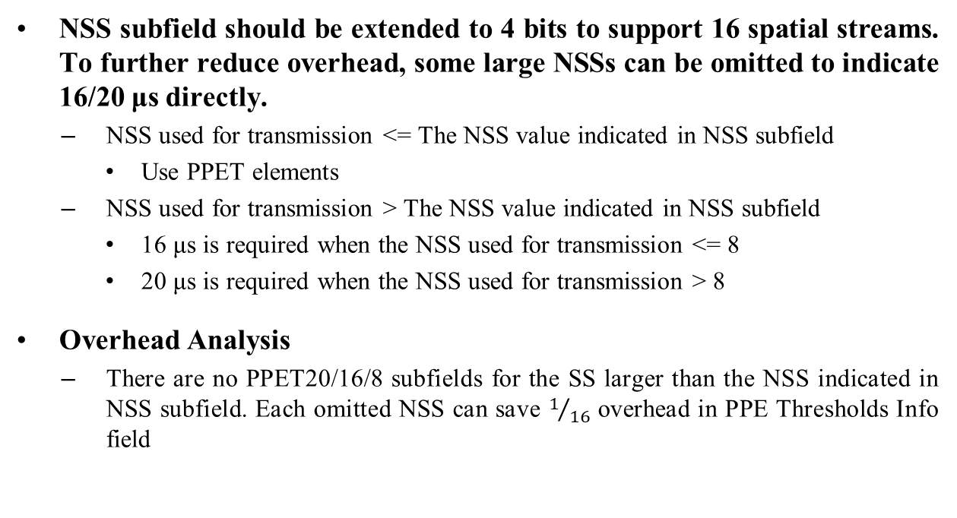
Simplification in NSS Subfield
NSS subfield should be extended to 4 bits to support 16 spatial streams. To further reduce overhead, some large NSSs can be omitted to indicate 16/20 μs directly.
  NSS used for transmission <= The NSS value indicated in NSS subfield
  Use PPET elements
  NSS used for transmission > The NSS value indicated in NSS subfield
  16 μs is required when the NSS used for transmission <= 8
  20 μs is required when the NSS used for transmission > 8
Overhead Analysis
  There are no PPET20/16/8 subfields for the SS larger than the NSS indicated in NSS subfield. Each omitted NSS can save $1/{16}$ overhead in PPE Thresholds Info field

Slide 4
Simplification in RU Index Bitmask Subfield (1/2)
To support more RU/MRU sizes, RU Index Bitmask subfield shall be extended.
  There is no need to give each large RU/MRU an RU allocation index. Some RUs/MRUs can share the same index. A 5-bit Bitmask is suggested with the meaning shown as follows:
RU allocation index | RU allocation size
0 | 242
1 | 484
2 | 484+242, 996
3 | 996+484, 996+484+242, 2×996
4 | 2×996+484, 3×996 3×996+484, 4×996

Slide 5
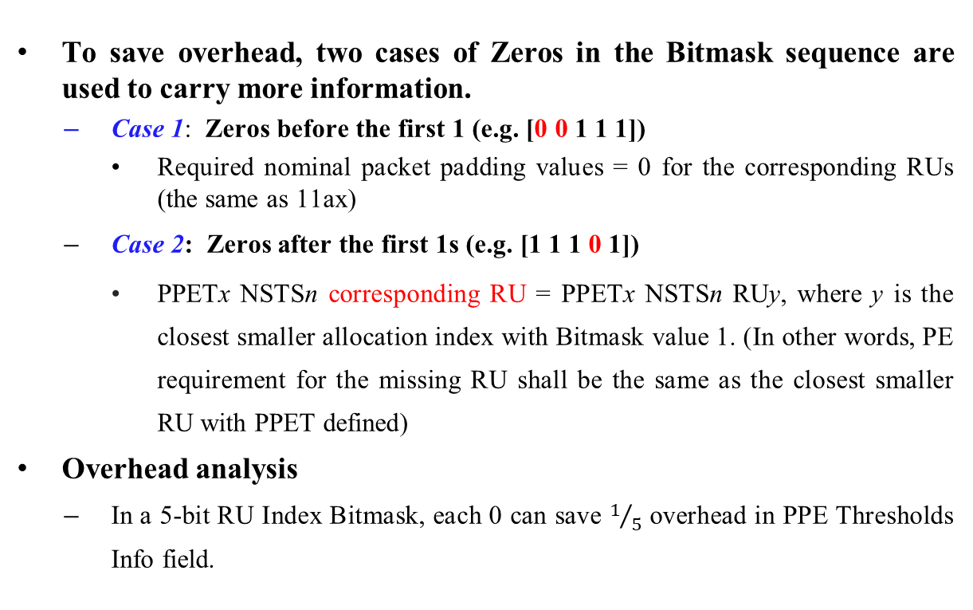
Simplification in RU Index Bitmask Subfield (2/2)
To save overhead, two cases of Zeros in the Bitmask sequence are used to carry more information.
  Case 1: Zeros before the first 1 (e.g. [0 0 1 1 1])
  Required nominal packet padding values = 0 for the corresponding RUs (the same as 11ax)
  Case 2: Zeros after the first 1s (e.g. [1 1 1 0 1])
  PPETx NSTSn corresponding RU = PPETx NSTSn RUy, where y is the closest smaller allocation index with Bitmask value 1. (In other words, PE requirement for the missing RU shall be the same as the closest smaller RU with PPET defined)
  Overhead analysis
  In a 5-bit RU Index Bitmask, each 0 can save $1/5$ overhead in PPE Thresholds Info field.

Slide 6

Summary
  4-bit NSS: 1 to 16 spatial streams
  Simplification for the NSS > the NSS indicated in the 4-bit NSS subfield
  Each omitted NSS can save $1/{16}$ overhead in PPE Thresholds Info field
5-bit RU Bitmap: [242, 484, 996, 996*2, 996*4]
  Simplification for RU Index Bitmask
  Each 0 can save $1/5$ overhead in PPE Thresholds Info field.

Slide 7
Straw Poll #1
  Do you agree that EHT PPE Thresholds field is defined similarly as 11ax with the following subfields?
  NSS subfield is extended to 4 bits to support 1-16 SS.
  RU Index Bitmask subfield is extended to 5 bits to support more RU/MRU sizes.
 | NSS | RU Index Bitmask | PPE Thresholds Info | PPE Pad
Bits | 4 | 5 | variable | 0 to 7
  Y
  N
  A

Slide 8
Straw Poll #2
  Do you agree with the following table of RU allocation index in EHT PPE Thresholds field?
RU allocation index | RU allocation size
0 | 242
1 | 484
2 | 484+242, 996
3 | 996+484, 996+484+242, 2×996
4 | 2×996+484, 3×996 3×996+484, 4×996
  Y
  N
  A

Slide 9
Straw Poll #3
  Do you agree that the following nominal packet padding value is used when the number of spatial streams (NSS) used for transmission is larger than the NSS value indicated in the NSS subfield?
  16 μs for any RU/Constellation when the NSS used for transmission <=8
  20 μs for any RU/Constellation when the NSS used for transmission >8 for R2
  Y
  N
  A

Slide 10
Straw Poll #4
  Do you agree with the following meanings of the Zeros in the Bitmask sequence in RU Index Bitmask subfield?
  For zeros before the first the 1
  Nominal packet padding value = 0 μs
  For zeros after the first 1
  The corresponding constellation index for the missing RU (Bitmask value = 0) shall be the same as the closest smaller RU with PPET defined (Bitmask value = 1)
  Y
  N
  A

Slide 11
References
[1] IEEE 11-21-0089r0 EHT PPE Thresholds Field Follow-up

