Slide 1
Signalling on Static Puncture Info
Date: 2021-1-25
Authors:
Name | Affiliations | Address | Phone | Email
Guogang Huang | Huawei |  |  | huangguogang1@huawei.com
Ming Gan
Yuchen Guo
Yunbo Li
Yiqing Li
Mengyao Ma
Notes:
September 2012

Slide 2
Introduction
We had agreed that an EHT BSS can advertise different BSS bandwidths respectively for EHT STA and non-EHT STA especially when static puncture is applied [1].
But the specific location of static puncture info is still undecided
In this contribution, we want to discuss where to carry the Puncture info and how to signal the Puncture info

Slide 3
Discussion
Generally, there are two possible options for the location of static puncture info
Option 1. Explicitly indicated through EHT Operation element
Option 2. Implicitly indicated through Transmit Power Envelope element
In the following, we will respectively discuss the above two options in detail.

Slide 4
Option 1 Explicitly indicated through EHT Operation element
Indication Rules.
For EHT Operation element, use a channel bitmap with the length of 2 octets
0: the corresponding 20 MHz channel is punctured
1: the corresponding 20 MHz channel is not punctured
If some 20 channels have different PSD, then only the PSD info on unpunctuated 20 MHz channels is indicated in Transmit Power Envelope element [2]. Specifically,
Use a reserved value (e.g. 5) to indicate values of N greater than 8.
If all 20 channels have the same PSD, then we can directly indicate the EIRP info for each typical channel width by setting N=0 //note: defined in 11ax

Slide 5
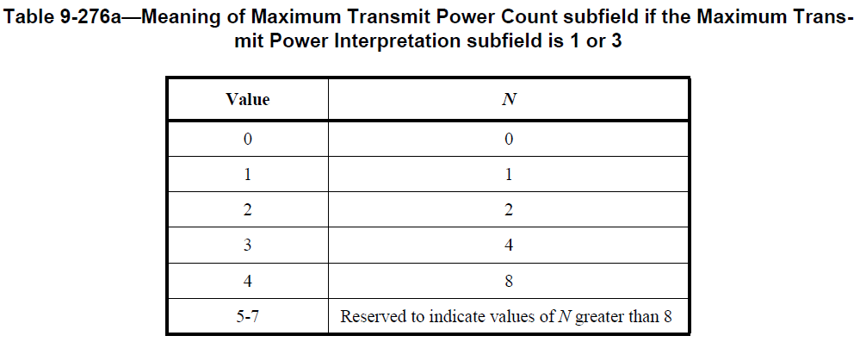
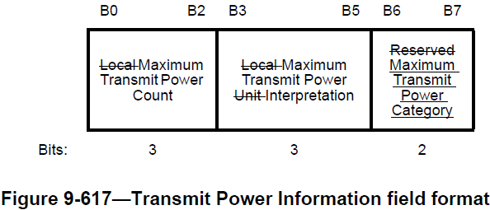
Option 2 Implicitly indicated through Transmit Power Envelope element
Indication Rules.
Use a reserved value (e.g. 5) to indicate values of N greater than 8.
If N is greater than 8, the Maximum Transmit PSD 1-8 subfields correspond to the 20 MHz channels from lowest to highest frequency, respectively, within the 160 MHz channel containing the primary 20 MHz channel. //note: defined in 11ax
The Maximum Transmit PSD X subfield is encoded as an 8-bit 2s complement signed integer. The value –128 indicates that the corresponding 20 MHz channel cannot be used for transmission[2]. //note: defined in 11ax

Slide 6
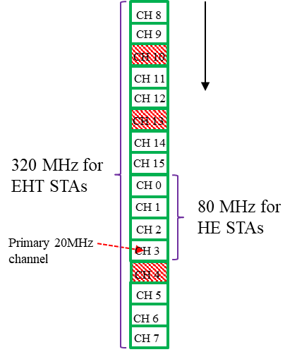
Example
For a 320 MHz EHT BSS, assume that CH 4, 10, 13 are punctured, as shown in the left Figure
If some 20 channels have different PSD, then the corresponding Transmit Power Envelope element is set as the right Figure
Note that the PSD info on each 20 MHz channel (including punctuated and unpunctuated channel) need to be included
Frequency

Slide 7
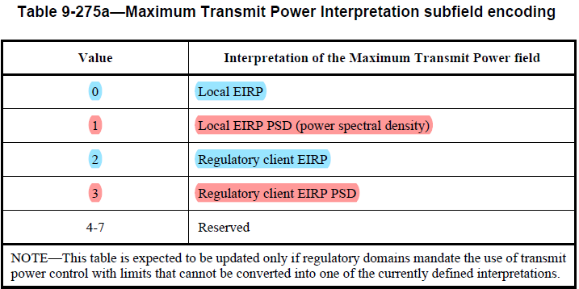
Comments
Option 2 has limitations/drawbacks as following:
We only can use indication manner 1 (EIRP PSD) and cannot use indication manner 2 (EIRP)
Possibly leading to multiple TPE elements be carried in the same Beacon to overcome this issue, in which case additional rules need to be specified as to what values the multiple TPEs need to be set.
HE STAs in 6 GHz band might have issues parsing the indication manner 1 of the TPE when N is >8.
Even when all 20 MHz channels have same PSD, we cannot directly indicate the max TX power for each typical channel width, i.e. 20 MHz, 40 MHz, 80 MHz,160 MHz and 320 MHz
Forced overhead increase in Beacons because
Generally, APs only include one PSD value applicable to all channels or use indication manner 2 (EIRP)
While enablement of Static puncture with this Option would require either or both of the following
Inclusion of multiple TPEs (one for EIRP and additional ones for static puncture bitmap signaling)
Inclusion of multiple PSDs per channel to indicate punctured info. (e.g., to signal a 16-bit puncture would require at least 16 octets)
Maximum Transmit Power For 320 MHz

Slide 8
Comments
Option 1 has the following pros
Lower signaling overhead compared with Option 2
It is simpler
Does not need to add multiple IEs/modify existing IEs, to tackle different use cases and ensure backwards compliance.

Slide 9
Reference
[1] 11-20-0680-02-00be-operating-bandwidth-indication-for-eht-bss.pptx
[2] Draft P802.11ax_D8.0

Slide 10
SP 1
Do you agree to include a 2-octet Static Puncture Bitmap field within EHT Operation element?
Yes
No
Abstain

