Slide 1
UL Spatial Reuse Subfield Design in Enhanced Trigger Frame
Date: 2021-01-25
Authors:
Name | Affiliation | Address | Phone | Email
Eunsung Park | LG Electronics | 19, Yangjae-daero 11gil, Seocho-gu, Seoul 137-130, Korea |  | esung.park@lge.com
Dongguk Lim |  |  |  | dongguk.lim@lge.com
Jinyoung Chun |  |  |  | jiny.chun@lge.com
Jeongki Kim |  |  |  | jeongki.kim@lge.com
Jinsoo Choi |  |  |  | js.choi@lge.com
Steve Shellhammer | Qualcomm |  |  | sshellha@qti.qualcomm.com

Slide 2
Introduction
In [1], an Enhanced Trigger Frame was proposed which is backward compatible with HE STAs
  For spatial reuse, 16-bit UL Spatial Reuse subfield and 8-bit Spatial Reuse subfield have been defined in the Common Info field and the Special User Info field, respectively
When only HE TB PPDU is triggered in R1, 16-bit UL Spatial Reuse subfield is copied and pasted into four Spatial Reuse fields in HE-SIG-A of HE TB PPDU
  There is no Special User Info field in Trigger Frame
When only EHT TB PPDU is triggered in R1, 8-bit Spatial Reuse subfield is copied and pasted into two Spatial Reuse fields in U-SIG of EHT TB PPDU
  There is still 16-bit UL Spatial Reuse subfield in Trigger Frame
In this contribution, we deal with how to set the 16-bit UL Spatial Reuse subfield as well as the 8-bit Spatial Reuse subfield when only EHT TB PPDU is triggered in R1

Slide 3
Spatial Reuse for OBSS STAs
As shown in [2], OBSS STAs can perform spatial reuse by obtaining spatial reuse values from either Trigger Frame or TB PPDU
  We focus on the former case
When Trigger Frame solicits only EHT TB PPDU, OBSS EHT STAs can perform spatial reuse by basically using the 8-bit Spatial Reuse subfield in the Special User Info field of Trigger Frame
Even though Trigger Frame solicits only EHT TB PPDU, the 16-bit UL Spatial Reuse subfield in the Common Info field of Trigger Frame can be set to certain values to enable OBSS HE STAs to perform spatial reuse
  There is an issue regarding the 11ax spec which will be handled in slide 7

Slide 4
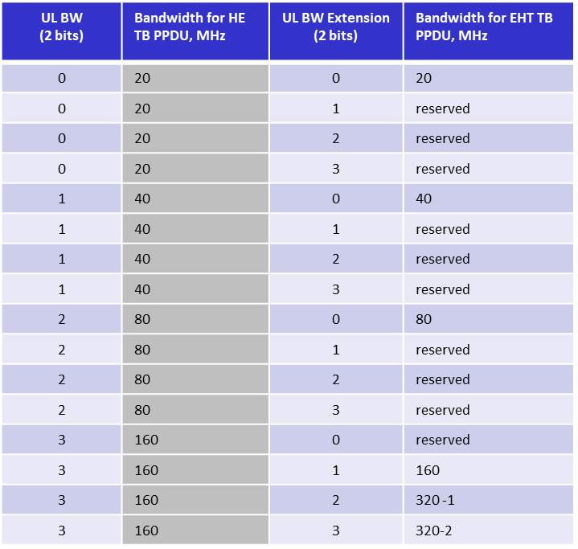
UL BW and UL BW Extension Subfields
Spatial Reuse values are closely related to the BW of TB PPDU
  OBSS EHT STAs can obtain the BW information from UL BW and UL BW Extension subfields
  OBSS HE STAs can obtain the BW information from only the UL BW subfield
In [3], a table for UL BW and UL BW Extension subfields is proposed to indicate the BW for HE / EHT TB PPDU in R1
  TGbe approved it
When only EHT TB PPDU is triggered, BW information indicated by the UL BW subfield which is decoded by OBSS HE STAs is
  the same as the BW of EHT TB PPDU when 20/40/80/160MHz EHT TB PPDU is triggered
  160MHz when 320MHz EHT TB PPDU is triggered

Slide 5
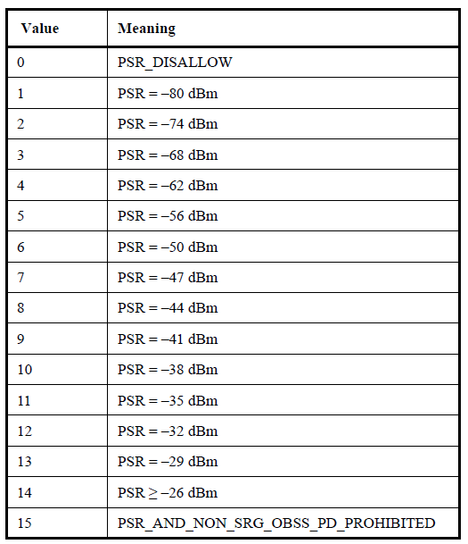
Terminologies
We use the following terminologies in each Spatial Reuse subfield of Trigger Frame
  8-bit Spatial Reuse subfield in the Special User Info field
    Two 4-bit values are *ESR1 and ESR2, i.e., these can be 0 to 15
  16-bit UL Spatial Reuse subfield in the Common Info field
    Four 4-bit values are **HSR1, HSR2, HSR3 and HSR4, i.e., these can be 0 to 15
ESR1
ESR2
*ESR: EHT Spatial Reuse value
8-bit Spatial Reuse subfield
HSR1
HSR2
HSR3
HSR4
16-bit UL Spatial Reuse subfield
**HSR: HE Spatial Reuse value

Slide 6
8-bit Spatial Reuse Subfield Design
Based on the passed motion, the 8-bit Spatial Reuse subfield in Trigger Frame can be designed
  There are two SR fields (4 bits each, total 8 bits), with granularity of half PPDU BW, but no smaller than 20 MHz, in the U-SIG of TB PPDU
    Values in SR fields are defined as the same as in 802.11ax
20MHz
  ESR1: a value corresponding to 20MHz
  ESR2: a value corresponding to 20MHz
40MHz
  ESR1: a value corresponding to first 20MHz
  ESR2: a value corresponding to second 20MHz (first 20MHz if 2.4GHz)
80/160/320MHz
  ESR1: a value corresponding to first 40/80/160MHz
  ESR2: a value corresponding to second 40/80/160MHz
ESR1
ESR2
8-bit Spatial Reuse subfield

Slide 7
16-Bit UL Spatial Reuse Subfield Design (1/5)
11ax spec says the following
  “A STA that identifies an PSR opportunity may issue a PHY-CCARESET.request to ignore the associated HE TB PPDU(s) that are triggered by the Trigger frame of the PSRR PPDU and that occurs within aSIFSTime + aRxPHYStartDelay + 2 × aSlotTime of the end of the last symbol on the air of the PPDU that contained the Trigger frame, provided that the value of the RXVECTOR parameter BSS_COLOR of the HE TB PPDU matches the BSS color of the PSRR PPDU.”
From the spec point of view, OBSS HE STAs cannot perform spatial reuse during an EHT TB PPDU transmission
  HE STAs cannot obtain the BSS color information from EHT TB PPDU
Here we provide one possible solution which is to simply set the 16-bit UL Spatial Reuse subfield to the value that disallows spatial reuse when only EHT TB PPDU is triggered as follows
  HSR1 = HSR2 = HSR3 = HSR4 = 0
  By doing so, we may avoid that OBSS HE STAs unnecessarily memorize BSS color information and spatial reuse values

Slide 8
16-Bit UL Spatial Reuse Subfield Design (2/5)
There may be a chance that a particular implementation enables OBSS HE STAs to perform spatial reuse during an EHT TB PPDU transmission
  OBSS HE STAs can expect a certain TB PPDU transmission form Trigger Frame and can perform spatial reuse without obtaining the BSS color information from that TB PPDU
  In this case, we can set the 16-bit UL Spatial Reuse subfield to meaningful values as proposed in next slides

Slide 9
16-Bit UL Spatial Reuse Subfield Design (3/5)
We provide two options as follows when 20/40/80/160MHz EHT TB PPDU is triggered in R1
  Note that in this case, the BW indication of the UL BW subfield is the same as the BW of EHT TB PPDU
  Option 1: Reuse the 11ax design
    For example 160MHz EHT TB PPDU is triggered in R1
      HSR1: a value corresponding to first 40MHz
      HSR2: a value corresponding to second 40MHz
      HSR3: a value corresponding to third 40MHz
      HSR4: a value corresponding to fourth 40MHz
  Option 2: Copy and paste the (modified) values in the 8-bit Spatial Reuse subfield
    20MHz
      HSR1 = HSR2 = HSR3 = HSR4 = ESR1
    40MHz
      HSR1 = HSR3 = ESR1
      HSR2 = HSR4 = ESR2
    80/160MHz
      HSR1 = HSR2 = *mESR1
      HSR3 = HSR4 = mESR2
*mESR means the modified ESR considering the difference of the channel size
(Please see Appendix)

Slide 10
16-Bit UL Spatial Reuse Subfield Design (4/5)
When 320MHz EHT TB PPDU is triggered in R1, the UL BW subfield indication is 160MHz and thus OBSS HE STAs consider that the 16-bit UL Spatial Reuse subfield is applied to a certain 160MHz channel which includes the channel on which they operate
  OBSS HE STA 1 which operates within 160MHz-1 considers the 16-bit UL Spatial Reuse subfield is applied to 40MHz-1, 40MHz-2, 40MHz-3 and 40MHz-4
  OBSS HE STA 2 considers the 16-bit UL Spatial Reuse subfield is applied to 40MHz-5, 40MHz-6, 40MHz-7 and 40MHz-8
  The 16-bit Spatial Reuse subfield needs to represent those two 160MHz channels
Note that the maximum operating channel for HE STA is 160MHz

Slide 11
16-Bit UL Spatial Reuse Subfield Design (5/5)
We provide two options as follows when 320 EHT TB PPDU is triggered in R1
  Option 1: Reuse the 11ax design with a minimum value selection
    HSR1: minimum value between 40MHz-1 and 40MHz-5
    HSR2: minimum value between 40MHz-2 and 40MHz-6
    HSR3: minimum value between 40MHz-3 and 40MHz-7
    HSR4: minimum value between 40MHz-4 and 40MHz-8
  Option 2: Copy and paste the minimum modified value in the 8-bit Spatial Reuse subfield
    HSR1 = HSR2 = HSR3 = HSR4 = min(*mESR1, mESR2)
  The value of the Spatial Reuse subfield is related to an acceptable interference level at the AP transmitting Trigger Frame and thus each Spatial Reuse subfield is set to the minimum between two values corresponding to 40/160MHz subchannels which are located in the same position in each 160MHz to guarantee the received interference power at the AP lower than or equal to the acceptable level in both subchannels
*mESR means the modified ESR considering the difference of the channel size
(Please see Appendix)

Slide 12
Conclusion
We have dealt with how to set the 8-bit Spatial Reuse subfield and the 16-bit UL Spatial Reuse subfield in Trigger Frame when only EHT TB PPDU is triggered in R1
The 8-bit Spatial Reuse subfield consists of two values and we have proposed that they are corresponding to lower and upper half of the BW of EHT TB PPDU, respectively
The 16-bit UL Spatial Reuse subfield consists of four values and we have provided some options as follows
  According to the 11ax spec, OBSS HE STAs cannot perform spatial reuse during an EHT TB PPDU transmission and thus we have provided one possible solution which is to simply set those values to zero to disallow spatial reuse
  Assuming there is a certain implementation which enables OBSS HE STAs to perform spatial reuse during an EHT TB PPDU transmission, we have provided two options
    Option 1 reuses the 11ax design
    Option 2 copies and pastes the (modified) values in the 8-bit Spatial Reuse subfield

Slide 13
Straw poll #1
Do you agree to add the following text to the TGbe SFD?
  8-bit Spatial Reuse subfield in the Special User Info field of Trigger Frame is defined as follows and is copied and pasted into the Spatial Reuse field in U-SIG of EHT TB PPDU
    20MHz
      ESR1: a value corresponding to 20MHz
      ESR2: a value corresponding to 20MHz
    40MHz
      ESR1: a value corresponding to first 20MHz
      ESR2: a value corresponding to second 20MHz (first 20MHz if 2.4GHz)
    80MHz
      ESR1: a value corresponding to first 40MHz
      ESR2: a value corresponding to second 40MHz
    160MHz
      ESR1: a value corresponding to first 80MHz
      ESR2: a value corresponding to second 80MHz
    320MHz
      ESR1: a value corresponding to first 160MHz
      ESR2: a value corresponding to second 160MHz
    ESR1 and ESR2 denote the first and second 4-bit values in 8-bit Spatial Reuse subfield, respectively
  Note: This is for release 1
Y/N/A: //

Slide 14
Straw poll #2
Which option do you prefer for the 16-bit UL Spatial Reuse subfield in the Common Info field of Trigger Frame when EHT TB PPDU is triggered in R1?
  Option A: 16-bit UL Spatial Reuse subfield is set to certain values to enable OBSS HE STAs to perform spatial reuse (like option 1 or option 2)
  Option B: 16-bit UL Spatial Reuse subfield is set to the value that disallows spatial reuse
Option A/Option B/A: //

Slide 15
Straw poll #2a
Do you agree to add the following text to the TGbe SFD?
  When EHT TB PPDU is triggered in R1, 16-bit UL Spatial Reuse subfield in the Common Info field of Trigger Frame is set to certain values to enable OBSS HE STAs to perform spatial reuse
  Note: This is for release 1
Y/N/A: //

Slide 16
Straw poll #2b
Do you agree to add the following text to the TGbe SFD?
  When EHT TB PPDU is triggered in R1, 16-bit UL Spatial Reuse subfield in the Common Info field of Trigger Frame is defined as follows
    HSR1 = HSR2 = HSR3 = HSR4 = 0
  HSR1, HSR2, HSR3 and HSR4 denote the first, second, third and fourth 4-bit values in 16-bit UL Spatial Reuse subfield, respectively
  Note: This is for release 1
Y/N/A: //

Slide 17
Straw poll #3
Which option do you prefer for the 16-bit UL Spatial Reuse subfield in the Common Info field of Trigger Frame when EHT TB PPDU is triggered in R1?
  Option 1: Reuse the 11ax design
  Option 2: Copy and paste the (modified) values in the 8-bit Spatial Reuse subfield
Option 1/Option 2/A: //

Slide 18
Straw poll #3a
Do you agree to add the following text to the TGbe SFD?
  When 20/40/80/160 MHz EHT TB PPDU is triggered in R1, 16-bit UL Spatial Reuse subfield in the Common Info field of Trigger Frame is defined the same as in 11ax
  Note: This is for release 1
Y/N/A: //

Slide 19
Straw poll #3b
Do you agree to add the following text to the TGbe SFD?
  When 20/40/80/160 MHz EHT TB PPDU is triggered in R1, 16-bit UL Spatial Reuse subfield in the Common Info field of Trigger Frame is defined as follows
    20MHz
      HSR1 = HSR2 = HSR3 = HSR4 = ESR1
    40MHz
      HSR1 = HSR3 = ESR1
      HSR2 = HSR4 = ESR2
    80/160MHz
      HSR1 = HSR2 = mESR1
      HSR3 = HSR4 = mESR2
    HSR1, HSR2, HSR3 and HSR4 denote the first, second, third and fourth 4-bit values in 16-bit UL Spatial Reuse subfield, respectively
    ESR1 and ESR2 denote the first and second 4-bit values in 8-bit Spatial Reuse subfield, respectively
    mESR1 is the value corresponding to the highest PSR lower than or equal to EPSR1 - 6 where EPSR1 is PSR corresponding to ESR1
    mESR2 is the value corresponding to the highest PSR lower than or equal to EPSR2 - 6 where EPSR2 is PSR corresponding to ESR2
  Note: This is for release 1
Y/N/A: //

Slide 20
Straw poll #4a
Do you agree to add the following text to the TGbe SFD?
  When 320 MHz EHT TB PPDU is triggered in R1, 16-bit UL Spatial Reuse subfield in the Common Info field of Trigger Frame is defined as follows
    HSR1: minimum value between 40MHz-1 and 40MHz-5
    HSR2: minimum value between 40MHz-2 and 40MHz-6
    HSR3: minimum value between 40MHz-3 and 40MHz-7
    HSR4: minimum value between 40MHz-4 and 40MHz-8
    HSR1, HSR2, HSR3 and HSR4 denote the first, second, third and fourth 4-bit values in 16-bit UL Spatial Reuse subfield, respectively
    40MHz-1,2,3 and 4 denote first, second, third and fourth 40MHz, respectively, in Primary 160MHz
    40MHz-5,6,7 and 8 denote first, second, third and fourth 40MHz, respectively, in Secondary 160MHz
  Note: This is for release 1
Y/N/A: //

Slide 21
Straw poll #4b
Do you agree to add the following text to the TGbe SFD?
  When 320 MHz EHT TB PPDU is triggered in R1, 16-bit UL Spatial Reuse subfield in the Common Info field of Trigger Frame is defined as follows
    HSR1 = HSR2 = HSR3 = HSR4 = min(mESR1, mESR2)
    HSR1, HSR2, HSR3 and HSR4 denote the first, second, third and fourth 4-bit values in 16-bit UL Spatial Reuse subfield, respectively
    mESR1 is the value corresponding to the highest PSR lower than or equal to EPSR1 - 12 where EPSR1 is PSR corresponding to ESR1
    mESR2 is the value corresponding to the highest PSR lower than or equal to EPSR2 - 12 where EPSR2 is PSR corresponding to ESR2
    ESR1 and ESR2 denote the first and second 4-bit values in 8-bit Spatial Reuse subfield, respectively
  Note: This is for release 1
Y/N/A: //

Slide 22
References
[1] 802-11-20/1429r5 Enhanced Trigger Frame for EHT Support
[2] 802-11-20/1880r1 SR Field in TB PPDU
[3] 802-11/20/1808r4 Backward Compatible EHT Trigger Frame Follow up

Slide 23
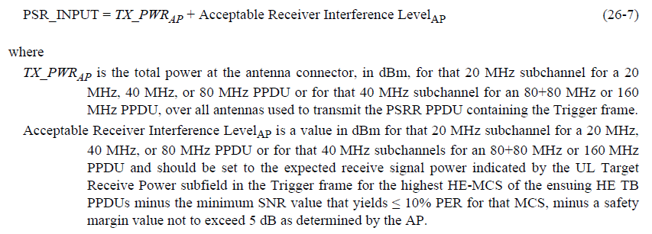
Appendix
In the 11ax spec, PSR (in dBM) is defined as follows
  For example, when Trigger Frame solicits 80MHz EHT TB PPDU, PSR corresponding to ESR is calculated based on 40MHz values but PSR corresponding to HSR needs to be set based on 20MHz and thus there is 6dBm difference
  When 160MHz EHT TB PPDU is triggered, there is also 6dBm difference between PSRs corresponding to ESR and HSR
  When 320MHz EHT TB PPDU is triggered, there is 12dBm difference between PSRs corresponding to ESR and HSR
  In option 2, when replacing HSR with ESR, we need to modify the ESR by considering these difference

Slide 24
Appendix
For 80/160MHz, mESR is the value corresponding to the highest PSR lower than or equal to EPSR - 6 where EPSR is PSR corresponding to ESR
For 320MHz, mESR is the value corresponding to the highest PSR lower than or equal to EPSR - 12 where EPSR is PSR corresponding to ESR
ESR or
mESR
EPSR [dBm]
For example, in 80/160MHz
ESR = 7, EPSR = -47dBm
The highest PSR lower than or equal to EPSR-6 (= -53) = -56dBm
Thus, mESR = 6

