Slide 1
Disambiguate Trigger Frame Special User Info Field
Date: 2021-02-22
Authors:
Name | Affiliations | Address | Phone | email
Steve Shellhammer | Qualcomm |  |  | shellhammer@ieee.org
Bin Tian |  |  |  | btian@qti.qualcomm.com
Yanjun Sun |  |  |  | yanjuns@qti.qualcomm.com
Alfred Asterjadhi |  |  |  | aasterja@qti.qualcomm.com

Slide 2
Issue
The issue is that it is possible that an EHT STA might be associated with an HE AP that assigns AID12 value 2007 to one of its STAs. And the AP locates this User Info field (2007) first in the Trigger frame
  This could lead the EHT STA to incorrectly think that this Trigger frame includes a Special User Info Field
We need a method to disambiguate between the following two cases:
  An HE AP sending a Trigger Frame with the first User Info Field having an AID12 value of 2007
  An EHT AP sending a Trigger Frame with the Special User Info Field
Here we will propose an explicit method to disambiguate between these two cases
  The current design is based on implicit signaling (EHT STA acts as an HE STA when associated to an HE AP)

Slide 3
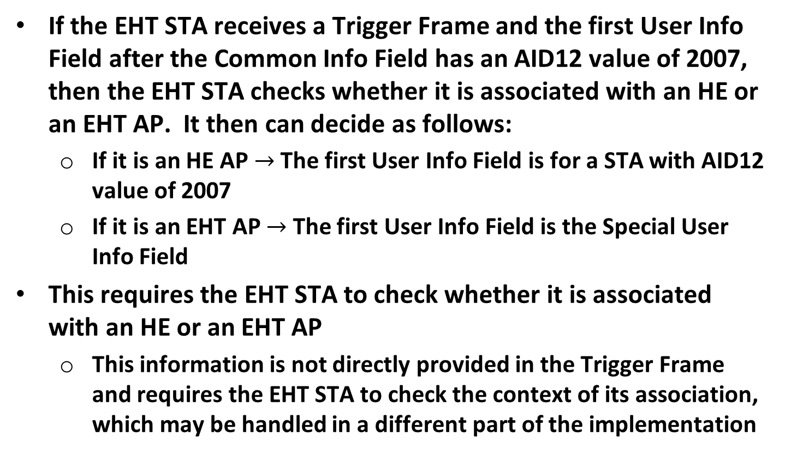
Implicit Signaling Method
If the EHT STA receives a Trigger Frame and the first User Info Field after the Common Info Field has an AID12 value of 2007, then the EHT STA checks whether it is associated with an HE or an EHT AP. It then can decide as follows:
  If it is an HE AP $→$ The first User Info Field is for a STA with AID12 value of 2007
  If it is an EHT AP $→$ The first User Info Field is the Special User Info Field
This requires the EHT STA to check whether it is associated with an HE or an EHT AP
  This information is not directly provided in the Trigger Frame and requires the EHT STA to check the context of its association, which may be handled in a different part of the implementation

Slide 4
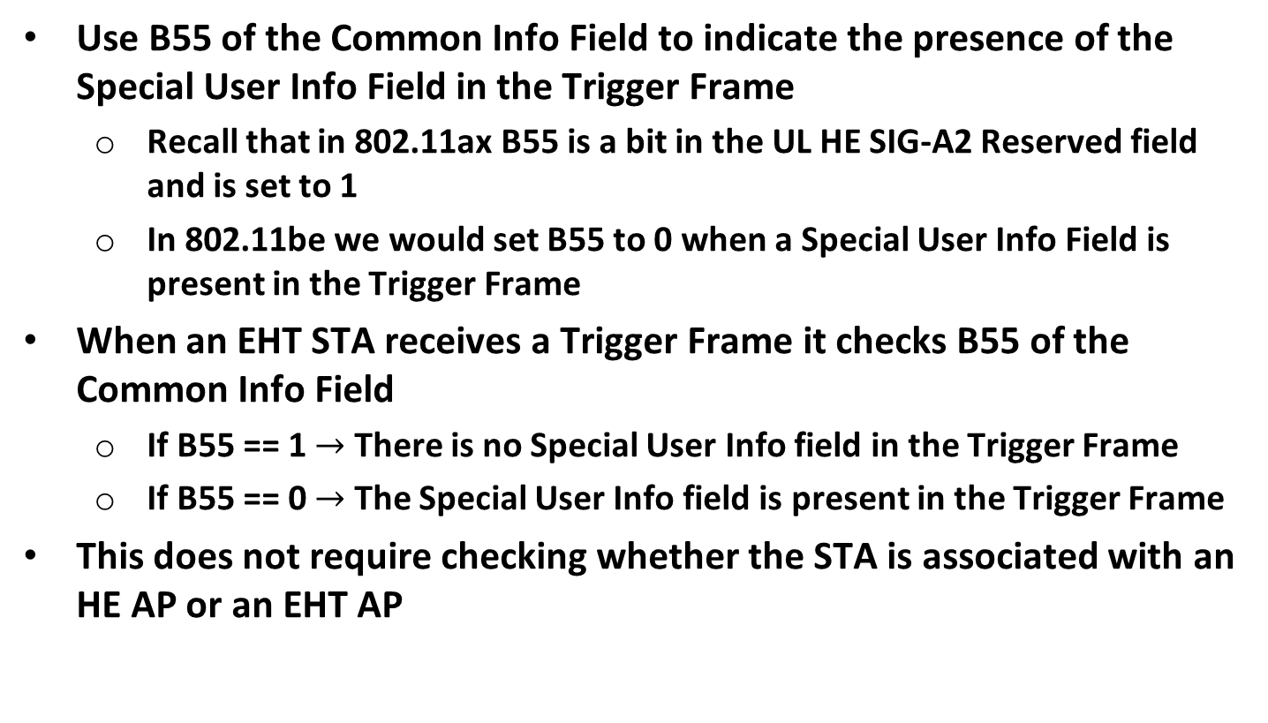
Explicit Signaling Method
Use B55 of the Common Info Field to indicate the presence of the Special User Info Field in the Trigger Frame
  Recall that in 802.11ax B55 is a bit in the UL HE SIG-A2 Reserved field and is set to 1
  In 802.11be we would set B55 to 0 when a Special User Info Field is present in the Trigger Frame
When an EHT STA receives a Trigger Frame it checks B55 of the Common Info Field
  If B55 == 1 $→$ There is no Special User Info field in the Trigger Frame
  If B55 == 0 $→$ The Special User Info field is present in the Trigger Frame
This does not require checking whether the STA is associated with an HE AP or an EHT AP

Slide 5
Straw Poll
Do you support using B55 of the Common Info Field to indicate the presence of the Special User Info Field in the Trigger Frame?
  B55 is set to 1 to indicate that there is no Special User Info field in the Trigger frame
  B55 is set to 0 to indicate that the Special User Info field is present in the Trigger frame

