Slide 1
Collaborative WLAN Sensing – Follow Ups
February, 2021
Date: 2021-2-01
Authors:
Name | Affiliation | Address | Phone | Email
Sang Kim | LG Electronics | 19, Yangjae-daero 11gil, Seocho-gu, Seoul 137-130, Korea |  | sanggook.kim@lge.com
Dongguk Lim |  |  |  | dongguk.lim@lge.com
Insun Jang |  |  |  | insun.jang@lge.com
Jeongki Kim |  |  |  | jeongki.kim@lge.com
Jinsoo Choi |  |  |  | js.choi@lge.com

Slide 2
Introduction
February, 2021
WLAN sensing has drawn increasing attention due to its potential enormous opportunities to create many applications such as in home security, health care, enterprise, and building automation/management markets, etc. [1- 8]
In [7] and [8], the importance of cooperating multiple STAs in terms of performance are noted.
In [4], we considered the group-based WLAN sensing in which multitude of Wi-Fi devices are involved and collaborated and possible benefits are also addressed in addition to overhead to achieve them.
In this contribution, we provide more illustrative information for better understanding of collaborative operation in WLAN sensing.

Slide 3
Recap: Example – Home Security
February, 2021
Intruder will use the entrances to home such as main entrance, windows, etc.
  Central entity (e.g., AP) can detect the presence of someone in the area of interest using sensing measurements.
  It may inform it to responsible person (e.g., home owner) to check.
  It may alert to responsible person if unusual pattern is detected, e.g., unusual gait pattern.
Wi-Fi devices with limited capabilities in terms of computation, power, etc. can be located around those areas for other purposes. For example, IoT devices can be used to control the curtain or blind for the window.
Devices (IoT devices, home appliances, etc.) around certain area of interest can be grouped and coordinated for home security.

Slide 4
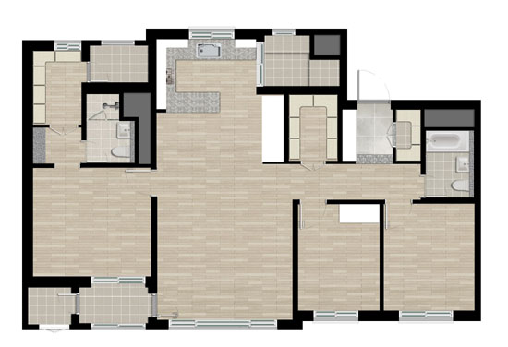



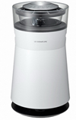
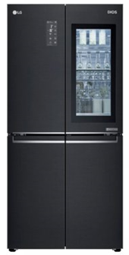


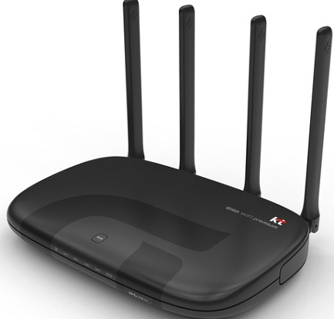
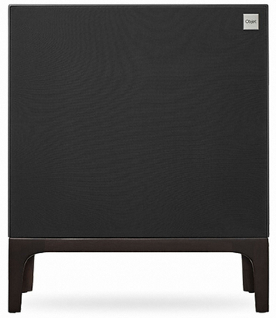
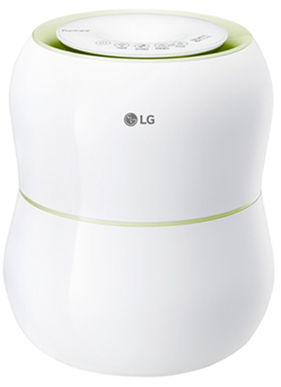
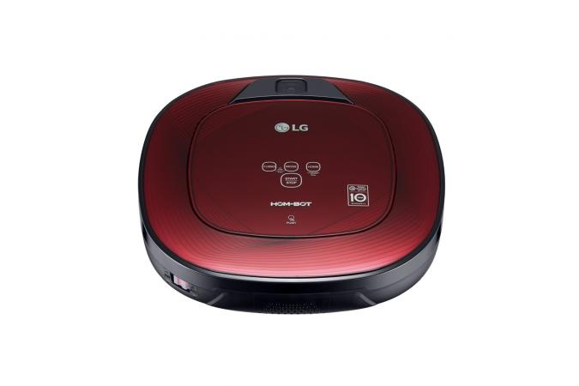



Recap: Example – Home Security (Cont’d)
February, 2021
Controlled by AP
AP can detect the presence of someone in the area of interest. It may simply inform to home owner the presence or may inform when unusual pattern is detected. In this example, sensing agent is located in AP, i.e., AP determines the presence based on the measurements by itself and from other STAs in the group.
Example illustration:
Controlled by TV
“Alert”
Each group may have its
own control point (CP)
for controlling the
operation of the group.
Intruder

Slide 5
Recap: Example – Home Security (Cont’d)
February, 2021
Configurations:
Sensing
Initiator (AP)
Example configuration: One initiator (AP) and two responders.
AP is control point (CP).
CP is triggering the sensing transmissions and
requesting feedbacks.
Sensing transmission and feedback may be burst-based [3] when a session consists of multiple bursts.
Illustration is based on burst-based.
Each burst has sensing measurement and feedback phases.
Sensing
Responder 1
Sensing
Responder 2

Slide 6
Recap: Example – Home Security (Cont’d)
February, 2021
Configurations:
Sensing
Initiator (AP)
Sensing
Transmitter
Sensing
Initiator (AP)
Feedback
Receiver
Sensing
Responder 1
Sensing
Responder 2
Sensing
Responder 1
Sensing
Responder 2
Sensing
Receiver
Sensing
Receiver
Feedback
Transmitter
Feedback
Transmitter
1st Burst: Transmission
Initiator transmits and two responders receive.
Available channel information: Initiator to responder 1 and
initiator to responder 2
1st Burst: Feedback
Two responders feedback the measurements to initiator.

Slide 7
Recap: Example – Home Security (Cont’d)
February, 2021
Configurations:
Sensing
Initiator (AP)
Sensing
Receiver
Sensing
Initiator (AP)
Feedback
Receiver
Sensing
Responder 1
Sensing
Responder 2
Sensing
Responder 1
Sensing
Responder 2
Sensing
Transmitter
Sensing
Receiver
Feedback
Transmitter
2nd Burst: Transmission
Responder 1 transmits, initiator and responder 2 receive.
Available channel information: Responder 1 to initiator and
responder 1 to responder 2.
2nd Burst: Feedback
Responder 2 feedbacks channel measurement between
responder 1 and itself.

Slide 8
Illustrative Example:
Explicit Feedbacks
February, 2021
STA 1 (AP)
Triggering
NDP 1 (1)
NDP 2 (1)
Feedback
Request
CH 1 → 2
Feedback
Request
CH 1→ 3
STA 2
Triggering
NDP 1 (1)
NDP 2 (1)
Feedback
Request
CH 1 → 2
STA 3
Triggering
NDP 1 (1)
NDP 2 (1)
Feedback
Request
CH 1 → 3
Sensing signal transmission
Feedback (Can be simultaneous)
Burst #1
CH i → j: Channel measurement information between STA i and STA j.
STA 2
STA 1
STA 2
STA 1
STA 3
STA 1
STA 3
Channel Measurement
Information
Topology
Note: 2 consecutive NDP transmissions are assumed for sensing transmission
for illustrative purpose. More than one feedback per burst.
STA1: AP, STA2: Responder 1, STA3: Responder 2

Slide 9
Illustrative Example:
Explicit Feedbacks
February, 2021
STA 2
Triggering
NDP 1 (2)
NDP 2 (2)
Channel Measurement information Available:
@ Initiator (STA1: AP)
STA 1 & 2 (Burst #1)
STA 1 & 3 (Burst #1)
STA 2 & 3 (Burst #2)
STA 1 (AP)
Triggering
NDP 1 (2)
NDP 2 (2)
Feedback
Request
CH 2 → 3
STA 3
Triggering
NDP 1 (2)
NDP 2 (2)
Feedback
Request
CH 2 → 3
Sensing signal transmission
Feedback
CH i → j: Channel measurement information between STA i and STA j.
Burst #2
STA 1
STA 2
STA 2
STA 3
STA 3
Channel
Measurement
Information
Topology
Note: 2 consecutive NDP transmissions are assumed for sensing transmission
for illustrative purpose. More than one feedback per burst.
STA1: AP, STA2: Responder 1, STA3: Responder 2

Slide 10
Illustrative Example:
Implicit Sensing Measurement + Explicit Feedbacks
February, 2021
STA 1 (AP)
Triggering
NDP 1 (2)
NDP 2 (2)
STA 2
Triggering
NDP 1 (2)
NDP 2 (2)
STA 3
Triggering
NDP 1 (1)
NDP 2 (1)
Sensing signal transmission
Implicit
STA 2
STA 2
STA 1
STA 1
Sensing Transmission for Channel
Measurement
STA 3
Topology
Burst #1
Note: 2 consecutive NDP transmissions are assumed for sensing transmission
for illustrative purpose.
STA1: AP, STA2: Responder 1, STA3: Responder 2

Slide 11
Illustrative Example:
Implicit Sensing Measurement + Explicit Feedbacks
February, 2021
Channel Measurement information Available:
@ Initiator (STA1: AP)
STA 1 & 2 (Burst #1)
STA 1 & 3 (Burst #2)
STA 2 & 3 (Burst #3)
STA 1 (AP)
Triggering
NDP 1 (3)
NDP 2 (3)
Feedback
Request
CH 3 → 2
STA 3
Triggering
NDP 1 (3)
NDP 2 (3)
CH i → j: Channel measurement information between STA i and STA j.
STA 2
Triggering
NDP 1 (3)
NDP 2 (3)
Feedback
Request
CH 3 → 2
Explicit
Feedback to
STA 1
Sensing signal transmission
Feedback
STA 2
STA 2
STA 3
Burst #2
STA 1
STA 3
STA 3
STA 1
Topology
Note: 2 consecutive NDP transmissions are assumed for sensing transmission
for illustrative purpose.
STA1: AP, STA2: Responder 1, STA3: Responder 2

Slide 12
Benefits
February, 2021
Accurate sensing over the area of interest can be achievable:
  Multitude of Wi-Fi capable devices selected for sensing (grouping) and their collaboration as a group in orderly fashion can provide additional information.
  Without grouping and collaboration, sensing can be considered as the one between one-to-one device or among one-to-many devices.
  With grouping and collaboration, sensing can be considered as the one among many-to-many devices. More information on channel can be obtained and processed, thus leading to accurate sensing.
  Note that grouping concept is logical on top of existing architecture.
Sensing requirements for different use cases can be tailored:
  Presence detection vs. Health monitoring.
  Less frequent sensing measurements using home appliances in the living room (presence detection).
  More frequent sensing measurements using the home appliances and IoT devices in the bedroom (health monitoring).
  Less number of devices for presence detection than for accurate health monitoring.

Slide 13
Benefits (Cont’d)
February, 2021
Computational benefit can be exploited by devices with less computational capability and power constraint:
  Sensing measurements can be delivered to AP for useful information extract over the area of interest.
  Computation to extract useful information may be done in AP or Cloud.
Aforementioned benefits, of course, entails increased overhead:
  For example, channel measurement gathering may require additional signaling and time allocation.
  We need to consider the trade-off depending on the applications, and etc.

Slide 14
Summary
February, 2021
WLAN sensing has drawn increasing attention due to its possible and potential opportunities to create many applications such as in home security, health care, enterprise, and building automation/management markets, etc.
In this contribution, we provide more illustrative information for better understanding of collaborative operation in WLAN sensing.
Consideration on protocol aspects will be followed in a separate contribution.

Slide 15
References
February, 2021
[1] Wi-Fi Sensing – A New Technology Emerges. v1.0, October 2019, Wireless Broadband Alliance (https://wballiance.com/wba-wi-fi-sensing/)
[2] 11-20/1239r0, Use Cases for Wireless LAN Sensing.
[3] 11-20/1232r0, Overview of WLAN sensing protocol.
[4] 11-20/1533r0, Collaborative WLAN Sensing.
[5] 11-20/1805r0, Discussion on WLAN Sensing Roles.
[6] 11-20/1804r0, Discussion on WLAN Sensing Procedure.
[7] 11-19/1416r0, Wi-Fi Sensing: Cooperation and Standard. Support.
[8] 11-19/1551r1, Wi-Fi Sensing in 60GHz band: Usage models, Performance and What is need in 802.11 Standard

Slide 16
SP #1
February, 2021
Do you support to have a sensing session that is comprised of multiple burst instances?

Slide 17
SP #2
February, 2021
Do you support the report by a receiver STA on channel information between sensing responders to a sensing initiator?

