Slide 1
Operation after Multi-link Setup
Date: 2021-01-xx
Authors:
Name | Affiliation | Address | Phone | Email
Insun Jang | LG Electronics | 19, Yangjae-daero 11gil, Seocho-gu, Seoul 137-130, Korea |  | insun.jang@lge.com
Jinsoo Choi |  |  |  | js.choi@lge.com
Jeongki Kim |  |  |  | jeongki.kim@lge.com
Namyeong Kim |  |  |  | namyeong.kim@lge.com
Sunhee Baek |  |  |  | sunhee.baek@lge.com

Slide 2
Introduction
We have determined many points of multi-link (ML) setup [1], [2]
Exchange of Association frames on a link only
Basic-variant ML element (including the common info and link info with complete information)
Including MLD-level information (e.g., AID, Listen Interval)
However, we need to clarify “How can AP(s) on link(s) to be setup, where association frames are not exchanged, operate with non-AP(s)”, which will be discussed in this contribution
We call the link(s) non-transmitting link while calling the link where association frames are exchanged transmitting link

Slide 3
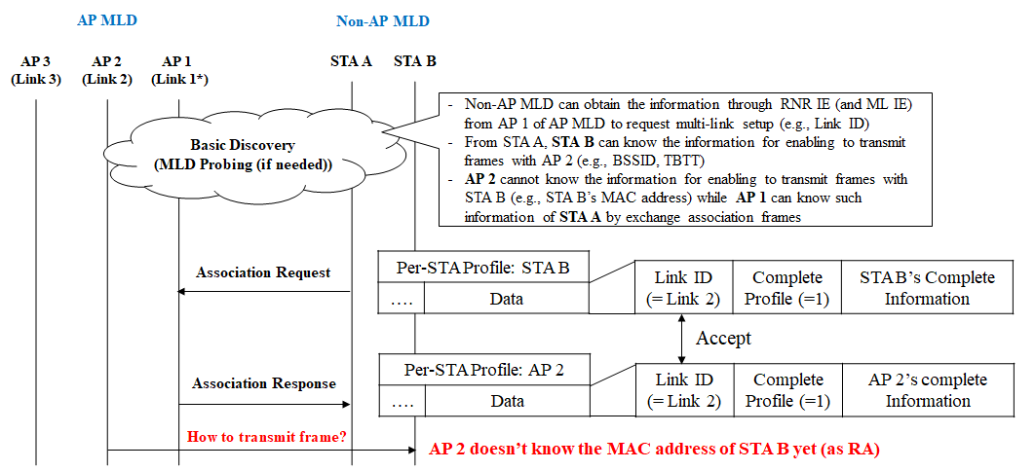
Motivation and Problem Statement
Non-AP MLD intends to setup Link 1 (transmitting link) and Link 2 (non-transmitting link) with AP MLD

Slide 4
Initial Transmission of Non-AP MLD
Non-AP STA (STA B) operating on non-transmitting link (link 2) can first transmit any frame (e.g., Class 1/2/3) to the AP (AP 2) corresponding to that link
It will include its MAC address in TA field, which lets AP 2 know STA B’s MAC address
However, AP 2 doesn’t know which MLD STA B is affiliated with
AP 2 cannot update the state/information regarding the non-AP MLD with which STA B is affiliated

Slide 5
Discussion and Possible Options
Consequently, an AP MLD needs the information to distinguish STAs affiliated with a non-AP MLD on non-transmitting links and bind STAs and their MLD
We can have several options
Option 1 (Preferred): Signaling MAC addresses of STAs during ML setup
It can be a good candidate and simply apply to current ML IE format based on D0.3
Option 2: Carries STA ID (derived from AID) on non-transmitting link right after ML setup
It can be carried in a control field with a new A-Control ID; however, it may be the waste of control ID only for resolving the issue
Option 3: Setting MAC address field as MLD MAC address on non-transmitting link right after ML setup
For example, when a non-AP STA transmits a certain frame initially right after ML setup, its TA field is set to the non-AP MLD’s MAC address; however, a new addressing rule is needed only for resolving the issue

Slide 6
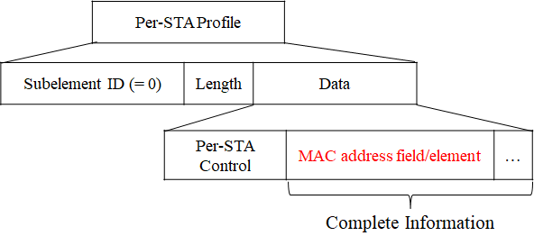
Main Proposal
We propose to indicate MAC addresses of STAs affiliated with a non-AP MLD during ML Setup
Beacon or Probe Response frame doesn’t need to include that information because it is unnecessary before ML setup (except for request of the complete information)
Therefore, MAC address field/element is included as a portion of the complete information (one fixed order…) indicated in the Link Info field of Per-STA Profile of Basic-variant ML element

Slide 7
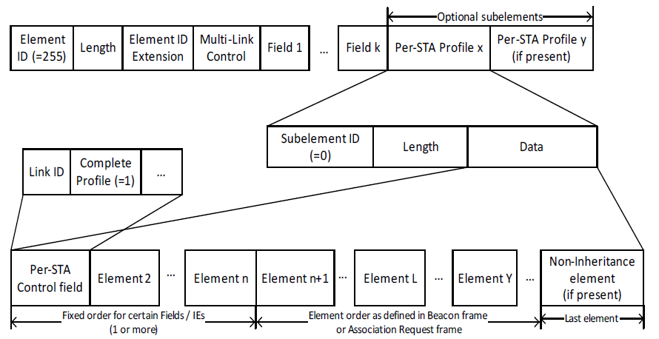
Applying to Current ML IE format
Currently, we have TBD fields in fixed order and TBD elements in fixed order in the complete information
Therefore, we can have a MAC address field or element in fixed order (e.g., in Element 2)

Slide 8
Conclusion
We observed an AP MLD needs the information to distinguish STAs affiliated with a non-AP MLD and bind STAs and their MLD in order to operate with non-AP STA(s) on non-transmitting link(s) after ML setup
Therefore, to enable that, we proposed indicate MAC addresses of STAs affiliated with a non-AP MLD during ML Setup
Specifically, MAC address field/element is included as a portion of the complete information indicated in the Link Info field of Per-STA Profile of Basic-variant ML element

Slide 9
SP #1
Do you agree to include the information of MAC addresses of STAs as a portion of the complete information indicated in the Link Info field of Per-STA Profile of Basic-variant ML element?
Signaling is TBD

Slide 10
References
[1] 802.11-19/1262r23 Specification Framework for TGbe
[2] IEEE P802.11be/D0.3, January 2021

