Slide 1
Phase Rotation for 320 MHz Non-HT Duplicate Transmission and Pre-EHT modulated Fields
Date: 2021-01-04
Authors:
Name | Affiliation | Address | Phone | Email
Chenchen Liu | Huawei Technologies Co., Ltd Huawei Technologies Co., Ltd | Huawei Base, Bantian, Shenzhen |  | liuchenchen1@huawei.com
Bo Gong
Ming Gan
Jian Yu

Slide 2
Abstract
In this contribution, we will discuss the phase rotation for 320 MHz Non-HT duplicate transmission and pre-EHT modulated fields.

Slide 3
Outline
Background
Rotation coefficients for 320 MHz Non-HT
Simulation Results
Rotation coefficients for 320 MHz Pre-EHT modulated fields
Summary
References

Slide 4
Backgrounds
Non-HT duplicate transmission is used to transmit to STAs that may be present in a part of a 40 MHz, 80 MHz, 160 MHz , or 320 MHz channel
For examples, a lot of control frame such as RTS, CTS and NDPA will be transmitted in non-HT duplicate form
With Non-HT duplicate transmission, the message is encoded and modulated according to 11a 20 MHz bandwidth, and then duplicated for every 20 MHz sub channel with a phase rotation to reduce the PAPR.
The supported modulation includes BPSK, QPSK, 16QAM, 64QAM and the supported coding rate 1/2,3/4.

Slide 5
Backgrounds
3.2 μs OFDM symbol prepended by a 0.8 μs cyclic prefix is used for Non-HT duplicate transmission.
Numbering the subcarrier locations ranging from −32, −31,. . ., −1, 0, 1,. . ., 31, the populated subcarriers are located at −26, −25,. . ., −2, −1, 1, 2,. . ., 25, 26 for each 20M sub channel
The coded bits are modulated on to 48 subcarriers. Four additional subcarriers are used as pilots for phase and frequency tracking and training. The pilot subcarriers are −21, −7, 7, 21.
Pre-EHT modulated fields shall be transmitted in the same way as in the Non-HT duplicate transmission, with the following exceptions:
  The Rate and Length fields
  The four additional subcarriers at indices ±27 and ±28

Slide 6
Backgrounds
The following motion has already passed
  802.11be supports the following phase rotation sequence for legacy preamble, RL-SIG, U-SIG and EHT-SIG in 320/160+160 MHz PPDU:
[1 -1 -1 -1 1 -1 -1 -1 -1 1 1 1 -1 1 1 1]
[Motion 115, #SP81, [16] and [70]]
We tested the PAPR performance of this sequence for 320 MHz Non-HT duplicate transmission.

Slide 7
Rotation coefficients for 320 MHz Non-HT
Option 1(per 80 MHz Rotation):
[1 -1 -1 -1, 1 -1 -1 -1, -1 1 1 1, -1 1 1 1]
[Motion 115, #SP81, [16] and [70]]
Option 2(per 20 MHz Rotation):
[1, 1, 1, 1, 1, -1, 1, 1, -1, -1, -1, 1, 1, -1, 1, -1]
Option 3(per 80 MHz Rotation):
[1, -1, -1, -1, 1, -1, -1, -1, 1, -1, -1, -1, -1, 1, 1, 1]

Slide 8
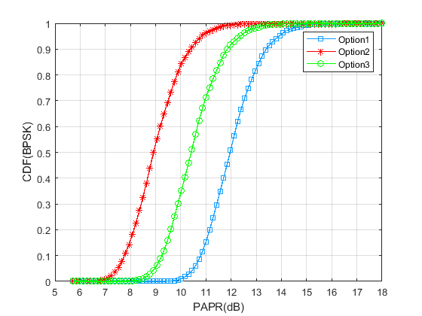
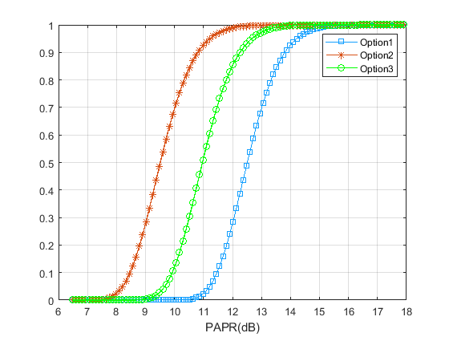
Simulation Results
PAPR for 320 MHz Non-HT duplicate transmission without preamble puncture(BPSK, 16QAM respectively)
CDF(16QAM)

Slide 9
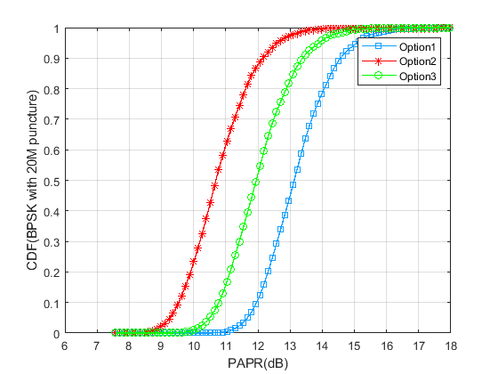
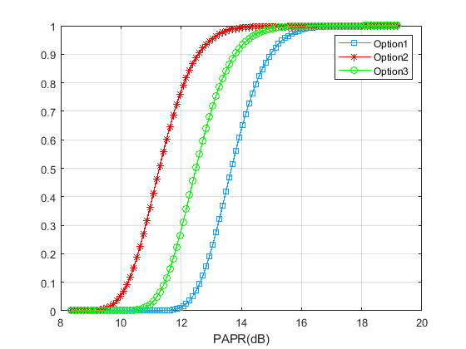
Simulation Results
Worst PAPR for 320 MHz Non-HT duplicate transmission with 20 MHz preamble puncture(BPSK, 16QAM respectively)
CDF(16QAM with 20M puncture)

Slide 10
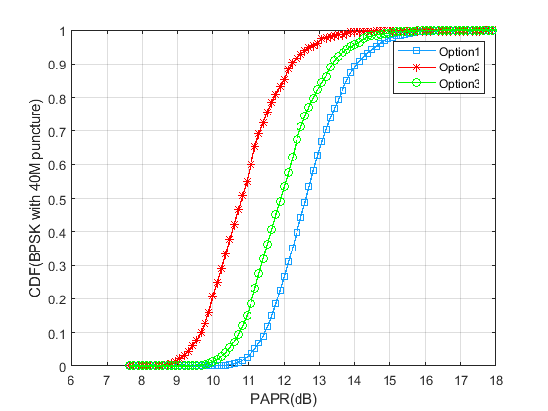
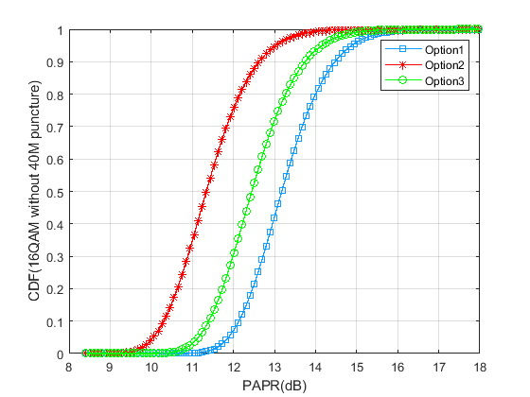
Simulation Results
Worst PAPR for 320 MHz Non-HT duplicate transmission with 40 MHz preamble puncture (RU3*996+RU484)

Slide 11
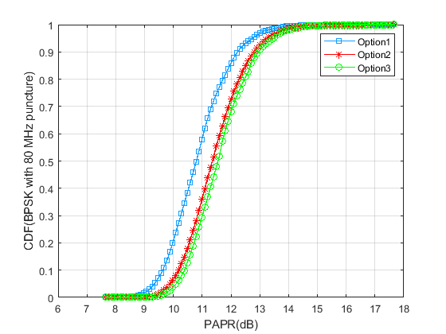
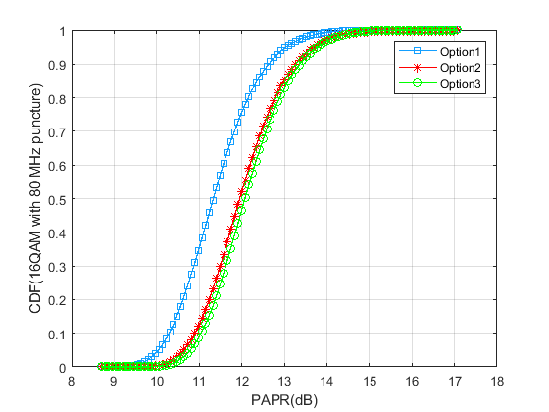
Simulation Results
Worst PAPR for 320 MHz Non-HT duplicate transmission with 80 MHz preamble puncture (RU3*996)

Slide 12
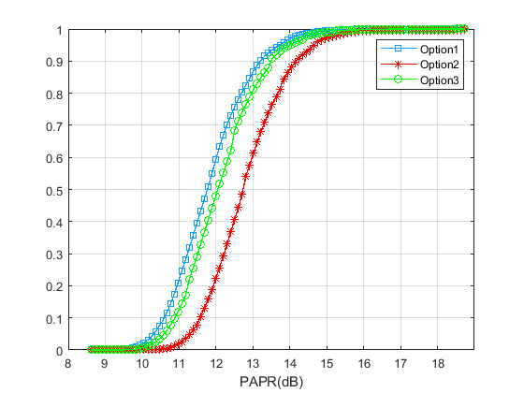
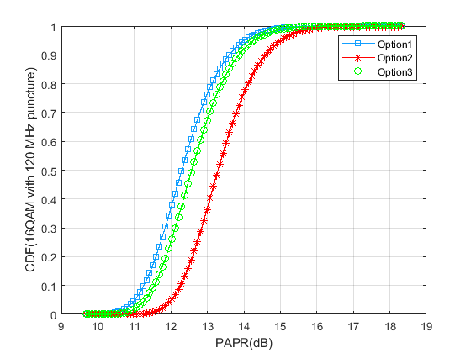
Simulation Results
Worst PAPR for 320 MHz Non-HT duplicate transmission with 120 MHz preamble puncture (RU2*996+RU484)
CDF(BPSK with 120M puncture)

Slide 13
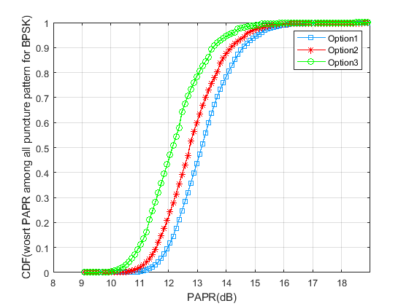
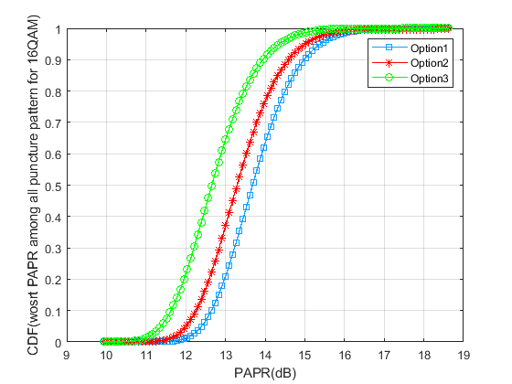
Simulation Results
Worst PAPR for 320 MHz Non-HT duplicate transmission among all puncture pattern (1 RU4*996, 16 RU3*996+RU484+RU242, 8 RU3*996+RU484, 2 RU3*996, 12 RU2*996+RU484)

Slide 14
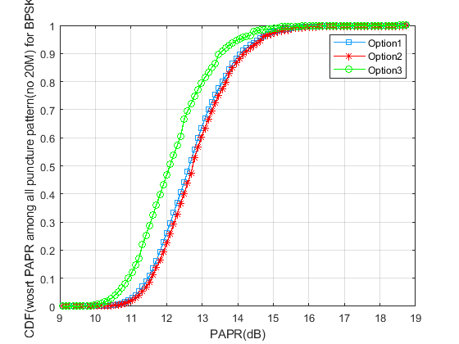
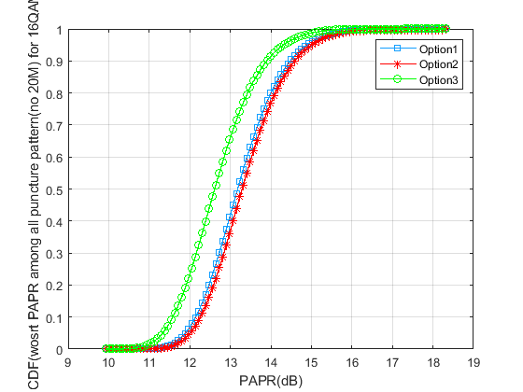
Simulation Results
Worst PAPR for 320 MHz Non-HT duplicate transmission among all puncture pattern (1 RU4*996, 8 RU3*996+RU484, 2 RU3*996, 12 RU2*996+RU484)

Slide 15
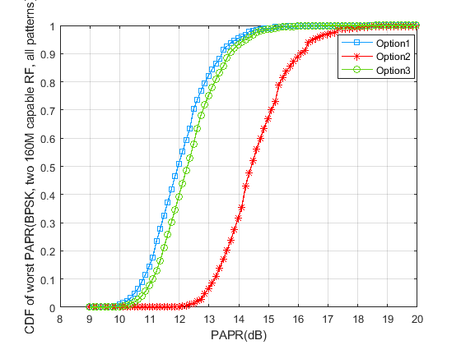
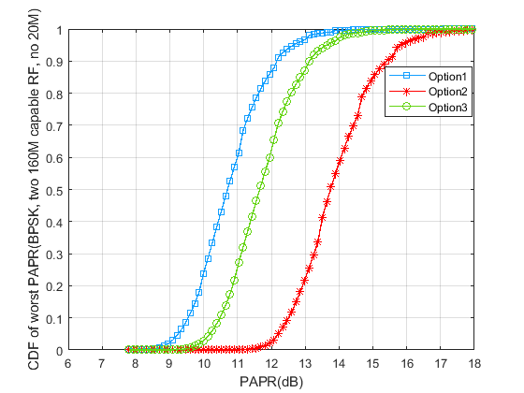
Simulation Results
Considering implementation with two 160M capable RF，the worst PAPR for 320 MHz Non-HT duplicate transmission among all puncture pattern

Slide 16
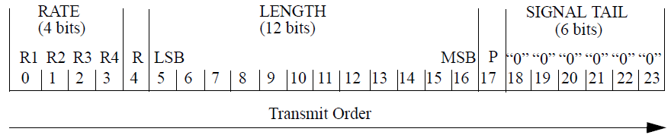
Rotation coefficients for 320M Pre-EHT modulated fields
The L-SIG and RL-SIG is transmitted in the same way as in the Non-HT duplicate transmission, with the following exceptions
  For L-SIG and RL-SIG, values [–1, –1, –1, 1] are mapped to the extra subcarriers [–28, –27, 27, 28]
  LENGTH field in L-SIG set to a value N such that mod(N, 3) = 0
  Rate=1101

Slide 17
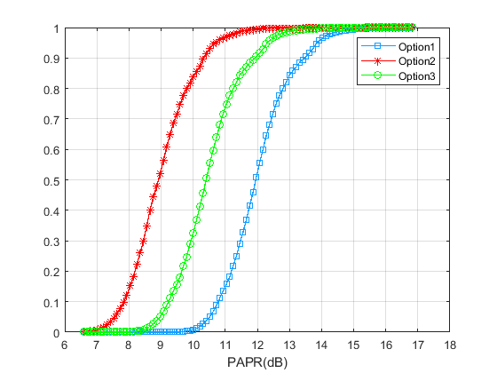
Rotation coefficients for 320M Pre-EHT modulated fields
PAPR for L-SIG and RL-SIG in 320M without preamble puncture

Slide 18
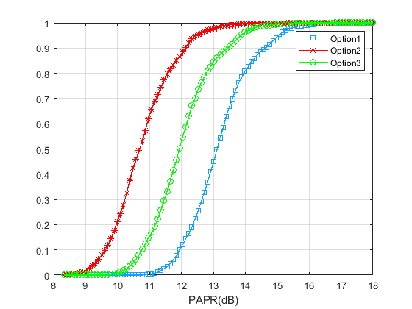
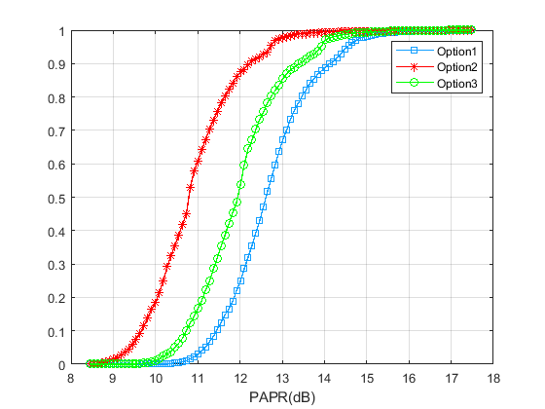
Rotation coefficients for 320M Pre-EHT modulated fields
Worst PAPR for L-SIG and RL-SIG in 320M with 20M and 40M preamble puncture
CDF(20M puncture)
CDF(20M puncture)

Slide 19
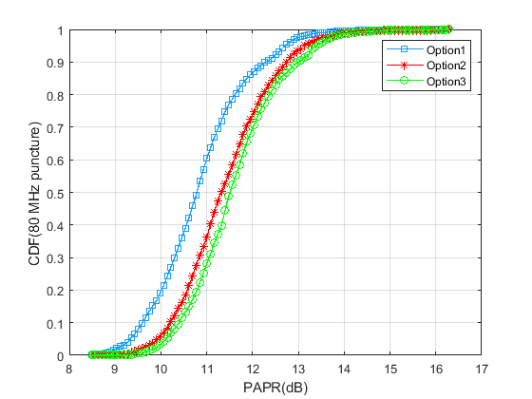
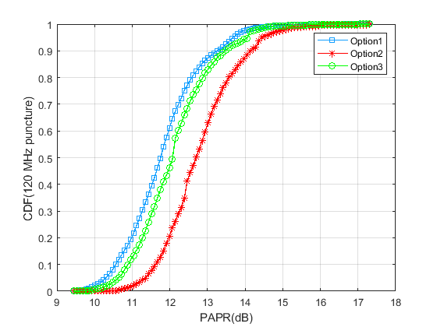
Rotation coefficients for 320M Pre-EHT modulated fields
Worst PAPR for L-SIG and RL-SIG in 320M with 80M and 120M preamble puncture

Slide 20
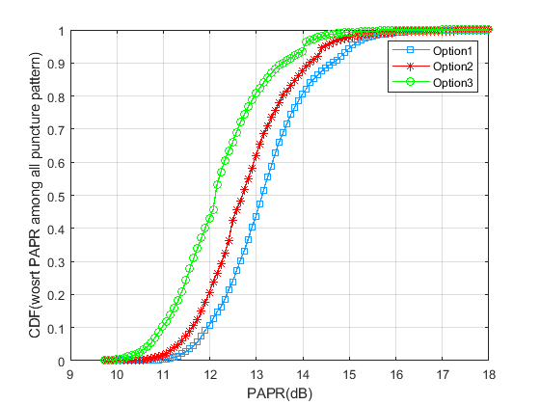
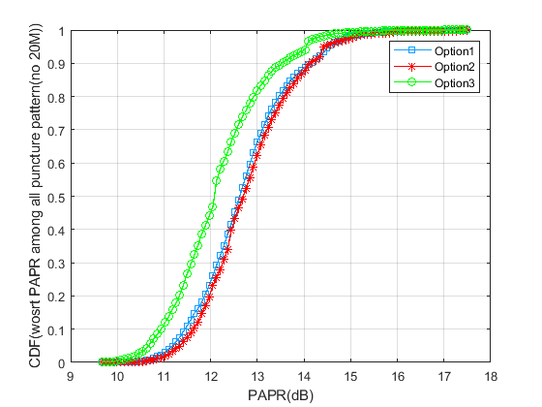
Rotation coefficients for 320M Pre-EHT modulated fields
Worst PAPR for L-SIG and RL-SIG in 320M among all puncture pattern(1 RU4*996, 16 RU3*996+RU484+RU242, 8 RU3*996+RU484, 2 RU3*996, 12 RU2*996+RU484)

Slide 21
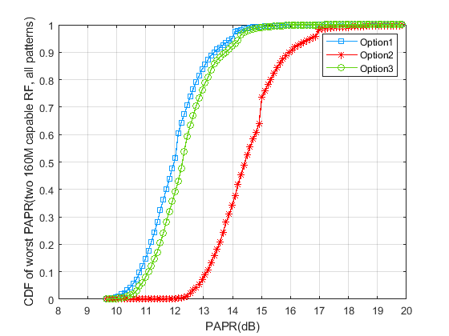
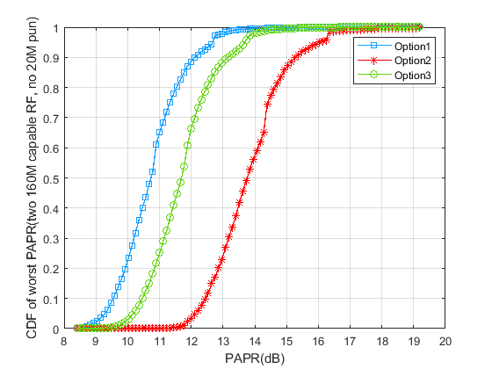
Rotation coefficients for 320M Pre-EHT modulated fields
Considering implementation with two 160M capable RF， the worst PAPR for L-SIG and RL-SIG in 320M among all puncture pattern

Slide 22
Summary
In this contribution, three sets of rotation coefficients are evaluated for Non-HT duplicate transmission and pre-EHT modulated filed under various preamble puncture pattern. The overall results shows that
  The per 80M rotation(Option3) has about 1dB PAPR gain compared to(Option1) in the sense of median PAPR of the worst case among all puncture pattern

Slide 23
References
[1] IEEE P802.11-REVmd™/D3.0
[2] IEEE P802.11ax™/D6.0
[3] Phase Rotation Proposal Follow-up, doc.: IEEE 802.11-20/0699r1
[4] Specification Framework for TGbe , doc.: IEEE 802.11-20/0566r23

Slide 24
SP1
Do you support to apply the following phase rotation for 320M Non-HT Duplicate transmission
  [1, -1, -1, -1, 1, -1, -1, -1, 1, -1, -1, -1, -1, 1, 1, 1](Option 3, per 80M)
  Y/N/Abs

Slide 25
SP2
Do you support to apply the following phase rotation for legacy preamble, U-SIG and EHT-SIG of 320M Pre-EHT modulated fields
  [1, -1, -1, -1, 1, -1, -1, -1, 1, -1, -1, -1, -1, 1, 1, 1](Option 3, per 80M)
  Y/N/Abs

Slide 26
SP3
Do you support to apply the following phase rotation for 320M Non-HT Duplicate transmission when implemented with one singular 320M capable RF
  [1, -1, -1, -1, 1, -1, -1, -1, 1, -1, -1, -1, -1, 1, 1, 1](Option 3, per 80M)
  Y/N/Abs

Slide 27
SP4
Do you support to apply the following phase rotation for legacy preamble, U-SIG and EHT-SIG of 320M Pre-EHT modulated fields when implemented with one singular 320M capable RF
  [1, -1, -1, -1, 1, -1, -1, -1, 1, -1, -1, -1, -1, 1, 1, 1](Option 3, per 80M)
  Y/N/Abs

Slide 28
Backup
Worst PAPR of L-LTF | No Puncture | 20MHz Puncture | 40MHz Puncture | 80MHz Puncture | 120MHz Puncture
Option1 | 8.4095 | 9.5729 | 9.0694 | 7.2900 | 8.2592
Option2 | 5.7493 | 7.4922 | 7.4206 | 8.2589 | 9.5062
Option3 | 6.8632 | 8.3940 | 8.6056 | 7.9370 | 8.7288
Worst PAPR of L-STF | No Puncture | 20MHz Puncture | 40MHz Puncture | 80MHz Puncture | 120MHz Puncture
Option1 | 7.7653 | 8.9287 | 8.4251 | 6.5568 | 7.5260
Option2 | 4.7322 | 6.4751 | 6.3556 | 7.2417 | 8.4890
Option3 | 6.2190 | 7.7498 | 7.5901 | 7.3156 | 7.6524

Slide 29
Backup
Worst PAPR for 320 MHz Non-HT duplicate transmission among all puncture pattern (1 RU4*996, 8 RU3*996+RU484, 2 RU3*996, 12 RU2*996+RU484)

