Slide 1
Reducing USIG PAPR via
Disregard Bit Value
Date: 2021-04-29
Authors:
Name | Affiliation | Address | Phone | Email
Shimi Shilo | Huawei Technologies
Oded Redlich
Genadiy Tsodik
Ross Jian Yu
Mengshi Hu

Slide 2
Background
  As of 11be D0.3, the agreed U-SIG design for an MU PPDU is the following:
  Similarly, for a TB PPDU the following is current design in D0.3:
  New in this r2: updated results based on simulations, adding all non-OFDMA puncturing cases, also verified all fields contain valid values (including relationship between fields); added reference

Slide 3
Background
  The ‘Disregard’ bits are “don’t care” for an R1 device; they may be used to convey information to R2 devices
  The ‘Validate’ bits are used by R1 devices to determine whether to terminate reception or not
  Since it is used to determine PPDU type/BW/color/TXOP etc., the U-SIG detection performance has to be significantly better than the corresponding data detection rate

Slide 4
Disregard Bit Value
  In an MU PPDU, the Disregard bits are currently defined as set to ‘1’
  In a TB PPDU, the Disregard bits may be copied from the Trigger Frame
    In 11ax, the reserved bits in HE-SIG-A are also copied from the Trigger frame and are set to ‘1’
  Validate bits are also set to ‘1’
  Many U-SIG options are not used – for example, in a 20MHz PPDU, there are only 14 ‘free’ bits (out of 26 bits) in the 1st U-SIG symbol of an MU PPDU
  In the next slide we look at the impact on the U-SIG PAPR

Slide 5
PAPR Observations
  We compare the PAPR CCDF of both U-SIG symbols for an MU PPDU with that of the data PAPR (assuming MCS 0), in 20MHz
  Due to the large number of fixed U-SIG bits, the remaining number of possible combinations is small, and
  the PAPR curve is not smooth
  (CLT doesn’t apply)
  Here, the PAPR of the 1st U-SIG
  symbol exceeds that of the data
  PAPR in ~3-4% of the cases
  (on average)
  There are many cases for which
  U-SIG values will be fixed over
  time with high PAPR, for example
  DL+BSS Color=46+TXOP=127
  yields ~11dB PAPR

Slide 6
Baseline
  Based on comments related to revision 1, we started by looking at the worst-case scenarios in terms of PAPR, and finding the value of the Disregard bits which can assist in those cases
  In general, 160 MHz and 320 MHz (in particular some of the puncturing cases) yield highest PAPR, so we start by evaluating these cases
  Preferably, value chosen should improve PAPR of 20/40/80 MHz, and definitely not degrade it

Slide 7
Data PAPR – 20, 40 and 80 MHz
  Below is the CCDF of the Data PAPR for 20, 40 and 80 MHz (considering all puncturing cases)

Slide 8
Data PAPR – 160 MHz
  Below is the CCDF of the Data PAPR for 160 MHz (considering all puncturing cases)

Slide 9
Data PAPR – 320 MHz
  Below is the CCDF of the Data PAPR for 320 MHz (considering all puncturing cases)

Slide 10
Data PAPR – Summary
  The results show that there is – as expected – a small difference in PAPR between BW
    Puncturing has little effect on the PAPR
  Highest data PAPR is ~13dB
  In the next slides we analyze the U-SIG PAPR for all BW values including all puncturing cases

Slide 11
TB U-SIG PAPR – w/o Puncturing
  Below is the CCDF of the TB U-SIG PAPR for all cases when there is no puncturing
  We can see that 320 MHz yields highest PAPR, followed by 160 MHz and 40 MHz

Slide 12
TB U-SIG PAPR – 80 MHz
  Below is the CCDF of the TB U-SIG PAPR for 80 MHz considering puncturing
  We can see that puncturing does indeed have a significant impact

Slide 13
TB U-SIG PAPR – 160 MHz
  Below is the CCDF of the TB U-SIG PAPR for 160 MHz considering puncturing
  Again – puncturing has a significant impact

Slide 14
TB U-SIG PAPR – 320 MHz
  Below is the CCDF of the TB U-SIG PAPR for 320 MHz considering puncturing (results for 320-2 are very similar)
  Again – puncturing has a significant impact

Slide 15
TB U-SIG PAPR – Analyzing Results
  The results show that TB U-SIG PAPR is, in majority of cases, higher than the data PAPR
    Puncturing has – as expected – an impact on the PAPR of the TB U-SIG signal, sometimes significant
  Highest TB U-SIG PAPR is ~17.5-18dB
  In order to reduce the PAPR, we simulated possible Disregard bit values and evaluated their impact, considering every BW and puncturing scenario

Slide 16
Reducing TB U-SIG PAPR
  Using value of ‘011110’ (’30’ in decimal) in the first U-SIG symbol, and value of ‘11011’ (’27’ in decimal) in the second U-SIG symbol leads to consistent PAPR reduction across all cases and for both U-SIG symbols
  In the next slides, we show simulation results which corroborate this

Slide 17
Impact on 320 MHz cases
  PAPR is reduced (improved) in all 320 MHz scenarios; below we show only the two worst-case scenarios
  Here, max PAPR is reduced by ~1.5dB

Slide 18
Impact on 160 MHz cases
  PAPR is reduced (improved) in all 160 MHz scenarios; below we show only the two worst-case scenarios
  Here, max PAPR is reduced by ~1.5dB

Slide 19
Impact on 80 MHz cases
  PAPR is reduced
  for all 80 MHz cases
  Consistent reduction
  for both U-SIG
  symbols, and
  max PAPR reduction
  by ~1.5dB

Slide 20
Impact on 20/40 MHz cases
  PAPR is reduced for both 20 MHz and 40 MHz
  Consistent reduction for both U-SIG symbols, and max PAPR reduction by ~1dB

Slide 21
TB U-SIG PAPR Reduction – Summary
  The results show that setting the Disregard bits to ‘011110’ in the 1st U-SIG symbol and ‘11011’ in the 2nd U-SIG symbol leads to significant TB U-SIG PAPR reduction
  This is consistent for all BW values and all puncturing cases
  Requires zero effort

Slide 22
MU U-SIG PAPR – w/o Puncturing
  Below is the CCDF of the U-SIG PAPR for all cases when there is no puncturing
  We can see that 320 MHz yields highest PAPR, followed by 160 MHz and 40 MHz

Slide 23
MU U-SIG PAPR – 80 MHz
  Below is the CCDF of the U-SIG PAPR for 80 MHz considering puncturing
  We can see that puncturing does indeed have a significant impact

Slide 24
MU U-SIG PAPR – 160 MHz
  Below is the CCDF of the U-SIG PAPR for 160 MHz considering puncturing
  Again – puncturing has a significant impact

Slide 25
MU U-SIG PAPR – 320 MHz
  Below is the CCDF of the U-SIG PAPR for 320 MHz considering puncturing
  Again – puncturing has a significant impact

Slide 26
MU U-SIG PAPR – 320 MHz-2
  Below is the CCDF of the U-SIG PAPR for 320 MHz-2 considering puncturing
  Again – puncturing has a significant impact

Slide 27
MU U-SIG PAPR – Summary
  The results show that U-SIG PAPR is, in most cases, higher than the data PAPR
    Puncturing has – as expected – an impact on the PAPR of the U-SIG signal, sometimes significant
  Highest U-SIG PAPR is ~17.5-18dB
  In order to reduce the PAPR, we simulated all possible Disregard bit values and evaluated their impact

Slide 28
Reducing MU U-SIG PAPR
  There isn’t a single global Disregard value which minimizes or even reduces the MU U-SIG PAPR for all cases (compared with the all 1s case)
  One value which appears in many cases, especially in wide BW, is Disregard = 9 (binary ‘01001’)
  In the next slides, we show that this value reduces the PAPR for the majority of highest PAPR cases, and doesn’t lead to degradation in majority of other cases

Slide 29
Impact on worst-case 320 MHz cases
  PAPR is reduced and improved in four worst-case 320 MHz scenarios (improves by ~0.5dB)

Slide 30
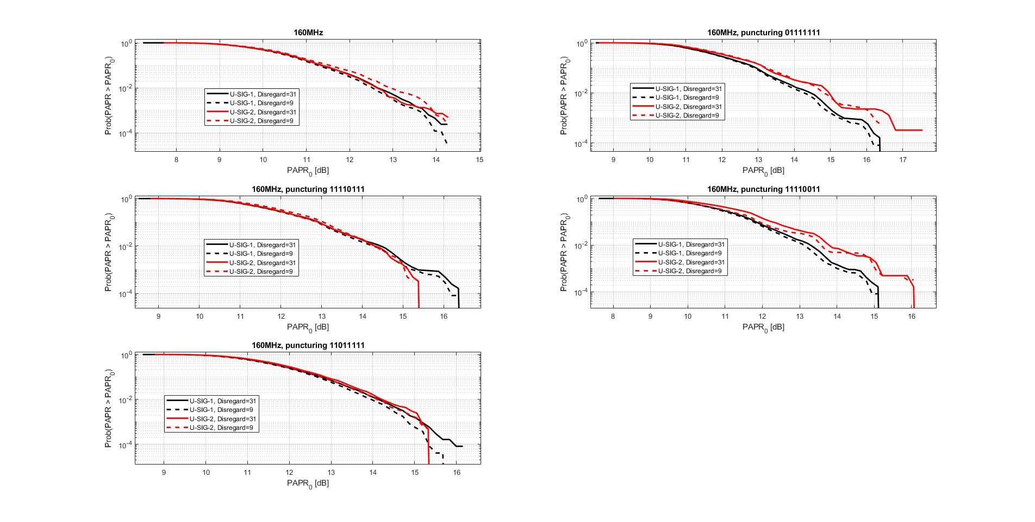
Impact on worst-case 160 MHz cases
  PAPR is reduced and improved in almost majority of worst-case 160 MHz scenarios

Slide 31
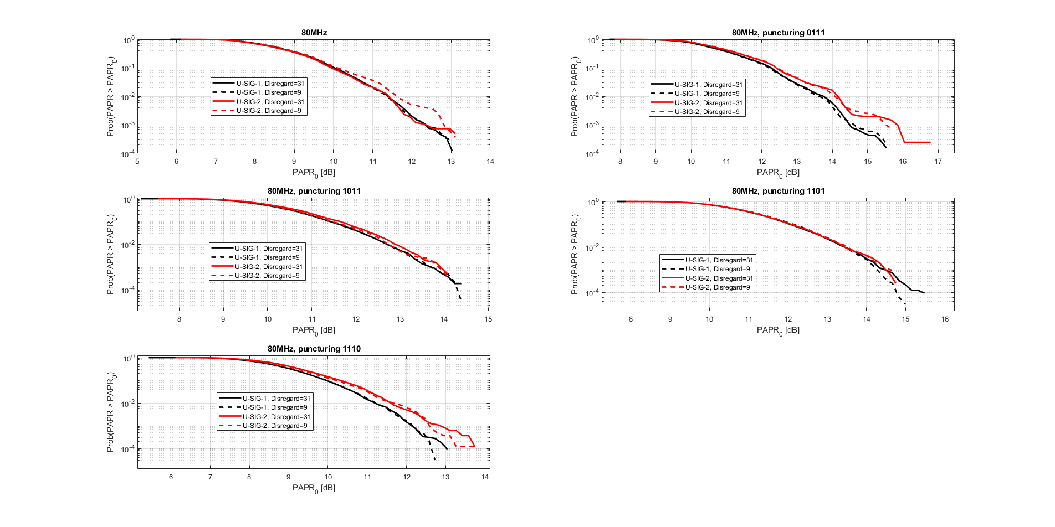
Impact on 80 MHz cases
  PAPR is reduced and improved in almost majority of 80 MHz cases (definitely reduces the worst-case scenario)

Slide 32
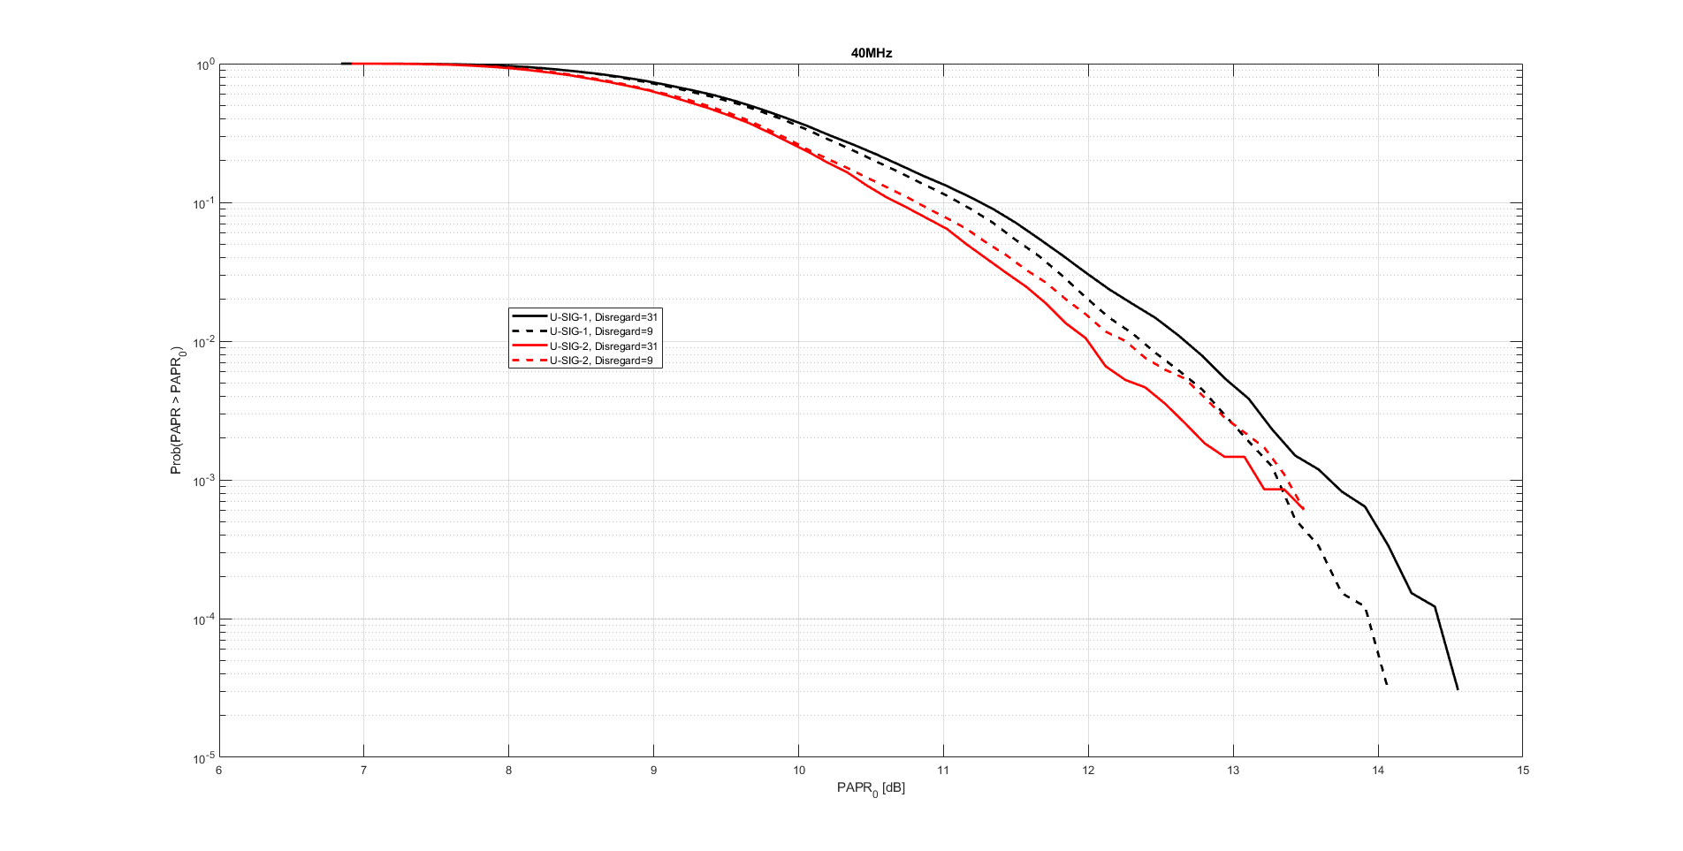
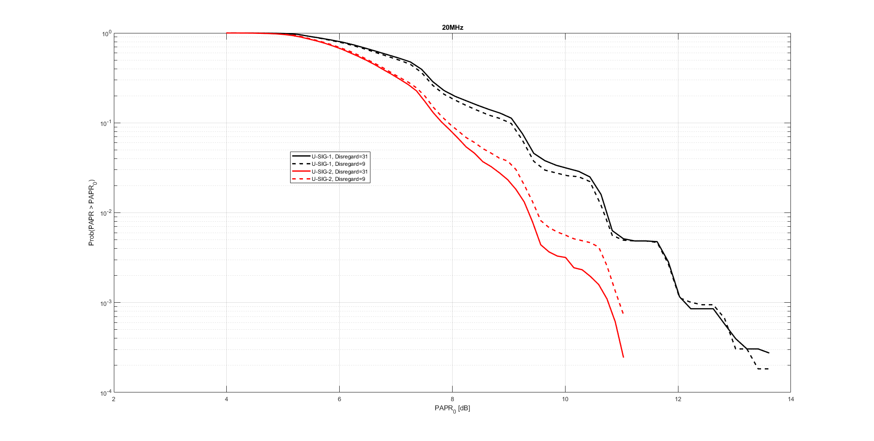
Impact on 20/40 MHz cases
  PAPR is reduced for 40 MHz and not degraded for 20 MHz

Slide 33
Summary
  We described the existing U-SIG design, in particular the fact that the Disregard bits are set to all 1s, and showed that this yields a high PAPR
  Changing the value of the Disregard bits can reduce the PAPR and improve the performance
    In particular, we propose to change from all 1s (Disregard = ’31’ in the U-SIG for MU PPDU) to ‘9’ (01001)
  Though the impact is not huge, it is very simple and requires zero effort and nothing in terms of complexity – simply changing the default bits in the U-SIG field
  A similar approach was presented during the discussions on HE-SIG-A in 11ax, see [1]

Slide 34
References
  [1] 11-16/0914r1: Bit Field Finalization of HE-SIG-A

Slide 35
Straw Poll #1
  Do you support to set the default value of the Disregard bits in an EHT TB PPDU to ‘0 1 1 1 1 0 1 1 0 1 1’?
    The default value of the Disregard bits may be defined in the U-SIG field or copied from the Trigger Frame
    This is for R1

Slide 36
Straw Poll #2
  Do you support to set the default value of the Disregard bits in an EHT MU PPDU to ‘0 1 0 0 1’ (‘9’ in decimal)?
    This is for R1

Slide 37
Appendix
  Results for 320MHz TB, no puncturing:

Slide 38
Appendix
  Results for 320MHz TB, puncturing 0011111111111111:

Slide 39
Appendix
  Results for 320MHz TB, puncturing 1100111111111111:

Slide 40
Appendix
  Results for 320MHz TB, puncturing 1111001111111111:

Slide 41
Appendix
  Results for 320MHz TB, puncturing 1111110011111111:

Slide 42
Appendix
  Results for 320MHz TB, puncturing 1111111100111111:

Slide 43
Appendix
  Results for 320MHz TB, puncturing 1111111111001111:

Slide 44
Appendix
  Results for 320MHz TB, puncturing 1111111111110011:

Slide 45
Appendix
  Results for 320MHz TB, puncturing 1111111111111100:

Slide 46
Appendix
  Results for 320MHz TB, puncturing 0000111111111111:

Slide 47
Appendix
  Results for 320MHz TB, puncturing 1111000011111111:

Slide 48
Appendix
  Results for 320MHz TB, puncturing 1111111100001111:

Slide 49
Appendix
  Results for 320MHz TB, puncturing 1111111111110000:

Slide 50
Appendix
  Results for 320MHz-2 TB, no puncturing:

Slide 51
Appendix
  Results for 320MHz-2 TB, puncturing 0011111111111111:

Slide 52
Appendix
  Results for 320MHz-2 TB, puncturing 1100111111111111:

Slide 53
Appendix
  Results for 320MHz-2 TB, puncturing 1111001111111111:

Slide 54
Appendix
  Results for 320MHz-2 TB, puncturing 1111110011111111:

Slide 55
Appendix
  Results for 320MHz-2 TB, puncturing 1111111100111111:

Slide 56
Appendix
  Results for 320MHz-2 TB, puncturing 1111111111001111:

Slide 57
Appendix
  Results for 320MHz-2 TB, puncturing 1111111111110011:

Slide 58
Appendix
  Results for 320MHz-2 TB, puncturing 1111111111111100:

Slide 59
Appendix
  Results for 320MHz-2 TB, puncturing 0000111111111111:

Slide 60
Appendix
  Results for 320MHz-2 TB, puncturing 1111000011111111:

Slide 61
Appendix
  Results for 320MHz-2 TB, puncturing 1111111100001111:

Slide 62
Appendix
  Results for 320MHz-2 TB, puncturing 1111111111110000:

Slide 63
Appendix
  Results for 160MHz TB, no puncturing:

Slide 64
Appendix
  Results for 160MHz TB, puncturing 01111111:

Slide 65
Appendix
  Results for 160MHz TB, puncturing 10111111:

Slide 66
Appendix
  Results for 160MHz TB, puncturing 11011111:

Slide 67
Appendix
  Results for 160MHz TB, puncturing 11101111:

Slide 68
Appendix
  Results for 160MHz TB, puncturing 11110111:

Slide 69
Appendix
  Results for 160MHz TB, puncturing 11111011:

Slide 70
Appendix
  Results for 160MHz TB, puncturing 11111101:

Slide 71
Appendix
  Results for 160MHz TB, puncturing 11111110:

Slide 72
Appendix
  Results for 160MHz TB, puncturing 00111111:

Slide 73
Appendix
  Results for 160MHz TB, puncturing 11001111:

Slide 74
Appendix
  Results for 160MHz TB, puncturing 11110011:

Slide 75
Appendix
  Results for 160MHz TB, puncturing 11111100:

Slide 76
Backup
How does the high PAPR impact the U-SIG PER?
We evaluate the PER in TGn-D NLOS, randomizing the ‘free’ U-SIG bits, and comparing between:
  U-SIG with
    No PA modeling
    PA, considering all ‘free’ U-SIG bits
    PA, considering only ‘free’ U-SIG-1
    bits that yield PAPR > 10dB
  Data, 1000B with LDPC and with PA
It is clear that for the ~5% cases where
PAPR>10dB, performance is severely
degraded – dangerously close to the data
(payload) performance

