Slide 1
Group Addressed Data Frame Delivery Methods for MLO
Date: 2021-1-19
Authors:
Name | Affiliations | Address | Phone | Email
Qi Wang Yong Liu Jarkko Kneckt Jinjing Jiang Tianyu Wu SK Yong | Apple Inc. |  |  | qi_wang2@apple.com
Matthew Fischer | Broadcom |  |  | matthew.fischer@broadcom.com
Srinivas Kandala Sharan Naribole | Samsung |  |  | srini.k1@samsung.com n.sharan@samsung.com

Slide 2
Overview
Per 11be SFD [1], group addressed data frames (GADFs) are transmitted independently over multiple links of MLD, and a non-AP MLD needs to select one link to receive GADFs.
As a result, a non-AP MLD can receive undetectable duplicated GADFs when switching link for GADF reception.
We propose group addressed data frame delivery methods to enable duplicate detection .
We also propose to use a single GTK, PN space per security domain for group addressed data frame delivery for MLO.

Slide 3
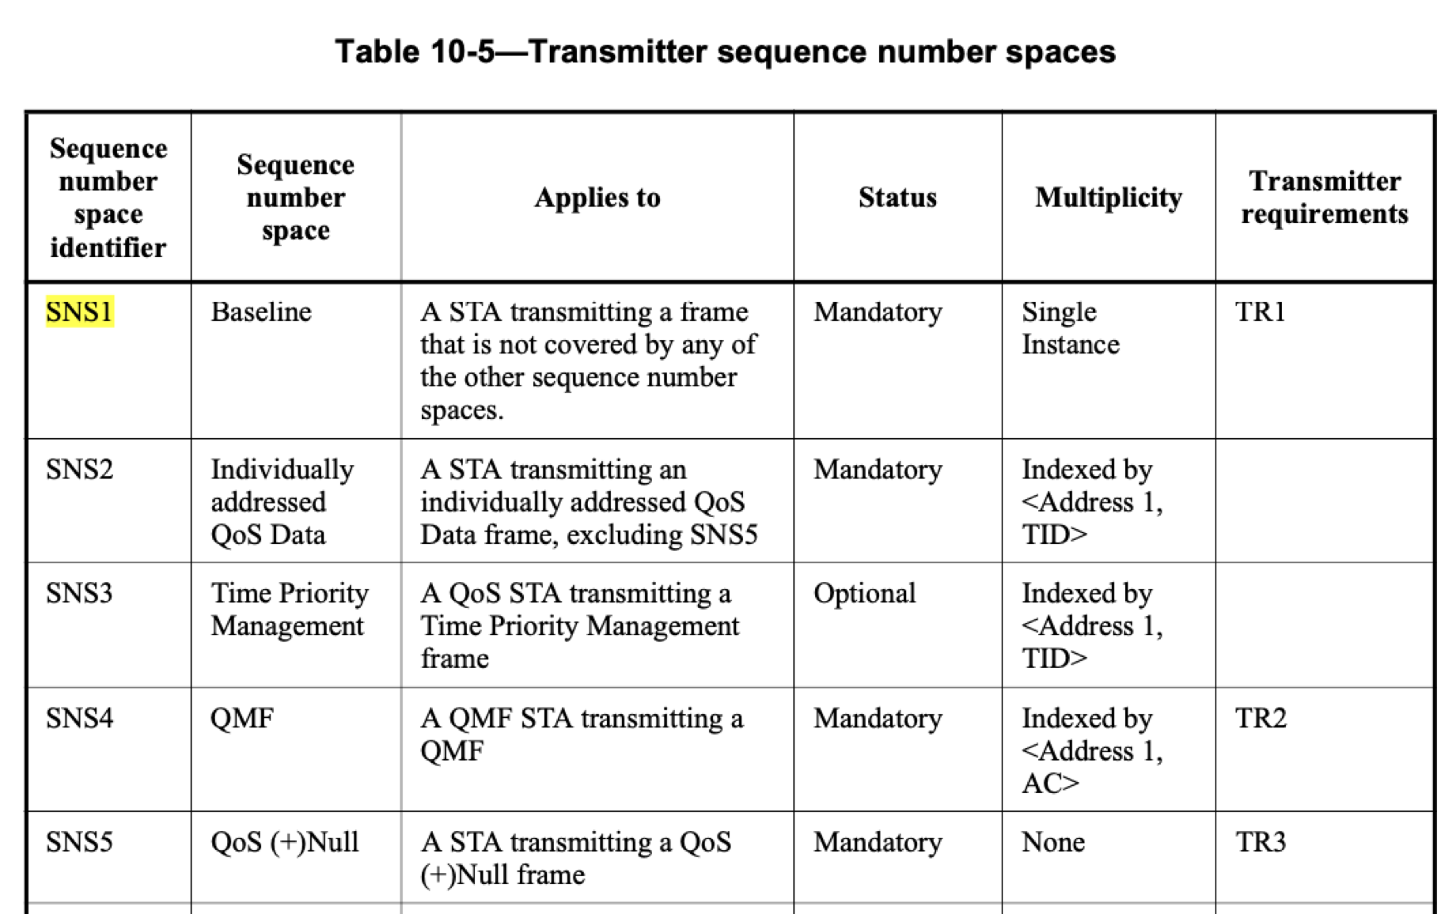
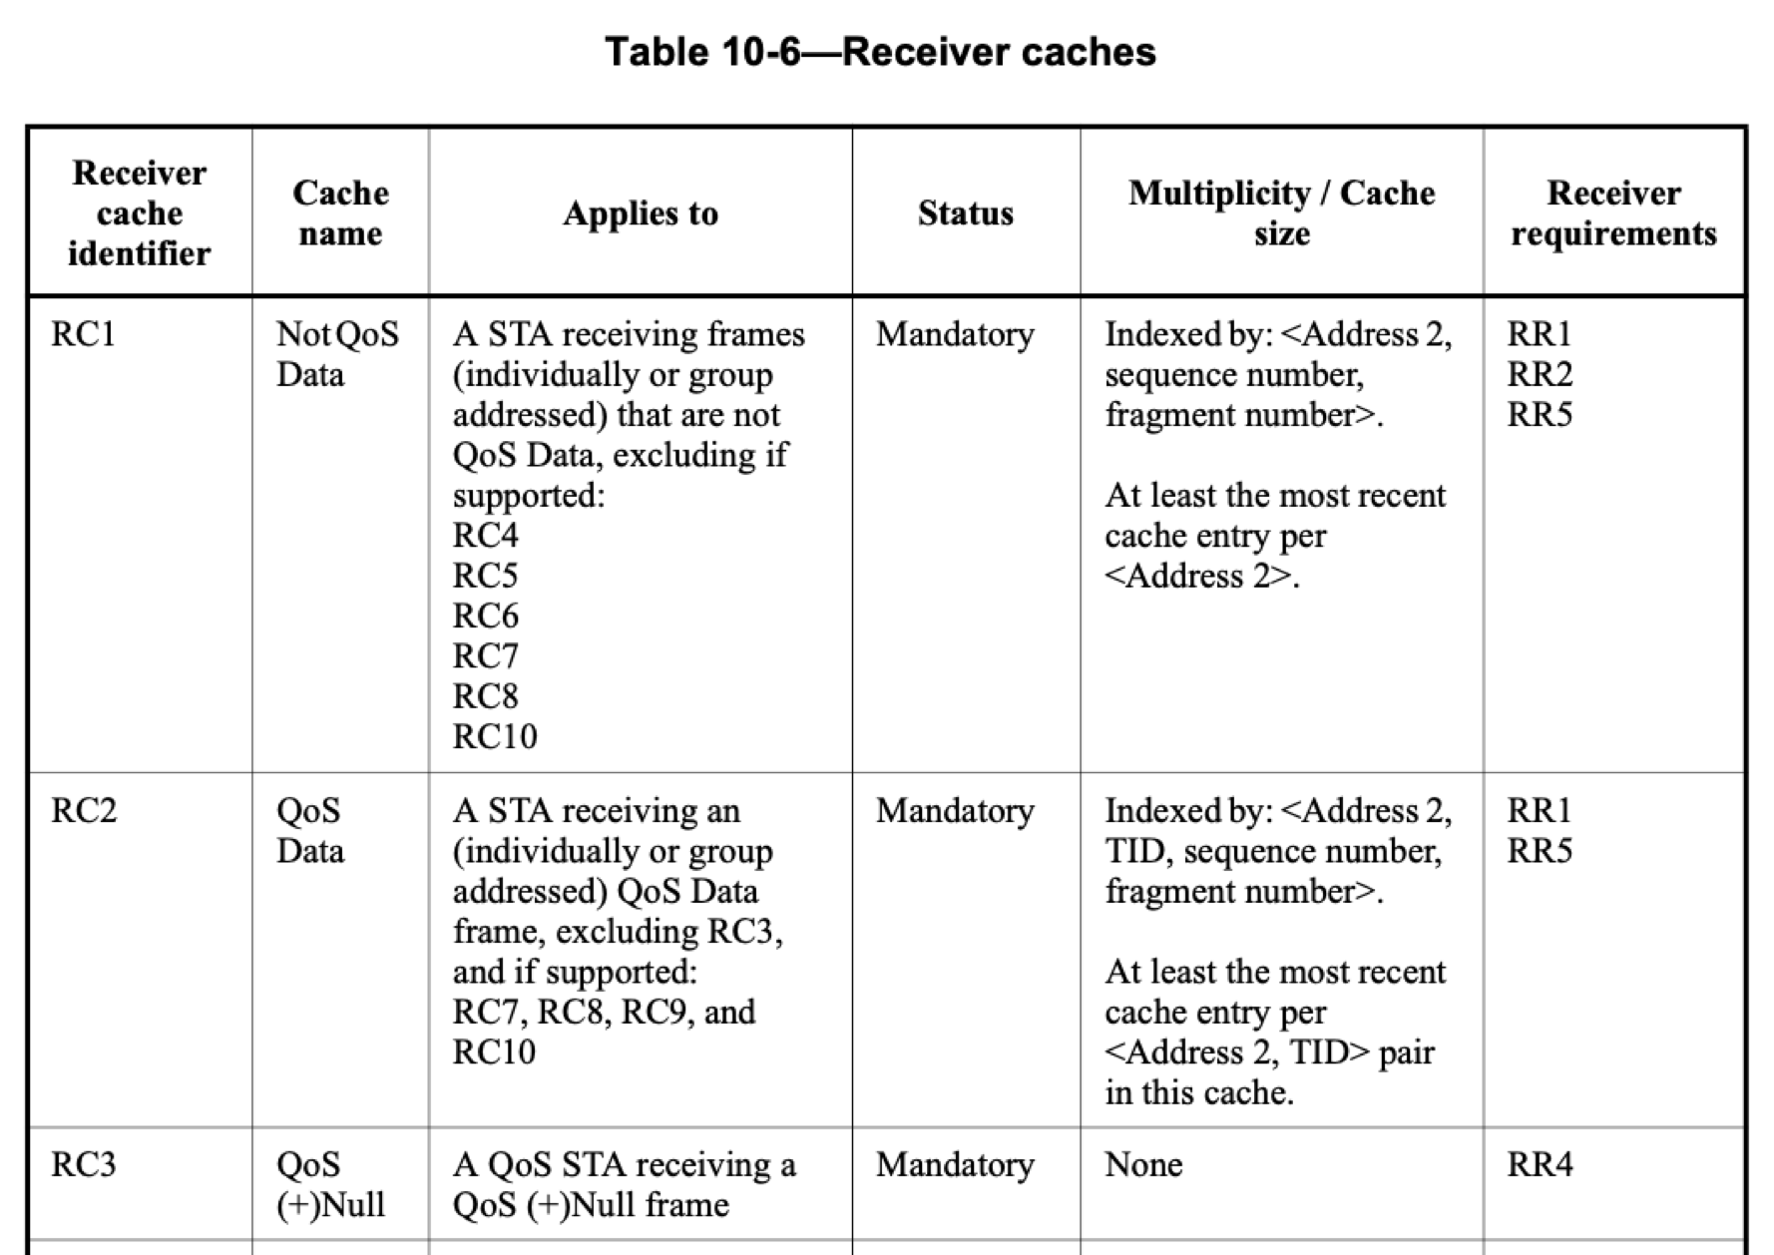
SNS 1 defined in 802.11 (Pre-11be)
SNS1 is used by:
-- Groupcast data (QoS, non-QoS);
-- Groupcast management frames.
-- Unicast data (Non-QoS);
-- Unicast management frames.

Slide 4
Problem of Undetected Duplicates
A GADF is transmitted independently on all links, with its SN assigned by the per link SNS1 independently.
When a STA switches link for GADF reception, it might receive undetectable duplicated GADFs.
STAs may need to switch link at any time. Selective timing for link switch to avoid undetected duplicates, as proposed in [2], is not workable (See slide 5, 6).
GC-Data frame
AP1
SNS1_1
AP2
SNS1_2
AP3
SNS1_3
GC-Data frame (SN = n1)
GC-Data frame (SN = n2)
Link 1
Link 2
Link 3
STA1
STA2
STA3
Undetected duplicate with link switch
(false negative)

Slide 5
Significant Limitation On Link Switch (1)
Case 1: With NO incoming GADFs between DTIM Beacon 1 and DTIM Beacon 2
DTIM Indication
G-BU_link 1= 1
G-BU_link 2 =1
DTIM Indication
G-BU_link 1 = 0
G-BU_link 2 = 0
Condition for link switch to avoid duplicates
DTIM
Beacon 1
DTIM
Beacon 2
Link 1
Wait time for link switch
Intended link switch time
Actual link switch time
DTIM Indication
G-BU_link 1 = 0
G-BU_link 2 = 1
DTIM Indication
G-BU_link 1
G-BU_link 2 = 0
Link 2
Wait time for link switch can be one DTIM Beacon Interval

Slide 6
Significant Limitation On Link Switch (2)
Case 2: With incoming GADFs
DTIM Indication
G-BU_link 1= 1
G-BU_link 2 =1
DTIM Indication
G-BU_link 1 = 1
G-BU_link 2 = 1
DTIM Indication
G-BU_link 1 = 1
G-BU_link 2 = 1
DTIM
Beacon 1
GADFs
GADFs
GADFs
DTIM
Beacon 3
GADFs
DTIM
Beacon 2
Link 1
Wait time for link switch
Intended link switch time
DTIM Indication
G-BU_link 1 = 1
G-BU_link 2 = 1
DTIM Indication
G-BU_link 1 = 1
G-BU_link 2 = 1
DTIM Indication
G-BU_link 1 = 1
G-BU_link 2 = 1
GADFs
GADFs
GADFs
GADFs
Link 2
Wait time for link switch can be indefinite!

Slide 7
Proposal: New SNS Design
Create a new SNS that is shared across all links, SNS_new_shared, used by:
  Groupcast data frames
  Groupcast management frames (ML) (i.e., generated at the ML level)
  Unicast management frames (ML)
Note: SNS_new_shared may have multiplicity distinguished by Address 1, TID, frame type, etc.
AP MLD
SNS_new_shared:
GC-data, GC-Mgmt (ML), UC-Mgmt (ML)
AP1
SNS1_1:
UC-data (non-QoS)
UC-Mgmt (Local)
GC-Mgmt (Local)
AP2
SNS1_2:
UC-data (non-QoS)
UC-Mgmt (Local)
GC-Mgmt
(Local)
AP3
SNS1_3:
UC-data (non-QoS)
UC-Mgmt (Local)
GC-Mgmt
(Local)
Link 1
Link 2
Link 3
STA1
STA2
STA3
The existing per link SNS1 remains to be used by:
  Unicast data (non-QoS)
  Unicast management frames (local) (i.e., generated at the local AP level)
  Groupcast management frames (local) (i.e., generated at the local AP level)

Slide 8
Proposal: New SNS Design – Receiver Behavior
A non-AP MLDs uses <address 1= group address, sequence number (SN) > for duplicate GADF detection.
  At least the most recent cache entry needs to be maintained at the MLD level.
Optional implementation-specific behavior
(Improvement on GADF reliability)
Mandatory/minimal requirement
(Sufficient for duplicate detection)
GADFs
GADFs
GADFs
GADFs
GADFs
GADFs
Link 1
Link 2
Link 3
Link 1
Link 2
Link 3
STA1
STA2
STA3
STA1
STA2
STA3
Non-AP MLD
Rx cache with N entries
Non-AP MLD
Rx cache with one entry
Rx (a) discards any GADFs with SN <= cache entries to avoid duplicates, (b) fill in the hole(s), if any, by reception on other link to improve reliability, where N is implementation specific.
Rx discards any GADFs with SN <= the cache entry to avoid duplicates.

Slide 9
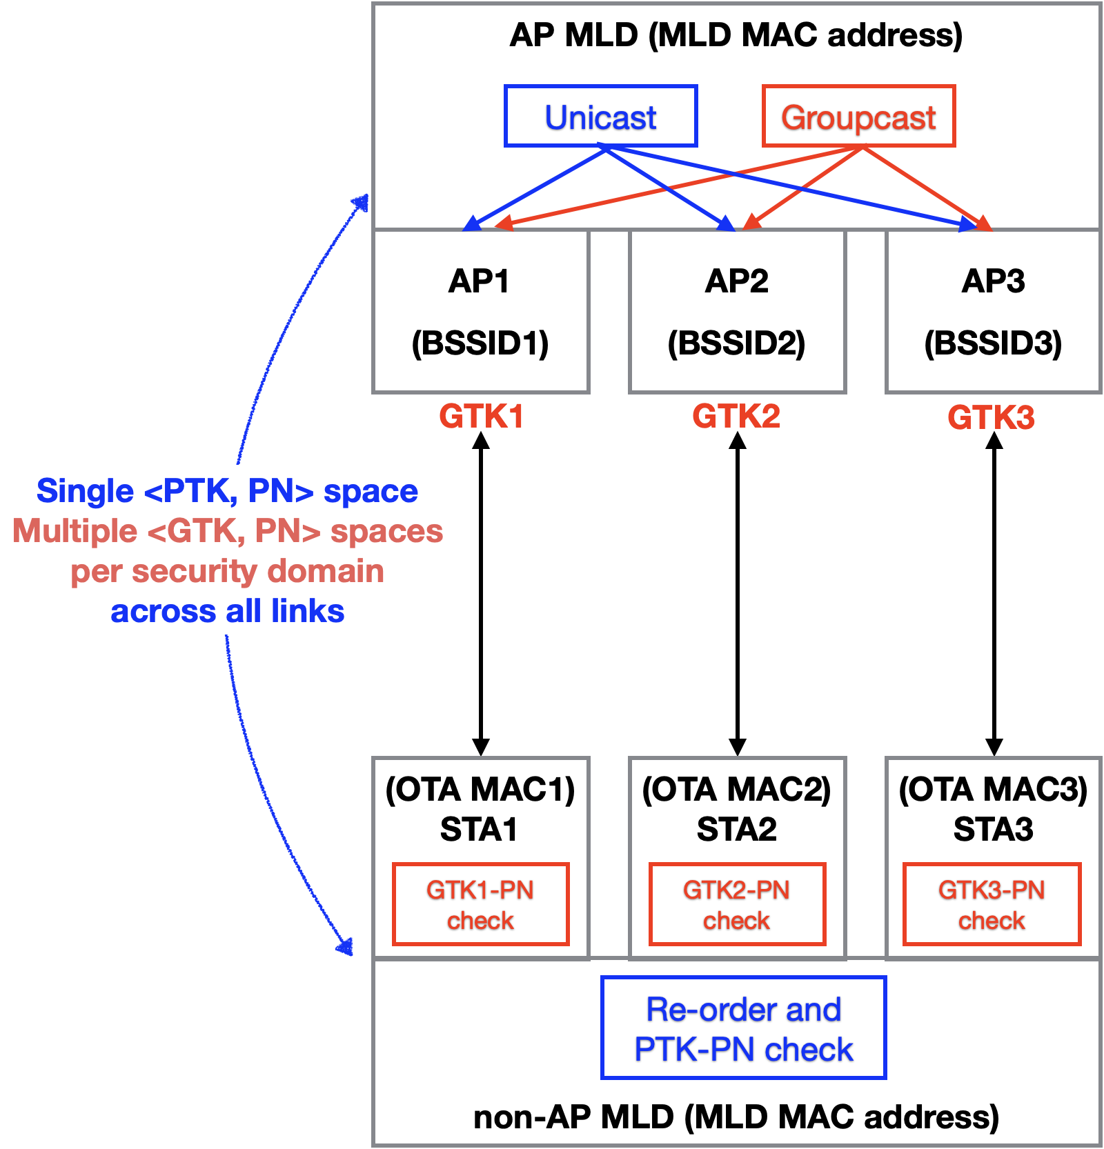
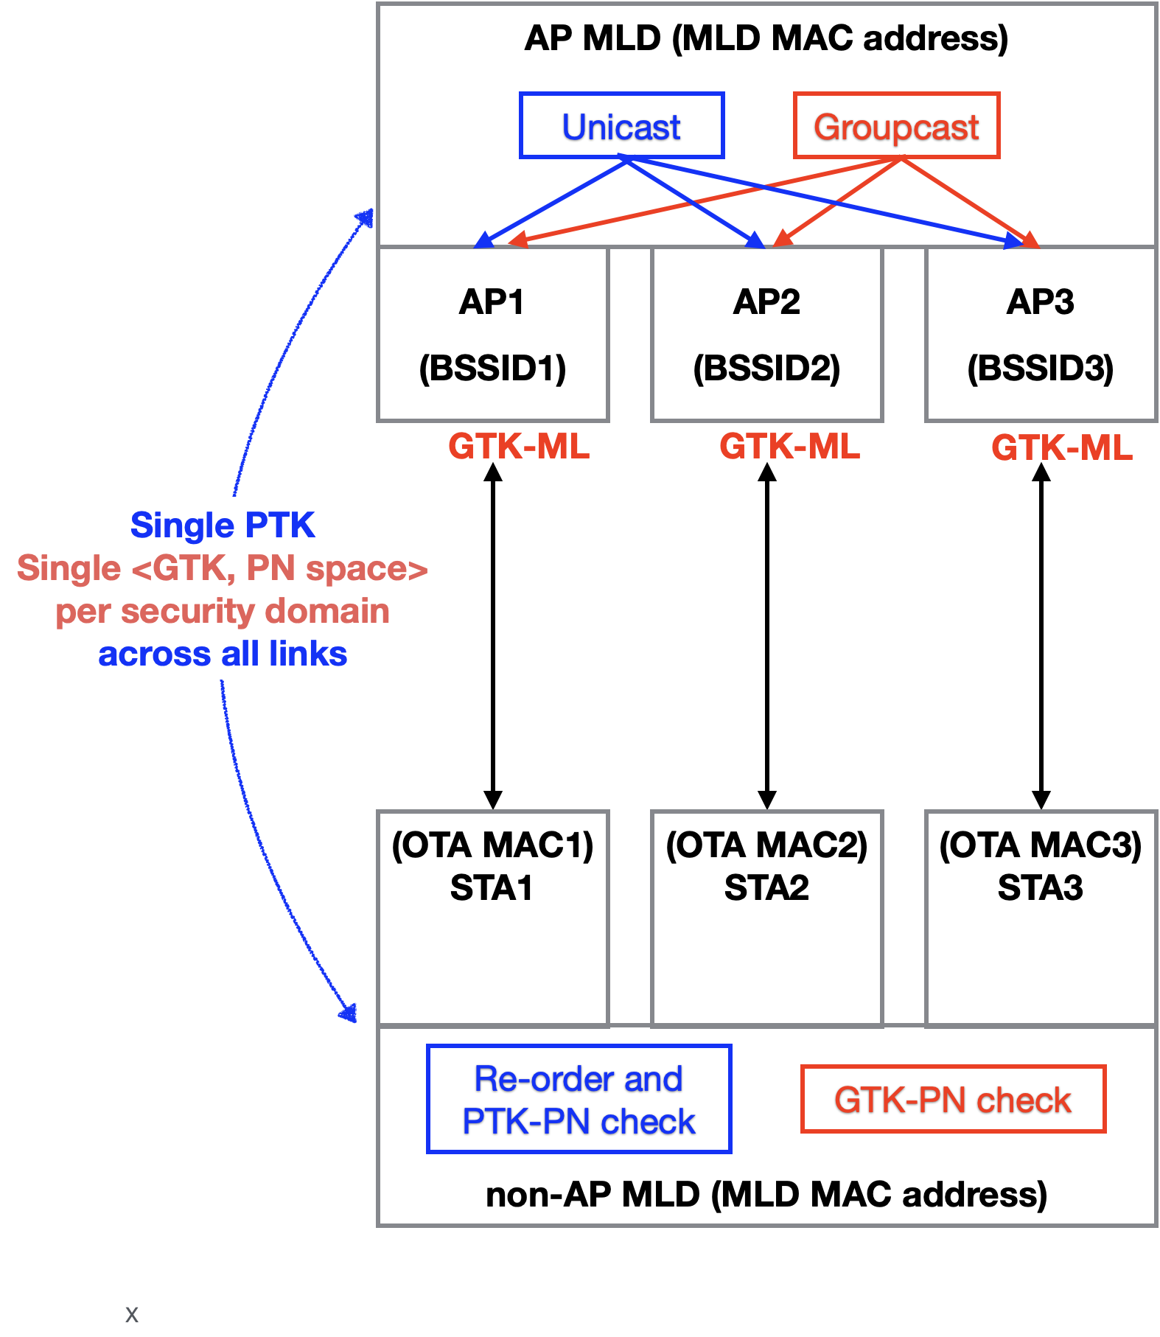
Proposal: Single GTK and PN Space for GADF Delivery for MLO
11be SFD:
Proposal (unified unicast and groupcast approach):

Slide 10
A Single GTK Per Security Domain Introduces No New Security Risks
AP MLD
SSID1 = Home
SSID2 = Guest
AP1
AP2
AP3
GTK_SSID2
_link1
GTK_SSID2_link3 = GTK_SSID2_link1?
GTK_SSID2
_link1
GTK_SSID2_link2 = GTK_SSID2_link1?
Link 1
Link 2
Link 3
STA1
STA2
STA3
Guest # 1: Single-link legacy
Guest # 2: Non-AP MLD
Guest #1 and Guest #2 are equally trusted by the host of SSID2.
Guest #2 obtains GTK_SSID2_link2 and GTK_SSID2_link3 from AP1, and can attack on link 2 and link 3.
Making GTK_SSID2_link1 = GTK_SSID2_link2 = GTK_SSID2_link3 introduces no new security risks.

Slide 11
Rationales: Single GTK and PN Space for GADF Delivery for MLO (1)
Reception over a single link:
  Duplicate detection for unicast frames occurs before decryption/replay detection (note: no duplicate issue for groupcast frames).
Unicast frames
Replay detection
(PN check)
Duplicate detection
Decryption
Reception over multiple links:
  It is desirable to maintain the same processing order (i.e., duplicate detection occurs before decryption/replay detection) for groupcast frames.
Groupcast data frames
Replay detection
(PN check)
Duplicate detection
Decryption
MLD level across all links,
enabled by new_shared_SNS
Desirable to have at the MLD level after duplicate detection

Slide 12
Rationales: Single GTK and PN Space for GADF Delivery for MLO (2)
Currently adopted methods for unicast frame delivery for MLO:
  A single PTK and PN check at the MLD level for all links.
  Duplicate detection occurs before decryption/replay detection.
  Replacement of relevant and required link level address with relevant MLD MAC address during AAD construction. Use of relevant MLD MAC address as A2 for Nonce construction. (See [3])
  Block Ack agreement is established at the MLD level.
    MLD level Block Ack agreement should be applied to GCR-BA for MLO as well.
Using a single GTK and PN check on all links unifies the design for unicast and groupcast data frame delivery for MLO!

Slide 13
Summary
The group addressed data frame delivery method described in 11be SFD can cause undetected duplicates at non-AP MLDs.
We have proposed to use a new shared SNS to enable duplicate detection of group addressed data frames by non-AP STAs while ensuring non-AP MLD’s flexibility to switch link.
We have also proposed to use a single and common GTK, PN space per security domain for group addressed data frame delivery on all links.

Slide 14
Reference
[1] IEEE 802.11-19/1262r22, “Specification framework for 11be”, Edward Au, Huawei
[2] IEEE 802.11-20/0903r10, “Multi-link group addressed data frame delivery follow up”, Po-Kai Huang, et al., Intel
[3] IEEE 802.11-20/1545r1, “MLD security considerations”, G. Patwardhan, et al.

Slide 15
SP1
Do you support to use a common SNS shared across all links of MLD for the transmission of group addressed data frames?

Slide 16
SP2
Do you support to use a common SNS shared across all links of MLD for the transmission of:
  Unicast management frames (ML) (i.e., generated at the ML level)
  Group addressed management frames generated at the MLD level
  Optionally, unicast management frames (Local) (i.e., generated at the local AP level) whose recipients are a STA affiliated with a non-AP MLD

Slide 17
SP3
Do you support to use a single and common GTK and PN space per security domain for group addressed data frame delivery on all links of a MLD?

Slide 18
Appendix

Slide 19
Problem with Using SNS_new_shared
SNS_new_shared can create false positive duplicate declaration by legacy STAs.
A corner case? Should this be addressed by the spec?
  Note: missing frames already occurs in single-link baseline.
Alternatively, we propose the method shown on next slide as a solution.
  See slide 19.
AP MLD
SNS_new_shared:
GC-data, GC-Mgmt (ML), UC-Mgmt (ML)
AP1
SNS1_1:
UC-data (non-QoS)
UC-Mgmt (Local)
GC-Mgmt (Local)
AP2
SNS1_2:
UC-data (non-QoS)
UC-Mgmt (Local)
GC-Mgmt (Local)
AP3
SNS1_3:
UC-data (non-QoS)
UC-Mgmt (Local)
GC-Mgmt (Local)
Retransmitted
UC-Mgmt frame (SN = n1)
Failed
UC-Mgmt frame (SN = n1)
GC-Data frame (SN = n1)
Link 1
Link 2
Link 3
Incorrectly declared duplicate
(false positive)
Legacy STA
STA2
STA3

Slide 20
Solution to False Positive Problem at Legacy STAs
Transmit an additional copy of GADFs with MLD Address as TA and BSSID.
Transmission:
 | Link(s) transmitted | Encryption Key | SNS_new_shared
GADF with TA = BSSID= MLD_address | All links | GTK-ML | A single SNS shared across all links for the GCF
GADF with TA = BSSID= AP_i_address | Link_i | GTK_i or GTK-ML | Transmission on link_i uses its own SNS1_link_i, as defined in the 802.11 base spec.
Reception:
 | Legacy_STA | MLD_STA
GADF with TA = BSSID = MLD_address | Discard | Receive and perform duplicate detection using SN
GADF with TA = BSSID = AP_i_address | Receive | Discard

