Slide 1
TGba CRC Telco Agenda and Motions
Date: 2021-1-4
Authors:

Slide 2
Abstract
This document contains
Agenda for TGba CRC call [January 4]
Call information
Join the Webex meeting here:
https://ieeesa.webex.com/ieeesa/j.php?MTID=ma244fe71373a40951ff6dbb70cf30078
Meeting number: 179 271 7300
Meeting password: wireless (94735377 from phones and video systems)
Join by phone:
Tap to call in from a mobile device (attendees only)
+1-408-418-9388 USA Toll
Global call-in numbers
Access code: 179 271 7300
Motions on comment resolutions (from motion# 9000)

Slide 3
Agenda [January 4]
Call meeting to order
Agenda setting
Patent policy (links in the next slide)
SA copyright policy
Attendance:
Use IMAT to register your attendance
SA ballot result review
Review CID 9001 and proposed resolution
Motion – comment resolution on CID 9001
Timeline
Adjourn

Slide 4
Teleconferences are subject to applicable policies and procedures
• IEEE Code of Ethics – https://www.ieee.org/about/corporate/governance/p7-8.html • IEEE Standards Association (IEEE-SA) Affiliation FAQ – https://standards.ieee.org/faqs/affiliation.html • Antitrust and Competition Policy – https://standards.ieee.org/content/dam/ieee-standards/standards/web/documents/other/antitrust.pdf • IEEE-SA Patent Policy – http://standards.ieee.org/develop/policies/bylaws/sect6-7.html – https://standards.ieee.org/about/sasb/patcom/ • IEEE 802 Working Group Policies &Procedures (29 Jul 2016) – http://www.ieee802.org/PNP/approved/IEEE_802_WG_PandP_v19.pdf • IEEE 802 LMSC Chair's Guidelines (Approved 13 Jul 2018) – https://mentor.ieee.org/802-ec/dcn/17/ec-17-0120-27-0PNP-ieee-802-lmsc-chairs-guidelines.pdf • Participation in IEEE 802 Meetings – https://mentor.ieee.org/802-ec/dcn/16/ec-16-0180-05-00EC-ieee-802-participation-slide.pptx • IEEE 802.11 WG OM: (Approved 10 Nov 2017) – https://mentor.ieee.org/802.11/dcn/14/11-14-0629-22-0000-802-11-operations-manual.docx

Slide 5
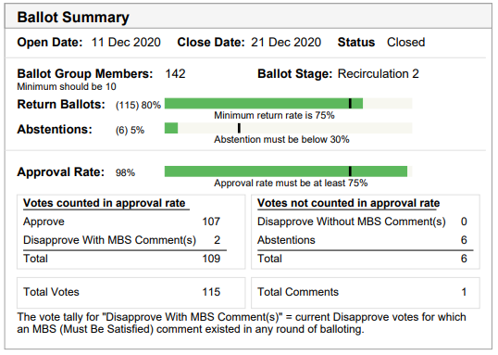
SA Ballot Summary
Approval rate: 98%
107 approve, 2 disapprove
1 editorial comment received

Slide 6
CID 9001
CID | Commenter | Clause Number(C) | Page(C) | Line(C) | Type of Comment | Part of No Vote | Comment | Proposed Change
9001 | Hamilton, Mark | 4.3.15 | 25 | 7 | E | No | Since 802.11ax has already added 4.3.15a, and this next text is labelled 4.3.15b, it should be inserted after subclause 4.3.15a (not 4.3.15). | Update the editing instructions to say "Insert a new subclause after subclause 4.3.15a as follows:"
802.11ba Draft 8.0 P25L7
“4. General description 4.3 Components of the IEEE Std 802.11 architecture Insert a new subclause after subclause 4.3.15 as follows: 4.3.15b Wake-up radio (WUR) AP and WUR non-AP STA”
Discussion: consulted with 802.11 WG chair (Dorothy Stanley, HPE) for a resolution for this comment and the WG chair provided a guidance stating that this editorial comment can be addressed by the IEEE SA publication editor during the publication editing.
Therefore, following the WG chair’s guidance, the proposed resolution for the comment is Reject with the following reason: “This comment will be forwarded to the publication editor for consideration during publication editing.”

Slide 7
Motion# 9000
Move to approve the following resolution for CID 9001:
Rejected. This comment will be forwarded to the IEEE SA editor for consideration during final publication.
Move: Po-Kai Huang
Second: Steve Shellhammer
Result: passes with unanimous consent

Slide 8
Timeline
2020
October: comment resolution on D7.0 complete
November 13 – 802 EC conditional approval
December: D8.0 Recirc (Dec 11-21)
2021
February 12 – Post draft to RevCom by this date
March: RevCom/SASB approval

