Slide 1
Reducing Feedback Overhead in Group-cast Transmissions
Date: 2020-12-25
Authors:
Name | Affiliations | Address | Email
Boyce Bo Yang | Huawei | Nanjing, China | yangbo59@huawei.com
Guangji Chen |  | Nanjing, China | jichenhe@huawei.com
Chenhe Ji |  | Nanjing, China | jichenhe@huawei.com
Notes:
September 2012

Slide 2
Recall[1] 802.11 multicast properties
Multicast / broadcast traffic is generally not retransmitted, because there is no acknowledgement
Multicast / broadcast traffic is generally sent at a “lowest common denominator” rate, known as a basic rate. This might be as low as 6 Mbps, when unicast links are operating at 600 Mbps.
Lower rate ⇒ larger frame, less airtime for everything else.
There are options, to improve multicast reliability –
  GroupCast with Retries (GCR)
  Directed Multicast Service (DMS)

Slide 3
Efficiency of multicast to large number of recipients is low
DMS(Direct Multicast Service) converts multicast to unicast, which is not efficient when the number of group recipients is large.
GCR(Group Cast Retry) defines two polices for the transmission of group addressed frames
  GCR Block ACK
    Initiates BA agreement with each group member. Transmitting AP
    regularly sends BAR to the STAs
    Suited to small to medium number of group members
  GCR unsolicited retry
    Retransmit MSDU one or more times without soliciting uplink feedbacks to increase probability of success
    Suited to large number of group members
    The selection of MCS or retransmission times is arbitrary and unreliable

Slide 4
GCR MU-BAR in 11ax
GCR MU-BAR mechanism is defined in 11ax, taking advantage of OFDMA access. However, it’s still not able to deal with the case of transmission to a large group of recipients.
  For a typical implementation of 40MHz BW, there are up to 18 RUs. 4 MU-BAR Triggers are needed to solicit BAs from each group transmission, if there are 60 recipients.
AP
Groupcast PPDU
MU BAR
MU BAR
MU BAR
MU BAR
STA 1
BA
STA 20
BA
STA 40
BA
STA 60
BA

Slide 5
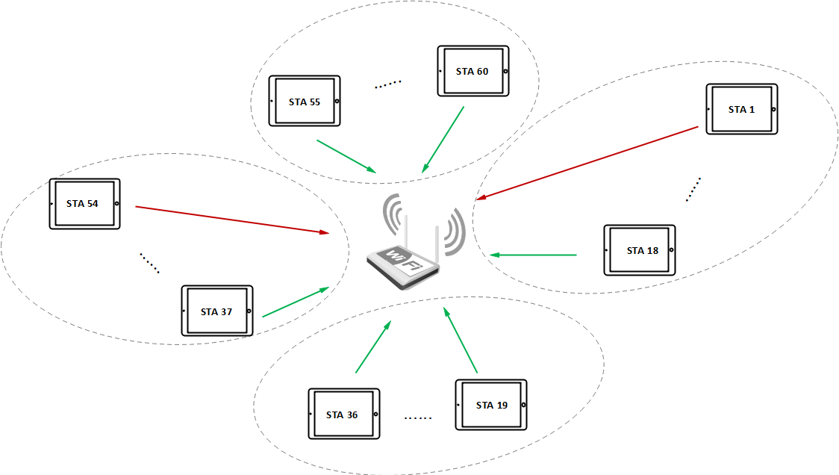
Observation on BAs of Group-Cast
When AP commence a group transmission, most of recipients can decode the group-casted A-MSDU/MSDUs correctly, and some can’t.
  If the recipients decode every MSDU correctly, that is only one bit info.
  If the recipient doesn’t decode every MSDU correctly, there are many possible error patterns, so a feedback bitmap is necessary for AP’s scheduling(retransmission, link adaptation, etc)
MU-BAR Trigger 4
MU-BAR Trigger 1
MU-BAR Trigger 3
BA bitmap with all 1s
BA bitmap with at least one 0
MU-BAR Trigger 2

Slide 6
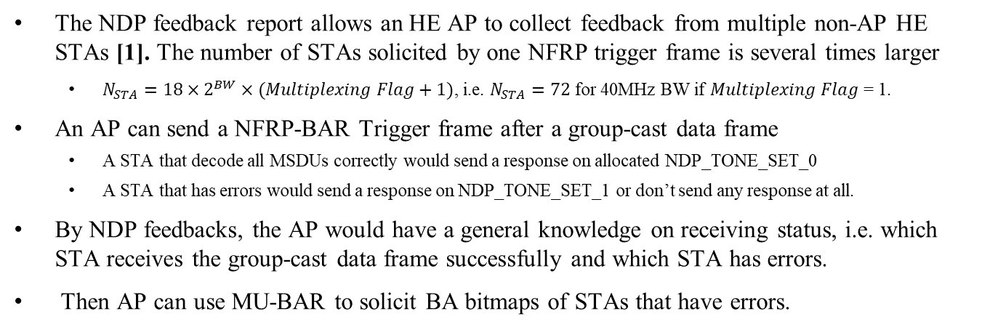
NDP Feedback can help reducing the number of BA responses
The NDP feedback report allows an HE AP to collect feedback from multiple non-AP HE STAs [1]. The number of STAs solicited by one NFRP trigger frame is several times larger
  $N_{STA}=18×2^{BW}×(Multiplexing Flag+1)$, i.e. $N_{STA}=72$ for 40MHz BW if $Multiplexing Flag$ = 1.
An AP can send a NFRP-BAR Trigger frame after a group-cast data frame
  A STA that decode all MSDUs correctly would send a response on allocated NDP_TONE_SET_0
  A STA that has errors would send a response on NDP_TONE_SET_1 or don’t send any response at all.
By NDP feedbacks, the AP would have a general knowledge on receiving status, i.e. which STA receives the group-cast data frame successfully and which STA has errors.
Then AP can use MU-BAR to solicit BA bitmaps of STAs that have errors.
AP
Group-cast PPDU
NFRP BAR
MU BAR
STAs 1
NDP
STA 20
NDP
BA
STA 40
NDP
STA 60
NDP
BA
Notes:
an (NDP) Ack frame

Slide 7
Evaluation on BA feedback overheads
Simulation setup
BW: 40MHz
Num of STAs with decoding errors: <=18
MCS for Trigger/BA: 4
Observations:
As shown in the figures, the gain is significant if there are more than 40 recipients
(us）
MF = 1
(us）
MF = 0
Number of Recipients
Number of Recipients

Slide 8
Proposed Changes to NFRP Trigger
Use one of the reserved values in Feedback Type field to indicate a GRC acknowledgement request
The starting sequence number and ending sequence number may also be needed in the modified NFRP Trigger frame
  Recipients that fail to decode the whole AMPDU may not know the first/latest sequence number that the AP has transmitted.
User info of NFRP variant Trigger
Starting AID
Reserved
Feedback Type
Reserved
UL Target Receive Power
Multiplexing Flag
GCR ACK Starting Sequence
Bits:
12
9
4
7
7
1
16
Table 9-31k—Feedback Type subfield encoding
Table 9-31k—Feedback Type subfield encoding
Value | Description
0 | Resource request
1 | GCR acknowledgement request
2-15 | Reserved
Value | Description
0 | Resource request
1-15 | Reserved
Notes:
The AP need to tell the STAs which sequence range the AP is asking for acknowledgement
What we need to change to the spec in 9.3.1.22.9 NFRP Trigger frame format is that replacing table 9-31k and inserting a new format

Slide 9
Proposed changes to spec text(1)
9.3.1.22.9 NFRP Trigger frame format
Change Figure 9-64l as follows
Insert a new row in Table 9-31k (Feedback Type subfield encoding) as follows and update the Reserved row as appropriate
Insert the following paragraphs at the end of this subclause
The GCR ACK Starting Sequence subfield is optionally present if the value of the Feedback Type subfield is 1. The Starting Sequence Number subfield of the GCR Starting Sequence Control subfield contains the sequence number of the first MSDU or A-MSDU for which this NFRP frame is sent. The Fragment Number subfield encoding of the GCR Starting Sequence Control subfield indicates the number of entries as defined in Table 9-30c (Fragment Number subfield encoding for the Multi-STA BlockAck variant), where each entry represents an MSDU or an A-MSDU.
Starting AID
Reserved
Feedback Type
Reserved
UL Target Receive Power
Multiplexing Flag
GCR ACK Starting Sequence
Bits:
12
9
4
7
7
1
16
Table 9-31k—Feedback Type subfield encoding
Value | Description
1 | GCR acknowledgement request

Slide 10
Proposed changes to spec text(2)
26.5.7 NDP feedback report procedure
Inset new subclause following 26.5.7.4 NDP feedback report for a resource request as follows
26.5.7.4 NDP feedback report for a GCR acknowledgement request
If the Feedback Type subfield in the User Info field of the NFRP Trigger frame is 1, a STA that is scheduled shall send an NDP feedback report response in order to signal to the AP that it is in the awake state and that it received all frames as indicated in NFRP Trigger frame.
Each STA that is scheduled is assigned a STARTING_STS_NUM and an RU_TONE_SET_INDEX to transmit a FEEDBACK_STATUS bit.
The meaning of the FEEDBACK_STATUS bit is defined in Table 26-4 (FEEDBACK_STATUS description):
Table 26-4—FEEDBACK_STATUS description
FEEDBACK_STATUS | Condition
0 | The STA is in the awake state and reports acknowledgements of all frames as indicated in NFRP Trigger frame.
1 | The STA is in the awake state and reports that at least one of the frames as indicated in NFRP Trigger frame is not correctly received.

Slide 11
Summary
We propose a method to reduce feedback overheads in case of high density multicast transmissions
An AP uses modified NFRP trigger to solicit one bit info(whether all MSDUs are decoded successfully).
Then the AP allocates RUs for STAs with decoding errors, the number of which would be much less.

Slide 12
Straw Poll 1
Do you support adding the proposed text on slide 7-8 to 802.11bc Draft.
Y/N/A

Slide 13
Reference
[1] IEEE 802.11-15/1261r2
[2] Draft P802.11ax_D7.0

Slide 14
Backup

