Slide 1
Analysis of SENS approaches
Date: 2021-01-07
Authors:

Slide 2
Abstract
Analyzing sensing functionality versus other measurements supported by 802.11 as an introduction to SFD

Slide 3
Sensing reference model on top of Figure 4-24—Portion of the ISO/IEC basic reference model covered in this standard
Sensing application
IP stack

Slide 4
Figure 6-3—Measurement request—accepted

Slide 5
Measurement and report delivery to application

Slide 6
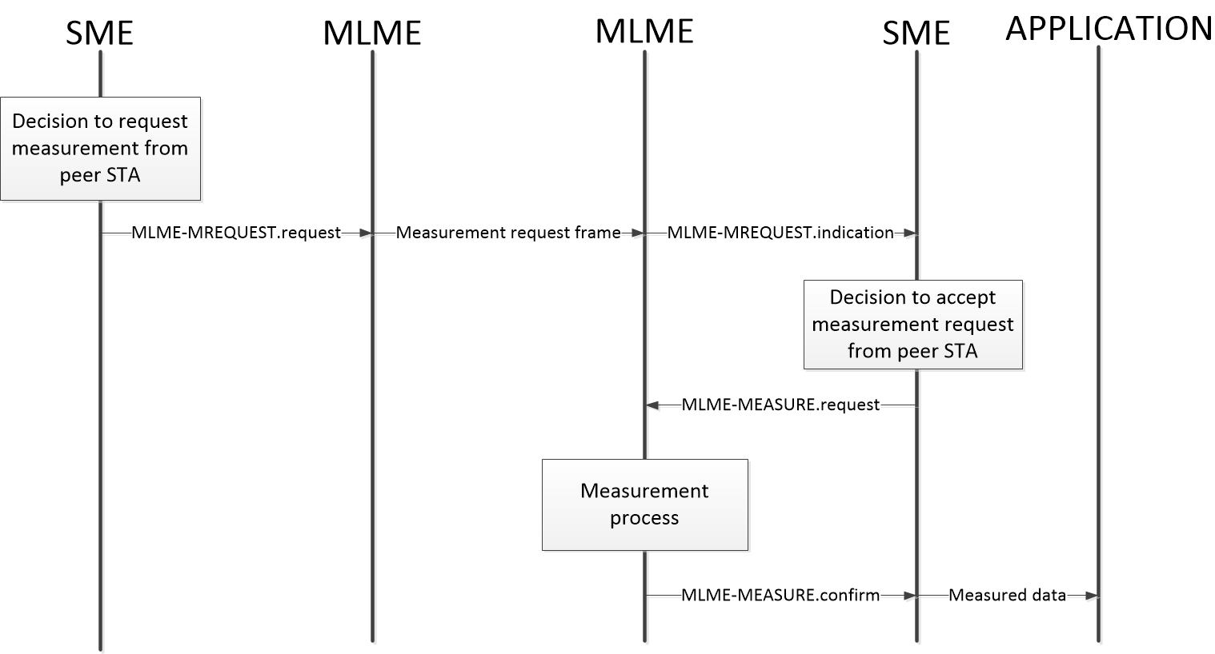
Measurement and report delivery to application (cont.)

Slide 7
Sensing taxonomy
Sensing methods
  Channel variation information (CVI) measurement
Measure combined channel changes over time and/or STAs (which include the impact from the target)
  Radar
Measure of direct reflection from the target.
The measurement of the distance to the object uses the propagation time of the signal between the radar transmitter and the radar receiver. To be able to provide the measurement the received echo shall be synchronized to the time base of the transmitted signal

Slide 8
Sensing Session
Sensing session
  The long-term agreement to maintain sensing and exchange results
  Session can be established proactively or by default
  Participants: initiator, transmitter(s), and receiver(s)
    Initiator identifies and initializes the Transmitter(s) and Receiver(s) to participate in the session, and organizes the session
    Transmitter(s) and Receiver(s) operate the Sensing measurements
  Instances of the Initiator, Transmitter and Receiver may coexist in the same STA
  Any non-initiator STA is the Responder STA
  Participants may be organized in a Sensing Group controlled by CP to maintain coordination
  Consumer represents the application that utilizes the measurement results and is not involved in the session coordination and measurements
NOTE: consumer, initiator, transmitter, and receiver are functions rather than fixed roles of STA

Slide 9
Measurement types
Active sensing
  Radar - STA measures the transmission of itself - monostatic Radar
    No connection to another STA is needed
  Radar - transmitting and receiving STAs tightly collaborate at the measurement – multistatic Radar
    Setup phase with participants to exchange parameters is needed
  Coordinated CVI measurement - receiving STA measures transmissions of frames sent by one or more dedicated transmitting STAs
    One or more sensing (receiving) STA measures transmissions of the dedicated transmission STAs
    Setup phase with participants to exchange parameters is needed
Passive sensing
  Opportunistic CVI measurement - receiving STA measures multiple frames transmitted by other stations
    Multiple sensing STAs (receiving) STA may use transmissions of the same transmitting STAs
    No signaling to setup parameters of the transmitters

Slide 10
Preparation for measurement
Active sensing
  Initial setup - establish rules (timing, channels, etc.) for measurement and reporting
  Coordinated CVI measurement:
    Requesting the specific transmitters to transmit using set of agreed/known parameters, or/and to the specific receivers
    Requesting the specific receivers to measure on top of frames received from the specific transmitter(s)
  Radar:
    Establish schedule for monostatic radar
    Setup the transmitter(s) and receiver(s) for Multistatic radar
Passive
  Opportunistic CVI measurement
    Using the existent traffic for the measurements

Slide 11
Exchange Measurement results
Active sensing
  Coordinated CVI measurement:
    The receiver(s) delivering measurement results to the indicated STA(s) or per request
    The measurement results may be delivered to the consumer
  Radar:
    The receiver(s) of the Multistatic radar delivering measurement results to the transmitter(s) to complete the measurement
    The measurement results may be delivered to the consumer
Passive sensing
  Opportunistic CVI measurement
    The measured STA consumes the results by it own and/or delivers to indicated consumer

Slide 12
Measurement requirements
Type of sensing | PPDU | Frame types to measure /addressing | MAC Protection Yes/No | Tx PHY control of the transmitter | Feedback/ Frame type
Monostatic Radar | Backward compatible | Frames that SME and MAC can initiate / unicast-self addressed | TBD | NA | NA
Multistatic Radar | Backward compatible | Frames that SME and MAC can initiate or respond / unicast | Yes | NA | Measurement results /Management
Coordinated CVI measurement | Backward compatible | Frames that SME and MAC can initiate or respond / unicast/ broadcast | Yes | Yes | Measurement results /Management
Opportunistic CVI measurement | Backward compatible | any | TBD | NA | NA

Slide 13
Requirements for measurement preparation
Type of sensing | Initiator | Transmitter | Receiver
Monostatic Radar | Schedule. Indicate consumer* | NA | NA
Multistatic Radar | Initial setup, invite transmitters and receivers to participate. Indicate consumer* | Initiate setup of multiple receivers | Initiate setup of multiple transmitters
Coordinated CVI measurement | Initial setup, invite transmitters and receivers to participate. Indicate consumer* | Inform receivers of Tx parameters | Request transmitters of Tx parameters
Opportunistic CVI measurement | Provide conditions for the Opportunistic CVI measurements. | TBD | NA
*Note: Consumer belongs to the application. It may be relevant to indicate the MAC address of the Consumer in the parameters exchanged at the measurement's preparation

Slide 14
Requirements to exchange results
Type of sensing | Layer of the STA to which results are delivered | Frame types
Monostatic Radar | Application | Data frames
Multistatic Radar | SME/Application | Management frames/Data frames
Coordinated CVI measurement | SME/Application | Management frames/Data frames
Opportunistic CVI measurement | Application | Data frames

Slide 15
Session topology
Type of sensing | Another involved STA(s) | Relationship with the general-purpose network(s) | Specific requirements
Monostatic Radar | Initiator | Unassociated STA, BSS | TBD
Multistatic Radar | Initiator, multiple transmitters/ receivers | Unassociated STA(s), BSS, multiple BSS | Group coordination may be required if the participants don’t belong to the same BSS
Coordinated CVI measurement | Initiator, multiple transmitters/ receivers | Unassociated STA(s), BSS, multiple BSS | Group coordination may be required if the participants don’t belong to the same BSS
Opportunistic CVI measurement | (TBD Initiator), Multiple transmitters | Unassociated STA(s), Multiple BSS | TBD

Slide 16
Sensing Group functionality and requirements
Type of sensing | Network TSF | Protection Encryption/ authentication | Sensing Group advertising: announcement of Control Point versus advertising of transmitters/receivers | Joining a Sensing Group: invitation versus join (association) request
Monostatic Radar | NA | NA | NA | NA
Multistatic Radar | Scheduling among the Sensing Group | Inside the Sensing Group | Beacons, Public frames like announce, exchange of frames like broadcast probe request/response | An association-like exchange of frames can be initiated by a potential member to join a group, or alternatively, join at the invitation of a CP. The invitation can be more effective if the CP already knows the capabilities of the participants.
Coordinated CVI measurement | -”- | -”- | -”- | -”-
Opportunistic CVI measurement | NA | NA | NA | NA
NOTE: The protection of the Sensing Group in the case that not all participants belong to the same BSS must be isolated from the general-purpose BSS(s) protection

