Slide 1
Analysis of SENS approaches
Date: YYYY-MM-DD
Authors:

Slide 2
Abstract
Analysis of the functionality of sensing as an introduction to the SFD

Slide 3
Sensing taxonomy
Sensing methods
  Unsynchronized measurement
The CSI measurement of the received frames is used to detect changes in the object parameters
  Radar
The measurement of the distance to the object uses the propagation time of the signal between the radar transmitter and the radar receiver. To be able to provide the measurement the received echo shall be synchronized to the time base of the transmitted signal

Slide 4
Sensing Session
Sensing session
  The long-term agreement to maintain sensing and exchange results
  Session can be established proactively or by default
  Participants: consumer, initiator, transmitter(s), and receiver(s)
    Initiator identifies and initializes the Transmitter(s) and Receiver(s) to participate in the session, and organizes the session
    Transmitter(s) and Receiver(s) operate the Sensing measurements
    Consumer represents the application that utilizes the measurement results and may be not involved in the session coordination and measurements
  Instances of the Consumer, Initiator, Transmitter and Receiver may coexist in the same STA
  Participants may be organized in a Sensing Group controlled by CP to maintain coordination
NOTE: consumer, initiator, transmitter, and receiver are functions rather than fixed roles of STA

Slide 5
Measurement types
Active sensing
  Radar - STA measures the transmission of itself - monostatic Radar
    No connection to another STA is needed
  Radar - transmitting and receiving STAs tightly collaborate at the measurement – multistatic Radar
    Setup phase with participants to exchange parameters is needed
  Coordinated unsynchronized measurement - receiving STA measures transmissions of frames sent by one or more dedicated transmitting STAs
    One or more sensing (receiving) STA measures transmissions of the dedicated transmission STAs
    Setup phase with participants to exchange parameters is needed
Passive sensing
  Opportunistic unsynchronized measurement - receiving STA measures multiple frames transmitted by other stations
    Multiple sensing STAs (receiving) STA may use transmissions of the same transmitting STAs
    No signaling to setup parameters of the transmitters

Slide 6
Preparation for measurement
Active sensing
  Initial setup - establish rules (timing, channels, etc.) for measurement and reporting
  Coordinated unsynchronized measurement:
    Requesting the specific transmitters to transmit using set of agreed/known parameters, or/and to the specific receivers
    Requesting the specific receivers to measure on top of frames received from the specific transmitter(s)
  Radar:
    Establish schedule for monostatic radar
    Setup the transmitter(s) and receiver(s) for Multistatic radar
Passive
  Opportunistic unsynchronized measurement
    Using the existent traffic for the measurements

Slide 7
Exchange Measurement results
Active sensing
  Coordinated unsynchronized measurement:
    The receiver(s) delivering measurement results to the indicated STA(s) or per request
  Radar:
    The receiver(s) of the Multistatic radar delivering measurement results to the transmitter(s) to complete the measurement
Passive sensing
  Opportunistic unsynchronized measurement
    The measured STA consumes the results by it own and/or delivers to indicated consumer

Slide 8
Measurement requirements
Type of sensing | PPDU | Frame types to measure /addressing | MAC Protection Yes/No | Tx PHY control of the remote STA | Feedback/ Frame type
Monostatic Radar | Backward compatible | Frames that SME and MAC can initiate / unicast-self addressed | TBD | NA | NA
Multistatic Radar | Backward compatible | Frames that SME and MAC can initiate or respond / unicast | Yes | NA | Measurement results /Management
Coordinated unsynchronized measurement | Backward compatible | Frames that SME and MAC can initiate or respond / unicast/ broadcast | Yes | Yes | Measurement results /Management
Opportunistic unsynchronized measurement | Backward compatible | any | TBD | NA | NA

Slide 9
Requirements for measurement preparation
Type of sensing | Initiator | Transmitter | Receiver
Monostatic Radar | Schedule. Indicate consumer* | NA | NA
Multistatic Radar | Initial setup, invite transmitters and receivers to participate. Indicate consumer* | Initiate setup of multiple receivers | Initiate setup of multiple transmitters
Coordinated unsynchronized measurement | Initial setup, invite transmitters and receivers to participate. Indicate consumer* | Inform receivers of Tx parameters | Request transmitters of Tx parameters
Opportunistic unsynchronized measurement | Provide conditions for the Opportunistic unsynchronized measurements. Indicate consumer* | TBD | NA
*Note: Consumer belongs to the application. It may be relevant to indicate the MAC address of the Consumer in the parameters exchanged at the measurement's preparation

Slide 10
Requirements to exchange results
Type of sensing | The results are delivered to the layer of the remote STA | Frame types
Monostatic Radar | Application | Data frames
Multistatic Radar | SME/Application | Management frames/Data frames
Coordinated unsynchronized measurement | SME/Application | Management frames/Data frames
Opportunistic unsynchronized measurement | Application | Data frames
It is relevant to provide MAC tools to report measurement results to the SME of the initiator or another participant. The delay of the echo in the case of multistatic radar and the CSI or changes in the CSI of the received frame are examples of such reports.

Slide 11
Session topology
Type of sensing | Another involved STA(s) | Relationship with the general-purpose network(s) | Specific requirements
Monostatic Radar | Consumer, Initiator | Unassociated STA, BSS | TBD
Multistatic Radar | Consumer, Initiator, multiple transmitters/ receivers | Unassociated STA(s), BSS, multiple BSS | Group coordination may be required if the participants don’t belong to the same BSS
Coordinated unsynchronized measurement | Consumer, Initiator, multiple transmitters/ receivers | Unassociated STA(s), BSS, multiple BSS | Group coordination may be required if the participants don’t belong to the same BSS
Opportunistic unsynchronized measurement | (TBD Consumer, Initiator), Multiple transmitters | Unassociated STA(s), Multiple BSS | TBD

Slide 12
Sensing Group functionality and requirements
Type of sensing | Network TSF | Protection Encryption/ authentication | Sensing Group advertising: announcement of Control Point versus advertising of transmitters/receivers | Joining a Sensing Group: invitation versus join (association) request
Monostatic Radar | NA | NA | NA | NA
Multistatic Radar | Scheduling among the Sensing Group | Inside the Sensing Group | CP may probe participants with the broadcast probe | The invitation can be more efficient when the CP already knows the capabilities of the participants.
Coordinated unsynchronized measurement | Scheduling among the Sensing Group | Inside the Sensing Group | CP may probe participants with the broadcast probe | The invitation can be more efficient when the CP already knows the capabilities of the participants.
Opportunistic unsynchronized measurement | NA | NA | NA | NA
NOTE: The protection of the Sensing Group in the case that not all participants belong to the same BSS must be isolated from the general-purpose BSS(s) protection

Slide 13
SP 1
Do you agree with the classification provided in the slides 3, 4, 5, 6, 7?
Yes [ ]
No [ ]
Abstain [ ]

Slide 14
SP 2
Do you agree with the Measurement requirements presented in the slide 8?
Yes [ ]
No [ ]
Abstain [ ]

Slide 15
SP 3
Do you agree with the Requirements for Measurement preparation presented in the slide 9?
Yes [ ]
No [ ]
Abstain [ ]

Slide 16
SP 4
Do you agree with the Requirements to exchange results presented in the slide 10?
Yes [ ]
No [ ]
Abstain [ ]

Slide 17
SP 5
Do you agree with the Session topology presented in the slide 11?
Yes [ ]
No [ ]
Abstain [ ]

Slide 18
SP 6
Do you agree with the Sensing Group functionality and requirements presented in the slide 12?
Yes [ ]
No [ ]
Abstain [ ]

Slide 19
BACKUP

Slide 20
Sensing reference model on top of Figure 4-24—Portion of the ISO/IEC basic reference model covered in this standard
Sensing application
IP stack

Slide 21
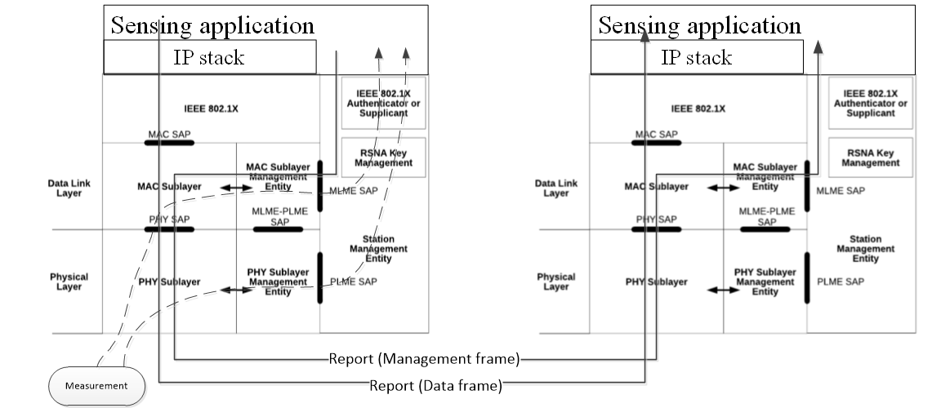
Measurement and report delivery

Slide 22
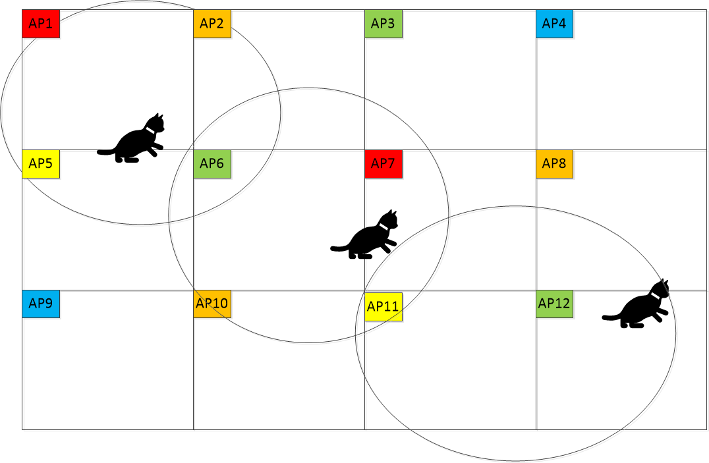
“The hardest thing of all is to find a black cat in a dark room, especially if there is no cat.”
― Confucius

