Slide 1
Tx FD Window Design for Secure LTF
Date: 2020-12-16
Authors:

Slide 2
Tx FD Window Design for Secure LTF
In this presentation, we evaluate performance of various Tx frequency-domain (FD) windows with OFDM for MMSE sample-by-sample attack [1] and Sphere Decoder + successive interference cancellation (SIC) attack [2]:
  Rectangular window [3]
  Raised-cosine (RC) window [4]
  Flat Top window

Slide 3
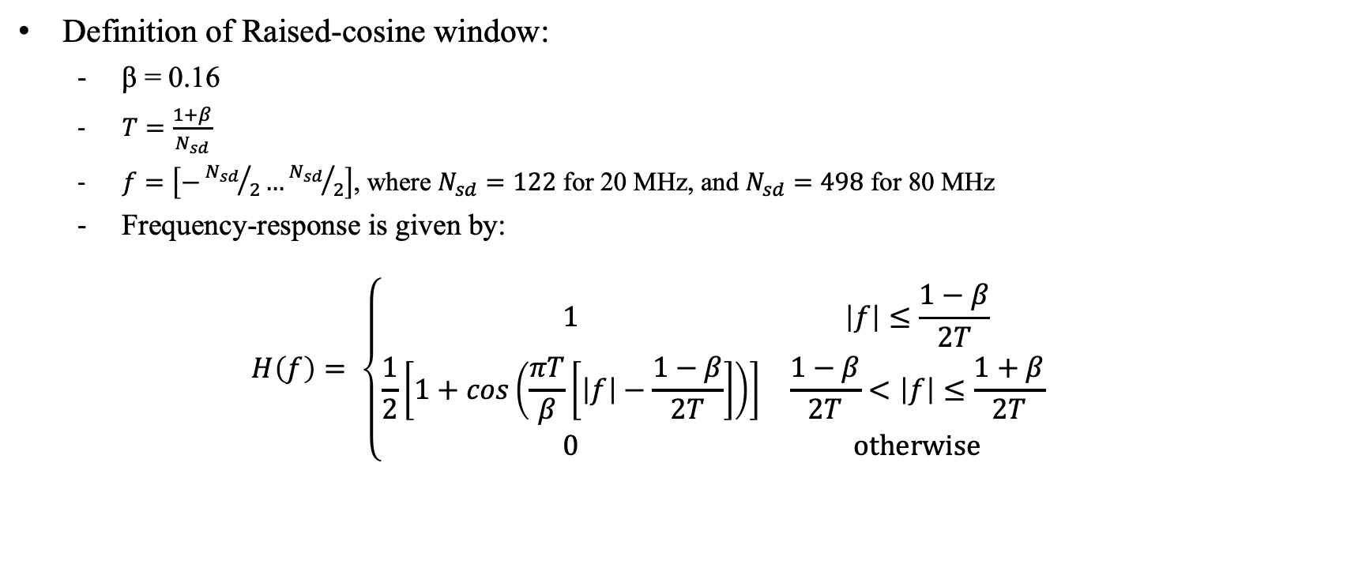
Tx Frequency-Domain Window: Raised-Cosine
Definition of Raised-cosine window:
  β = 0.16
  $T=\frac{1+β}{N_{sd}}$
  $f=\left[−{N_{sd}}/2…{N_{sd}}/2\right]$, where $N_{sd}=122$ for 20 MHz, and $N_{sd}=498$ for 80 MHz
  Frequency-response is given by:
  $$H\left(f\right)= \left\{\begin{matrix}1 & \left|f\right|≤\frac{1−β}{2T} \\ \frac{1}{2}\left[1+cos\left(\frac{πT}{β}\left[\left|f\right|−\frac{1−β}{2T}\right]\right)\right] & \frac{1−β}{2T}<\left|f\right|≤\frac{1+β}{2T} \\ 0 & \text{otherwise}\end{matrix}\right.$$

Slide 4
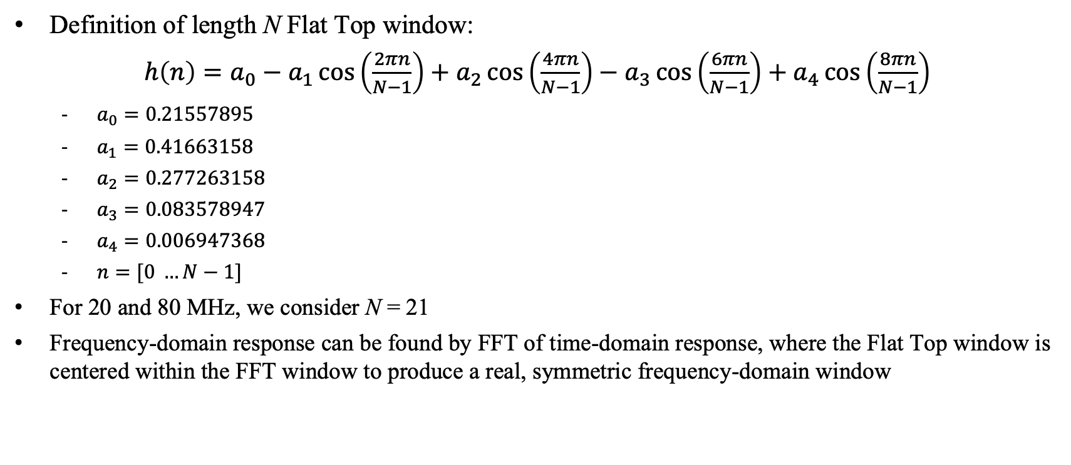
Tx Frequency-Domain Window: Flat Top
Definition of length N Flat Top window:
$h\left(n\right)=a_{0}−a_{1}\cos\left(\frac{2πn}{N−1}\right)+a_{2}\cos\left(\frac{4πn}{N−1}\right)−a_{3}\cos\left(\frac{6πn}{N−1}\right)+a_{4}\cos\left(\frac{8πn}{N−1}\right)$
  $a_{0}=0.21557895$
  $a_{1}=0.41663158$
  $a_{2}=0.277263158$
  $a_{3}=0.083578947$
  $a_{4}=0.006947368$
  $n=[0 …N−1]$
For 20 and 80 MHz, we consider N = 21
Frequency-domain response can be found by FFT of time-domain response, where the Flat Top window is centered within the FFT window to produce a real, symmetric frequency-domain window

Slide 5
Tx Frequency-Domain Window: Impulse Response
Time-domain response: 20 MHz
Time-domain response: 80 MHz

Slide 6
Tx Frequency-Domain Window: Frequency Response
Freq-domain response: 20 MHz
Freq-domain response: 80 MHz

Slide 7
Tx Frequency-Domain Window: Spectrum
Spectrum with window: 20 MHz
Spectrum with window: 80 MHz
A time-domain window (ex: RevMD D4.0 17-4) is applied to 6.4 us Secure LTF signal to shape spectrum

Slide 8
Tx Frequency-Domain Window: Bandwidth Comparison
Ranging accuracy is approximately proportional to inverse of signal BW (rule of thumb) ⇒ larger BW is better!
Tx FD Window | 20 MHz: BW (10 dB) | Relative BW to Rectangular | 80 MHz: BW (10 dB) | Relative BW to Rectangular
Rectangular | 19.4 MHz | 100% | 78.4 MHz | 100%
Raised-cosine | 17.1 MHz | 88.1% | 69.7 MHz | 88.9%
Flat Top | 19.1 MHz | 98.5% | 78.2 MHz | 99.7%

Slide 9
MMSE Sample-by-Sample Attack
Simulation assumptions:
  CBW = 20 MHz (N_{FFT} = 128, N_{sd} = 122), CBW = 80 MHz (N_{FFT} = 512, N_{sd} = 498)
  SNR = 40 dB
  i.i.d. AWGN noise
  Constellations: 4096QAM
  Tx FD windows: Rectangular, Raised Cosine, Flat Top – all windows are normalized to same RMS value
  Correlation over entire LTF symbol
  Time advance of signal: Ta = 2, 3, 4

Slide 10
MMSE Sample-by-Sample Attack: SNR=40 dB, Ta=2
Flat top window has much better performance than either Rectangular or RC windows

Slide 11
MMSE Sample-by-Sample Attack: SNR=40 dB, Ta=3
Flat top window has much better performance than either Rectangular or RC windows

Slide 12
MMSE Sample-by-Sample Attack: SNR=40 dB, Ta=4
Flat top window has much better performance than either Rectangular or RC windows

Slide 13
Sphere Decoder + SIC Attack
Simulation assumptions:
  CBW = 20 MHz (NFFT = 128, Nsd = 122+DC)
  SNR = 40 dB
  i.i.d. AWGN noise
  Constellations: 64QAM
  Attacker uses OSR = 2 and applies Hamming window
  Sphere decoder based on Matlab toolbox with infinite radius (R = ∞)
  Observation window: To = 75% (M = 96)
  Sphere decoder sizes: 4×4
  Correlation over entire LTF symbol

Slide 14
Sphere Decoder + SIC Attack: SNR=40 dB
Flat top window has better performance than either Rectangular or RC windows

Slide 15
Summary
Simulation results show that Tx FD windows (Raised-cosine and Flat Top) improve cross-correlation against both MMSE-based sample-by-sample and Sphere Decoder + SIC attacks when compared to Rectangular window
Flat Top window shows the best security performance of three windows
Flat Top window also maintain large transmission BW (~98-99% of bandwidth of rectangular window ⟹ results in excellent ranging accuracy
Finally, Flat Top window is well-known and easy to implement

Slide 16
Proposal
ISTA/RSTA support the following frequency domain windowing:
  Rectangular window (equivalent to no windowing) is default
  Flat Top window is optional
Flat Top window:
  Optional but recommended for improved security
  Future-proofs device in case lower correlation is needed to provide improved security
  In case some receiving STA will remove the frequency domain windowing, transmitting STA indicate whether the flat top window is used to receiving STA.
Transmit system components may have impact on FD windowing:
  Suggest not to define test in 11az spec for ISTA/RSTA Tx window ⇒ honor system

Slide 17
Straw Poll
Do you agree that ISTA/RSTA support following frequency domain windowing?
  Default is Rectangular window (equivalent to no windowing)
  Flat Top window is optional, but recommended for improved security
    Transmitting STA will indicate to receiving STA whether flat top window is used
    Signaling method TBD
  No test for ISTA/RSTA Tx window defined in 11az spec

Slide 18
References
[1] 802.11-20/1373r0 Attacks to Fully Random OFDM Sounding Signal
[2] 802.11-20/0964r0 Attacks to Fully Random 64QAM Sounding Signal
[3] 802.11-20/0836r0 11az Secure LTF Design
[4] 802.11-20/1855r0 Further Updated on 11az Secure LTF Design

