Slide 1
TXOP Sharing for use in MU P2P
Date: 2021-04-19
Authors:

Slide 2
Content
11be has agreed that the 802.11be amendment will have mechanism(s) for an AP to assist a STA to communicate with another STA and one of them [1] provides means for an AP to share time resource obtained in a TXOP for peer-to-peer frame exchanges
  This one mechanism builds upon the use of a MU-RTS TXS Trigger frame that allocates time within a TXOP for transmitting one or more non-TB PPDUs
Further improvements in latency performance can be achieved with additional mechanisms with which an AP could allocate resources of its TXOP for multiple simultaneous peer-to-peer frame exchanges
In this presentation, we discuss the case of triggered multiuser peer-to-peer and propose the 11be to consider this extension as a R1/R2 feature

Slide 3
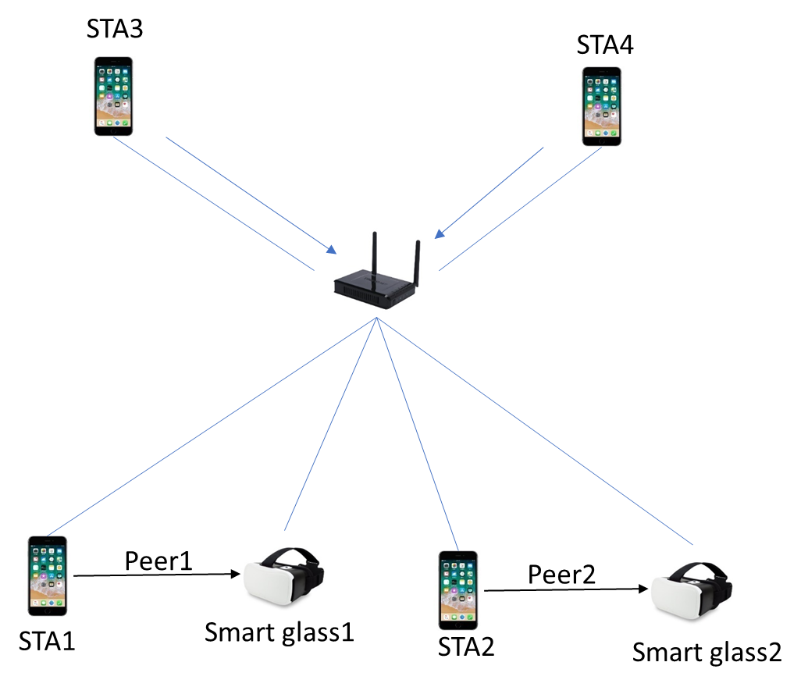
Deployment example with 11be features
Four Wi-Fi smart phones (STA1, STA2, STA3, STA4) and two Wi-Fi equipped smart glasses (G1, G2) connect to the same AP.
Locally stored contents are streamed from the smart phones (STA1, STA2) to the smart glasses. Simultaneously, STA3 and STA4 are used for cloud services through the AP.
Today’s approach:
  Peer-to-peer communication like TDLS may be used between the smart phones and the smart glasses for direct streaming
Tomorrow’s approach with triggered TXOP sharing (already agreed in 11be):
  The AP may allocate a portion of its obtained TXOP for use in one peer-to-peer link
  Benefits: coordination of the P2P communications
Tomorrow’s approach with more advanced 11be support:
  The AP may allocate a portion of its obtained TXOP for simultaneous use in multiple peer-to-peer links
  Benefits: further improving latency performance and spectral efficiency especially in dense deployment cases

Slide 4
Exchange sequence
Frequency
STA1,G1 tuning the channel to the first 20MHz
STA2, G2 tuning the channel to the second 20MHz
MU-RTS TXS TF
duplicated
CTS
PPDU(STA2->G2)
ACK
(G2->STA2)
20Mhz
Second
MU-RTS TXS TF
(RU1=STA1,Target RX: G1-AID,
RU2=STA3, Target RX:G2-AID)
CTS
PPDU(STA1->G1)
ACK
(G1->STA1)
First
20Mhz
SIFS
SIFS
SIFS
TXOP
Note: RU is allocated in 20MHz(242 tones),40MHz,80MHz, etc. manner, which is aligned with PHY adjacent channel rejection(ACR).

Slide 5
Proposal
Building upon the following two motions [1] that have passed in the 11be
  The 802.11be amendment shall define mechanism(s) for an AP to assist a STA that communicates with another STA.
  802.11be supports defining a procedure for an AP to share time resource obtained in a TXOP for peer to peer (STA-TO-STA) frame exchanges.
    Whether it is in R1 or R2 is TBD.
We propose to define a mechanism for an AP to transmit a frame (TXOP MU Sharing frame) that shares resources of an obtained TXOP for two or more simultaneous peer-to-peer frame exchanges
  The AP assigns resource units (RU) to individual non-AP STA pairs for use in peer-to-peer frame exchange and indicates those assignments in the transmitted TXOP MU Sharing frame together with the allocated portion of the obtained TXOP.
  TXOP MU Sharing frame may need to solicit CTS or alike in uplink before any peer-to-peer frames can be exchanged.

Slide 6
Summary
In this proposal, we have discussed the benefits of a procedure with which two or more simultaneous peer-to-peer frame exchanges may be facilitated by an AP
We propose that the 11be defines such a procedure e.g. as an optional extension of the triggered SU procedure currently under discussion in the TG

Slide 7
SP
Do you support that 11be defines a mechanism for an AP to transmit a frame that allocates a portion of its obtained TXOP for simultaneous use in multiple peer-to-peer links?
  Whether it is in R1 or R2 is TBD.
Results: Y/N/A

Slide 8
References
[1]: https://mentor.ieee.org/802.11/dcn/21/11-21-0087-06-00be-pdt-mac-triggered-su.docx

