Slide 1
TB SU PPDU and TB P2P PPDU Consideration
Date: 2020-12-08
Authors:

Slide 2
Recap-1
802.11ax introduce TB PPDU , which is a more efficient method for MU-UL transmission.
According to the definition of the SPEC, P2P (peer-to-peer)link includes:
1) A direct link within a quality-of-service (QoS) basic service set (BSS),
2) a tunneled direct-link setup (TDLS) link,
3) a STA-to-STA communication in an independent basic service set (IBSS).
As to P2P transmission, it’s still based on the competing radio resource method.

Slide 3
Recap-2(references)
20/0095r2 & 20/813r3 & 20/967r0 : Triggered P2P transmissions (follow up)
The contribution shows the benefit of TB P2P case which allow multi P2P PPDUs transmit simultaneously with less competing, And also mentions the following P2P scenarios:
→SU P2P case;
→MU P2P case;
→MU P2P + UL hybrid case;
20/1312R0: AP assisted SU PPDU Tx for 11be R1
The contribution proposes TB SU PPDU and TB SU P2P PPDU via signalling in multi-RTS frames.

Slide 4
Proposal
Considering to reduce the latency of the UL SU and P2P transmission, covering the scenarios that more than one P2P PPDU transmission in parallel and P2P+ UL PPDU hybrid transmission, we propose to define a TB (P2P)SU PPDU, TB P2P MU PPDU and TB P2P+UL PPDU hybrid transmission method via Trigger frame in this prestation.

Slide 5
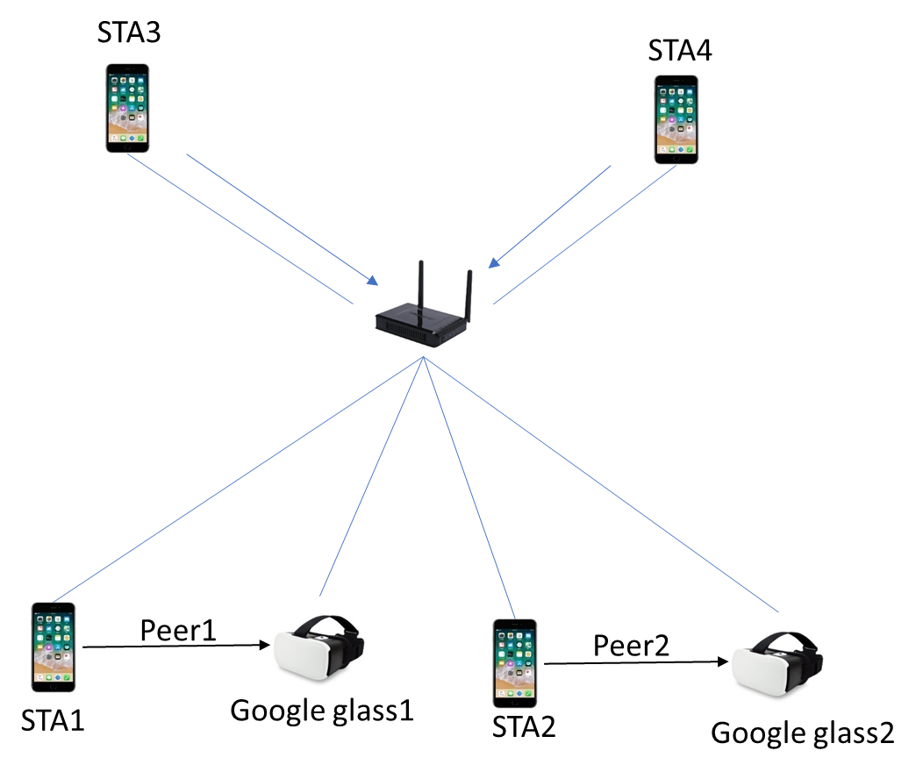
Example
Case description:
Sta1, Sta2, Sta3, Sta4, Google glass1(G1) and Google glass2(G2) connects to the same AP.
STA1 and G1 set up a TDLS link, and STA2 and G2 set up another TDLS link.
STA1 and STA2 want to share some video stream to G1 and G2(P2P). Meanwhile, STA3 and STA3 want to upload some files to internet through AP(UL).
Issue1: It’s not supported that STA1 and STA2 transmit data frame(like video stream) to Google Glass1,Google Glass2 simultaneously.
Issue2: It’s not supported the UL PPDU and P2P PPDU transmission simultaneously.

Slide 6
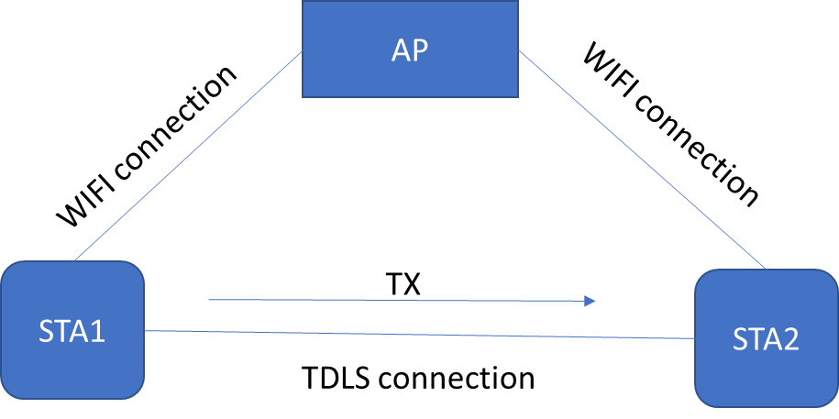
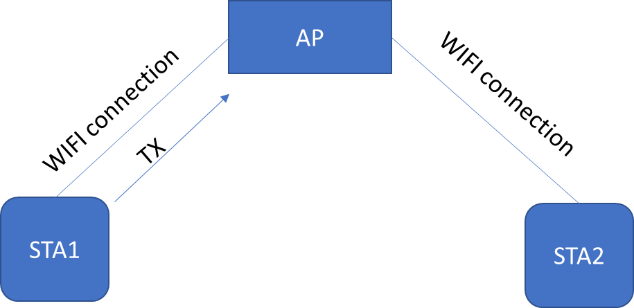
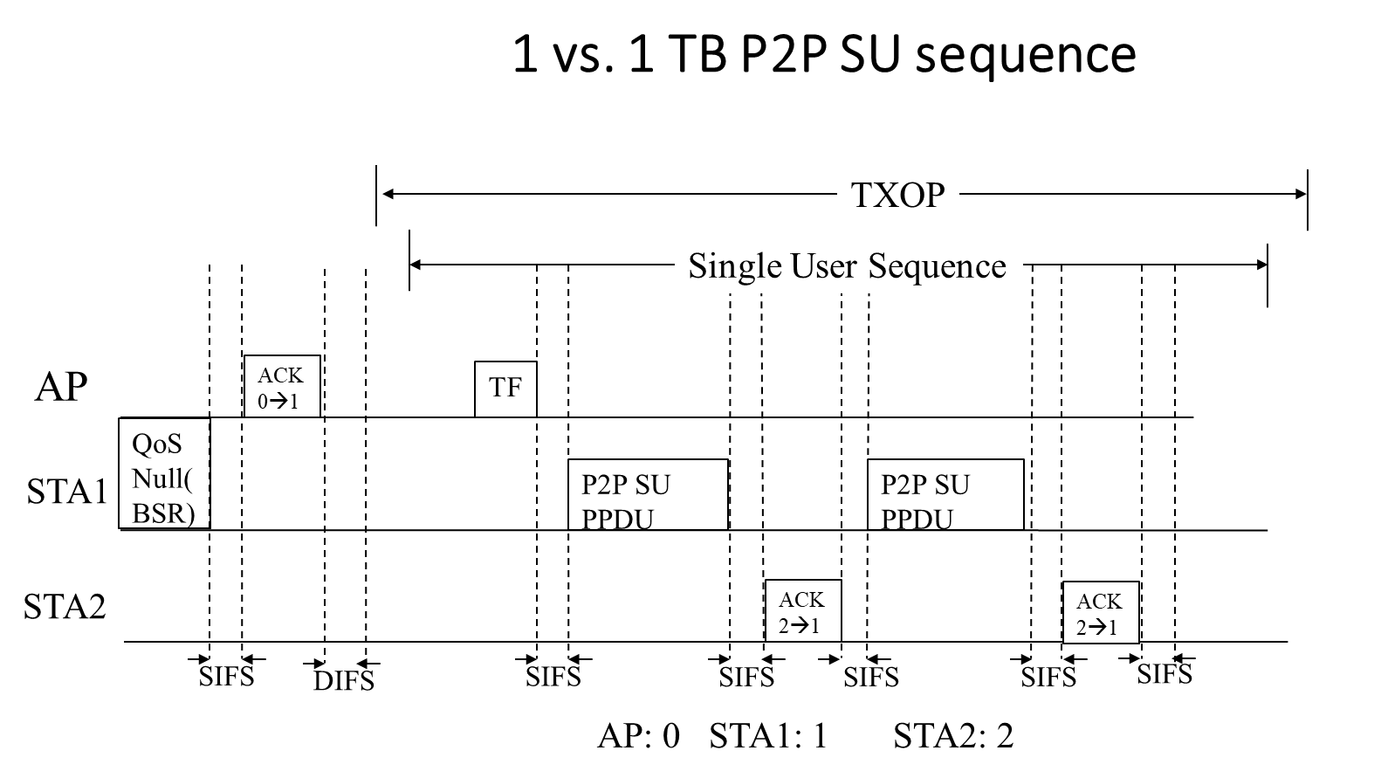
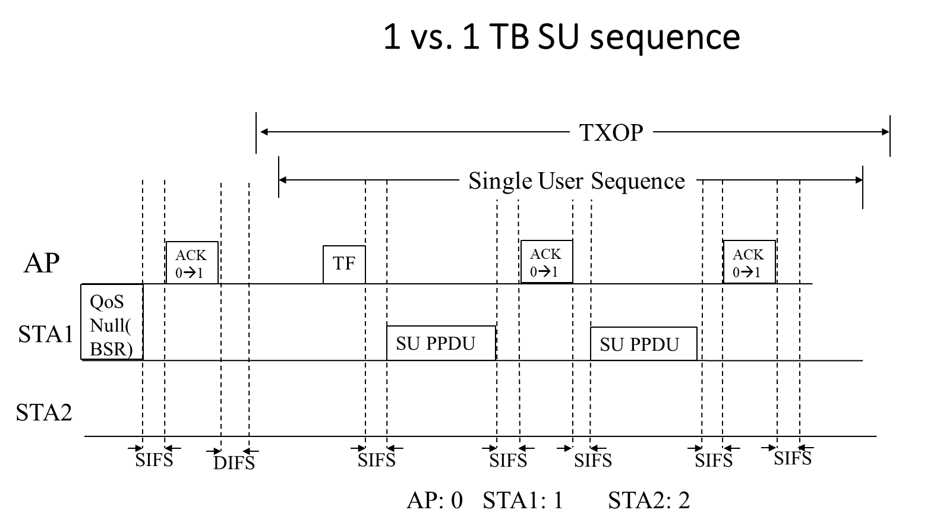
1 vs.1 network topology

Slide 7
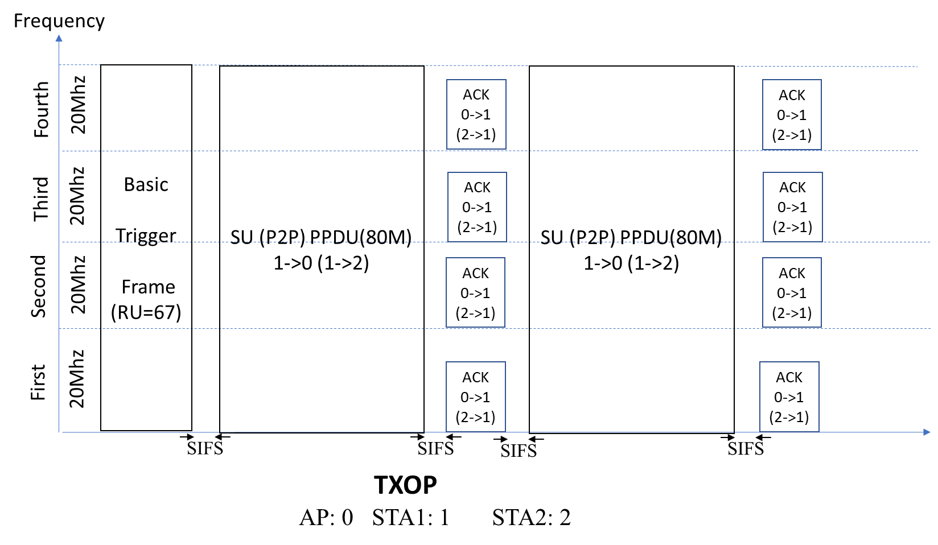
1 vs.1 RU allocation
Note: RU resource is allocated to single User for the P2P or UL SU case.

Slide 8
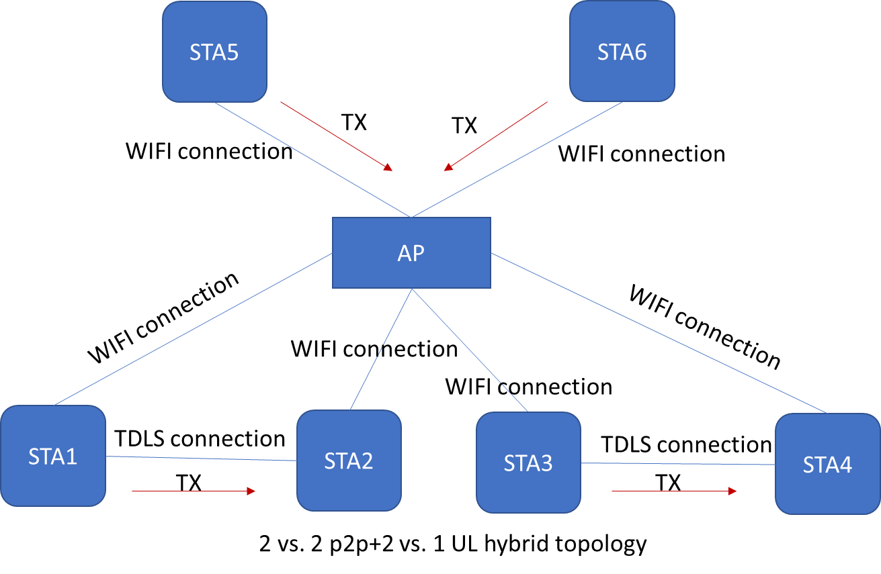
2 vs. 2 P2P + 2 vs. 1 UL hybrid network topology

Slide 9
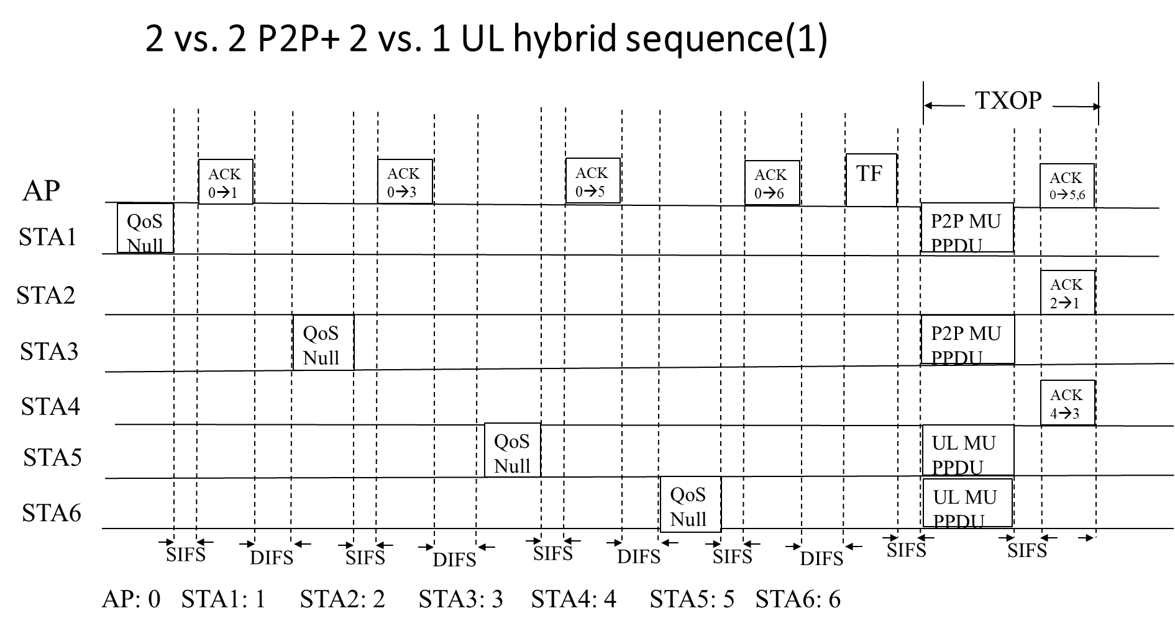
2 vs. 2 P2P+ 2 vs. 1 UL hybrid sequence

Slide 10
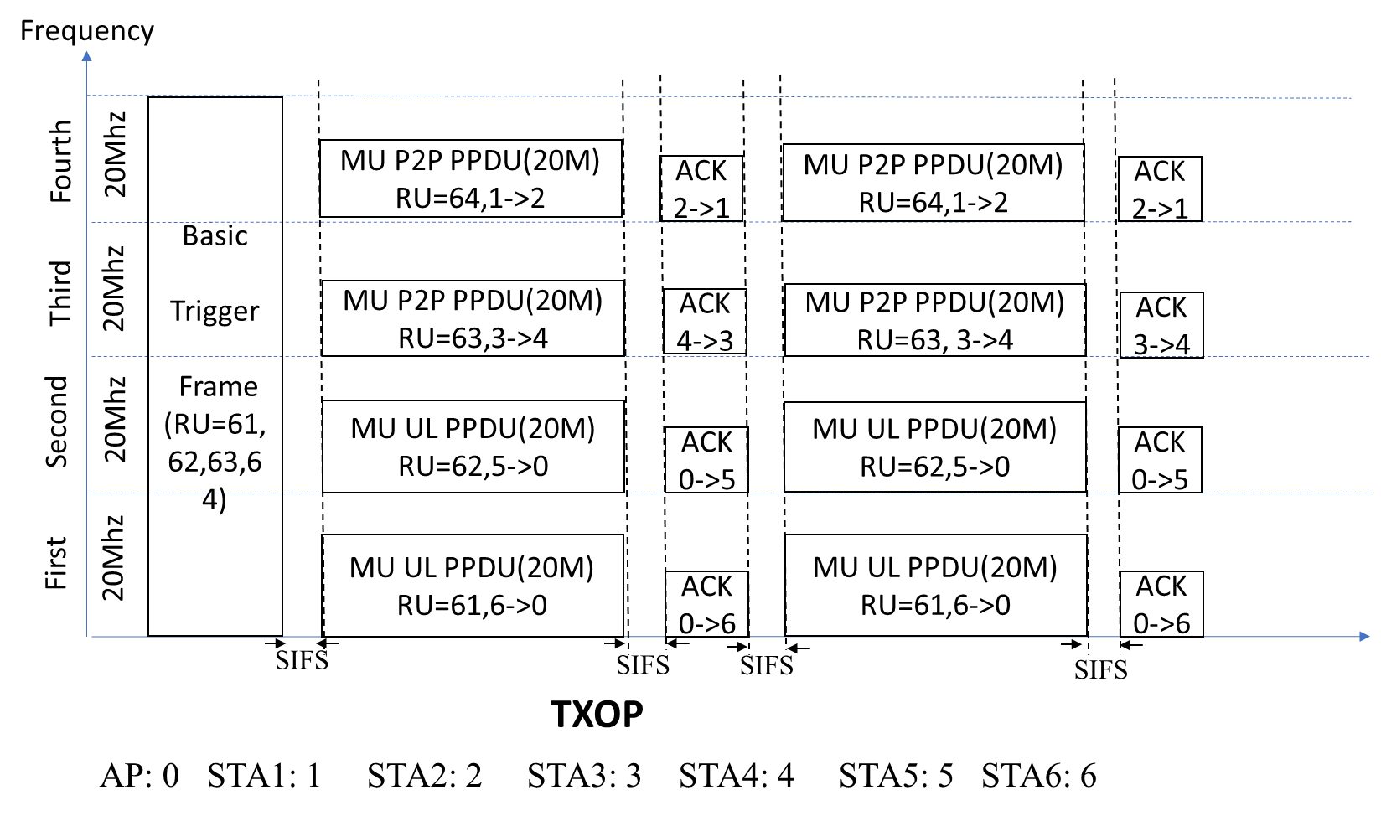
RU allocation for 2 vs. 2 P2P+ 2 vs. 1 UL hybrid

Slide 11
Implement via BSR and Trigger frame
BSR Control field
Extend to
P2P mode flag: 0→ UL mode; 1→ P2P mode;
Target AID12: the AID on receiver side
Note: the name of subfield can be changed

Slide 12
Implement via BSR and Trigger frame-2
User Info in Trigger frame
Extend to

Slide 13
Reference
[1] 20/0813r7 Triggered P2P transmissions follow up
[2] 20/0871r0 Simplified Triggered P2P for R1
[3]. 20/0095r2: Triggered P2P transmissions
[4]. 20/967r0: Multi-user Triggered P2P Transmission
[5]. 20/1312r0: AP assisted SU PPDU Tx for 11be R1

Slide 14
Summary
TB SU(UL/P2P) PPDU and TB MU(P2P or hybrid) PPDU transmission method are talked in this presentation.
The implement method via changing in Trigger fame and BSR frame.

Slide 15
SP1
Do you support that 11be defines in R1, an AP affiliated an AP MLD shares the obtained TXOP for single user UL transmission(non-AP STA to AP) by signaling in a Basic Trigger frame.
Note :
Format of trigger frame is TBD.
Informing the AP of UL traffic required resource, may be based on any existing mechanism, such as BSR .
Results: Y/N/A

Slide 16
SP2
Do you support that 11be defines in R1, an AP affiliated an AP MLD shares the obtained TXOP for peer-to-peer (non-AP STA to non-AP STA) frame exchanges by signaling in a Basic Trigger frame.
Note :
Format of trigger frame is TBD.
Informing the AP of P2P traffic required resource, may be based on any existing mechanism, such as BSR .
Results: Y/N/A

Slide 17
SP3
Do you support that 11be defines in R1, an AP affiliated an AP MLD shares the obtained TXOP for peer-to-peer (non-AP STA to non-AP STA) + UL hybrid method by signaling in a Basic Trigger frame.
Note :
Format of trigger frame is TBD.
Informing the AP of P2P and UL traffic required resource, may be based on any existing mechanism, such as BSR .
Results: Y/N/A

Slide 18
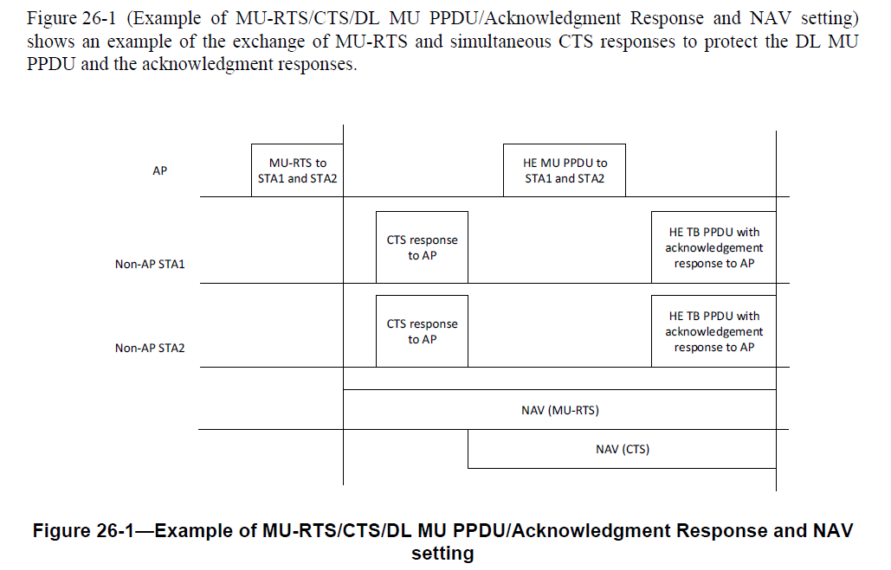
Backup-1

Slide 19
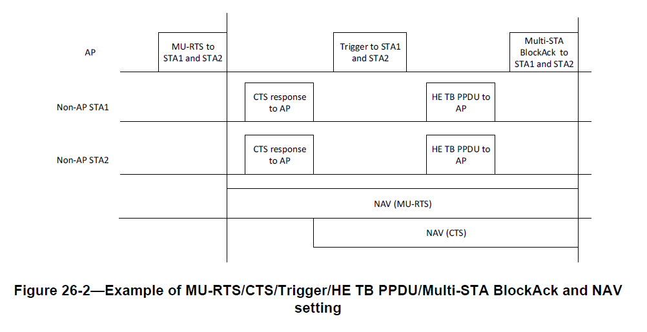
Backup-2

