Slide 1
Random Access for 11be
Date: 2021-07-08
Authors:

Slide 2
Outline
Key Points on Random Access
Proposal: Random-Access NFRP (RA-NFRP) for 802.11be
  RA-NFRP Principle
  Illustration
  RA-NFRP Efficiency versus UORA
  Scalability towards 802.11 technologies or services
Annex
  Legacy 802.11ax UORA procedure
  Legacy 802.11ax NFRP procedure
  Details on RA-NFRP (advantages, example format)

Slide 3
Key points
UORA provides low efficiency [1]:
  empty RUs 37%, collision 26%, efficiency 37%
  lost random RUs (either unused or collided) occur on large transmission durations
Random Access still required for 11be !
  Many contributions in 11be report that random-access support becomes now difficult but still required :
    11-20-831r2, 11-20-1192r1, 11-20-1902r0, 11-21-428r0, 11-21-0400r1 …
This contribution proposes a Random-Access mechanism based on NFRP:
  The “Triggered PPDU” is quite universal, as only energy in RU Tone set
    Some vendors have already support NFRP: 11-21-0362r1
  By offering greater efficiency (74%)

Slide 4
Proposal: Random-Access NFRP (RA-NFRP)
RA-NFRP Principle:
  Reuse the 802.11ax NFRP design, with following modifications :
  AP provides a NFRP request with Random allocations
    RA-NFRP TF identified by predefined Starting_AID value (Typically value 0)
  Random Access to access a RU Tone allocation, by a STA :
    1st random phase: STA randomly selects a RU Tone Set Index
    2nd random phase: STA randomly selects a Feedback Status (response Y or N)
  AP then schedules with Basic TF :
    Schedules a Responding STA by using a sort of temporary AID that corresponds to the RU tone set allocation the STA used
      By the indexes of RU Tone Sets that correspond to RU Tone Set with a single feedback
    Easy Collision detection
      AP considers as correct only a single feedback (responses Y and N means collision, thus no scheduling for such index)
Top Benefits
  Greater efficiency (see next slides), changes limited to MAC.

Slide 5
RA-NFRP Illustration
Random access:
- select random RU Tone Set index (e.g. using backoff)
- FEEDBACK_STATUS is random
RA-NFRP identification :
starting AID = 0, 2047, …
Basic TF scheduling:
AP schedules STAs using RU Tone Set index
AP
AP
AP
NFRP Trigger
Frame
(starting AID = 0)
NDP (sent by STA₁)
A
Basic Trigger
Frame
(schedule RUs by using RU_TONE_SET_INDEX )
Data frame (sent by STA₁)
Multi-STA BA
26 tone RU
B
Primary 20MHz
channel
(242 tones)
collided
C
Collided Data frame
(sent by at least 2 STAs)
26 tone RU
NDP (sent by STA₂₀)
D
NDP (sent by STA₂)
SIFS
SIFS
SIFS
SIFS
Case | NDP Feedback detection by AP | Comment
A | correct (single feedback) | One single STA transmits a TB NDP Feedback
B | Not used (no feedback) | No further RU scheduled
C | correct !! (2 STAs use same feedback value) | RA-NFRP can not detect the error ! : collided data will not be acknowledged
D | Error (two feedbacks) | 2 tone sets used as Feedback (tones for 0 and 1, so feedback=3)

Slide 6
RA-NFRP Efficiency
RA-NFRP is a very efficient RA mechanism, that splits the random access and data communication phases :
  Detection of Empty NDP RUs will avoid having empty data RUs
  Early Collision detection (where half of RU_TS collisions are detected thanks to NDP feedback) will reduce waste for further data RUs.
 |  | Collision domain (due to random access) | Data TX domain (Basic TF) | Efficiency in Data RU (among 9 Data RUs per 20Mhz)
UORA | empty | 37% (same domains) |  | 3 or 4
 | collided | 26% (same domains) |  | 2 or 3
 | correct | 37% (same domains) |  | 3 or 4
RA-NFRP + Basic TF | empty | 37% ( 6.66 RU_TS)
 | collided | 26% / 2 = 13% (2.33 RU_TS) | 13/(13+37) = 26% | 3 or 2
 | correct | 37% (6.66 RU_TS) | 37/(13+37) = 74 % | 6 or 7
Note: UORA uses 9 Data RUs per 20Mhz channel; RA-NFRP uses 18 NDP_RU_TS per 20 MHz channel
The empty NDP RU Tone Sets are not scheduled for data
All 9 Data RUs are used
26% of Aloha collision, halfed by 2-bit feedback

Slide 7
RA-NFRP scalability
As only energy is received as NFRP feedback, AP needs to know what kind of station it will address.
There is room in ‘User Info’ field of NFRP format to signal the technologies to schedule/trigger subsequent transmissions:
  9 bits in the reserved field (see examples in Annex slide 15)
  Could be used to signal a given technology …
    Basic 11ax TF, Basic 11be TF, future version, …
    or given service or usage :
    multi-AP TF…

Slide 8
Summary
This document presented a Random Access procedure for 11be, on top of NFRP mechanism.
Efficiency is close to 74%, extremely greater than the legacy UORA (37%).
Scalable to future versions of the 802.11 standard
We think 802.11be would largely benefit from such mechanism.

Slide 9
Questions / Answers
(received since presentation in 11be Joint meeting 7/7/2021)
Question: what is the advantage compared to legacy (schedule) NFRP ?
  These random/schedule schemes are complementary
    according to AP’s decision, scenario…
  Legacy NFRP, scheduling large range of stations, has drawbacks such as :
    Energy consuming: all STAs in the range have to respond (even for a NO answer)
    Large band required for NFRP operation (AID order is mandatory kept in responses)
    Holes in RU tone set indexes (some STAs, that may not support NFRP, fits within the AID range ; Un-allocated AIDs in the range → possibly energy holes could be large and this is an issue)
  Random NFRP (RA-NFRP) allows only interesting STAs to respond, and this occurs in a reduced band of operation
Question: can RA-NFRP be used for non-associated STAs ?
  Yes. It can be used for STAs outside a BSS (e.g. association, multi-AP, …)

Slide 10
Questions / Answers (cont)
Question: can you detail more the efficiency of RA-NFRP ?
  Basic concept of RA-NFRP is to split the contention vs the communication phases.
  We discuss about efficiency in Data communication (final efficiency)
  We propose 2 random selection stages (for NFRP contention):
    1st random stage (mandatory): RU Tone set Index
      Due to Aloha, 37% of NDP RUs (RU Tone Set Idx) are empty
      Those empty NDPs are no longer scheduled for data ! So no empty data RUs.
      Data efficiency: (good NDP RUs / total NDP RUs to be scheduled further) : 37/ (37+26) = 58%
        → maximum Data efficiency = 58%
    2nd random stage (complementary): Feedback value 0/1
      A RU Tone Set has 2 possible values, but the answer is useless (a STA only responds to NFRP TF if it wants, its NDP communication is already an answer : so no matters the Feedback value is)
      It is at no cost to use a random selection of feedback 0/1
      Therefore, the 26% collided NDP RUs have 1 chance out of 2 to be discovered (both 0 and 1 is detected as error) -> it remains 13% collision
      Data efficiency: (good NDP RUs / total NDP RUs to be scheduled further) : 37/ (37+13) = 74%
        → maximum Data efficiency = 74%
  This is why we propose both 2 stages (see next slide).

Slide 11
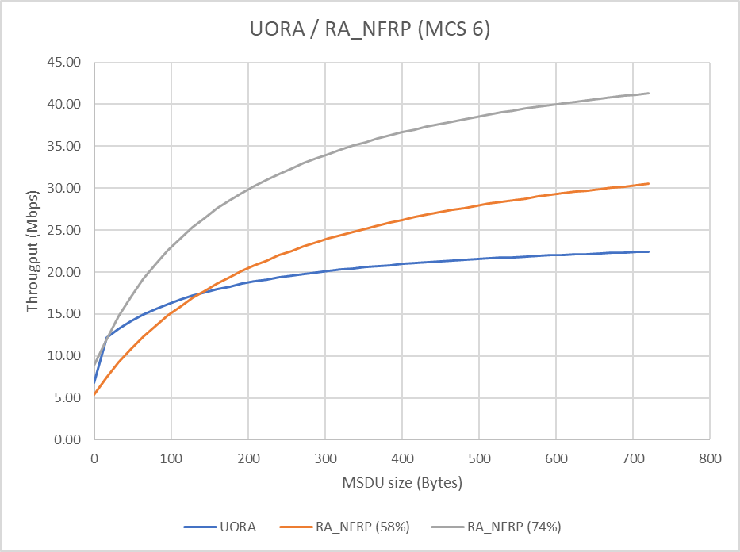
Questions / Answers (cont)
Illustration of Data efficiency (max Throughput vs MSDU Size):
  Example with MCS 6 inside TXOP (MCS0 for initial TF) (other parameters in Notes)
RA_NFRP 74%
Operating range of RA-NFRP operation
RA_NFRP 58%
UORA
For information, 256 Bytes is the default threshold for ‘NDP feedback report for a resource request’ (Feedback Type 1).
Typically for such resource request feedback, only STAs having buffer greater than this threshold will talk with RA-NFRP.
256
Notes:
Duration of 1st TF (NFRP TF and UORA TF, having both 1 User Info):
MAC size: 33 Bytes (20 header/FCS TF + 8 Common Info + 5 User Info), at 6Mbps
Duration: 64µs (20 PHY + 44 MAC)
Duration of HE TB feedback NDP : (802.11ax-2021 §27.3.18)
72µs = 40µs header + 2* HE-LTF-4X (12.8 + 3.2GI )
Duration of Basic TF: (successive to NFRP inside same TXOP, MCS6)
MAC size: 73 Bytes (20 header/FCS TF + 8 Common Info + 9 * 5 User Info), at 73Mbps (mcs6)
Duration: 28 µs (20 PHY + 8 MAC)
MCS 6 for data: For 26-tone RU, 7.5 Mbps

Slide 12
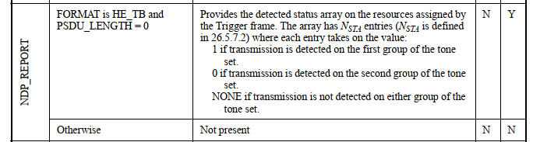
Questions / Answers (cont)
Question: what happens for the PHY report when 2 feedbacks received?
  RA-NFRP runs at MAC layer, and wants that 2 feedbacks (0+1) are considered as false.
  According to 802.11ax-2021, table 27-1 seems to report no usage in that collided case (TB feedback NDP is NONE), which is an appropriate behaviour for RA-NFRP (thus this situation is filtered by PHY instead of MAC) :
Question: what happens if the PHY wrongly reports 1 feedback instead of 2 (because of TxPower or interference issue) ?
  This means the second random stage fails, so the maximum efficiency fluctuates in between 1st stage and 2nd stage (58% to 74%).
    Only if all RU Tone Sets have in the same problematic, the max efficiency fails to 58% (still better than UORA).
  Note: a UL_Target_Revceive_Power is specified in User-Info field of TF
Notes:
UL Target Receive Power: The UL Target Receive Power subfield indicates the expected receive signal power, measured at the AP's
antenna connector and averaged over the antennas, for the HE portion of the HE TB PPDU transmitted on
the assigned RU and is defined in Table 9-29j

Slide 13
Straw Poll #1
Do you support that 802.11be allows NFRP mechanism to support a Random-Access allocation ?
  STAs randomly select an RU Tone Set Index and a Feedback Status
  STAs that win NFRP contention are then scheduled by their RU Tone set Index.
  Note: This is an R2 feature.
Results: Y/N/A

Slide 14
Annex

Slide 15
Recall: UL OFDMA-based Random Access (UORA)
UORA allows a non-AP HE STA to access one of a number of resource units designated for random access by the HE AP [1].
UORA provides low efficiency:
  theoretical probability for random access distributions (Slotted-Aloha type):
    empty RUs 37%, collision 26%, efficiency 37%
  lost random RUs (either unused or collided) occur on large transmission durations !
  802.11be needs a more efficient RA mechanism !

Slide 16
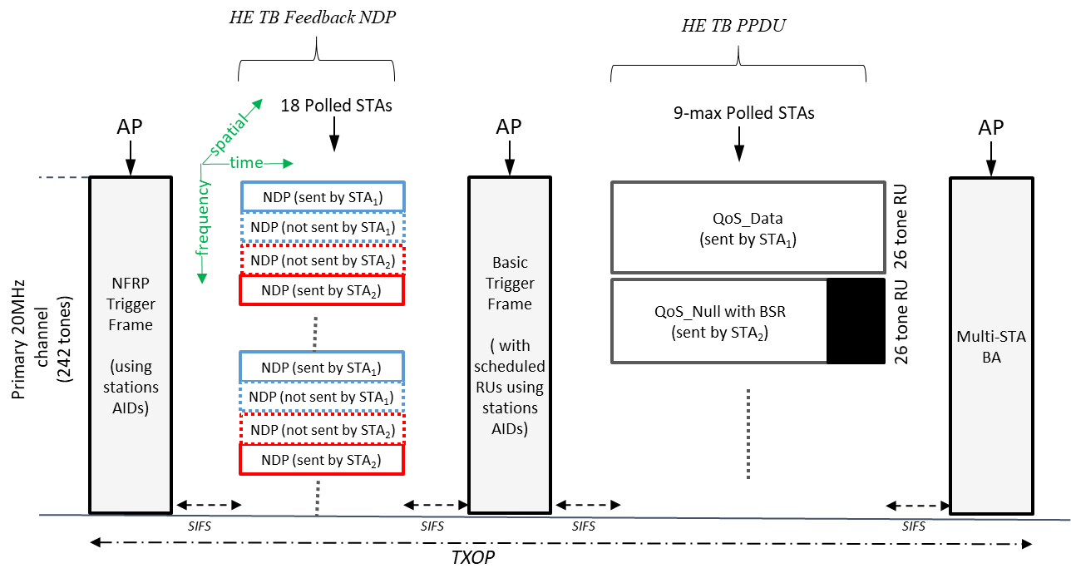
Recall : 802.11ax NFRP procedure
NDP Feedback Report Poll (NFRP) TF is used to collect feedback from a range of associated STAs [1]:
  STAs are identified by a range of AIDs, starting from value of ‘Starting_AID’ field
  Scheduled STAs select a tone set according to STA’s RU_TONE_SET_INDEX ([1] table 27-32), and modulate tones of the tone set according to the FEEDBACK_STATUS (0/1) to emit.
Later, based on received NDP feedbacks, AP may solicit (e.g. via Basic TF for UL MU) some responding STAs
Illustration:
e.g. Feedback is 0
e.g. Feedback is 1

Slide 17
NFRP TF format (802.11ax)
340

Slide 18
RA-NFRP Advantages
Fully compliant with legacy 802.11ax format :
  Keep 11ax design format
    ‘Starting AID’ field takes value 0 (optionally 2047…), any predefined AID value outside the range of AID assigned by AP to associated stations
Very efficient random-access mechanism
  random access is moved to the short time NDP Feedback report procedure
  AP schedules only used RU Tone Set:
    no empty data RUs are met in the subsequent UL MU operation
    Possibly still collisions on UL data RU, but half of the collisions compared to UORA(case C of previous slide)
Tips:
  AP later determines the STA AID (at final stage upon receiving HE TB data PPDU), but this is not an issue.

Slide 19
RA-NFRP TF format
TF Techno bitmap
This field tells
the inquired technology.
Value | Description
0 | Resource request
1 | Universal request
2-15 | Reserved
B0 B5 | B6 | B7 | B8
Reserved | … | EHT | HE
Bits: 6 | 1 | 1 | 1
  Keeping conventional Feedback Type (0) or this new value (1) is TBD

Slide 20
Reference
[1]. Draft P802.11ax_D8.0
[2].

