Slide 1
Discussion on ambiguity function, range Doppler map and link level simulation
Date: 2020-12-15
Authors:
Name | Affiliation | Address | Phone | Email
Rui Du | Huawei Technologies Co. Ltd | F3, Huawei Base, Shenzhen, China |  | Ray.du@Huawei.com
Danny Tan Kai Pin
Meihong Zhang
Chenchen Liu
Yingxiang Sun

Slide 2
Outline
Abstract
Ambiguity function
Range Doppler map
The range Doppler map generated with two types of receivers
Range Doppler map generated with correlation receiver
Link level simulation
The information of link level simulation could provide
The relationship between range Doppler map and link level simulation
Comparison of ambiguity function, range Doppler map and link level simulation
Summary
References
Rui Du, et al. (Huawei)

Slide 3
Abstract
Ambiguity function, range Doppler map and link level simulation have been discussed in previous presentations[1-3].
In this contribution, the relationships among ambiguity function, range Doppler map and link level simulation are further discussed and presented.
Rui Du, et al. (Huawei)

Slide 4
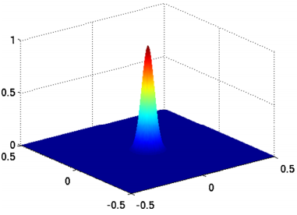
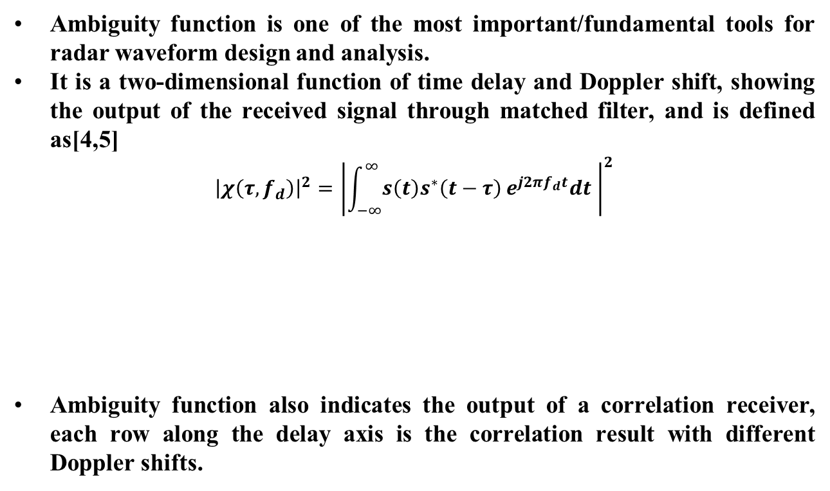
Ambiguity function
Ambiguity function is one of the most important/fundamental tools for radar waveform design and analysis.
It is a two-dimensional function of time delay and Doppler shift, showing the output of the received signal through matched filter, and is defined as[4,5]
$${\left|χ\left(τ,f_{d}\right)\right|}^{2}={\left|\int_{−∞}^{∞}{s\left(t\right)s^{∗}\left(t−τ\right)}e^{j2πf_{d}t}dt \right|}^{2}$$
Ambiguity function also indicates the output of a correlation receiver, each row along the delay axis is the correlation result with different Doppler shifts.
Doppler
Delay
Rui Du, et al. (Huawei)

Slide 5
The range Doppler map generated with two types of receivers
Correlation receiver and matched filter receiver are two types of receivers could be adopted in sensing to generate range Doppler map.
For matched filter receiver, the range Doppler map generated by the receiver is the ambiguity function! If the signal is long enough, range and speed information could be estimated simultaneously.
For correlation receiver, fast time, slow time processing is used to generate the range Doppler map. The correlation result of each pulse with different Doppler shift is indicated in the ambiguity function!
According the discussion in [3], correlation receiver is more likely to be adopted in WLAN sensing. So, in the following slides of the presentation, the discussion is mainly focused on correlation receiver.
Rui Du, et al. (Huawei)

Slide 6
Range Doppler map generated with correlation receiver
To generate a range Doppler map with correlation receiver, many parameters need to be set as follows.
Number of pulses
This parameter defines the pulses used for integration, and its maximum value is usually limited by the channel coherent time(CPI).
Pulse repetition interval or frequency
This parameter limit the maximum Doppler shift could be detected.
Target information
The range and speed information of target(s) need to be set in order to generate a range Doppler map.
For each range Doppler map generated with correlation receiver, one (or more) target(s) is(are) needed. For each individual target, the Doppler component is usually constant during the CPI. It is hard to investigate all the possible Doppler shift in a range Doppler map generated with correlation receiver !
Rui Du, et al. (Huawei)

Slide 7
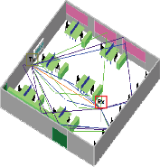
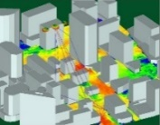
Link level simulation
The link level simulation proposed in [6].
 Waveform generation
 Transmitter
● Environment/channel model
Target, interference and noise
Channel
◆ Type (new sequence, new waveform, WLAN PPDU,…)
◆ Parameters (PRI, BW, f_{s}, duration…)
◆ Array geometry
◆ Element radiation pattern (gain)
◆ ERIP
Location
…
◆ Number of targets
◆ Parameters (RCS, delay, velocity,…)
Indoor
◆ Number of clutter
◆ Parameters (reflectivity, delay, AoD, AoA,…)
Outdoor
◆ Noise
■ Signal processing and performance evaluation
❍ Receiver
Performance evaluation
Parameter estimation
◆ Range accuracy
◆ Velocity accuracy
◆ Angle accuracy
◆ …
◆ Range estimation
◆ Velocity estimation
◆ Angle estimation
◆ …
◆ Array geometry
Element radiation pattern (gain)
◆ Array and element errors
◆ Location
Sampling parameters (f_{s}, duration…)
…
Rui Du, et al. (Huawei)

Slide 8
The information of link level simulation could provide
Sensing performance in different applications scenarios.
The results indicates the simulated sensing performance and will be helpful to evaluate the gap between simulated system performance and usage model requirements in different application scenarios.
Sensing performance with different signal to noise ratio(SNR).
The result provides further insight of the performance with Accuracy vs. SNR results.
Sensing performance with different sensing architecture.
Monostatic sensing
Bistatic sensing
…
Rui Du, et al. (Huawei)

Slide 9
The relationship between range Doppler map and link level simulation
The first step of the link level simulation at the receiver is the generation of range Doppler map. So, some similar parameters are also need to be set, e.g.
Number of pulses,
Pulse repetition interval or frequency,
Target information.
But in link level simulation, further processing will be done based on range Doppler map.
Detecting the range and Doppler information from the map.
Analyzing the error between estimated parameters and ground truth (accuracy).
So, the range Doppler map is part the link level simulation. With a few further steps, an end to end link level simulation could be done !
Rui Du, et al. (Huawei)

Slide 10
Comparison of ambiguity function, range Doppler map and link level simulation
In the above figure, the waveform generation, transmitter, channel and receiver are same with the corresponding modules in slide 7.
Some details of the signal processing part is shown,
correlation receiver could be used to generate the range Doppler map,
a detector is adopted to estimate target’s parameters,
performance analysis is done to evaluation the sensing results.
Rui Du, et al. (Huawei)

Slide 11
Comparison of ambiguity function, range Doppler map and link level simulation
Name | Pros | Cons
Ambiguity function(range Doppler map generated with matched filter receiver) | It is the output of the matched filter receiver, and it compensates the delay and Doppler simultaneously to achieve the maximum output. The 2 D matrix also indicates the correlation result with different Doppler shifts between transmitting signal and receiving signal. It is a fundamental theoretical analysis of sequence/waveforms. | High computation complexity.
Range Doppler map generated with correlation receiver | Similar output with matched filter receiver, but the computation complexity is much lower. Suitable for pulse signal (e.g. the way sequence could be transmitted in the TRN). Suitable to be evaluated in a link level simulation. | It is a result with certain Doppler shift and if you want to have a comprehensive analysis with all possible Doppler shifts, many different Doppler shifts are need to be tested.
Link level simulation
Range Doppler map (no matter generated with matched filter receiver or correlation receiver) is part of the link level simulation.
Accuracy vs. SNR could provide further insight of the sensing performance in different application scenarios and sensing architecture.
Rui Du, et al. (Huawei)

Slide 12
Summary
The relationship between ambiguity function, range Doppler map (generated with correlation receiver) and link level simulation is discussed and shown.
The ambiguity function is a fundamental theoretical analysis of waveform/sequence. It shows the output of the matched filter receiver and also indicates the output of correlator with different Doppler shifts.
The link level simulation is able to investigate the sensing performance in different sensing applications with different sensing architecture.
Rui Du, et al. (Huawei)

Slide 13
References
[1] 11-20-1328-00-SENS-discussion-on-wlan-sensing-sequence-design.pptx
[2] 11-20-1444-00-SENS-Golay Sequences and Ambiguity Function.pptx
[3] 11-20-1529-00-SENS-discussion-on-wlan-sensing-sequence-design-follow-up
[4] Skolnik M I. Introduction to radar systems[M]. New York: McGraw-hill, 1980.
[5] Mahafza B R. Radar systems analysis and design using MATLAB[M]. CRC press, 2002.
[6] 11-20-1642-00-00bf-wlan-sensing-link-level-simulation.pptx
Rui Du, et al. (Huawei)

