Slide 1
OBSS EDCA Parameter Sets for RTA
Date:
Authors:
Name | Affiliation | Address | Phone | Email
Evgeny Khorov | IITP RAS
Dmitry Bankov | IITP RAS
Ilya Levitsky | IITP RAS
Ivan Startsev | IITP RAS
Kirill Chemrov | IITP RAS

Slide 2
Abstract
This presentation proposes and evaluates a method to reduce channel access delay in case of OBSS by tuning and synchronizing EDCA parameters at neighboring APs.

Slide 3
Outline
Use case
Single BSS Scenario
  Problem of RTA Caused by CSMA/CA
  Performance Evaluation
OBSS Scenario
  Problem of RTA Caused by OBSS
  Performance Evaluation, OBSS Scenario
Proposal

Slide 4
Thoughts on RTA
Wi-Fi is based on CSMA/CA
  Even modern OFDMA works upon CSMA/CA (OFDMA transmission/TF can be sent only if the AP accesses the channel according to EDCA)
Wi-Fi is full of legacy devices
  A user may upgrade all his/her APs, but it is hardly possible to quickly upgrade all the devices connected to these AP
  802.11be may include new channel access methods, but a typical 802.11 network consists of devices of various generation, including those not supporting new features. We need to satisfy RTA requirements in the presence of legacy devices transmitting heavy delay-tolerant flows.

Slide 5
Use cases
Large houses
  Multiple APs cover the house area. From time to time the RTA service is needed.
  User can configure the APs in a static way.
  The APs may contain some sophisticated algorithms but the APs work independently from each other
  No interference from other networks
VR/AR clubs
  Large area isolated from external radio, need RTA support for wireless VR headsets.

Slide 6
Problem of RTA Caused by CSMA/CA
If a STA generates an RTA frame but the channel is occupied, it has to wait until the channel becomes idle. After that, the STA has to win the contention for channel
Total delay = Channel access delay + Frame transmission
Channel access delay = Ongoing transmission duration + AIFS + Backoff
Ongoing transmission duration is limited by TXOP limit.
Backoff: To make sure that an RTA STA does not contend with non-RTA STAs, it is necessary to set AIFSN_{RTA} + CWmax_{RTA} < AIFSN_{non-RTA} (holds for every non-RTA AC)
By tuning these EDCA parameters, we can reduce channel access delay.
RTA frame generation
Total delay
Backoff
Other STA’s transmission
AIFS
RTA frame
SIFS
Ack
t
Channel access delay
Frame transmission

Slide 7
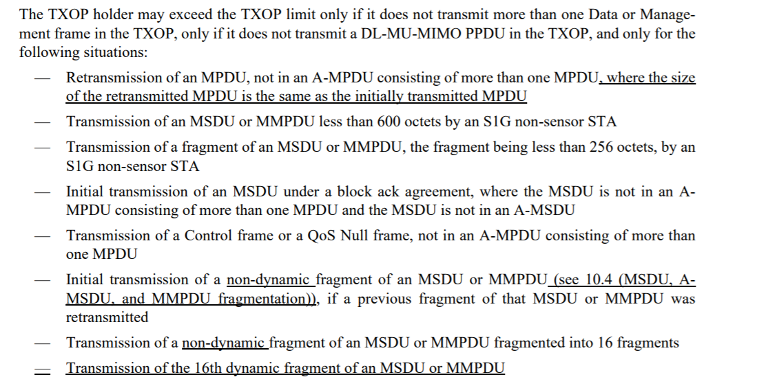
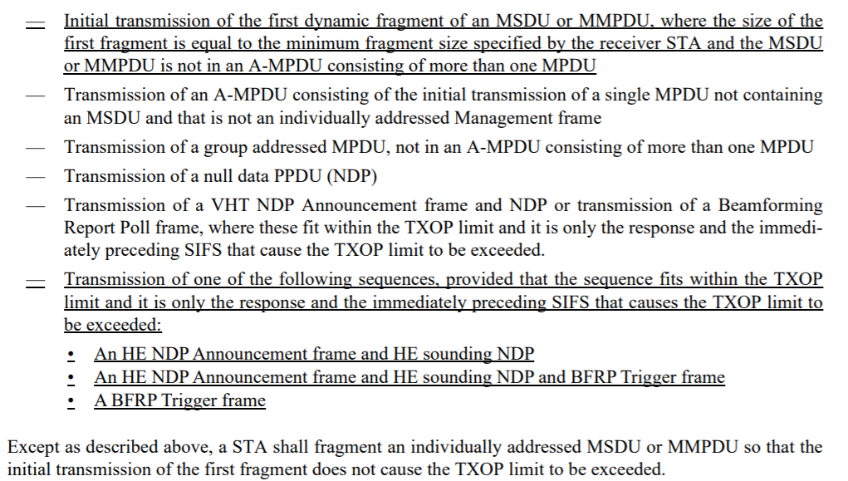
Remark about TXOP limits
According to 10.23.2.9 TXOP limits, by setting a small and non-zero TXOP limit, we can limit the duration of almost all frames

Slide 8
Tuning EDCA parameters improves RTA in a single BSS Scenario
1…10 RTA STAs, each of which generates an RTA packet with a period of 20 ms
10 non-RTA STAs generate saturated traffic
All STAs are in the TX range of each other
Transmissions of RTA STAs last 0.5 ms (incl. DATA+SIFS+ACK)
Transmissions of non-RTA STAs are limited by the TXOP limit

Slide 9
Performance Evaluation, 1 BSS Scenario
 | Default EDCA Parameters |  | Tuned EDCA Parameters
 | RTA (AC_VO) | Non-RTA (AC_BE) | RTA | Non-RTA
AIFSN | 2 | 3 | 2 | 10
CWmin | 3 | 15 | 7 | 15
CWmax | 7 | 1023 | 7 | 1023
TXOP Limit | 2.528 ms But RTA TX = 0.5 ms | 2.528 ms | 2.528 ms But RTA TX=0.5 ms | {0.5, 1, 2, 2.5}ms
AIFSN_{non-RTA} =
AIFSN_{RTA} + CW_{RTA} +1
Changed from 3 to 7 to reduce contention

Slide 10
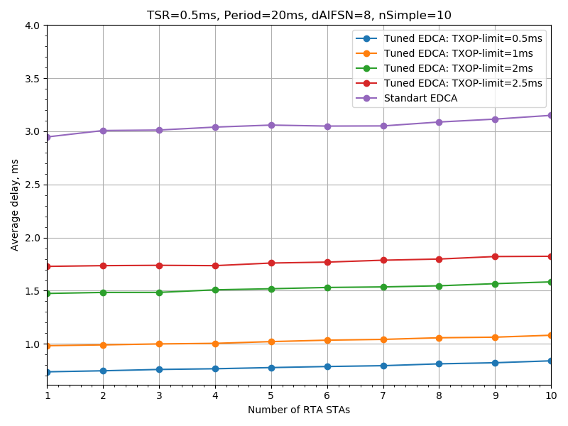
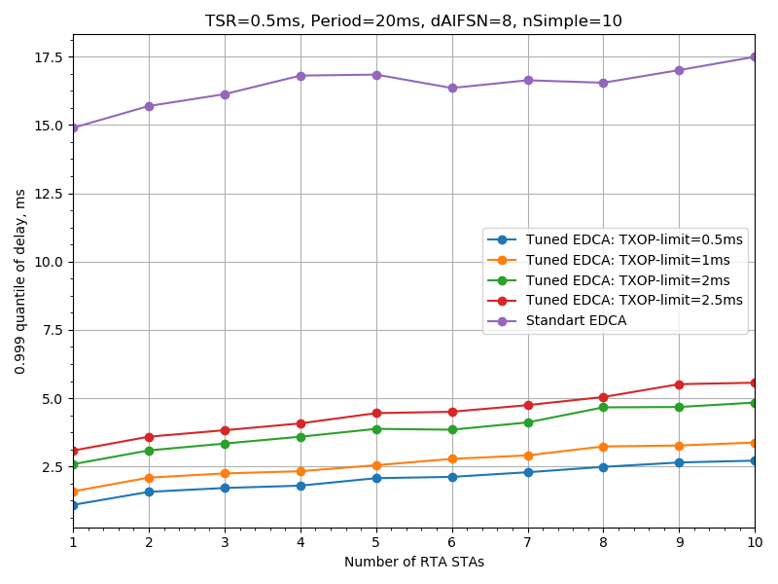

Performance Evaluation, Delay
With Tuned EDCA, we can satisfy RTA requirements, e.g., provide delay less than 10 ms with a high probability
Average delay
99.9% percentile of delay
On the contrary, standard EDCA provides ~2 times higher average delay and much higher delay percentile

Slide 11
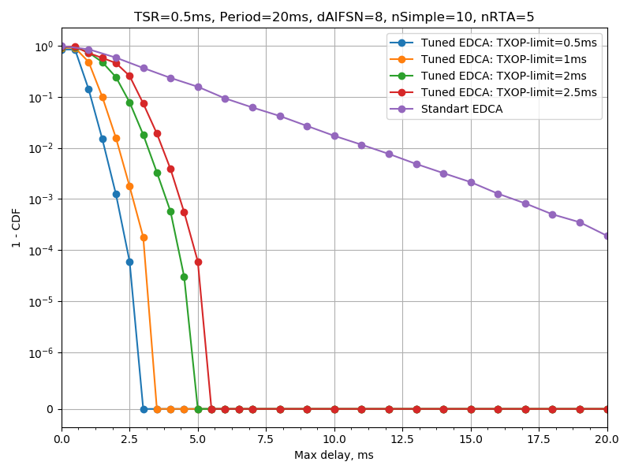
Delay distribution for 5 RTA STAs
Probability that the delay restriction is violated
Delay, ms

Slide 12
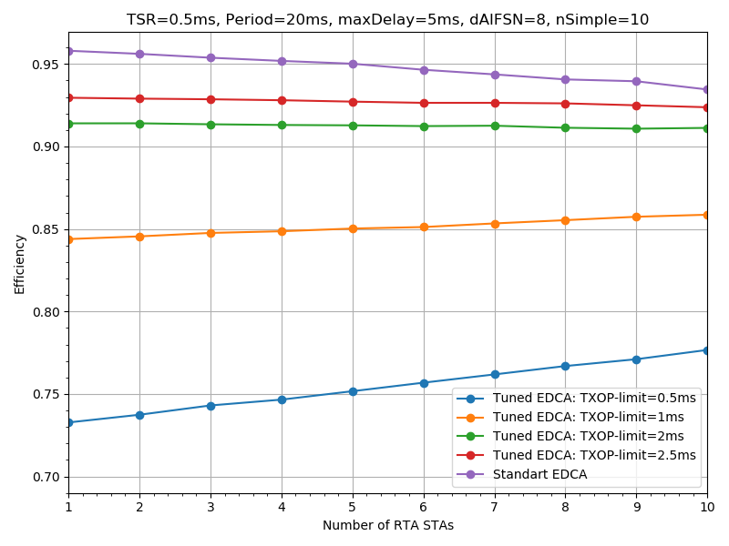
Channel Usage Efficiency
Channel usage efficiency is measured as the portion of channel time occupied by payloads of successful data transmission by RTA and non-RTA STAs
The cost for providing low-delay channel access is up to 25% reduction of the channel usage efficiency. So it should be activated only when there is RTA traffic. The static configuration of EDCA Parameters is not efficient.
The efficiency of Default EDCA is higher because the AIFSN and TXOP limit parameters of non-RTA traffic are lower than in case of Tuned EDCA
EDCA Parameter Set can be used to dynamically configure EDCA parameters for one BSS

Slide 13
Problem of RTA Caused by OBSS
In case of OBSS, the AP cannot control EDCA parameters at neighboring APs.
We need a mechanism to coordinate TXOP limits and AIFSN in OBSS.
We propose a method that allows neighboring APs to synchronize their EDCA parameters in order to satisfy the RTA requirements.
The APs that support this and other TBD features are referred to as RTA-friendly.
If all APs in OBSS are RTA-friendly, we obtain an RTA-friendly environment.
  NOTE: To support RTA we need the absence of RTA non-friendly APs (that allow transmitting heavy flows with minimal AIFSN and CWmin) or extremely low traffic in such BSSs

Slide 14
OBSS Scenario
Non-RTA STA
RTA STA
Transmission range of each other
BSS1
BSS2
2 BSS operate in the same area
BSS1 (RTA-friendly)
  N RTA and 5 non-RTA STAs
  EDCA Parameters are tuned. TXOP limit is shown in the legend
BSS2 (RTA-friendly or non-RTA-friendly)
  5 non-RTA STAs
  EDCA Parameters are tuned only if BSS2 is RTA-friendly

Slide 15
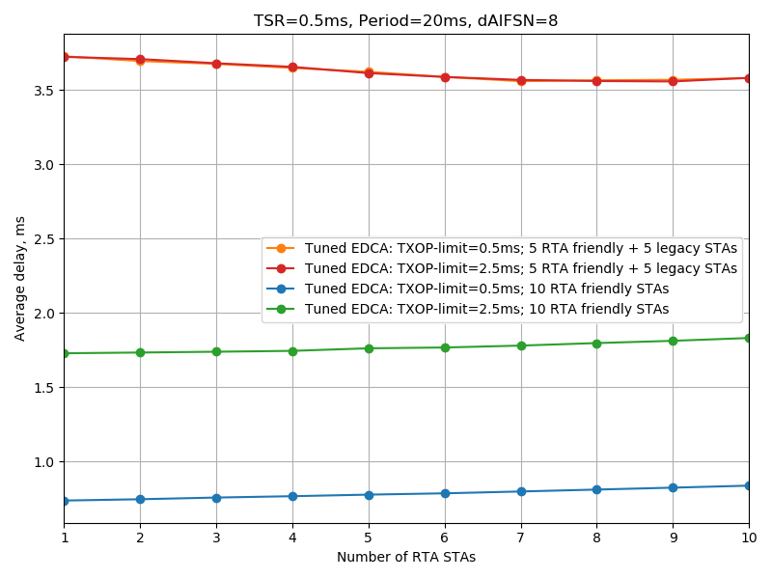
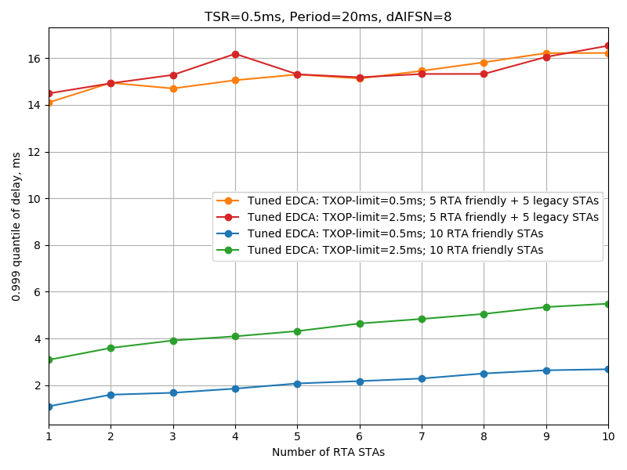
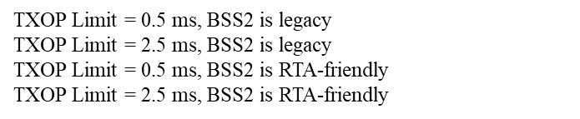
Performance Evaluation, Delay
Average delay
99.9% percentile of delay
Caused by tuning EDCA at
neighboring APs
Legacy STAs have default AC_BE parameters and their transmissions can collide with RTA STAs’ transmissions
With legacy OBSS operation (5+5), delays are even a bit higher than without tuning EDCA Parameters in own BSS (see slide 10).

Slide 16
Proposal
An RTA-friendly AP can ask the neighboring RTA-friendly APs
to limit the maximal TXOP Limit of all ACs
to limit the minimal AIFSN[AC] for all non-RTA ACs
Other EDCA parameters TBD.
For that, the AP that has RTA traffic, indicates in its beacons (or other frames) the requested maximal TXOP Limit and minimal AIFSN for neighboring APs during the time, when and if such limitations are needed.
The neighboring RTA-friendly APs need to receive such a request in the beacon and they shall modify the EDCA parameter set and MU EDCA Parameter set for their BSSs to satisfy the limits.
  Note: only the AP-AP interaction is proposed. AP-STA interaction works as is.
  Note: In case of AP MLDs, the proposed operation works independently on each link.

Slide 17
Container for the Requested Parameters. Option 1
Use the existing EDCA Parameter Set element but add a 1-bit field called RTA EDCA Parameters Request to specify that the AP requests the neighboring APs to tune their EDCA parameters according to the limits calculated from the EDCA Parameter Set of the requesting AP
Requested TXOP Limit = maximal TXOP limit of the EDCA Parameter set
Minimal AIFSN = minimal AIFSN of non-RTA ACs limit of the EDCA Parameter set
The request is valid during some preassigned value, e.g., a beacon interval or a DTIM interval
Pros: small overhead
Cons: in case of multiple OBSS with RTA traffic, all APs are tuned according to the strongest limitations (see next slide)

Slide 18
Container for the Requested Parameters. Option 1 (cont.)
In case of multiple OBSS with RTA traffic, all APs are tuned according to the strongest limitations.
Consider multiple BSSs of RTA-friendly APs as shown below. All APs sense beacons of the neighboring APs.
AP1, AP2 and AP3 have RTA traffic and set up the RTA EDCA Parameters Request bit
AP1
AP2
AP3
Requests AIFSN_{non-RTA}=10
Requests AIFSN_{non-RTA}=15
Requests AIFSN_{non-RTA}=5

Slide 19
Container for the Requested Parameters. Option 1 (cont.)
In case of multiple OBSS with RTA traffic, all APs are tuned according to the strongest limitations
Consider multiple BSSs of RTA-friendly APs as shown below. All APs sense beacons of the neighboring APs.
AP1, AP2 and AP3 have RTA traffic and set up the RTA EDCA Parameters Request bit
AP1
AP2
AP3
Requests AIFSN_{non-RTA}=10
Requests AIFSN_{non-RTA}=15
Beacon
Requests AIFSN_{non-RTA}=5
AIFSN_{non-RTA} =15
AP1
AIFSN=10
All use
AIFSN_{non-RTA} =15
AP2
AIFSN=10
AIFSN_{non-RTA}=15
AP3
AIFSN=15

Slide 20
Container for the Requested Parameters. Option 2
A candidate container is an RTA EDCA Information Element with the fields
Requested TXOP Limit ( 2 octets)
Minimal AIFSN (1 octet)
Validity (1 octet) – measured in beacon intervals
Other fields – TBD
Such IE should be included in all beacons while the restriction is needed.
Pros: Better flexibility, explicit notification fixes the problem from previous slide
Cons: Need to design an additional element

Slide 21
Conclusion
Configuration of TXOP limit and AIFSN for RTA and non-RTA transmissions can provide delay less than 10 ms with reliability higher than 99.999%
In OBSS scenarios, we need to sync EDCA Parameters at neighboring APs.
A method to sync EDCA Parameters is proposed and evaluated.

Slide 22
SP 1
Do you support to define a method intended to limit the values in the EDCA parameters set and MU EDCA Parameter set at neighboring APs?

Slide 23
SP 2
Do you support to define an RTA-friendly AP that shall follow specific channel access rules to support RTA, regardless of the presence of RTA traffic.
  Note: The exact name for RTA-friendly AP is TBD
  Note: The exact channel access rules are TBD (e.g., tuning EDCA parameters)

Slide 24
SP 3
Do you support that an 11be AP can declare itself as RTA friendly by setting an RTA-friendly flag in its capability information element?

Slide 25
SP 4
Which option do you prefer as the container for requesting EDCA parameters in beacons:
Option 1 (RTA EDCA Parameters Request Bit)
Option 2 (RTA EDCA Parameter Set Information Element)
Both
Neither
Need more info
Abstain
  Note: Exact names are TBD
  Exact location of RTA EDCA Parameters Request Bit is TBD

