Slide 1
Channel Modeling for WLAN Sensing Indoor Scenario
Date: 2020-11-17
Authors:
 | Affiliation | Address | Phone | Name
Meihong Zhang | Huawei Technologies Co. Ltd | F3, Huawei Base, Shenzhen, China |  | zhangmeihong@huawei.com
Hailiang Xie
Rui Du
Xiaohui Peng
Danny Kai Pin Tan
Chenchen Liu
Yingxiang Sun
Jie Xu | CUHK (SZ)
Rui Wang | SUSTC
Shuai Wang

Slide 2
1. Abstract
In [1], three options for generating rays used in channel realization generation process were presented, including
Option 1: execute ray tracing software for each scenario;
Option 2: integrate an abstract target model into existing channel model;
Option 3: establish a database which records the results obtained by
ray tracing software.
In this contribution, we will show some ray tracing simulation results of a specified indoor scenario (corresponding to option 1 and 3).

Slide 3
2. Scenario
Static living room scenario,
Our proposed scenario (right picture) is similar with the home living room in 11ad, but with different parameters;
AP (TX) and STA (RX) at fixed positions;
Isotropic V polarization antennas are adopted for both transmitter and receiver.
11ad: Home Living Room

Slide 4
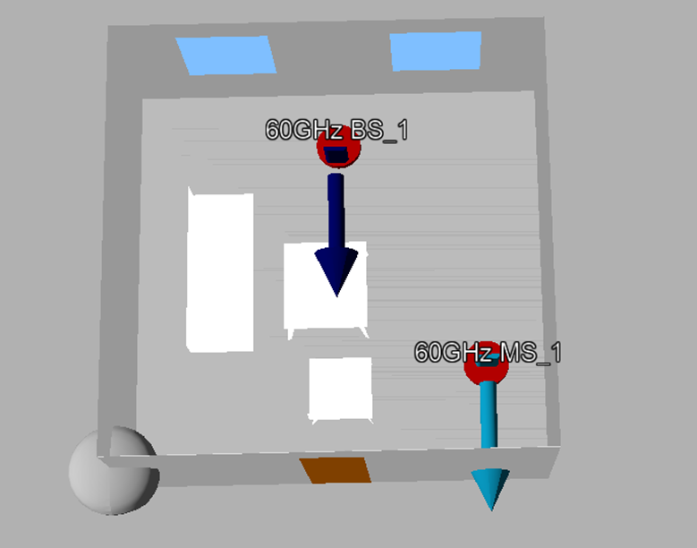
3. Deterministic Channel Model – Ray Tracing (1)
Corresponding 3D model depicted by the ray tracing software is shown below,
Specified parameters are listed in the table；
Object | size | material
Chair | 2.8m*1.05m*1m | wood
Chair with feet | 1.05m*1.05m*1m | wood
Table with feet | 1.5m*0.7m*0.8m | wood
Door | width=1m, height=2.5m | wood
Windows | Width=1.5m,height=1m~2.5m | glass
Wall |  | concrete
Floor |  | concrete
Frequency | 60GHz
Bandwidth | 2160MHz

Slide 5
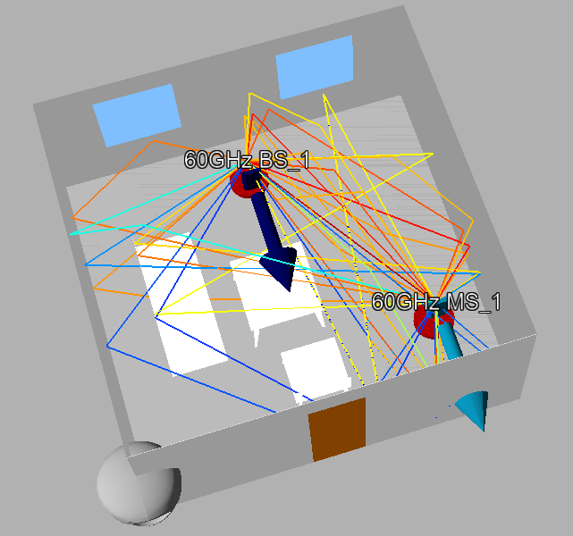
3. Deterministic Channel Model – Ray Tracing (2)
Simulation results,
LOS ray, First order reflections and Second order reflections are considered;
Diffraction mechanism will be considered in our future work.

Slide 6
4. Sensing Scenario
Dynamic living room scenario
A target (35cm*35cm*1m) traveling in a straight path at a speed of 1 m/s inside the static living room as illustrated below.

Slide 7
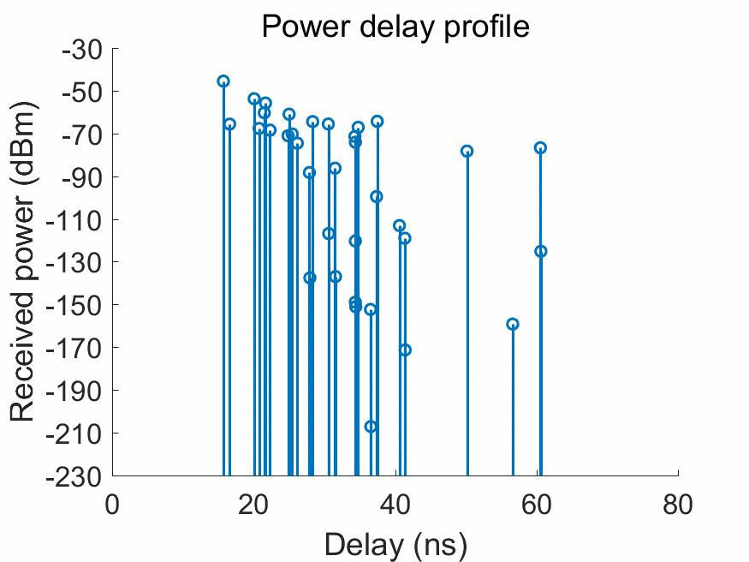
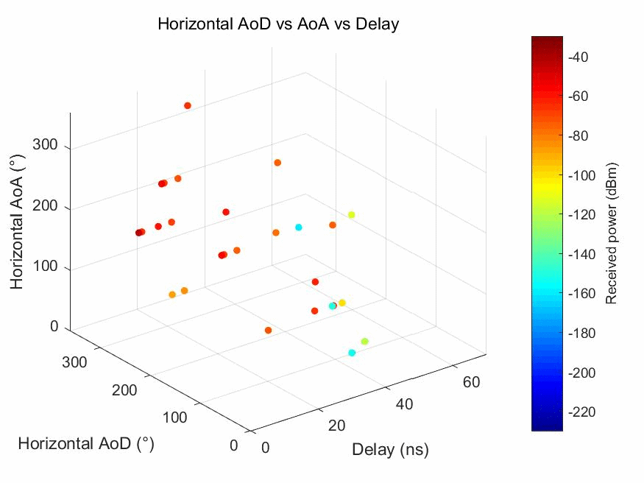
5. Sensing Channel Model – Ray Tracing (1)
Simulation results
Main characteristics,
  As the target moves in the environment,
    Parameters (power, AoA, AoD, and delay) of some rays are changing;
    Some new rays are generated, like TX→Target→RX，TX→Wall→Target→RX；
    Some rays first appear and then disappear.
    Some rays first disappear and then re-appear, like TX→Wall→RX；
    Some rays disappeared.

Slide 8
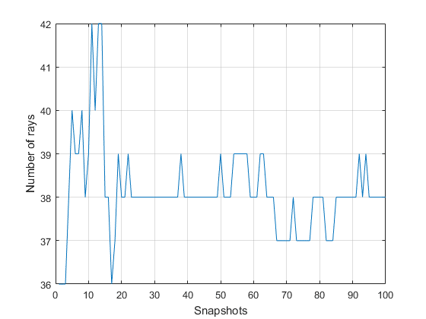
5. Sensing Channel Model – Ray Tracing (2)
Simulation results,
  The total number of rays is changing, this figure can also validate the generation and disappearance of some rays.

Slide 9



5. Sensing Channel Model – Ray Tracing (3)
More details on the underlying propagation mechanisms implanted in the ray tracer are not public to us since the software we used is an encapsulated commercial software.
  Maybe some values of parameters adopted in 11ay can be reused in WLAN sensing channel model, such as
  LOS ray power can be calculated as free-space pathloss with oxygen absorption;
  ground-reflected power calculated as free-space pathloss with oxygen absorption, with additional reflection loss calculated on the base of Fresnel equations.
  However, pathloss reflected from human needs to consider additional factors, like permittivity, surface roughness, reflection loss, …
$$P_{LOS}=20\log_{10}\left(\frac{λ}{4πd_{LOS}}\right)−A_{0}d_{LOS}$$
$$P_{⊥}=20\log_{10}\left(\frac{λ}{4πd_{G}}\right)−A_{0}d_{G}+R_{⊥}+F$$
$$P_{∥}=20\log_{10}\left(\frac{λ}{4πd_{G}}\right)−A_{0}d_{G}+R_{∥}+F$$

Slide 10
6. Conclusion
In this presentation, some ray tracing simulation results of a specified indoor scenario are proposed.
Corresponding to the options we proposed in [1],
  For option 1, we can execute the ray tracing software for each snapshot just like what we did in this slide when performing the channel realization generation process;
  For option 3, we can perform the ray tracing simulations offline, then store the parameters (powers, delays and angles) we obtained at each snapshot in the database for future use.

Slide 11
7. Follow Up
We will try to conduct some experimental measurements to validate the accuracy of our ray tracing results.

Slide 12
8. References
[1] 11-20-1334-00-SENS-a-brief-description-of-the-channel-realization-generation-process.pptx

