Slide 1
Reconsideration on STA MAC Address of Non-AP MLD
Date: 2020-09-02
Authors:
Name | Affiliations | Address | Phone | Email
Guogang Huang | Huawei |  |  | huangguogang1@huawei.com
Michael Montemurro
Stephen McCann
Yuchen Guo
Yunbo Li
Yiqing Li
Ming Gan
Mengyao Ma
Wei Lin
Notes:
September 2012

Slide 2
Introduction
The following motion is passed
  802.11be supports that if different affiliated APs of an AP MLD have different MAC addresses, then different affiliated non-AP STAs of a non-AP MLD with more than one affiliated STA have different MAC addresses.
  [Motion 112, #SP38, [13] and [99]]
In this contribution, we will point out that non-AP MLD can use the same affiliated STA MAC address as the non-AP MLD MAC address
Revisions
  Revision 0: Initial version of the document.
  Revision 1: Updated based on offline feedback
  Revision 2: Addressed comments received during the call, and provide a solution for the addressing issue of management frames

Slide 3
Background
https://mentor.ieee.org/802.11/dcn/20/11-20-1545-01-00be-mld-security-considerations.pptx [1]
  The contribution describes the addressing scheme for the unicast data frame between non-AP MLD and AP MLD, as shown in the below Table
    Note that when it is transmitted through a specific link, then both A1and A2 will be replaced by using the transmitting link MAC Address. For the A-MSDU case, A3 will also be replaced by using the transmitting link MAC Address
  But it does not provide a solution for unicast management frames.
Frame Type | Direction | AAD
 |  | A1 | A2 | A3
 |  |  |  | MSDU | A-MSDU
Unicast data frame | DL | Non-AP MLD MAC Address | AP MLD MAC Address | SA | AP MLD MAC Address
 | UL | AP MLD MAC Address | Non-AP MLD MAC Address | DA | AP MLD MAC Address

Slide 4
Technical Problem
In the base 802.11 standard, the addressing of unicast management frames is as follows:
  A1 = RA/DA, A2 = TA/SA, A3= BSSID
In the multi-link operation (MLO), the legacy AP is split into two logical entities (an affiliated AP and an AP MLD), with security management in the AP MLD.
The addressing of the unicast management frame is no longer correct, as the existing base 802.11 scheme indicates that frames may be directed to the affiliated AP, which does not manage security and therefore management frames cannot be encoded or decoded

Slide 5
Technical Problem
AP MLD
2.4 GHz AP-1
5 GHz
AP-2
No Security Association (communications over this link use the AP MLD security association)
Security Association with AP MLD
2.4 STA-1
5 STA-2
Non-AP MLD

Slide 6
Solution
The base 802.11 standard addressing scheme for unicast management frames is updated for Multi-Link Operation (MLO).
The addressing scheme is updated, so that unicast Management frames are forwarded between the affiliated STA and the MLD STA (e.g. the split logical entities) internally within an MLD, to allow transmission and reception of the frames at the affiliated STA and security encoding and decoding of the frames at the MLD STA.
The routing of link-level unicast management frames (e.g. RRM) can be done by setting the A3 address to the affiliated AP/BSSID or the AP MLD.

Slide 7
Solution (Cont.)
For the unicast MMPDU between non-AP MLD and AP MLD, the proposed AAD construction is shown as the below table
  When it is transmitted through a specific link, then both A1 and A2 within MMPDU Header will be replaced by using the transmitting link MAC Address
    Note A3 within MMPDU Header will NOT be replaced by using the transmitting link MAC Address
Frame Type | Direction | AAD
 |  | A1 | A2 | A3
Unicast MLD-level MMPDU between MLDs | DL | Non-AP MLD MAC Address | AP MLD MAC Address | AP MLD MAC Address
 | UL | AP MLD MAC Address | Non-AP MLD MAC Address | AP MLD MAC Address
Unicast link-level MMPDU between MLDs | DL | Non-AP MLD MAC Address | AP MLD MAC Address | Affiliated AP BSSID of target link
 | UL | AP MLD MAC Address | Non-AP MLD MAC Address | Affiliated AP BSSID of target link

Slide 8
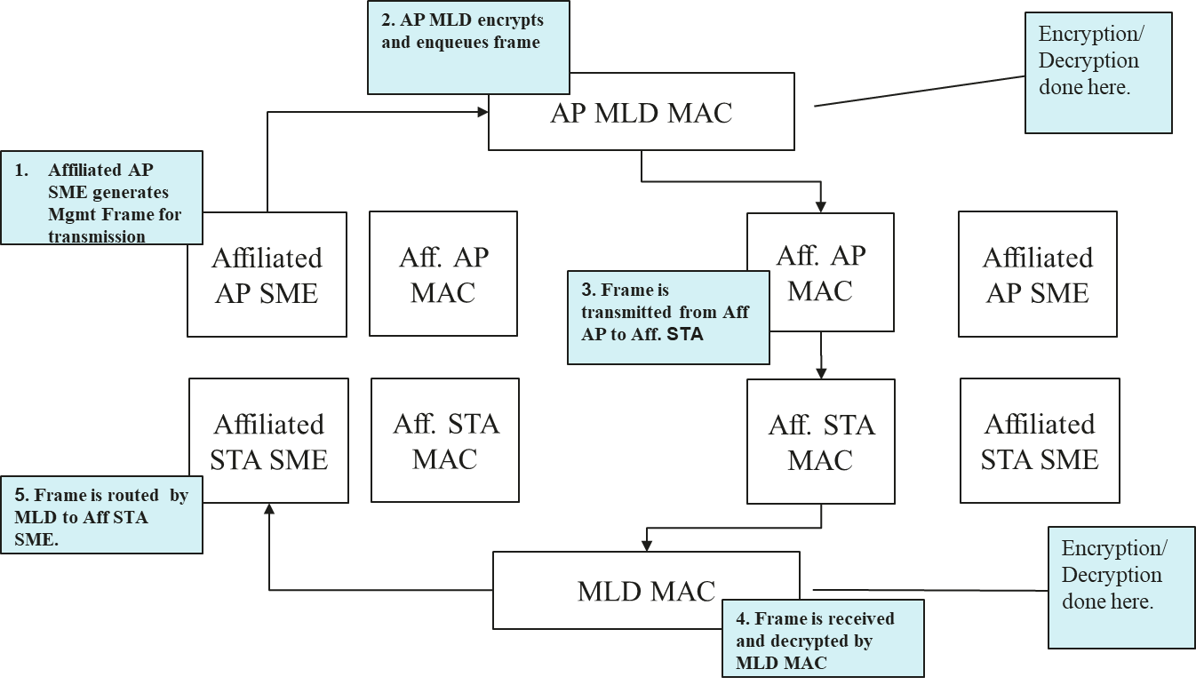
MLD Architecture – Unicast Management frame path

Slide 9
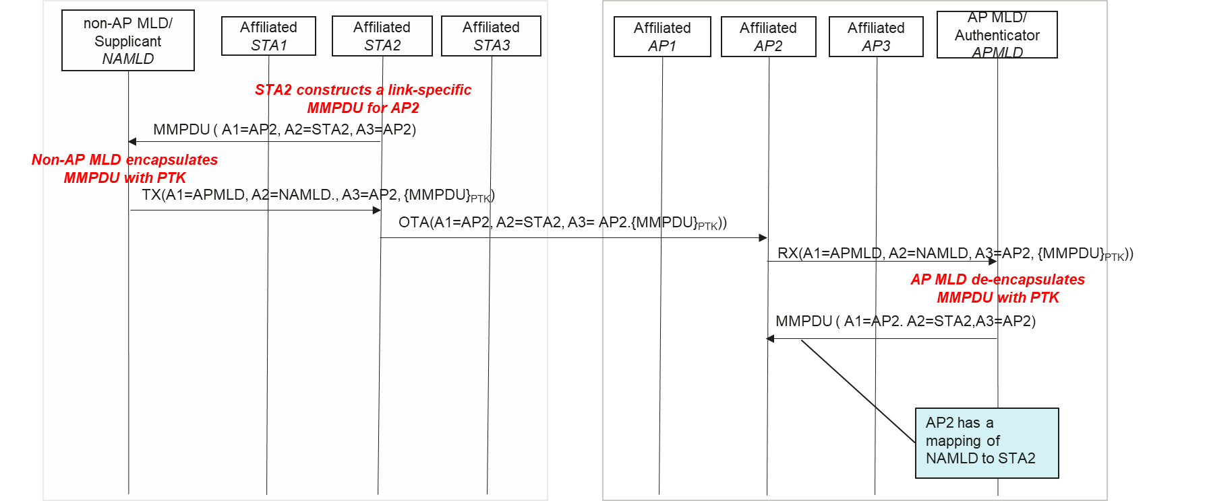
Example link-level management frame flow

Slide 10
Benefits
The proposed solution for the unicast Management frame has the following benefits:
  The Management frame can be transmitted through any link just like the Data frame, irrespective of the link-level Management frame or the MLD-level Management frame
  When retransmitted through another link, the AAD will not change and thus no need to re-encrypt it.
  Fully decouple the encryption with selecting the transmitting link

Slide 11
TDLS Extension
For the unicast P2P Data frame, the AAD construction is shown as the below table
  For case 2, when it is transmitted through a specific direct link, then A1, A2 and A3 will be replaced by using the corresponding direct link MAC Address
Frame Type | Direction | AAD
 |  | A1 | A2 | A3
Case 1: Unicast P2P Data frame between legacy STA and non-AP MLD | P2P | Non-AP MLD MAC Address | legacy STA MAC Address | Affiliated AP MAC Address
 | P2P | legacy STA MAC Address | Non-AP MLD MAC Address | Affiliated AP’s MAC Address
Case 2: Unicast p2p Data frame between non-AP MLDs | P2P | Non-AP MLD MAC Address 1 | Non-AP MLD MAC Address 2 | AP MLD MAC Address

Slide 12
Addressing for Non-AP MLD
With the above solution, the non-AP MLD can use the same affiliated STA MAC address as the non-AP MLD address without any security issue
A single MAC Address for the non-AP MLD has the following benefits
  For the AP side, there is no need to do address conversion for non-AP MLD
  No addressing issue, e.g.
    It can simplify the non-AP MLD’s roaming between a legacy AP and an AP MLD [3].
    It can simplify the TDLS addressing proposed in [4]
  Low signaling overhead
    E.g. Association Request, 4-way handshake [5]

Slide 13
Signaling
The Spec. can define the following two modes:
  Transparent mode. Non-AP STAs affiliated with a non-AP MLD use the same MAC address as the MLD MAC address
  Nontransparent mode. Non-AP STAs affiliated with a non-AP MLD use the different MAC address
Use a bit within the Multi-link Control field of Multi-link element to indicate which mode (transparent/nontransparent) is used
  0: Transparent mode
  1: Nontransparent mode. Then the MAC Address field for the corresponding STA is present in Per-STA Control field of ML element

Slide 14
Conclusions
With the proposed Addressing scheme, the security for the unicast Management frame can function correctly within a multi-link device.
Furthermore, the non-AP MLD can use the same affiliated STA MAC address as the non-AP MLD address without any security issue

Slide 15
Reference
[1] 11-19-1900-03-00be-mla-security-considerations
[2] 11-20-1545-01-00be-mld-security-considerations
[3] 11-20-0669-04-00be-mld-transition
[4] 11-20-1692-01-00be-tdls-handling-in-mlo.pptx
[5] 11-20-0727-00-00be-mla-link-mac-addresses-security.pptx

Slide 16
SP 1
Do you agree with the following AAD construction for the unicast Management frame
  Note. When the frame is transmitted through a specific link, then both A1 and A2 within MPDU Header will be replaced by using the corresponding link MAC Address
  Y
  N
  A
Frame Type | Direction | AAD
 |  | A1 | A2 | A3
Unicast MLD-level management frame between MLDs | DL | Non-AP MLD MAC Address | AP MLD MAC Address | AP MLD MAC Address
 | UL | AP MLD MAC Address | Non-AP MLD MAC Address | AP MLD MAC Address
Unicast link-level management frame between MLDs | DL | Non-AP MLD MAC Address | AP MLD MAC Address | Target affiliated AP BSSID
 | UL | AP MLD MAC Address | Non-AP MLD MAC Address | Target affiliated AP BSSID

Slide 17
SP 2
Do you agree with the following AAD construction for the unicast p2p Data frame
  Note. For case 2, when it is transmitted through a specific link, then A1, A2 and A3 within MPDU Header will be replaced by using the corresponding link MAC Address
  Y
  N
  A
Frame Type | Direction | AAD
 |  | A1 | A2 | A3
Case 1: Unicast P2P Data frame between legacy STA and non-AP MLD | P2P | Non-AP MLD MAC Address | legacy STA MAC Address | Affiliated AP MAC Address
 | P2P | legacy STA MAC Address | Non-AP MLD MAC Address | Affiliated AP’s MAC Address
Case 2: Unicast p2p Data frame between non-AP MLDs | P2P | Non-AP MLD MAC Address 1 | Non-AP MLD MAC Address 2 | AP MLD MAC Address

Slide 18
SP 3
Do you support that different affiliated non-AP STAs of a non-AP MLD with more than one affiliated STA can use the same MAC address as the non-AP MLD MAC address?
  Y
  N
  A

Slide 19
SP 4
Do you agree to use a bit within the Multi-link Control field of the Multi-link element to indicate which mode (transparent/nontransparent) is used
  0: Transparent mode. Then the STA MAC Address field for the corresponding STA affiliated with a non-AP MLD is not present in Per-STA Control field of Basic-variant ML element
  1: Nontransparent mode. Then the STA MAC Address field for the corresponding STA affiliated with a non-AP MLD is present in Per-STA Control field of Basic-variant ML element
  Y
  N
  A

