Slide 1
Secure LTFs – Additional Design Details
Date: 2020-12-07
Authors:
Name | Affiliations | Phone | email
Steve Shellhammer | Qualcomm |  | shellhammer@ieee.org
Bin Tian |  |  | btian@qti.qualcomm.com
Ali Raissinia |  |  | alirezar@qti.qualcomm.com
Youhan Kim |  |  | youhank@qti.qualcomm.com
Anuj Batra | Apple |  | anuj.batra@apple.com
John Dogan |  |  | mithat_dogan@apple.com
Tianyu Wu |  |  | tianyu@apple.com
Vinko Erceg | Broadcom |  | vinko.erceg@broadcom.com
Nehru Bhandaru |  |  | nehru.bhandaru@broadcom.com
Luis Gutierrez |  |  | luis.gutierrez@broadcom.com
Manas Deb |  |  | manas.deb@broadcom.com
Mengchang Doong |  |  | mengchang.doong@broadcom.com
Hossein Roufarshbaf |  |  | hossein.roufarshbaf@broadcom.com
Robert Stacey | Intel |  | robert.stacey@intel.com
Gadi Shor |  |  | gadi.shor@intel.com

Slide 2
Introduction
In an earlier contribution [1] we provided a proposal for Secure LTF design
The proposal was extended from 64QAM to 64QAM+4PSK in [2]
Here we discuss three Design Details for the Secure LTFs
Phase Rotation for Multi-Stream Secure LTFs
AES-128 Counter Mode Output Processing
160-MHz Secure LTFs

Slide 3
Phase Rotation for Multi-Stream Secure LTFs

Slide 4
Background
It is important to change the phase rotation values for the spatial streams for each Repetition, so that any unintended beamforming does not repeat from one Repetition to another
  For each stream, the phase rotation is the same across all tones within the LTF and is held constant over all LTFs within one repetition. From one repetition to another, the phase rotation for each stream may change.
  The phase rotation values for the spatial streams need to stay constant within a Repetition, to avoid a complex matrix inversion
  See the section on “Multi-Stream Signal Case” in [1] for more on the reasons for this design

Slide 5
Design
Pseudo Random Phase Rotation
We use pseudo random bits from the AES-128 CTR Mode to generate the random phase rotations for the various spatial streams
Additional Deterministic Phase Rotation
Starting with Repetition #2 we apply an additional deterministic phase rotation to each of the spatial streams
This additional phase rotation is designed so that the phase values do not generally repeat

Slide 6

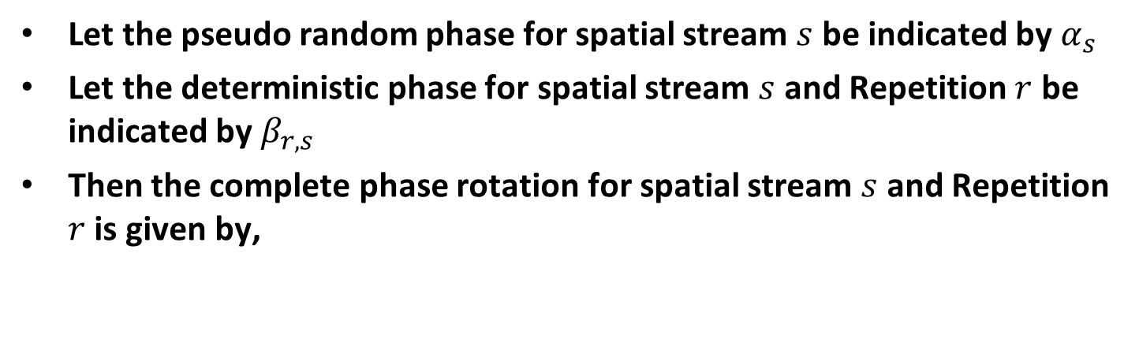
Combining Pseudo Random and Deterministic Phase Values
Let the pseudo random phase for spatial stream $s$ be indicated by $α_{s}$
Let the deterministic phase for spatial stream $s$ and Repetition $r$ be indicated by $β_{r,s}$
Then the complete phase rotation for spatial stream $s$ and Repetition $r$ is given by,
$$θ_{r,s}=α_{s}+β_{r,s}$$

Slide 7
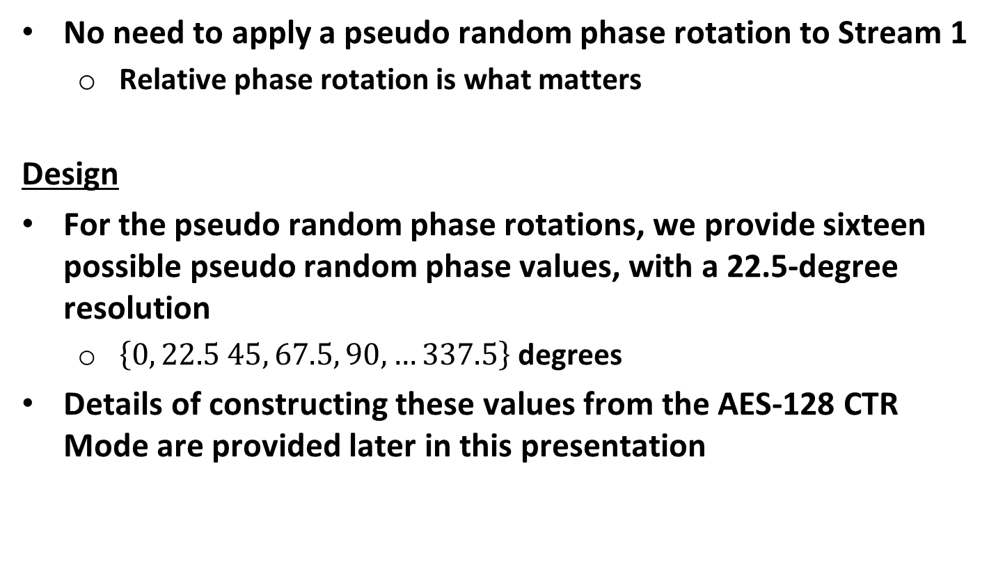
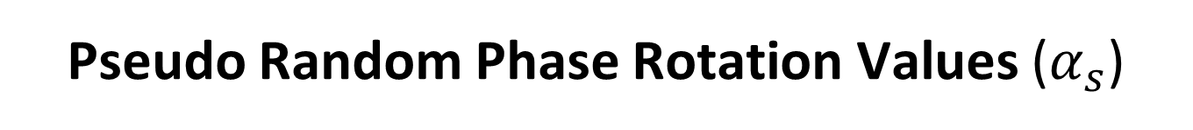
Pseudo Random Phase Rotation Values ($α_{s}$)
No need to apply a pseudo random phase rotation to Stream 1
  Relative phase rotation is what matters
Design
For the pseudo random phase rotations, we provide sixteen possible pseudo random phase values, with a 22.5-degree resolution
  $\left\{0, 22.5 45, 67.5, 90, …337.5\right\}$ degrees
Details of constructing these values from the AES-128 CTR Mode are provided later in this presentation

Slide 8
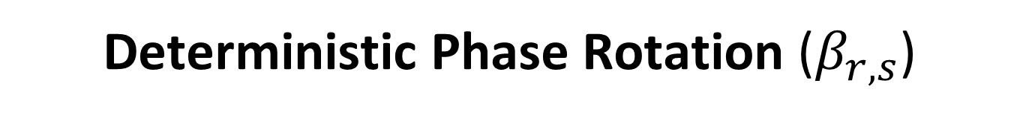
Deterministic Phase Rotation ($β_{r,s}$)
The phase rotation should depend on two parameters
  The Spatial Stream Number
  The Repetition Number
The rotation for the first Repetition should be zero degrees
  No additional phase rotation beyond the pseudo random phase rotation
The phase rotation for subsequent Repetitions should generally be different than the previous Repetitions
  This provides different beamforming patterns on different Repetitions
  We provide eight different phase rotation values with resolution of 45 degrees

Slide 9
Deterministic Phase Rotation
Here we provide a table of deterministic phase rotations (in degrees)
There is a phase rotation for each spatial stream and each repetition within the Secure LTF
SS1
SS2
SS3
SS4
SS5
SS6
SS7
SS8
R1
0 0 0 0 0 0 0 0
0 90 135 225 180 270 315 45
0 135 225 45 180 315 90 270
0 315 270 180 45 225 135 90
0 45 180 270 315 225 135 90
0 270 45 90 315 180 225 135
0 180 315 135 90 45 225 270
0 225 90 315 45 180 270 135
R2
R3
R4
R5
R6
R7
R8
No phase value repetitions in any of the rows
A few columns (after SS4) with a repeated phase value

Slide 10
AES-128 CTR Mode Output Processing

Slide 11
Background
Background
The AES-128 CTR mode outputs 128 bits at a time
  16 Bytes at a time
These bits are needed for two purposes:
  Pseudo random phase rotation of the spatial streams
  Pseudo random 64QAM+4PSK symbols for Secure LTF Symbols
Introduction
For a hardware-friendly implementation byte-oriented processing is preferred
Here we proposed a byte-oriented process for constructing the pseudo random phase rotations and the pseudo random 64QAM+4PSK symbols

Slide 12
Convert AES-128 CNT Mode into a Sequence of Bytes
For each output of the AES-128 CTR Mode we convert the 128 bits into a sequence of 16 bytes
  This can be implemented with a small 128-bit register that saves the output of the AES-128 CTR Mode
  The 16 Bytes can be read from the register while the next AES-128 CTR Mode output is being generated
The Byte order is least significant Byte First

Slide 13
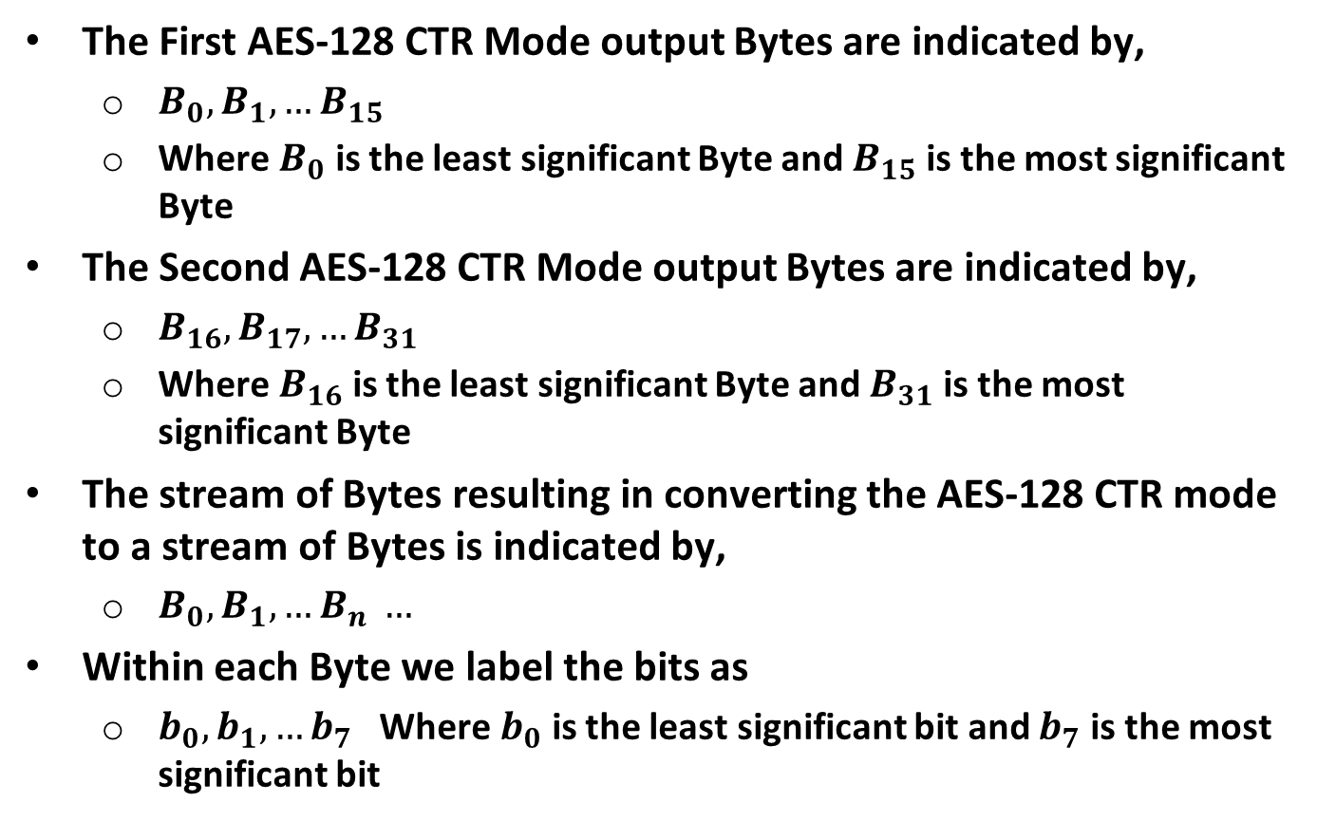
Notation
The First AES-128 CTR Mode output Bytes are indicated by,
  $B_{0}, B_{1}, …B_{15}$
  Where $B_{0}$ is the least significant Byte and $B_{15}$ is the most significant Byte
The Second AES-128 CTR Mode output Bytes are indicated by,
  $B_{16}, B_{17}, …B_{31}$
  Where $B_{16}$ is the least significant Byte and $B_{31}$ is the most significant Byte
The stream of Bytes resulting in converting the AES-128 CTR mode to a stream of Bytes is indicated by,
  $B_{0}, B_{1}, …B_{n} …$
Within each Byte we label the bits as
  $b_{0}, b_{1}, …b_{7}$ Where $b_{0}$ is the least significant bit and $b_{7}$ is the most significant bit

Slide 14
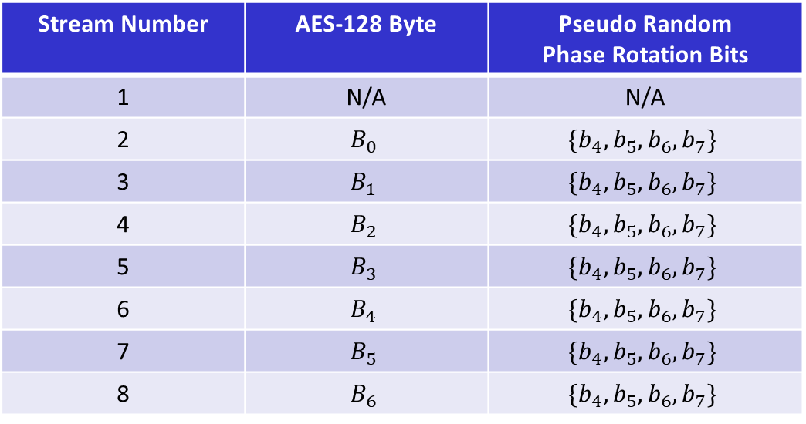
Pseudo Random Phase Rotation Values
We propose to use the first seven bytes to generate the pseudo random phase rotations for Streams 2 through 8
In an implementation where less than eight stream are used, then some of these seven least significant bytes will be unused
Stream Number | AES-128 Byte | Pseudo Random Phase Rotation Bits
1 | N/A | N/A
2 | $$B_{0}$$ | $$\{{b_{4},b}_{5}, b_{6},b_{7}\}$$
3 | $$B_{1}$$ | $$\{{b_{4},b}_{5}, b_{6},b_{7}\}$$
4 | $$B_{2}$$ | $$\{{b_{4},b}_{5}, b_{6},b_{7}\}$$
5 | $$B_{3}$$ | $$\{{b_{4},b}_{5}, b_{6},b_{7}\}$$
6 | $$B_{4}$$ | $$\{{b_{4},b}_{5}, b_{6},b_{7}\}$$
7 | $$B_{5}$$ | $$\{{b_{4},b}_{5}, b_{6},b_{7}\}$$
8 | $$B_{6}$$ | $$\{{b_{4},b}_{5}, b_{6},b_{7}\}$$

Slide 15
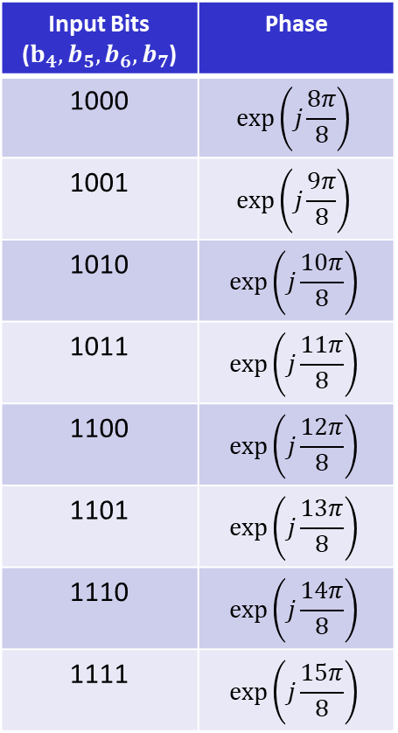
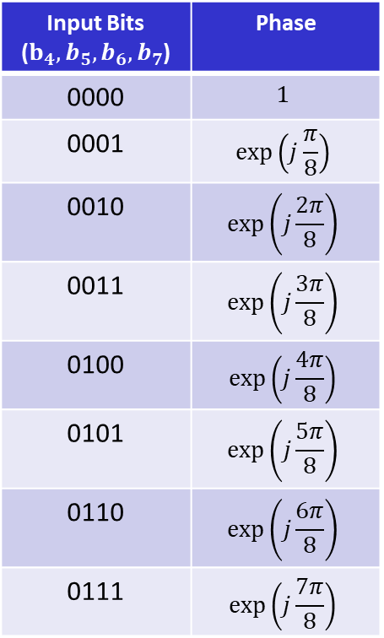
Pseudo Random Phase Rotation Values
Input Bits ($b_{4}, b_{5},b_{6}, b_{7}$) | Phase
1000 | $$\exp\left(j\frac{8π}{8}\right)$$
1001 | $$\exp\left(j\frac{9π}{8}\right)$$
1010 | $$\exp\left(j\frac{10π}{8}\right)$$
1011 | $$\exp\left(j\frac{11π}{8}\right)$$
1100 | $$\exp\left(j\frac{12π}{8}\right)$$
1101 | $$\exp\left(j\frac{13π}{8}\right)$$
1110 | $$\exp\left(j\frac{14π}{8}\right)$$
1111 | $$\exp\left(j\frac{15π}{8}\right)$$
Input Bits ($b_{4}, b_{5},b_{6}, b_{7}$) | Phase
0000 | $$1$$
0001 | $$\exp\left(j\frac{π}{8}\right)$$
0010 | $$\exp\left(j\frac{2π}{8}\right)$$
0011 | $$\exp\left(j\frac{3π}{8}\right)$$
0100 | $$\exp\left(j\frac{4π}{8}\right)$$
0101 | $$\exp\left(j\frac{5π}{8}\right)$$
0110 | $$\exp\left(j\frac{6π}{8}\right)$$
0111 | $$\exp\left(j\frac{7π}{8}\right)$$

Slide 16
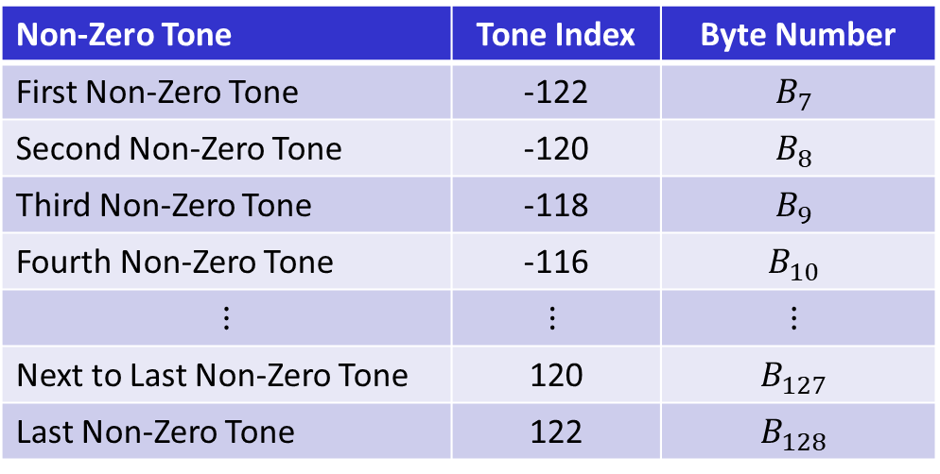
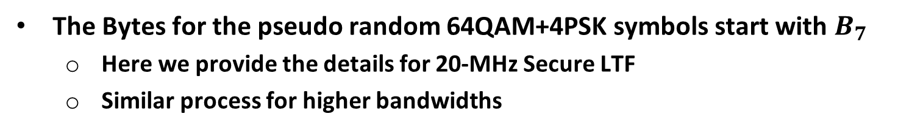
Pseudo Random 64QAM+4PSK Symbols
First Secure LTF Symbols
The Bytes for the pseudo random 64QAM+4PSK symbols start with $B_{7}$
  Here we provide the details for 20-MHz Secure LTF
  Similar process for higher bandwidths
Non-Zero Tone | Tone Index | Byte Number
First Non-Zero Tone | -122 | $$B_{7}$$
Second Non-Zero Tone | -120 | $$B_{8}$$
Third Non-Zero Tone | -118 | $$B_{9}$$
Fourth Non-Zero Tone | -116 | $$B_{10}$$
$$⋮$$ | $$⋮$$ | $$⋮$$
Next to Last Non-Zero Tone | 120 | $$B_{127}$$
Last Non-Zero Tone | 122 | $$B_{128}$$

Slide 17
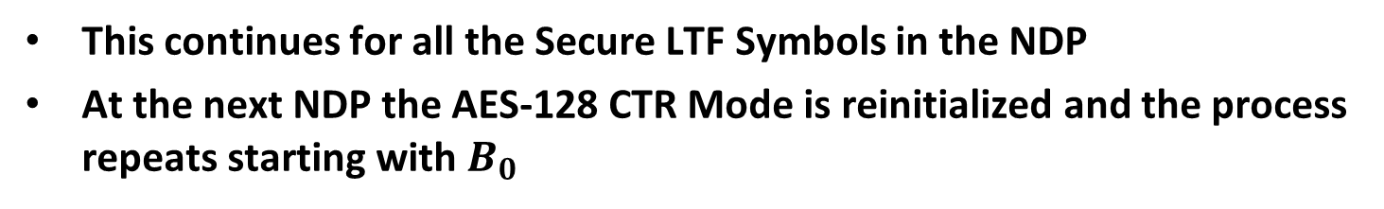
Second 20 MHz Secure LTF Symbols
The Second Secure LTF Symbol picks up where the First Secure LTF Symbol left off
Non-Zero Tone | Tone Index | Byte Number
First Non-Zero Tone | -122 | $$B_{129}$$
Second Non-Zero Tone | -120 | $$B_{130}$$
Third Non-Zero Tone | -118 | $$B_{131}$$
Fourth Non-Zero Tone | -116 | $$B_{132}$$
$$⋮$$ | $$⋮$$ | $$⋮$$
Next to Last Non-Zero Tone | 120 | $$B_{249}$$
Last Non-Zero Tone | 122 | $$B_{250}$$
This continues for all the Secure LTF Symbols in the NDP
At the next NDP the AES-128 CTR Mode is reinitialized and the process repeats starting with $B_{0}$

Slide 18
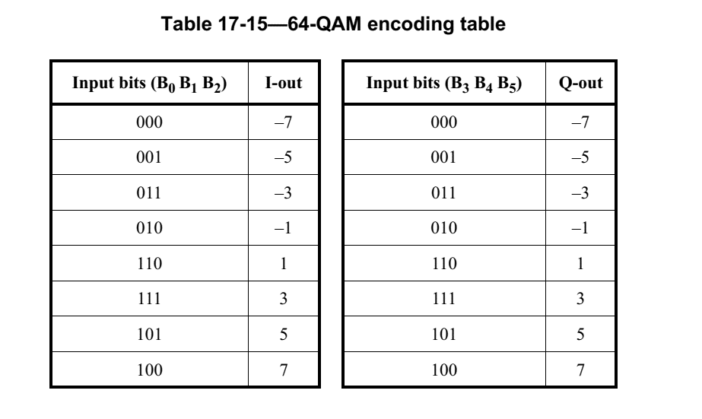
Mapping bits of Pseudo Random Byte to 64QAM+4PSK Symbols
For reference we provide Table 17-15 from the 802.11-2016 Standard for 64QAM Modulation
  We see that the six LSBs are used for 64QAM Modulation
  Note: the standard uses large “B” for bit (while we use small “b”) for bit in this presentation and large “B” for Byte
We propose using the six LSBs of the pseudo random byte to generate the 64QAM modulation as in Table 17-15

Slide 19
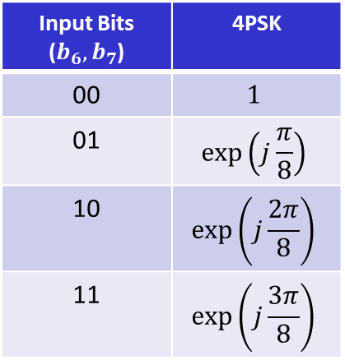
Mapping bits of Pseudo Random Byte to 64QAM+4PSK Symbols
The remaining two bits ($b_{6}, b_{7}$) in the pseudo random Byte can be used for the 4PSK modulation
Here we provide the tables for 64QAM and 4PSK
Input Bits ($b_{0},b_{1}, b_{2}$) | 64QAM I-Out
000 | -7
001 | -5
011 | -3
010 | -1
110 | 1
111 | 3
101 | 5
100 | 7
Input Bits ($b_{3},b_{4}, b_{5}$) | 64QAM Q-Out
000 | -7
001 | -5
011 | -3
010 | -1
110 | 1
111 | 3
101 | 5
100 | 7
Input Bits ($b_{6},b_{7}$) | 4PSK
00 | $$1$$
01 | $$\exp\left(j\frac{π}{8}\right)$$
10 | $$\exp\left(j\frac{2π}{8}\right)$$
11 | $$\exp\left(j\frac{3π}{8}\right)$$
A figure for the 64QAM+4PSK, with the bits from the pseudo random Byte is shown on the next slide

Slide 20
Mapping bits of Pseudo Random Byte to 64QAM+4PSK Symbols

Slide 21
160-MHz Secure LTFs

Slide 22
Background
For bandwidths less than or equal to 80 MHz the tones of the Secure LTF Symbols are populated from the lowest frequency to the highest frequency
For 160 MHz bandwidth we propose using a segment parser to distribute the pseudo random bytes between 80-MHz segments

Slide 23
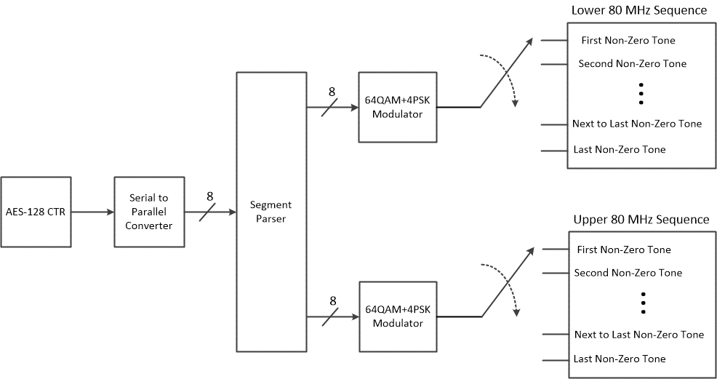
Proposed Design

Slide 24
Conclusions
Design Details for the Secure LTFs have been provided covering the following topics
Multi-Stream Phase Rotations
  Combines Pseudo Random and Deterministic Phase Rotations
AES-128 CTR Mode Output Processing
160-MHz Secure LTFs

Slide 25
Straw Poll
Do you agree to replace the existing 802.11az secure LTF design parameters with the following changes
  Using secure pseudo random 64QAM+4PSK modulation as defined in document 802.11-20/1855r0
    Security LTF value is pseudo randomized per tone and per OFDM symbol and is the same across all streams
  Using AES-128 Counter (CTR) Mode as a pseudo random bit generator for the sounding NDP sequence
    A 256-bit sequence from KDF is used to initialize AES128-CTR by using the first 128 bits as the Key and second 128 bits as IV, at the beginning of the NDP
  Using per-stream phase rotation which is updated every secure LTF Repetition
    Per-stream phase rotation angles are the same for all the tones and all the LTFs in one repetition
    Pseudo random phase rotation is generated at the beginning of the NDP using bits from the AES-128 Counter Mode
    An additional deterministic per-stream phase rotation is applied in each Repetition

Slide 26
References
Bin Tian, et. al., “11az Secure LTF Design,” IEEE 802.11-20/836r0, May 2020
Anuj Batra, et. al., “Further Updates on 11az Secure LTF Design,” IEEE 802.11-20/1855r0, November 2020

