Slide 1
802.11bc: UL Overview
Date: 2020-11-17
Name | Affiliation | Address | Phone | Email
Abhishek Patil | Qualcomm Inc. |  |  | appatil@qti.qualcomm.com
George Cherian
Alfred Asterjadhi
Stephen McCann | Huawei
Bahar Sadeghi | Intel
Antonio De La Oliva Delgado | Interdigital

Slide 2
Abstract
This presentation is a slide for joint telco with ARC to discuss the eBCS uplink architecture.

Slide 3
eBCS UL Scenario
An eBCS non-AP STA broadcasts UL eBCS (Mgmt) frame which includes:
URI to the remote destination
A small payload carrying content from higher layer
Optionally includes security parameters (certificate, timestamp and frame signature)
Optionally includes a request to embed metadata
Expected to be periodic in nature
An eBCS AP that provides forwarding service:
Forwards the higher layer content to the specified remote destination
AP may perform source authentication or limit the amount/frequency of forwarding or embed metadata before forwarding. This can be based on an agreement with remote destination
Forwarding service is best effort:
Non-AP STA may be unassociated with the forwarding AP
Non-AP STA is not required to monitor the medium to discover APs that support forwarding
It is possible that more than one AP in the neighborhood forwards the frame.

Slide 4
eBCS UL Operation
Key highlights
  Public Action frame broadcasted by an eBCS STA
    Self contained frame – includes destination address, higher layer data, security parameters (optional) and request to embed metadata (optional)
  Forwarding AP extracts destination address and higher layer content
    creates an IP packet to be sent to the remote destination (out of scope of .11)
  Forwarding AP may have a relationship with remote server
    Authentication, throttling and format of metadata based on relationship with remote destination
      End-to-end authentication is out of scope of .11.
    Otherwise, assumes higher layer authentication and local throttling policies

Slide 5
Appendix

Slide 6
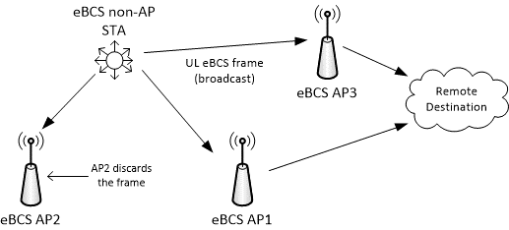
eBCS AP configuration
Each forwarding AP sends an IP packet to the remote destination
Possibility of a single IP packet directed to the remote destination when forwarding APs belong to the same ESS

Slide 7
Use Case 10: AP tagged UL forwarding
Topology/Architecture
Stakeholders
  IoT Users, IoT operators, tracking services, etc
  Manufactures of semiconductor, APs, networking and mobile devices
Service scene
  An eBCS AP provides forwarding service to an end-servers for eBCS non-AP STAs that may not be associated with the AP
  An eBCS AP appends on additional information before forwarding the packet to the addressed server
Required function
Pre-configured low-cost low power tracker device automatically connects to an end server through eBCS APs in the neighborhood with zero setup action
Tracker device periodically reports to its server through eBCS APs without scanning and association
eBCS AP appends metadata (such as IP, date/time, location, RSSI etc) to the packets before forwarding to the destination server
Meta-data from an eBCS AP will be protected
Expected benefits:
  Ability to broadcast information destined to the end server
  Ability to reduce cost and implementation complexity
  Ability to enable low power STA operations

Slide 8
OCB for UL Data
In the early days of the project, TGbc discussed OCB as an option for UL forward use case and decided to not pursue it
Primary reasons being:
  OCB doesn’t have the concept of infra-BSS
  As a result, a forwarding eBCS AP would need to implement at least two interfaces
    One to support eBCS AP operation
    Another to operate as an eBCS ‘STA’

Slide 9
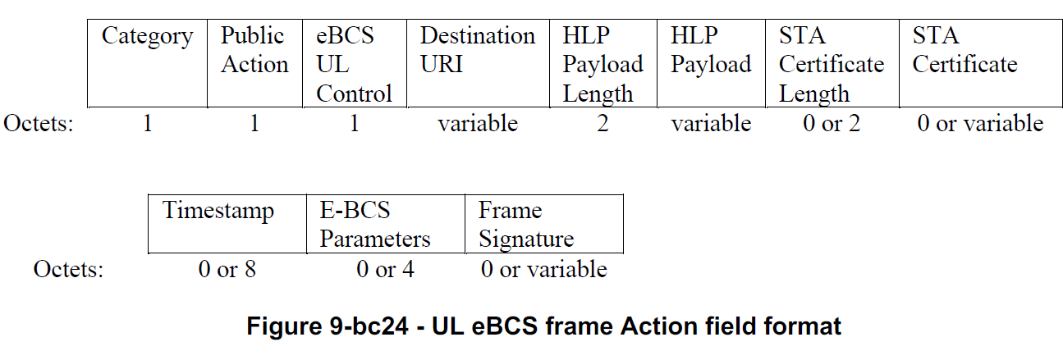
UL eBCS frame format

