Slide 1
Channel access rules for NSTR AP MLD
Date: 2021-02-09
Authors:

Slide 2
Introduction
The NSTR AP operation as a soft AP has been agreed on SFD [1]
“802.11be defines mechanisms to support the operation of a Non-STR AP MLD in R1. The mechanisms are limited to instantiate a Non-STR Non-AP MLD as a Soft AP that could utilize all its links under TBD conditions. The exact language to govern such scope is TBD. ”
The NSTR AP operation should be limited, as the timing of uplink transmission cannot be predicted
This presentation suggests NSTR AP concept and the basic uplink operation

Slide 3
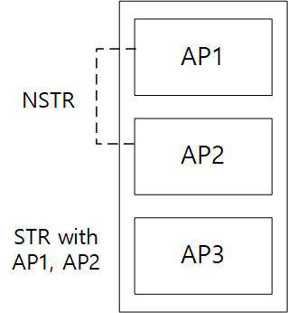
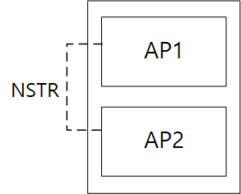
NSTR AP cases
The NSTR AP includes at least one NSTR link pair:
It may include STR link pair
It may include only NSTR link pair

Slide 4
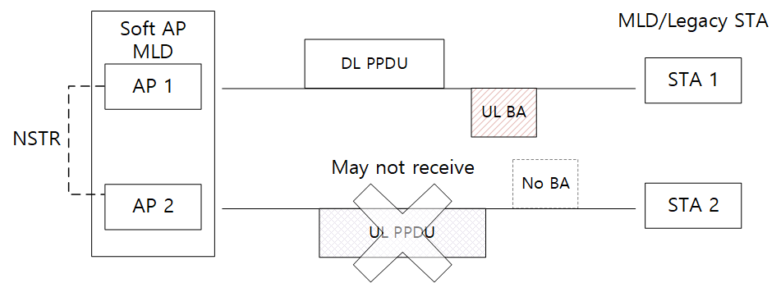
The NSTR AP problem
As in previous contributions, the NSTR link pair in AP may cause performance degradation [2-6]
Caused by the unpredicted uplink transmissions from non-AP MLD and Legacy STA

Slide 5
Proposal for NSTR AP: Basic link
To address the problem caused by uplink transmission, the uplink access from non-AP STA MLD and legacy STA should be restricted
In order to manage the uplink transmission, we propose to define a basic link concept among the NSTR link pair
As in primary link in NSTR link grouping in [2-3] and basic link set[5]
Our definition of Basic link is:
If a link is STR with the other links in the AP, it is a basic link
If a link is NSTR with at least one link of other links, only one link of NSTR link set can be a basic link
NSTR link set: a inseparable group of links in which each link is NSTR with another link in the same group
Note: A NSTR AP may have more than one basic links

Slide 6
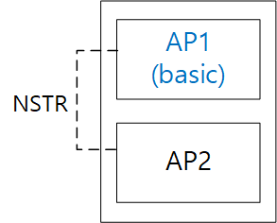
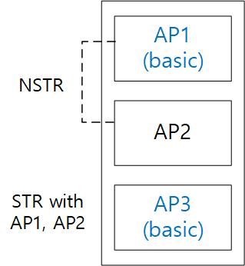
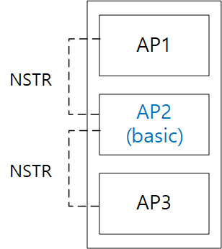
Proposal for NSTR AP: Basic link
Examples on the Basic link concept:
When a NSTR AP only contains NSTR link pair, only one link in the NSTR link set can be defined as a basic link
Any pair of links in mutually exclusive NSTR link set shall be STR
When a NSTR AP contains a NSTR link pair and a STR link, the STR link and one of links in NSTR link pair are basic link

Slide 7
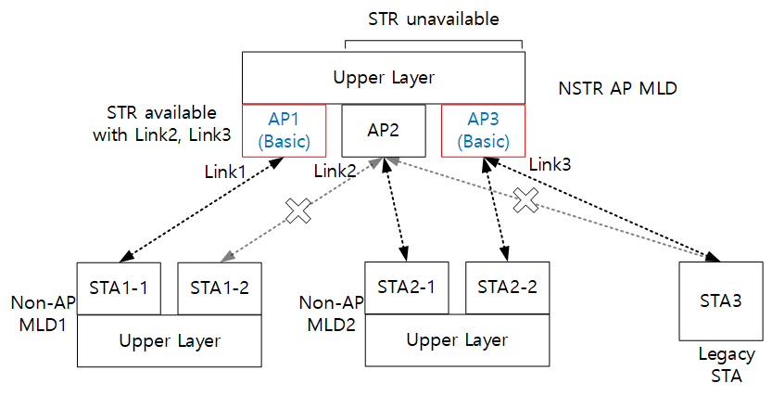
Association rules with the basic link concept
Legacy STAs are allowed to associate with AP MLD only in basic link(s)
Non-AP STA MLD is allowed to associate with AP MLD only if the negotiated links for MLO includes the basic link(s) within the NSTR link set

Slide 8
Channel access rule with basic link
The independent EDCA contention in the non-basic link is not allowed basically:
Legacy STA may not be able to operate in non-basic link
Non-AP STA MLD may transmit using the synchronized ML transmission
The synchronized transmission should include the other NSTR links which is Basic link
Simple rule to manage uplink transmission, but causes low usage of non-basic link(s)

Slide 9
Additional transmission rule with basic link
The channel access rule with the basic link may cause low usage of non-basic links
Results in too many congestion only in the basic links
To relieve that, the conditional transmission on the non-basic link may be allowed
E.g. The transmission on the non-basic link during the PPDU [6] transmission time of the basic link

Slide 10
Conclusion
In this presentation, we have discussed about the operation of NSTR AP
The main constraint of NSTR AP operation is caused by the unpredicted uplink transmission
To manage the uplink transmission from non-AP STA, the concept of basic link is proposed
The basic rule with the basic link is proposed
The association of legacy STA is allowed in the basic link
The independent EDCA channel access in non-basic link is not allowed

Slide 11
Straw Poll 1
Do you agree to add in SFD for R1:
NSTR AP MLD defines basic link as follows
If a link in AP MLD is STR with the other links in the same MLD, it can be a basic link
If a link in AP MLD is NSTR with at least one link in the same MLD, at most one link in the NSTR link set can be a basic link
Note: NSTR link set is an inseparable group of links in which each link is NSTR with another link in the same group

Slide 12
References
[1] 20/0566r91, Compendium of straw polls and potential changes to the Specification Framework Document, Edward Au (Huawei)
[2] 19/1993r1, Discussion about single and multiple primary channels in synchronous multi-link, Yunbo Li (Huawei)
[3] 20/0034r0, Multi-link grouping, Jason Yuchen Guo (Huawei)
[4] 20/0755r1, Non-STR AP Operation, Jinjing Jiang (Apple)
[5] 20/1036r5, Terminology for Soft AP MLD, Jinjing Jiang (Apple)
[6] 20/1540r0, Proposals for an NSTR soft AP, Shubhodeep Adhikari (Broadcom)
[7] 20/1576r0, Multilink Management for Non-STR Soft AP, Ronny Yongho Kim (KNUT)

