Slide 1
Overview of Wi-Fi sensing protocol
Date: 2020-11-12
Authors:
Name | Affiliations | Address | Phone | Email
Cheng Chen | Intel |  |  | cheng.chen@intel.com
Claudio da Silva |  |  |  | claudio.da.silva@intel.com
Bahareh Sadeghi |  |  |  | bahareh.sadeghi@intel.com
Carlos Cordeiro |  |  |  | carlos.cordeiro@intel.com
Notes:
September 2012

Slide 2
Abstract
In this contribution, we propose a possible framework of a WLAN sensing protocol.
We divide a sensing session into different phases and go through them individually.

Slide 3
Assumptions
We use the terminologies defined in [1] to describe the different roles in a sensing session.
  i.e., Sensing initiator/responder, Sensing transmitter/receiver.
Discovery of sensing capable STAs is already done.
  i.e., STAs involved in the sensing session already exchanged sensing related capabilities and know each other’s capabilities.

Slide 4
Protocol Overview
Discovery
    Capabilities exchange (For example, during association)
Negotiation
    Establishment of a sensing session
    Identification of sensing transmitter(s) and sensing receiver(s)
    Determination of associated parameters of sensing transmissions
Measurement exchange
    Sensing transmitter(s) perform transmissions to sensing receivers for measurement
    Depending on scenarios, sensing receiver(s) may need to feedback measurement results to the Sensing Initiator
Teardown (May be implicit)
    Ending the sensing session
Note: Whether each of the phases is mandatory or optional is TBD.
Sensing Initiator
Sensing Responder
Discovery
Negotiation
Measurement exchange
Sensing
session
Teardown

Slide 5
Negotiation
We need to define a specific information element, say, Sensing Parameters element, to include related information that will be exchanged between the sensing initiator and sensing responder(s) during negotiation. The information may include:
  Identification of the roles of sensing transmitter and sensing receiver
  Scheduling information of sensing periods/windows
  Parameters of transmissions used for WLAN sensing, such as channel bandwidth and number of antennas.
  Measurement feedback type
  Other sensing parameters.
Sensing Initiator
Sensing Responder
Sensing Request
ACK
Note: The ACK may not be necessary depending
on how we define the Sensing Request/Response
frame.
Sensing Response
ACK

Slide 6
Measurement Exchange
Measurement exchange always includes sensing transmission, but sensing report is optional, depending on the roles of sensing transmitter and receiver.
  When the sensing receiver is the STA that requests sensing results, then there is no need to feedback the sensing measurement results.
Sensing Transmitter
Sensing Receiver
Sensing Receiver
Sensing Transmitter
Sensing transmissions
Sensing Measurement Feedback
Sensing transmissions
When sensing transmitter is the STA
that requests sensing results
When sensing receiver is the STA
that requests sensing results

Slide 7
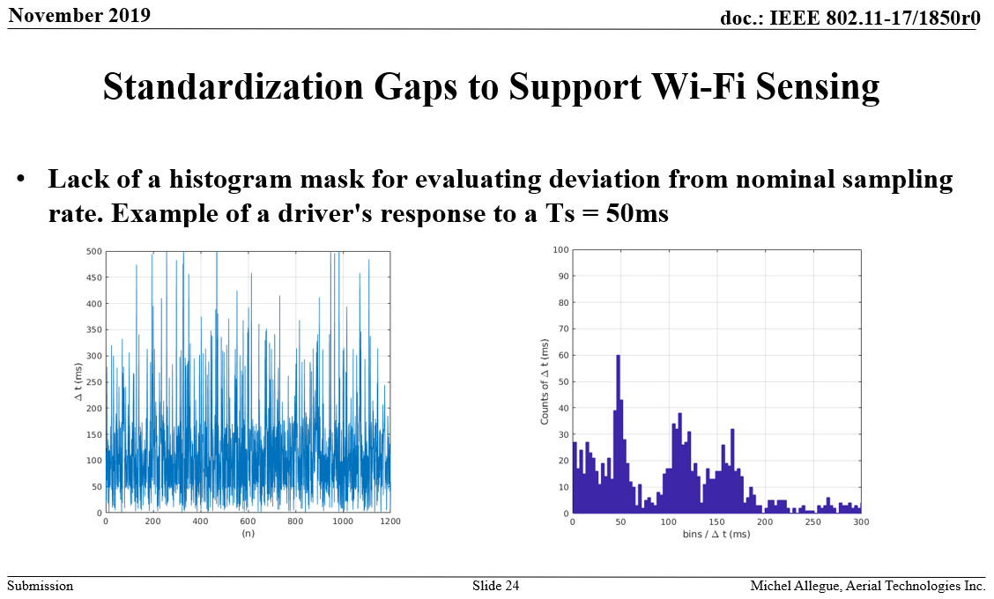
Measurement Exchange
Scheduling of transmissions used for sensing measurement is key to obtain a more regular “sampling interval” of the channel and, therefore, improve WLAN sensing.
  Example given in 19/1850r0 by Michel Allegue (Aerial) [2]:

Slide 8
Measurement Exchange
Transmissions used for measurement within a sensing session may be defined to have certain characteristics.
  Example: PHY configuration freeze/hold – PPDUs used for measurement shall be transmitted with same set of transmit parameters
Different scheduling options should be considered.
  Example 1: Regular interval
  Example 2: “Bursts”
  Note: The scheduling examples here are only for illustrative purposes. We are not proposing to place any hard limits in terms of scheduling for now.

Slide 9
Termination
Implicit sensing session termination
  A sensing session automatically terminates at the end of the sensing session negotiated between the sensing initiator and sensing responder(s).
Explicit sensing session termination
  A sensing session may also be terminated before the end of the sensing session through some message.
  For example, by adding some specific indications in the Sensing PPDUs or Sensing Measurement Feedback to enable the sensing transmitter or receiver to terminate the sensing session.
  Alternatively, define a separate Sensing Termination frame for either the sensing initiator or responder to terminate the sensing session.
Slide 9

Slide 10
Conclusions
In this contribution we proposed a high-level overview of the framework of a WLAN sensing protocol consisting of several phases.

Slide 11
SP1
Do you agree with the following?
  A sensing session is composed of one or more of the following phases: negotiation phase, measurement phase, and termination phase.
    In the negotiation phase, operational parameters associated with the sensing session are exchanged between STAs.
    In the measurement phase, sensing measurements are performed and sensing results are reported.
    In the termination phase, STAs stop performing measurements and terminate the sensing session.

Slide 12
References
[1] 11-20-1849-00-00bf-Wi-Fi-Sensing-Definitions
[2] 11-19-1850-00-SENS-wi-fi-sensing-technical-feasibility-standardization-gaps
[3] 11-20-1804-00-00bf-discussion-on-wlan-sensing-procedure

