Slide 1
Overview of typical Wi-Fi sensing scenarios
Date: 2020-11-15
Authors:
Name | Affiliations | Address | Phone | Email
Cheng Chen | Intel |  |  | cheng.chen@intel.com
Claudio da Silva |  |  |  | claudio.da.silva@intel.com
Bahareh Sadeghi |  |  |  | bahareh.sadeghi@intel.com
Carlos Cordeiro |  |  |  | carlos.cordeiro@intel.com
Notes:
September 2012

Slide 2
Abstract
This contribution proposes an overview of typical Wi-Fi sensing scenarios that we are likely to consider in later protocol development.

Slide 3
Recap of definitions introduced in [1]
Sensing session
  A sensing procedure allows a STA to perform WLAN sensing and obtain measurement results. A sensing session is an instance of a sensing procedure with the associated scheduling if applicable, and operational parameters of that instance.
Roles in Wi-Fi sensing
  Sensing initiator and sensing responder
    Sensing initiator: a STA that initiates a WLAN sensing session
    Sensing responder: a STA that participates in a WLAN sensing session initiated by a sensing initiator
  Sensing transmitter and sensing receiver
    Sensing transmitter: a STA that transmits PPDUs used for sensing measurements in a sensing session
    Sensing receiver: a STA that receives PPDUs sent by a sensing transmitter and performs sensing measurements
  Note: A STA can assume multiple roles in one sensing session.

Slide 4

Scenario 1
A single STA is the sensing initiator, sensing responder, sensing transmitter and sensing receiver.
Sensing PPDU transmission
Target
Sensing feedback transmission
Echo
STA1
Sensing Initiator and Sensing Responder
Sensing Transmitter and Sensing Receiver

Slide 5
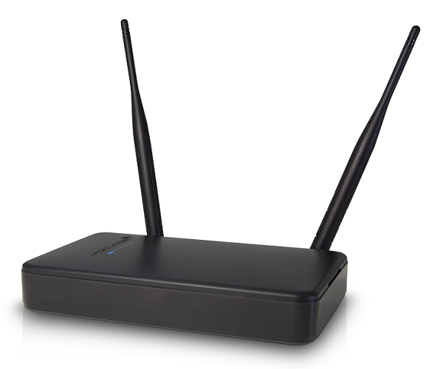
Scenario 2
One STA is the sensing initiator and sensing receiver.
Another STA is the sensing responder and sensing transmitter.
Sensing Responder
Sensing Transmitter
Sensing PPDU transmission
Sensing feedback transmission
STA2
STA1
Sensing Initiator
Sensing Receiver

Slide 6
Scenario 3
One STA is the sensing initiator and sensing transmitter.
Another STA is the sensing responder and sensing receiver.
Sensing Initiator
Sensing Transmitter
Sensing PPDU transmission
Sensing feedback transmission
STA2
STA1
Sensing Responder
Sensing Receiver

Slide 7

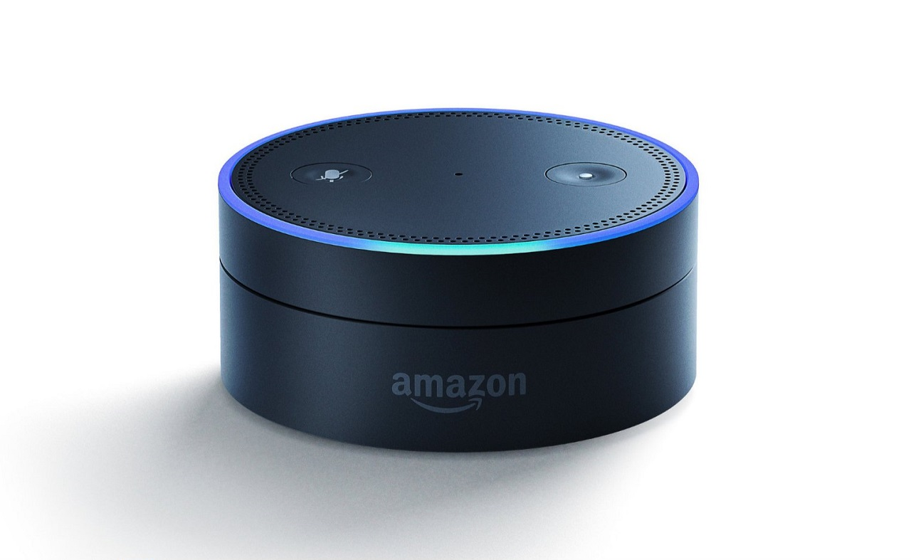
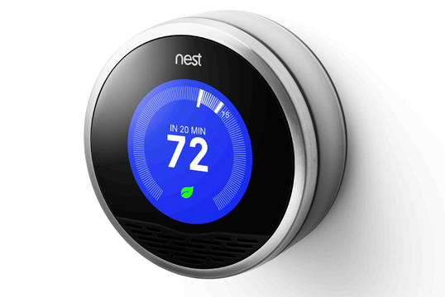
Scenario 4
One STA is the sensing initiator and sensing receiver.
Multiple STAs are sensing responders and sensing transmitters.
Sensing Initiator
Sensing Receiver
Sensing PPDU transmission
STA5
Sensing feedback transmission
STA1
STA2
STA3
STA4
Sensing Responders
Sensing Transmitters

Slide 8
Scenario 5
One STA is the sensing initiator and sensing transmitter.
Multiple STAs are sensing responders and sensing receivers.
Sensing Initiator
Sensing Transmitter
Sensing PPDU transmission
STA5
Sensing feedback transmission
STA1
STA2
STA3
STA4
Sensing Responders
Sensing Receivers

Slide 9
Scenario 6
One STA is the sensing initiator and sensing transmitter.
Multiple STAs are the sensing responders. Some STAs are sensing receivers, some are sensing transmitters [3].
  Need a mechanism to enable STA2 to transmit feedback to STA3 after receiving sensing PPDU transmitted from STA1.
Sensing Initiator
Sensing Receiver
Sensing PPDU transmission
STA3
Sensing feedback transmission
STA1
STA2
Sensing Responder
Sensing Transmitter
Sensing Responder
Sensing Receiver

Slide 10
Summary
In this contribution we present several representative sensing scenarios we are likely to consider in developing the protocol in 11bf.
The sensing protocol we will define in 11bf needs to address all or a subset of these scenarios.

Slide 11
SP
Do you agree that 11bf shall consider all scenarios described in Slide 4-9?

Slide 12
References
[1] 11-20-1850-01-SENS-Wi-Fi-Sensing-Definitions
[2] 11-20-1266-00-SENS-wlan-sensing-procedures-and-use-cases
[3] 11-20-1533-00-SENS-collaborative-wlan-sensing

