Slide 1
EHT PPE Thresholds Field
Date: 2020-11-10
Authors:
Name | Affiliations | Address | Phone | email
Mengshi Hu | Huawei |  |  | humengshi@Huawei.com
Oded Redlich | Huawei |  |  | oded.redlich@huawei.com
Ross Jian Yu | Huawei |  |  | ross.yujian@huawei.com
Ming Gan | Huawei |  |  | ming.gan@huawei.com
Shimi Shilo | Huawei |  |  | Shimi.Shilo@huawei.com
Avner Epstein | Huawei |  |  | avner.epstein@huawei.com

Slide 2
Background
Nominal Packet Padding value in 11ax
  Nominal Packet Padding value along with Pre-FEC Padding Factor (a) determines the Nominal T_{PE} values for PE field.
  The duration of the PE field, T_{PE}, may take values of 0, 4, 8, 12 or 16 µs, and should be equal to the Nominal T_{PE} to minimize the PE overhead.
Nominal T_{PE} values
Nominal Packet Padding value
Pre-FEC Padding Factor (a) | TXVECTOR parameter NOMINAL_PACKET_PADDING (HE SU PPDU or HE ER SU PPDU) or NOMINAL_PACKET_PADDING[u] (HE MU PPDU)
 | 0 μs | 8 μs | 16 μs
1 | 0 μs | 0 μs | 4 μs
2 | 0 μs | 0 μs | 8 μs
3 | 0 μs | 4 μs | 12 μs
4 | 0 μs | 8 μs | 16 μs

Slide 3
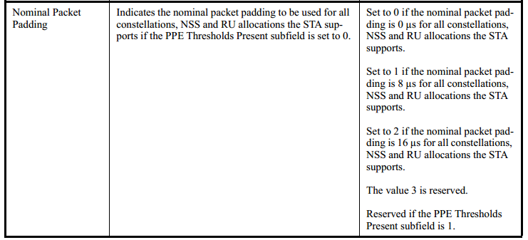
Selection of Nominal Packet Padding value (1/2)
Two methods are used to determine the Nominal Packet Padding value in 11ax:
  Method 1: If the PPE Thresholds Present subfield is equal to 0, the Nominal Packet Padding value is decided by the Nominal Packet Padding subfield [1].

Slide 4
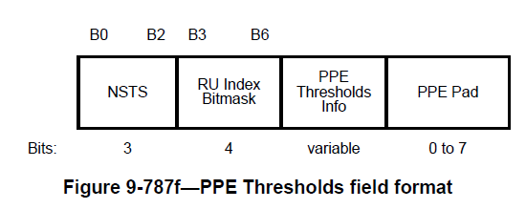
Selection of Nominal Packet Padding value (2/2)
  Method 2: If the PPE Thresholds Present subfield is equal to 1, the Nominal Packet Padding value is decided by the PPE Thresholds field.
In [2], a 20 μs nominal packet padding value is considered for Method 1 to add more processing time for receivers.
  Set to 3 if the nominal packet padding is 16 μs for all modes with constellation<=1024, NSS<=8 and RU<=996*2, and 20 μs for all other modes the STA supports [2].
In this contribution we consider 20 μs based on Method 2.

Slide 5
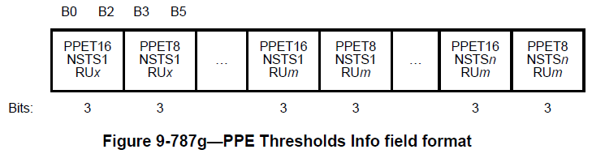
Introduction of PPE Thresholds field (1/3)
PPE Thresholds Info format
  The NSTS subfield and the RU Index Bitmask subfield show the selected values of the indication scope of the PPE Thresholds Info field.
  Each PPET16/8 subfield is used to indicate a modulation threshold (constellation index) at the corresponding NSTS and RU size.

Slide 6
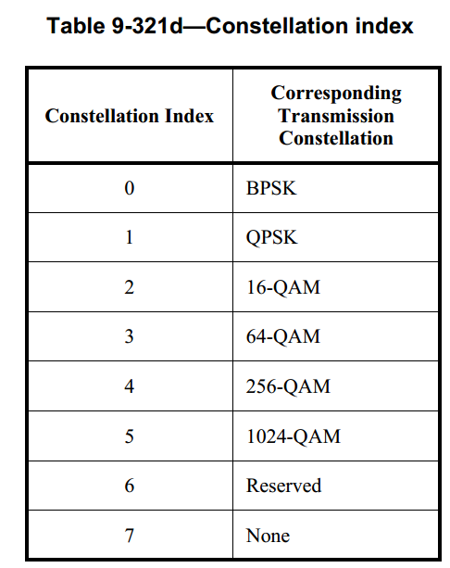
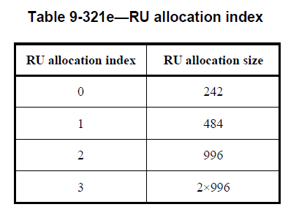
Introduction of PPE Thresholds field (2/3)
NSTS subfield in 11ax
  3 bits to indicate 1-8 SS
  RU Index Bitmask subfield in 11ax
  Contains a bitmask that indicates whether the PPE Thresholds Info field contains PPET16 and PPET8 values for the four possible RU sizes
  4 bits to indicate RU 242, 484, 996 and 2*996.
In the following, we show what the constellation index in each PPET16/8 subfield is used for.

Slide 7
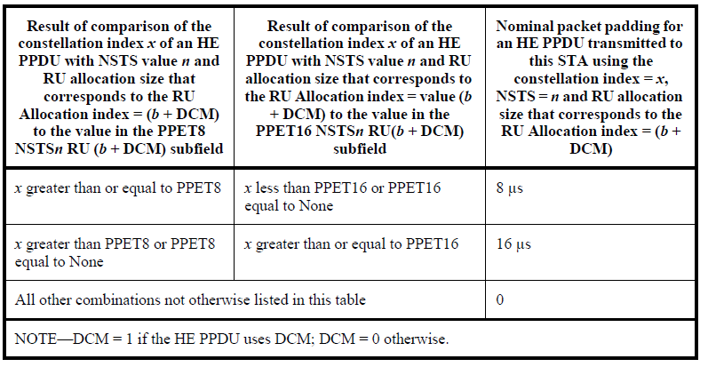
Introduction of PPE Thresholds field (3/3)
The constellation index is used in the following table:
How to determine the Nominal Packet Padding value at a specific NSTS and RU size?
  See the above table. If the two requirements in a row are both satisfied, the corresponding Nominal Packet Padding value is selected (8 or 16). Other combinations not otherwise listed indicate the Nominal Packet Padding value 0.
Note: None in the table indicates ignoring the corresponding requirement

Slide 8
PPE Thresholds field for EHT
As a straightforward extension to 11ax, we consider supporting the threshold notification for 20 μs similar to the designs for 16/8 μs.
  Add PPET20 subfield
 | NSTS | RU Index Bitmask | PPE Thresholds Info | PPE Pad
Bits | TBD | TBD | 3 per each | 0-7
 | PPET20 NSTS1 RUx | PPET16 NSTS1 RUx | PPET8 NSTS1 RUx | … | PPET20 NSTSn RUm | PPET16 NSTSn RUm | PPET8 NSTSn RUm | …
Adding PPET20 subfield provides a flexible threshold notification based on Method 2.

Slide 9
Update the PPE Threshold Info Field
16 SS, 320MHz and 4096-QAM are supported in 11be. Therefore,
  NSTS subfield is extended to 4 bits to support 1-16 SS.
  RU Index Bitmask is extended to 6 bits to support 3*996 and 4*996 (Add entries for 3*996 and 4*996).
  Use Constellation Index = 6 to indicate 4096-QAM.
PPE Thresholds in 11be
 | NSTS (NSS) | RU Index Bitmask | PPE Thresholds Info | …
Bits | 4 | 6 | 3 per each
4 | 3*996
4096-QAM
5 | 4*996

Slide 10
Omission of PPET subfields
PPET16/8 subfields can exist both in HE Capabilities element and EHT Capabilities element
We consider 2 options of signaling PPET in EHT
Opt. 1: No omission
  Even though some of the PPET16/8 subfields are notified in HE Capabilities element, a STA still notifies them in EHT Capabilities element.
Opt. 2: Support omission
  The PPET16/8 subfields notified in HE Capabilities element do not need to occur again in the EHT Capabilities element to save overhead.

Slide 11
Summary
Proposed EHT PPE Thresholds field
  Add PPET20 subfield similar to the PPET16/8 styles in 11ax
Discussed some TBD issues related to the PPE Thresholds in 11be:
  NSTS subfield, RU Index Bitmask subfield and Constellation Index
  Whether or not to omit some of the PPET16/8 subfield in PPE Thresholds Info field

Slide 12
Straw Poll #1
  Do you agree to define PPE Thresholds field in EHT Capabilities element?
  The existence of the PPET Thresholds field is indicated by the PPET Thresholds Present subfield in EHT PHY Capabilities Information field.
  Y
  N
  A

Slide 13
Straw Poll #2
  Do you agree with the following changes in EHT PPE Thresholds field?
  NSTS subfield is extended to 4 bits to support 1-16 SS.
  RU Index Bitmask subfield is extended to 6 bits to support 3*996 and 4*996.
  Use Constellation Index = 6 to indicate 4096-QAM.
  Y
  N
  A

Slide 14
References
[1] IEEE P802.11ax™/D7.0
[2] IEEE 11-20-1331r0 EHT pre-FEC padding and packet extension

