Slide 1
RU Allocation Subfield Design for EHT Trigger Frame Follow up
Date: 2020-11-11
Authors:

Slide 2
Introduction
11be task group has approved that 11be shall allow the following PHY features [1].
  320 MHz PPDU
  802.11be shall allow more than one RUs to be assigned to a single STA.
Design aspects regarding Trigger frame to support these above features have been discussed in several contributions [2][3].
In [4], we proposed the 9-bit RU Allocation subfield for EHT Trigger frame so that RU allocation signaling for Trigger based UL MU transmissions can cover the supported bandwidths and MRU combinations.

Slide 3
Introduction (Cont’d)
In [5], two options for MRU indication utilizing the 9-bit RU Allocation subfield in trigger frames were proposed.
  Option1: Follows 11ax style and aims to reduce the entries in RU Allocation table
  Option2: Designed on the basis of 11ax style and aims to make the RU Allocation table clear
In [6], 9-bit RU Allocation subfield considering 11ax backward compatibility for EHT Trigger frame was proposed.
  But, the mapping rule for MRU of 2×RU996+RU484 is not consistent with the mapping rules for remaining MRU combinations.
Therefore, in this contribution, we address modified 9-bit RU Allocation subfield for Trigger frame by changing the mapping rule only for MRU of 2×RU996+RU484 from RU Allocation subfield table in [6].

Slide 4
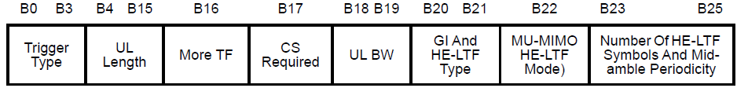
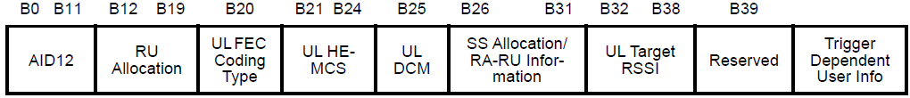
EHT Trigger Frame Format
In 11ax, a Trigger frame allocates resources for and solicits one or more HE TB PPDU transmissions. The Trigger frame also carries other information required by the responding STA to send an HE TB PPDU.
  Trigger frame format in 11ax
EHT Trigger frame can be designed by modifying an existing HE Trigger frame in order to allocate RU or MRU to STAs for UL MU transmissions in EHT.
  E.g., UL BW in Common Info is expanded to support BW of 320MHz. (2 bits => 3 bits)
  E.g., RU Allocation subfield in User Info field is expanded to indicate MRU assignment.
We focus on RU Allocation subfield design to enable trigger based UL MU in 11be to support BW of 320MHz and MRU aggregation.
Frame Control | Duration | RA | TA | Common Info | User Info List | Padding | FCS

Slide 5
Structure of RU Allocation subfield for Each STA
Existing 8-bit RU Allocation subfield in User info field in Trigger frame does not allow indicating BW of 320MHz and multiple RU or MRU allocation information.
To support the larger bandwidths and MRU combinations, we can consider the extended 9-bit RU allocation subfield.
  2 bits of [X1 X0]: Used to indicate the location of channel that RU allocation applies
  7 bits of [X8 - X2]: Used to indicate RU or MRU assignment
RU Allocation subfield for EHT
X8 X7 X6 X5 X4 X3 X2 X1 X0

Slide 6
RU Allocation Subfield for 320 MHz BW
In 11ax, one bit (B0) in the RU Allocation subfield in Trigger frame is used to indicate the Primary 80MHz or Secondary 80MHz channel.
To cover the supported bandwidth of 320 MHz in EHT, it is preferred to use two bits, [X1 X0], to indicate the location of channel that RU or MRU allocation applies as follows.
Example
X0 (LU) | If the UL BW subfield indicates 320 MHz, X0 of the RU Allocation subfield is set to 0 to indicate that the RU allocation applies to the lower 160 MHz channel and set to 1 to indicate that the RU allocation applies to the upper 160 MHz channel. (Lower/Upper 160 MHz channel)
X1 | If the UL BW subfield indicates 320 MHz, X1 of the RU Allocation subfield is set to 0 to indicate that the RU allocation applies to the lower 80 MHz channel in 160 MHz as indicated by X0 of the RU Allocation subfield and set to 1 to indicate that the RU allocation applies to the upper 80 MHz channel in 160 MHz as indicated by X0 of the RU Allocation subfield. If the UL BW subfield indicates 160 MHz, X1 of the RU Allocation subfield is set to 0 to indicate that the RU allocation applies to the lower 80 MHz channel and set to 1 to indicate that the RU allocation applies to the upper 80 MHz channel.
 | [X1 X0]
 | Lower 160MHz |  | Upper 160MHz
 | Lower 80MHz | Upper 80MHz | Lower 80MHz | Upper 80MHz
160MHz | [0 x] | [1 x] | - | -
320 MHz | [0 0] | [1 0] | [0 1] | [1 1]

Slide 7
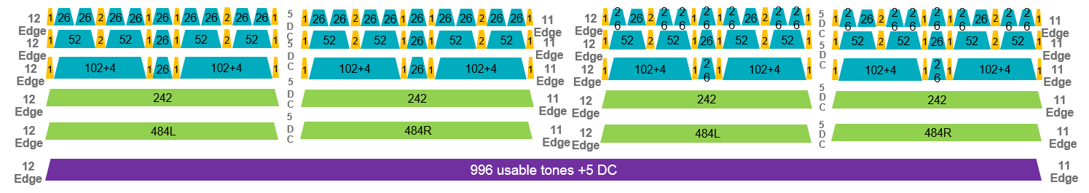
26-tone RU Indices in Both DL and UL for 11be
In 802.11be D0.1, indices of RU1 to RU36 for 26-tone RUs are defined in an 80MHz EHT PPDU. This is not consistent with 11ax.
In [6], they proposed to define the 26-tone RU indices in UL for an 80MHz EHT PPDU as follows for the consistency with 11ax,
  RU1-RU18 for lower 40MHz and RU20-RU37 in upper 40MHz
  There is the index of RU19 for 26-tone DC RU (RU19 is the DC RU in HE OFDMA 80MHz). But it does not exist in 11be.
For the consistency in DL and UL, we propose to apply this modified 26-tone RU indices in both DL and UL.
11be D0.1
RU1
RU18
RU19
RU36
Proposed 26-tone RU Indices for 11be
RU1
RU18
RU19
RU20
RU37

Slide 8
26-tone RU Indices in Both DL and UL for 11be (Cont’d)
We propose to use the following modified 26-tone RU indices for an 80MHz, 160MHz, and 320HMz EHT PPDU in both DL and UL.
  26-tone RU indices for an 80MHz EHT PPDU in both DL and UL
    RU1-RU18 for lower 40MHz and RU20-RU37 in upper 40MHz
    There is the index of RU19 for 26-tone DC RU. But it does not exist in 11be.
  26-tone RU indices in both DL and UL for a 160MHz and 320HMz EHT PPDU are defined based on 26-tone RU indices for an 80MHz EHT PPDU above in both DL and UL .
RU type | RU index and subcarrier range
26-tone RU | RU 1 [–499: –474] | RU 2 [–473: –448] | RU 3 [–445: –420] | RU 4 [–419: –394] | RU 5 [–392: –367]
 | RU 6 [–365: –340] | RU 7 [–339: –314] | RU 8 [–311: –286] | RU 9 [–285: –260]
 | RU 10 [–252: –227] | RU 11 [–226: –201] | RU 12 [–198: –173] | RU 13 [–172: –147] | RU 14 [–145: –120]
 | RU 15 [–118: –93] | RU 16 [–92: –67] | RU 17 [–64: –39] | RU 18 [–38: –13] | RU 19 [It does not exist.]
 | RU 20 [13: 38] | RU 21 [39: 64] | RU 22 [67: 92] | RU 23 [93: 118] | RU 24 [120: 145]
 | RU 25 [147: 172] | RU 26 [173: 198] | RU 27 [201: 226] | RU 28 [227: 252]
 | RU 29 [260: 285] | RU 30 [286: 311] | RU 31 [314: 339] | RU 32 [340: 365] | RU 33 [367: 392]
 | RU 34 [394: 419] | RU 35 [420: 445] | RU 36 [448: 473] | RU 37 [474: 499]

Slide 9
Indication for Multiple RU Allocation Info
Considering the number of entries needed for MRU combinations, it is possible to indicate the allocated MRU aggregation to STAs with the reserved entries of RU Allocation subfield table for the Trigger frame in 11ax .
First, we define indices for MRU combinations based on data and pilot subcarrier indices for RUs.
Then, based on the defined indices for MRU combinations, new entries to indicate various combinations for MRU aggregation are added to the conventional RU Allocation subfield in 11ax.
In the followings, the details of RU Allocation subfield design for indication of allocated MRU are described.

Slide 10
Define Indices for MRUs
Based on Table 27-7 & Table 27-8 in 11ax, the location of MRUs are defined as follows.
  Indices for small-size MRUs in an OFDMA 20 MHz EHT PPDU and
    Indices for MRUs are defined based on RU indices in Table 27-7 (Data and pilot subcarrier indices for RUs in a 20 MHz HE PPDU and in a non-OFDMA 20 MHz HE PPDU).
  Indices for small-size MRUs in an OFDMA 40 MHz EHT PPDU
    Indices for MRUs are defined based on RU indices in Table 27-8 (Data and pilot subcarrier indices for RUs in a 40 MHz HE PPDU and in a non-OFDMA 40 MHz HE PPDU).
MRU type | MRU index | MRU combination
RU52+RU26 | MRU 1 | 52-tone RU 2 + 26-tone RU 2
 | MRU 2 | 52-tone RU 2 + 26-tone RU 5
 | MRU 3 | 52-tone RU 3 + 26-tone RU 8
RU106+RU26 | MRU 1 | 106-tone RU 1 + 26-tone RU 5
 | MRU 2 | 106-tone RU 2 + 26-tone RU 5
MRU type | MRU index | MRU combination
RU52+RU26 | MRU 1 | 52-tone RU 2 + 26-tone RU 2
 | MRU 2 | 52-tone RU 2 + 26-tone RU 5
 | MRU 3 | 52-tone RU 3 + 26-tone RU 8
 | MRU 4 | 52-tone RU 6 + 26-tone RU 11
 | MRU 5 | 52-tone RU 6 + 26-tone RU 14
 | MRU 6 | 52-tone RU 7 + 26-tone RU 17
RU106+RU26 | MRU 1 | 106-tone RU 1 + 26-tone RU 5
 | MRU 2 | 106-tone RU 2 + 26-tone RU 5
 | MRU 3 | 106-tone RU 3 + 26-tone RU 14
 | MRU 4 | 106-tone RU 4 + 26-tone RU 14

Slide 11
Define Indices for MRUs (Cont’d)
The location of MRUs are defined as follows.
  Indices for small-size MRUs in an OFDMA 80 MHz EHT PPDU
    Indices for MRUs are defined based on 52-tone RU indices in Table 36.5 (Data and pilot subcarrier indices for RUs in an 80 MHz EHT PPDU (11be D0.1)) and 26-tone RU indices in slide 8 (Proposed 26-tone RU Indices in Both DL and UL for 11be).
MRU type | MRU index | MRU combination | Note
NoteRU52+RU26 | MRU 1 | 52-tone RU 2 + 26-tone RU 2 | Not supported in BW≥80 MHz
 | MRU 2 | 52-tone RU 2 + 26-tone RU 5 | -
 | MRU 3 | 52-tone RU 3 + 26-tone RU 8 | -
 | MRU 4 | 52-tone RU 6 + 26-tone RU 11 | -
 | MRU 5 | 52-tone RU 6 + 26-tone RU 14 | -
 | MRU 6 | 52-tone RU 7 + 26-tone RU 17 | Not supported in BW≥80 MHz
 | MRU 7 | 52-tone RU 10 + 26-tone RU 21 | Not supported in BW≥80 MHz
 | MRU 8 | 52-tone RU 10 + 26-tone RU 24 | -
 | MRU 9 | 52-tone RU 11 + 26-tone RU 27 | -
 | MRU 10 | 52-tone RU 14 + 26-tone RU 30 | -
 | MRU 11 | 52-tone RU 14 + 26-tone RU 33 | -
 | MRU 12 | 52-tone RU 15 + 26-tone RU 36 | Not supported in BW≥80 MHz
RU106+RU26 | MRU 1 | 106-tone RU 1 + 26-tone RU 5 | -
 | MRU 2 | 106-tone RU 2 + 26-tone RU 5 | Not supported in BW≥80 MHz
 | MRU 3 | 106-tone RU 3 + 26-tone RU 14 | Not supported in BW≥80 MHz
 | MRU 4 | 106-tone RU 4 + 26-tone RU 14 | -
 | MRU 5 | 106-tone RU 5 + 26-tone RU 24 | -
 | MRU 6 | 106-tone RU 6 + 26-tone RU 24 | Not supported in BW≥80 MHz
 | MRU 7 | 106-tone RU 7 + 26-tone RU 33 | Not supported in BW≥80 MHz
 | MRU 8 | 106-tone RU 8 + 26-tone RU 33 | -

Slide 12
Define Indices for MRUs (Cont’d)
The location of MRUs are defined as follows.
  Indices for large-size MRUs in an 80 MHz EHT PPDU and in a non-OFDMA 80 MHz EHT PPDU
MRU type | MRU index | MRU combination
RU484+RU242 | MRU 1 | RU484+RU242; [empty-RU242 RU242 RU484]
 | MRU 2 | RU484+RU242; [RU242 empty-RU242 RU484]
 | MRU 3 | RU484+RU242; [RU484 empty-RU242 RU242]
 | MRU 4 | RU484+RU242; [RU484 RU242 empty-RU242]

Slide 13
Define Indices for MRUs (Cont’d)
The location of MRUs are defined as follows.
  Indices for large-size MRUs in an 160MHz EHT PPDU and in a non-OFDMA 160MHz EHT PPDU
MRU type | MRU index | MRU combination
RU484+RU242 | MRU 1 | RU484+RU242; [empty-RU242 RU242 RU484]
 | MRU 2 | RU484+RU242; [RU242 empty-RU242 RU484]
 | MRU 3 | RU484+RU242; [RU484 empty-RU242 RU242]
 | MRU 4 | RU484+RU242; [RU484 RU242 empty-RU242]

Slide 14
Define Indices for MRUs (Cont’d)
The location of MRUs are defined as follows.
  Indices for large-size MRUs in an 160MHz EHT PPDU and in a non-OFDMA 160MHz EHT PPDU
MRU type | MRU index | MRU combination
RU996+RU484 | MRU 1 | RU996+RU484; [empty-RU484 RU484 RU996]
 | MRU 2 | RU996+RU484; [RU484 empty-RU484 RU996]
 | MRU 3 | RU996+RU484; [RU996 empty-RU484 RU484]
 | MRU 4 | RU996+RU484; [RU996 RU484 empty-RU484]
RU996+RU484+ RU242 (Only for non-OFDMA) | MRU 1 | RU996+RU484+RU242; [empty-RU242 RU242 RU484 RU996]
 | MRU 2 | RU996+RU484+RU242; [RU242 empty-RU242 RU484 RU996]
 | MRU 3 | RU996+RU484+RU242; [RU484 empty-RU242 RU242 RU996]
 | MRU 4 | RU996+RU484+RU242; [RU484 RU242 empty-RU242 RU996]
 | MRU 5 | RU996+RU484+RU242; [RU996 empty-RU242 RU242 RU484]
 | MRU 6 | RU996+RU484+RU242; [RU996 RU242 empty-RU242 RU484]
 | MRU 7 | RU996+RU484+RU242; [RU996 RU484 empty-RU242 RU242]
 | MRU 8 | RU996+RU484+RU242; [RU996 RU484 RU242 empty-RU242]

Slide 15
Define Indices for MRUs (Cont’d)
The location of MRUs are defined as follows.
  Indices for large-size MRUs in a 320MHz EHT PPDU and in a non-OFDMA 320MHz EHT PPDU
MRU type | MRU index | MRU combination
2×RU996+RU484 | MRU 1 | 2×RU996+RU484; [empty-RU484 RU484 RU996 RU996 empty-RU996]
 | MRU 2 | 2×RU996+RU484; [RU484 empty-RU484 RU996 RU996 empty-RU996]
 | MRU 3 | 2×RU996+RU484; [RU996 empty-RU484 RU484 RU996 empty-RU996]
 | MRU 4 | 2×RU996+RU484; [RU996 RU484 empty-RU484 RU996 empty-RU996]
 | MRU 5 | 2×RU996+RU484; [RU996 RU996 empty-RU484 RU484 empty-RU996]
 | MRU 6 | 2×RU996+RU484; [RU996 RU996 RU484 empty-RU484 empty-RU996]
 | MRU 7 | 2×RU996+RU484; [empty-RU996 empty-RU484 RU484 RU996 RU996]
 | MRU 8 | 2×RU996+RU484; [empty-RU996 RU484 empty-RU484 RU996 RU996]
 | MRU 9 | 2×RU996+RU484; [empty-RU996 RU996 empty-RU484 RU484 RU996]
 | MRU 10 | 2×RU996+RU484; [empty-RU996 RU996 RU484 empty-RU484 RU996]
 | MRU 11 | 2×RU996+RU484; [empty-RU996 RU996 RU996 empty-RU484 RU484]
 | MRU 12 | 2×RU996+RU484; [empty-RU996 RU996 RU996 RU484 empty-RU484]
3×RU996 | MRU 1 | 3×RU996; [empty-RU996 RU996 RU996 RU996]
 | MRU 2 | 3×RU996; [RU996 empty-RU996 RU996 RU996]
 | MRU 3 | 3×RU996; [RU996 RU996 empty-RU996 RU996]
 | MRU 4 | 3×RU996; [RU996 RU996 RU996 empty-RU996]
3×RU996+RU484 | MRU 1 | 3×RU996+RU484; [empty-RU484 RU484 RU996 RU996 RU996]
 | MRU 2 | 3×RU996+RU484; [RU484 empty-RU484 RU996 RU996 RU996]
 | MRU 3 | 3×RU996+RU484; [RU996 empty-RU484 RU484 RU996 RU996]
 | MRU 4 | 3×RU996+RU484; [RU996 RU484 empty-RU484 RU996 RU996]
 | MRU 5 | 3×RU996+RU484; [RU996 RU996 empty-RU484 RU484 RU996]
 | MRU 6 | 3×RU996+RU484; [RU996 RU996 RU484 empty-RU484 RU996]
 | MRU 7 | 3×RU996+RU484; [RU996 RU996 RU996 empty-RU484 RU484]
 | MRU 8 | 3×RU996+RU484; [RU996 RU996 RU996 RU484 empty-RU484]

Slide 16
RU Allocation Subfield Design for RU, Small-size MRU, and RU484+RU242
Two bits of [X1 X0] are used to indicate the location of channel that RU or small-size MRU or MRU combinations of RU484+RU242 apply.
[X8-X2] is used to indicate the defined indices for RU or small-size MRU or MRU combinations of RU484+RU242 as follows.
9 bits RU Allocation subfield |  |  | UL BW subfield | RU size | RU Index
X0(LU) | X1 | X8-X2 of RU Allocation subfield
[X0 X1] are used to indicate the location of channel that RU or MRU allocation applies. |  | 0-8 | 20 MHz, 40 MHz, 80 MHz, 160 MHz, 320 MHz | RU26 | RU1 to RU9, respectively
 |  | 9–17 | 40 MHz, 80 MHz, 160 MHz, 320 MHz |  | RU10 to RU18, respectively
 |  | 18 | -- |  | RU19 (It does not exist in 11be.)
 |  | 19–36 | 80 MHz, 160 MHz, 320 MHz |  | RU20 to RU37, respectively
 |  | 37–30 | 20 MHz, 40 MHz, 80 MHz, 160 MHz, 320 MHz | RU52 | RU1 to RU4, respectively
 |  | 41–44 | 40 MHz, 80 MHz, 160 MHz, 320 MHz |  | RU5 to RU8, respectively
 |  | 45–52 | 80 MHz, 160 MHz, 320 MHz |  | RU9 to RU16, respectively
 |  | 53, 54 | 20 MHz, 40 MHz, 80 MHz, 160 MHz, 320 MHz | RU106 | RU1 and RU2, respectively
 |  | 55, 56 | 40 MHz, 80 MHz, 160 MHz, 320 MHz |  | RU3 and RU4, respectively
 |  | 57–60 | 80 MHz, 160 MHz, 320 MHz |  | RU5 to RU8, respectively
 |  | 61 | 20 MHz, 40 MHz, 80 MHz, 160 MHz, 320 MHz | RU242 | RU1
 |  | 72 | 40 MHz, 80 MHz, 160 MHz, 320 MHz |  | RU2
 |  | 63,64 | 80 MHz, 160 MHz, 320 MHz |  | RU3 and RU4, respectively
 |  | 65 | 40 MHz, 80 MHz, 160 MHz, 320 MHz | RU484 | RU1
 |  | 66 | 80 MHz, 160 MHz, 320 MHz |  | RU2
 |  | 67 | 80 MHz, 160 MHz, 320 MHz | RU996 | RU1
 |  | 68 | 160 MHz, 320 MHz | 2×996 | RU1
 |  | 69 | 320 MHz | 4×RU996 | RU1
 |  | 70-72 | 20 MHz, 40 MHz, 80 MHz, 160 MHz, 320 MHz | RU52+RU26 | MRU1 to MRU3, respectively
 |  | 73-75 | 40 MHz, 80 MHz, 160 MHz, 320 MHz |  | MRU4 to MRU6, respectively
 |  | 76-81 | 80 MHz, 160 MHz, 320 MHz |  | MRU7 to MRU12, respectively
 |  | 82,83 | 20 MHz, 40 MHz, 80 MHz, 160 MHz, 320 MHz | RU106+RU26 | MRU1 and MRU2, respectively
 |  | 84,85 | 40 MHz, 80 MHz, 160 MHz, 320 MHz |  | MRU3 and MRU4, respectively
 |  | 86-89 | 80 MHz, 160 MHz, 320 MHz |  | MRU5 to MRU8, respectively
 |  | 90-93 | 80 MHz, 160 MHz, 320 MHz | RU484+RU242 | MRU1 to MRU4, respectively

Slide 17
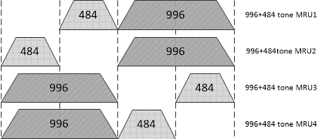
RU Allocation Subfield Design for RU996+RU484
MRU combinations of RU996+RU484 are allowed within 160MHz channels. So, X1 is not used to indicate the channel.
[X8-X1] is used to indicate the defined indices for MRU combinations of RU996+RU484 by informing the punctured RU484 as follows.
9bits RU Allocation subfield |  |  | RU size | Location of punctured RU484 with (X1×2) + (X8-X2) – 94 | RU Index
X0(LU) | X1 | X8-X2 of RU Allocation subfield
[X0] is used to indicate the location of channel that RU or MRU allocation applies. | 0 | 94 | RU996+RU484 | 0 | MRU1
 | 0 | 95 |  | 1 | MRU2
 | 1 | 94 |  | 2 | MRU3
 | 1 | 95 |  | 3 | MRU4

Slide 18
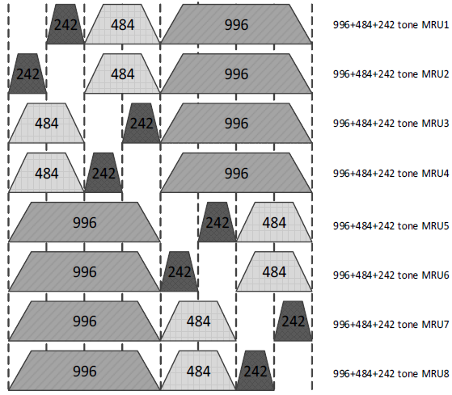
RU Allocation Subfield Design for RU996+RU484+RU242
MRU combinations of RU996+RU484+RU242 are allowed within 160MHz channels. So, X1 is not used to indicate the channel.
[X8-X1] is used to indicate the defined indices for MRU combinations of RU996+RU484+RU242 by informing the punctured RU242 as follows.
9bits RU Allocation subfield |  |  | RU size | Location of punctured RU242 with (X1×2²) + (X8-X2) - 96 | RU Index
X0(LU) | X1 | X8-X2 of RU Allocation subfield
[X0] is used to indicate the location of channel that RU or MRU allocation applies. | 0 | 96 | RU996+RU484+RU242 | 0 | MRU1
 | 0 | 97 |  | 1 | MRU2
 | 0 | 98 |  | 2 | MRU3
 | 0 | 99 |  | 3 | MRU4
 | 1 | 96 |  | 4 | MRU5
 | 1 | 97 |  | 5 | MRU6
 | 1 | 98 |  | 6 | MRU7
 | 1 | 99 |  | 7 | MRU8

Slide 19
RU Allocation Subfield Design for 2×RU996+RU484
MRU combinations of 2×RU996+RU484 are allowed within 320MHz channels. So, 2bits of [X1 X0] are not used to indicate the channel.
[X8-X0] is used to indicate the defined indices for MRU combinations of 2×RU996+RU484 by informing the punctured RU996 and RU484 as follows.
  X0 is used to indicate of the location of punctured RU996.
  [X8-X1] are used to indicate of the punctured RU484 in the certain 3×RU996.
9bits RU Allocation subfield |  |  | RU size | Location of punctured RU484 with (X1×2²) + (X8-X2) – 100 | RU Index
X0(LU) | X1 | X8-X2 of RU Allocation subfield
0 | 0 | 100 | 2×RU996+RU484 | 0 | MRU1
0 | 0 | 101 |  | 1 | MRU2
0 | 0 | 102 |  | 2 | MRU3
0 | 0 | 103 |  | 3 | MRU4
0 | 1 | 100 |  | 4 | MRU5
0 | 1 | 101 |  | 5 | MRU6
1 | 0 | 100 |  | 0 | MRU7
1 | 0 | 101 |  | 1 | MRU8
1 | 0 | 102 |  | 2 | MRU9
1 | 0 | 103 |  | 3 | MRU10
1 | 1 | 100 |  | 4 | MRU11
1 | 1 | 101 |  | 5 | MRU12

Slide 20
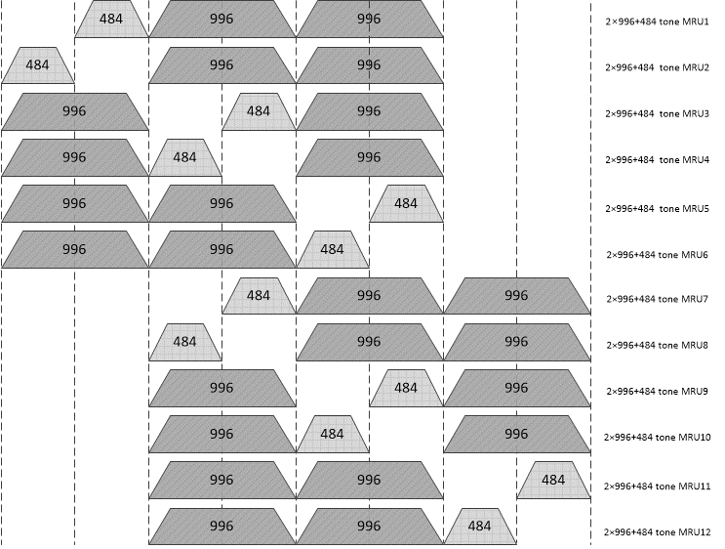
RU Allocation Subfield Design for 2×RU996+RU484 (Cont’d)

Slide 21
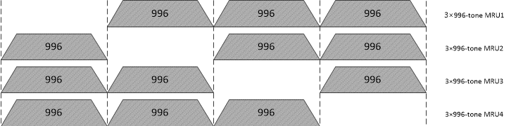
RU Allocation Subfield Design for 3×RU996
MRU combinations of 3×RU996 are allowed within 320MHz channels. So, 2bits of [X1 X0] are not used to indicate the channel.
[X8-X0] is used to indicate the defined indices for MRU combinations of 3×RU996 by informing the punctured RU996 as follows.
9bits RU Allocation subfield |  |  | RU size | Location of punctured RU996 with (X0×2) + (X1) | RU Index
X0(LU) | X1 | X8-X2 of RU Allocation subfield
0 | 0 | 104 | 3×RU996 | 0 | MRU1
0 | 1 | 104 |  | 1 | MRU2
1 | 0 | 104 |  | 2 | MRU3
1 | 1 | 104 |  | 3 | MRU4

Slide 22
RU Allocation Subfield Design for 3×RU996+RU484
MRU combinations of 3×RU996+RU484 are allowed within 320MHz channels. So, 2bits of [X1 X0] are not used to indicate the channel.
[X8-X0] is used to indicate the defined indices for MRU combinations of 3×RU996+RU484 by informing the punctured RU484 as follows.
9bits RU Allocation subfield |  |  | RU size | Location of punctured RU484 with (X0×2²) + (X1×2¹) + (X8-X2) – 105 | RU Index
X0(LU) | X1 | X8-X2 of RU Allocation subfield
0 | 0 | 105 | 3×RU996+RU484 | 0 | MRU1
0 | 0 | 106 |  | 1 | MRU2
0 | 1 | 105 |  | 2 | MRU3
0 | 1 | 106 |  | 3 | MRU4
1 | 0 | 105 |  | 4 | MRU5
1 | 0 | 106 |  | 5 | MRU6
1 | 1 | 105 |  | 6 | MRU7
1 | 1 | 106 |  | 7 | MRU8

Slide 23
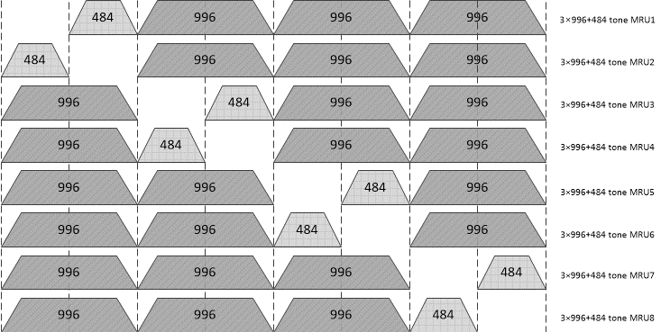
RU Allocation Subfield Design for 3×RU996+RU484 (Cont’d)

Slide 24
RU Allocation Subfield Table for EHT Trigger frame
Based on the previous logics, the mapping of X8–X0 of the RU Allocation subfield for EHT Trigger frame is defined as follows.
9 bits RU Allocation subfield |  |  | UL BW subfield | RU size | RU Index
X0(LU) | X1 | X8-X2 of RU Allocation subfield
[X0 X1] are used to indicate the location of channel that RU or MRU allocation applies. |  | 0-8 | 20 MHz, 40 MHz, 80 MHz, 160 MHz, 320 MHz | RU26 | RU1 to RU9, respectively
 |  | 9–17 | 40 MHz, 80 MHz, 160 MHz, 320 MHz |  | RU10 to RU18, respectively
 |  | 18 | -- |  | RU19 (It does not exist in 11be.)
 |  | 19–36 | 80 MHz, 160 MHz, 320 MHz |  | RU20 to RU37, respectively
 |  | 37–30 | 20 MHz, 40 MHz, 80 MHz, 160 MHz, 320 MHz | RU52 | RU1 to RU4, respectively
 |  | 41–44 | 40 MHz, 80 MHz, 160 MHz, 320 MHz |  | RU5 to RU8, respectively
 |  | 45–52 | 80 MHz, 160 MHz, 320 MHz |  | RU9 to RU16, respectively
 |  | 53, 54 | 20 MHz, 40 MHz, 80 MHz, 160 MHz, 320 MHz | RU106 | RU1 and RU2, respectively
 |  | 55, 56 | 40 MHz, 80 MHz, 160 MHz, 320 MHz |  | RU3 and RU4, respectively
 |  | 57–60 | 80 MHz, 160 MHz, 320 MHz |  | RU5 to RU8, respectively
 |  | 61 | 20 MHz, 40 MHz, 80 MHz, 160 MHz, 320 MHz | RU242 | RU1
 |  | 72 | 40 MHz, 80 MHz, 160 MHz, 320 MHz |  | RU2
 |  | 63,64 | 80 MHz, 160 MHz, 320 MHz |  | RU3 and RU4, respectively
 |  | 65 | 40 MHz, 80 MHz, 160 MHz, 320 MHz | RU484 | RU1
 |  | 66 | 80 MHz, 160 MHz, 320 MHz |  | RU2
 |  | 67 | 80 MHz, 160 MHz, 320 MHz | RU996 | RU1
 |  | 68 | 160 MHz, 320 MHz | 2×996 | RU1
 |  | 69 | 320 MHz | 4×RU996 | RU1
 |  | 70-72 | 20 MHz, 40 MHz, 80 MHz, 160 MHz, 320 MHz | RU52+RU26 | MRU1 to MRU3, respectively
 |  | 73-75 | 40 MHz, 80 MHz, 160 MHz, 320 MHz |  | MRU4 to MRU6, respectively
 |  | 76-81 | 80 MHz, 160 MHz, 320 MHz |  | MRU7 to MRU12, respectively
 |  | 82,83 | 20 MHz, 40 MHz, 80 MHz, 160 MHz, 320 MHz | RU106+RU26 | MRU1 and MRU2, respectively
 |  | 84,85 | 40 MHz, 80 MHz, 160 MHz, 320 MHz |  | MRU3 and MRU4, respectively
 |  | 86-89 | 80 MHz, 160 MHz, 320 MHz |  | MRU5 to MRU8, respectively
 |  | 90-93 | 80 MHz, 160 MHz, 320 MHz | RU484+RU242 | MRU1 to MRU4, respectively

Slide 25
RU Allocation Subfield Table for EHT Trigger frame (Cont’d)
9 bits RU Allocation subfield |  |  | UL BW subfield | RU size | RU Index
X0 | X1 | X8-X2 of RU Allocation subfield
[X0] is used to indicate the location of channel that RU or MRU allocation applies. | 0 | 94 | 160 MHz, 320 MHz | RU996+RU484 | MRU1
 | 0 | 95 |  |  | MRU2
 | 1 | 94 |  |  | MRU3
 | 1 | 95 |  |  | MRU4
 | 0 | 96 | 160 MHz, 320 MHz | RU996+RU484+RU242 | MRU1
 | 0 | 97 |  |  | MRU2
 | 0 | 98 |  |  | MRU3
 | 0 | 99 |  |  | MRU4
 | 1 | 96 |  |  | MRU5
 | 1 | 97 |  |  | MRU6
 | 1 | 98 |  |  | MRU7
 | 1 | 99 |  |  | MRU8
0 | 0 | 100 | 320 MHz | 2×RU996+RU484 | MRU1
0 | 0 | 101 |  |  | MRU2
0 | 0 | 102 |  |  | MRU3
0 | 0 | 103 |  |  | MRU4
0 | 1 | 100 |  |  | MRU5
0 | 1 | 101 |  |  | MRU6
1 | 0 | 100 |  |  | MRU7
1 | 0 | 101 |  |  | MRU8
1 | 0 | 102 |  |  | MRU9
1 | 0 | 103 |  |  | MRU10
1 | 1 | 100 |  |  | MRU11
1 | 1 | 101 |  |  | MRU12
0 | 0 | 104 | 320 MHz | 3×RU996 | MRU1
0 | 1 | 104 |  |  | MRU2
1 | 0 | 104 |  |  | MRU3
1 | 1 | 104 |  |  | MRU4
0 | 0 | 105 | 320 MHz | 3×RU996+RU484 | MRU1
0 | 0 | 106 |  |  | MRU2
0 | 1 | 105 |  |  | MRU3
0 | 1 | 106 |  |  | MRU4
1 | 0 | 105 |  |  | MRU5
1 | 0 | 106 |  |  | MRU6
1 | 1 | 105 |  |  | MRU7
1 | 1 | 106 |  |  | MRU8

Slide 26
Summary
In this contribution, we proposed the modified 9-bit RU Allocation subfield for Trigger frame to indicate the supported bandwidths and MRU combinations in EHT by changing the mapping rule only for MRU of 2×RU996+RU484 from RU Allocation subfield table in [6].

Slide 27
Straw Poll #1
Do you support the following 26-tone RU indices for an 80MHz, 160MHz, and 320HMz EHT PPDU in both DL and UL ?
  26-tone RU indices for an 80MHz EHT PPDU in both DL and UL
    RU1-RU18 for lower 40MHz and RU20-RU37 in upper 40MHz
    There is the index of RU19 for 26-tone DC RU. But it does not exist in 11be.
  26-tone RU indices in both DL and UL for a 160MHz and 320HMz EHT PPDU are defined based on 26-tone RU indices for an 80MHz EHT PPDU above in both DL and UL .
RU type | RU index and subcarrier range
26-tone RU | RU 1 [–499: –474] | RU 2 [–473: –448] | RU 3 [–445: –420] | RU 4 [–419: –394] | RU 5 [–392: –367]
 | RU 6 [–365: –340] | RU 7 [–339: –314] | RU 8 [–311: –286] | RU 9 [–285: –260]
 | RU 10 [–252: –227] | RU 11 [–226: –201] | RU 12 [–198: –173] | RU 13 [–172: –147] | RU 14 [–145: –120]
 | RU 15 [–118: –93] | RU 16 [–92: –67] | RU 17 [–64: –39] | RU 18 [–38: –13] | RU 19 [It does not exist.]
 | RU 20 [13: 38] | RU 21 [39: 64] | RU 22 [67: 92] | RU 23 [93: 118] | RU 24 [120: 145]
 | RU 25 [147: 172] | RU 26 [173: 198] | RU 27 [201: 226] | RU 28 [227: 252]
 | RU 29 [260: 285] | RU 30 [286: 311] | RU 31 [314: 339] | RU 32 [340: 365] | RU 33 [367: 392]
 | RU 34 [394: 419] | RU 35 [420: 445] | RU 36 [448: 473] | RU 37 [474: 499]

Slide 28
Straw Poll #2
Do you support the EHT Trigger Frame RU Allocation subfield table design described in slide 19-20 of 20/1845r0?

Slide 29
Appendix

Slide 30
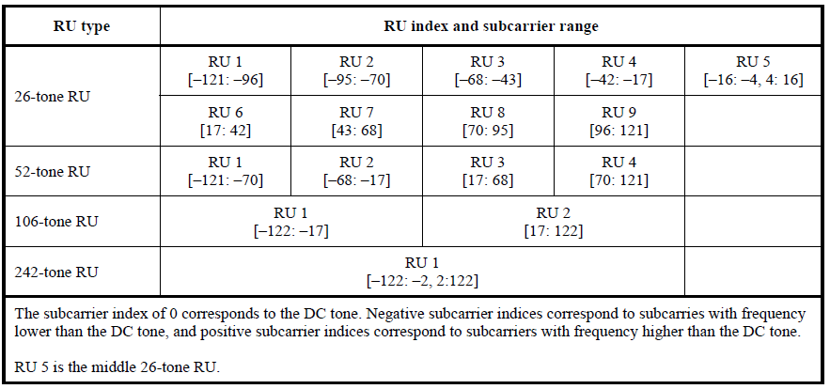
Table 27-7 in 11ax: Data and pilot Subcarrier Indices for RUs in an 20 MHz HE PPDU and in a Non-OFDMA 20 MHz HE PPDU

Slide 31
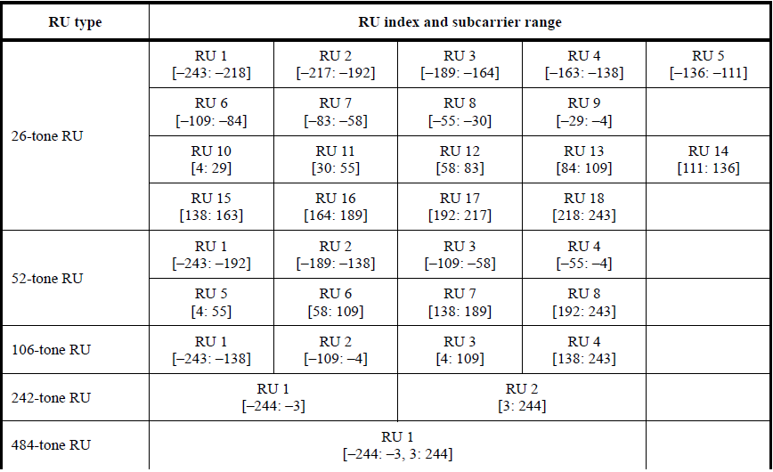
Table 27-8 in 11ax: Data and pilot Subcarrier Indices for RUs in an 40 MHz HE PPDU and in a Non-OFDMA 40 MHz HE PPDU

Slide 32
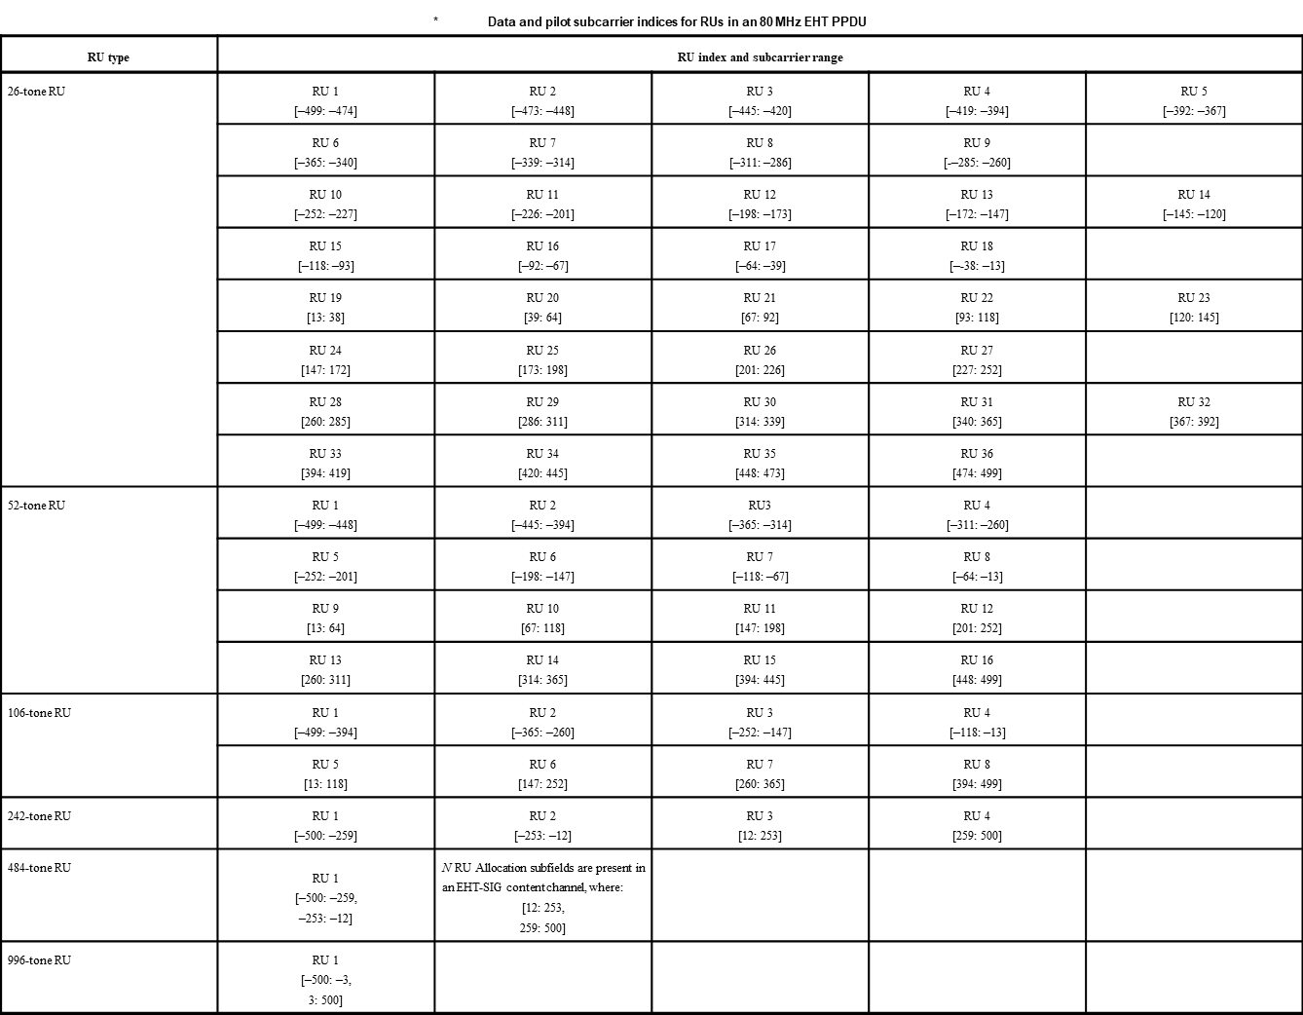
  Table 36.5-Data and pilot subcarrier indices for RUs in an 80 MHz EHT PPDU (11be D0.1)

Slide 33
Reference
[1] 802.11-20/0566r23, Specification Framework for TGbe.
[2] 802.11-20/0416r0, Multi-RU Indication in Trigger Frame.
[3] 802.11-20/0413r1, Discussion on EHT Trigger based UL MU
[4] 802.11-20/0828r6, RU Allocation Subfield Design for EHT Trigger Frame
[5] 802.11-20/0000r0, Multi-RU Indication in Trigger Frame Follow-up
[6] 802.11-20/1703r1, IEEE 802.11ax Backward Compatible Trigger Frame RU Allocation Table
[7] 802.11-20/1429r1, Enhanced Trigger Frame for EHT Support

