Slide 1
Backward compatible EHT trigger frame follow up
Date: 2020-11-01
Authors:

Slide 2
Background
We agree that the trigger frame in 802.1be shall be backward compatible
The same Trigger frame can be used to solicit the TB PPDU from both the HE STA(s) and EHT STA(s)
All the Per User Info fields in a Trigger frame other than MU-BAR Trigger shall have the same size.
One unified RU allocation table (for both SU and MU) for the RU allocation field in the User Info field of the Trigger frame
Some remaining issue are still TBD for the trigger frame
HE/EHT indication, a signalling that indicates TB PPDU format
UL BW extension
RU allocation table and SS allocation in the user info field
In this contribution, we try to address the above remaining issues for backward compatible trigger frame

Slide 3
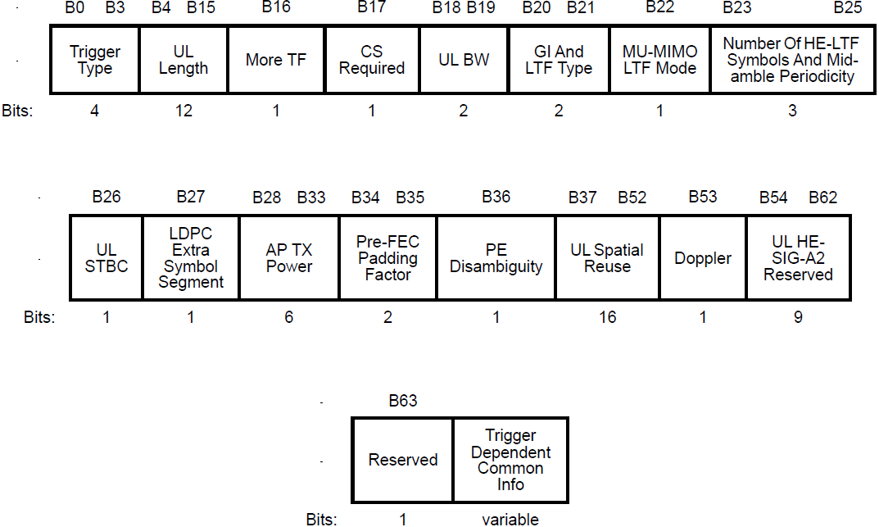
Recap-HE trigger frame
HE trigger frame is shown as below
Common Info field and a list of User Info fields

Slide 4
Trigger frame
For the common part, it is easy for find the reserved bits by using the UL HE SIG-A reserved field or a special User Info field
However, User Info field needs careful design since there is only one clean reserved bit now
Subfield | HE Bits | EHT Bits Opt 2 [2] | EHT Bits Opt 1 [1] | EHT Bits Opt 1’ [1] and [3]
AID12 | 12 | 12 | 12 | 12
RU Allocation | 8 | 8 | 8 | 8
UL FEC Coding Type | 1 | 1 | 1 | 1
MCS | 4 | 4 | 4 | 4
DCM | 1 | 0 (Merges DCM with MCS) | 0 (Merges DCM with MCS) | 0 (Merges DCM with MCS)
SU/MU | 0 | 0 | 0 | 1(0)
SS Allocation | 6 | 6 (4+2, only 4 ss for SU) | 6 (4+2, only 4 ss for SU) | 6 (4+2 for MU-MIMO, 4 for SU)
UL Target RSSI | 7 | 7 | 7 | 7
HE/EHT Format |  | 1 | 0 (move to Common) | 0 (move to Common)
P/S160 MHz or L/H 160 MHz |  | 1 | 1 | 0 (by using a special user info)
Reserved | 1 | 0 | 1 | 1(2)

Slide 5
HE/EHT indication
HE/EHT indication is used to indicate which TB PPDU format the EHT STA is solicited to transmit
There are two options
Opt1: HE/EHT indication is in the Common part of the Trigger frame, that is per 80MHz segment [1]
2 or 4 bits for HE/EHT indication. It has two bits if we limit to HE PPDU only on Primary 160 MHz
Opt2: HE/EHT indication is in the User Info field of the Trigger frame [2]
1 bit in each User Info field
For EHT STA | Opt 1 | Opt 2
Overhead | Small, only 2 or 4 bits | Large, depending on the number of user fields
Reserved bit | At least one clean reserved bit | No clean reserved bit (MSB of AID 12 field is debatable)
Extensible | Yes, it is easy to find bits in the common part | No, there exists extensible signaling issue if it is in User Info field with fixed length, i.e., no space to accommodate EHT/EHT+/EHT++ indication

Slide 6
HE/EHT indication and PHY Version
Since A-PPDU is a feature in R2, so we propose EHT PPDU could transmit either EHT TB PPDU or HE TB PPDU
HE/EHT indication in the common part has 2 bits, each bit corresponds to one 80 MHz segment within primary 160 MHz
Moreover, EHT STA always transmits EHT TB PPDU in R1
PHY version in the trigger frame has overlapped function as EHT/HE indication and it is not needed
Once one of them is known is by EHT STA, it could set the PHY version field in U-SIG of TB PPDU correctly
PHY version just functions as 1 bit to EHT STA

Slide 7
UL BW
BW Expansion (B59) | BW | Bandwidth
0 | 0 | 20 MHz
0 | 1 | 40 MHz
0 | 2 | 80 MHz
0 | 3 | 80+80 MHz or 160 MHz
1 | 0 | 320 MHz
1 | 1 | Reserved
1 | 2 | Reserved
1 | 3 | Reserved
BW Expansion [3]
This bit can be combined with the two-bit BW Field
Possible bit mapping (on right)
However, the simple bw extension can not work
One example
Simple extension can not cover the following solicited transmission
80 MHz for HE TB PPDU, 80 MHz for EHT TB PPDU
Non-HT
L-P+RL
U-SIG
EHT M-BA
Secondary
80MHz
Non-HT
L-P+RL
U-SIG
Non-HT
L-P+RL
U-SIG
Non-HT
trigger
L-P+RL
U-SIG
Non-HT
L-P+RL
SIG-A
HE M-BA
Primary
80MHz
Non-HT
L-P+RL
SIG-A
Non-HT
L-P+RL
SIG-A
Non-HT
trigger
L-P+RL
SIG-A
Trigger frame
TB PPDU

Slide 8
UL BW
Another example
Simple extension can not cover the following solicited transmission
160 MHz for HE TB PPDU and 80 MHz for EHT TB PPDU
Non-HT
L-P+RL
U-SIG
EHT M-BA
Non-HT
L-P+RL
U-SIG
Non-HT
L-P+RL
U-SIG
Secondary
160MHz
Non-HT
trigger
L-P+RL
U-SIG
Punctured 80MHz channel
Non-HT
L-P+RL
SIG-A
HE M-BA
Secondary
80MHz
Non-HT
L-P+RL
SIG-A
Non-HT
L-P+RL
SIG-A
Non-HT
trigger
L-P+RL
SIG-A
Non-HT
L-P+RL
SIG-A
HE M-BA
Primary
80MHz
Non-HT
L-P+RL
SIG-A
Non-HT
L-P+RL
SIG-A
Non-HT
trigger
L-P+RL
SIG-A
Trigger frame
TB PPDU

Slide 9
UL BW
Moreover, we agreed that we need differentiate 320-1 from 320-2 for BW in DL PPDU [4]
To help spatial reuse (identify OBSS PPDU) and intra-PPDU power save
To keep consistent with U-SIG in DL PPDU, 320-1/2 indication in the trigger frame is also needed
UNII5 |  |  |  |  |  | UNII6 | UNII6/7 | UNII7 |  |  | UNII7 /8 | UNII8
80 | 80 | 80 | 80 | 80 | 80 | 80 | 80 | 80 | 80 | 80 | 80 | 80 | 80
160 |  | 160 |  | 160 |  | 160 |  | 160 |  | 160 |  | 160
320-1 |  |  |  | 320-1 |  |  |  | 320-1
 |  | 320-2 |  |  |  | 320-2 |  |  |  | 320-2

Slide 10
UL BW
Two possible UL BW extension indications
The left figure needs 1 bit , but can not cover 320-1/320-2 and can not reflect the real BW of HE PPDU and EHT PPDU in some cases
The right figure works well, but it needs two bits
The other way is to have another BW field, it requires 3 bits
No benefit compared with 2 bits UL BW extension but with more overhead
UL BW Extension (2 bits) | UL BW | Bandwidth for EHT TB PPDU , MHz | Bandwidth for HE TB PPDU, MHz
reserved | 0 | 20 | 20
reserved | 1 | 40 | 40
0 | 2 | 80 | 80
1 | 2 | 160 | 80
2 | 2 | 320 -1 | 80
3 | 2 | 320-2 | 80
0 | 3 | 80 | 160
1 | 3 | 160 | 160
2 | 3 | 320 -1 | 160
3 | 3 | 320-2 | 160
UL BW Extension (1 bit) | BW | Bandwidth for EHT TB PPDU, MHz | Bandwidth for HE TB PPDU, MHz
0 | 0 | 20 | 20
1 | 0 | 320 | 20
0 | 1 | 40 | 40
1 | 1 | 320 | 40
0 | 2 | 80 | 80
1 | 2 | 320 | 80
0 | 3 | 160 | 160
1 | 3 | 320 | 160

Slide 11
Summary
We propose a backward compatible trigger frame by adding the following fields
HE/EHT indication per 80 MHz in the common part
UL BW extension

Slide 12
References
[1] 11-20-0840-03-00be-backward-compatible-eht-trigger-fram
[2] 11-20-1429-02-00be-enhanced-trigger-frame-for-eht-support
[3] 11-20-1669-02-00be-spatial-stream-allocation-in-trigger-frames
[4] 11-20-1467-00-00be-bw320-signaling

Slide 13
SP 1
Do you agree to add the UL BW Extension field to the common part of the Trigger frame in R1?
The UL BW Extension field and the UL BW field together indicate the bandwidth of the EHT TB PPDU solicited by the Trigger frame

Slide 14
SP 2
Do you agree to add the following UL BW Extension field to the common part of the Trigger frame in R1?
UL BW Extension (2 bits) | UL BW | Bandwidth for EHT TB PPDU, MHz | Bandwidth for HE TB PPDU, MHz
reserved | 0 | 20 | 20
reserved | 1 | 40 | 40
0 | 2 | 80 | 80
1 | 2 | 160 | 80
2 | 2 | 320 -1 | 80
3 | 2 | 320-2 | 80
0 | 3 | 80 | 160
1 | 3 | 160 | 160
2 | 3 | 320 -1 | 160
3 | 3 | 320-2 | 160

Slide 15
SP 3
Do you agree to include a 2-bit (1-bit) EHT/HE indication where each bit corresponds to an 80 (160) MHz within primary 160 MHz in the common part of the Trigger frame, indicating to the EHT STA whether to transmit an HE or EHT TB PPDU in R2?
It is TBD whether EHT/HE indication has 1 bit or 2 bits

Slide 16
Appendix

Slide 17
User Info field in trigger frame
The following subfields in the User Info field may be impacted by the new features in EHT
RU allocation subfield
SS allocation subfield
However, there is only one reserved bit in User Info field. From the philosophy of design, it is better to keep it.
We propose to have a special User Info field to divide the User Info fields into two categories
Keep the existing 8-bit RU allocation subfield, and add MRU mode and large RUs to 7-bit table (refer to appendix)
RU allocation subfield in the 1st part indicates a RU within or larger than primary160 MHz
RU allocation subfield in the 2nd part indicates a RU within or larger than second 160 MHz
User Info 1
User Info 2
…
User Info X
Special User Info
User Info X+1
User Info X+2
…
User Info X+n
The first part, the assigned RU is within or larger than primary 160 MHz
The second part, the assigned RU is within or larger than secondary 160 MHz

Slide 18
HE/EHT indication
Example for Opt 1
An EHT AP sends non-HT duplicated trigger frame: two user info fields are for two EHT STAs, respectively. Both of these two User Info fields are EHT format
HE/EHT=10 in the common part （ 1-HE 0-EHT）
Case 1: If EHT STA is assigned to some certain RU in S80/second 80 MHz, then it is solicited to send EHT TB PPDU
Case 2: If EHT STA is assigned to some certain RU in P80/first 80 MHz, then it is solicited to send HE TB PPDU
Non-HT
L-P+RL
U-SIG
EHT M-BA
Secondary
80MHz
Non-HT
L-P+RL
U-SIG
Non-HT
L-P+RL
U-SIG
Non-HT
trigger
L-P+RL
U-SIG
Non-HT
L-P+RL
SIG-A
HE M-BA
Primary
80MHz
Non-HT
L-P+RL
SIG-A
Non-HT
L-P+RL
SIG-A
Non-HT
trigger
L-P+RL
SIG-A
Trigger frame
TB PPDU-UL

Slide 19
HE/EHT indication
Another example for Opt 1
An EHT AP sends non-HT duplicated trigger frame: two user info fields are for two EHT STAs, respectively. One user info field is EHT format， the other one is HE format
HE/EHT=10 in the common part （ 1-HE 0-EHT）
Case 1: If EHT STA is assigned to some certain RU in S80, then it is solicited to send EHT TB PPDU
Case 2: If EHT STA is assigned to some certain RU in P80, then it is solicited to send HE TB PPDU
Non-HT
L-P+RL
U-SIG
EHT M-BA
Secondary
80MHz
Non-HT
L-P+RL
U-SIG
Non-HT
L-P+RL
U-SIG
Non-HT
trigger
L-P+RL
U-SIG
Non-HT
L-P+RL
SIG-A
HE M-BA
Primary
80MHz
Non-HT
L-P+RL
SIG-A
Non-HT
L-P+RL
SIG-A
Non-HT
trigger
L-P+RL
SIG-A
Trigger frame
TB PPDU-UL

