Slide 1
Backward compatible EHT trigger frame follow up
Date: 2020-11-01
Authors:

Slide 2
Background
We agree that the trigger frame in 802.1be shall be backward compatible
  The same Trigger frame can be used to solicit the TB PPDU from both the HE STA(s) and EHT STA(s)
  All the Per User Info fields in a Trigger frame other than MU-BAR Trigger shall have the same size.
  One unified RU allocation table (for both SU and MU) for the RU allocation field in the User Info field of the Trigger frame
  Some remaining issue are still TBD for the trigger frame
  HE/EHT indication, a signalling that indicates TB PPDU format
  UL BW extension
  RU allocation table and SS allocation in the user info field
In this contribution, we try to address the above remaining issues for backward compatible trigger frame

Slide 3
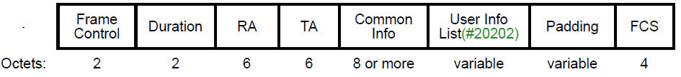
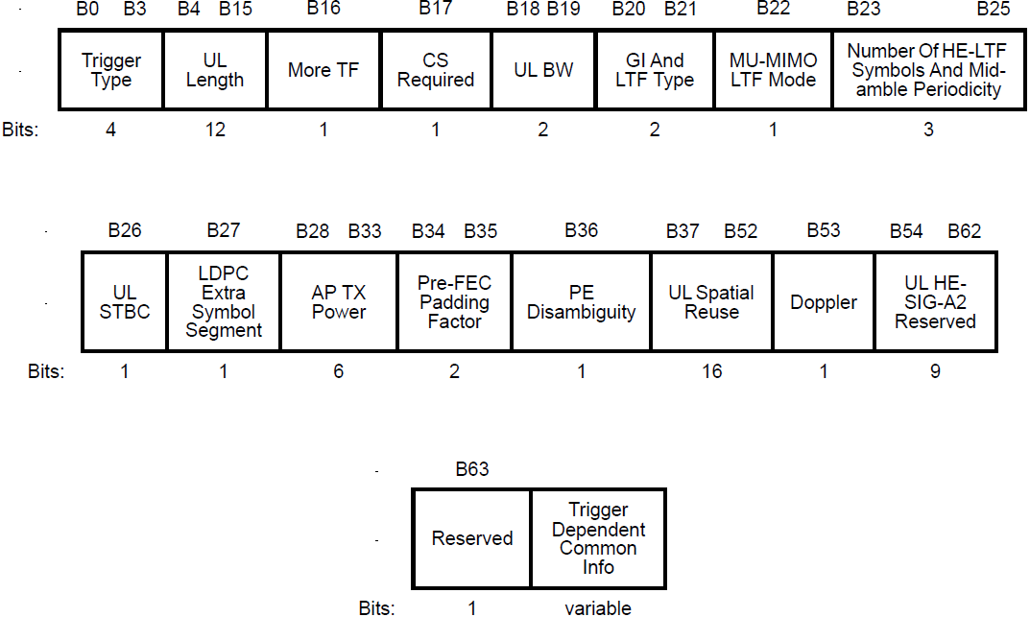
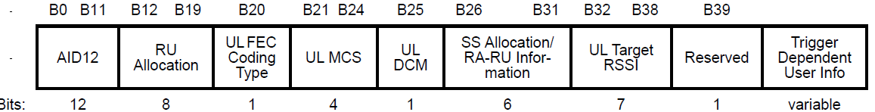
Recap-HE trigger frame
HE trigger frame is shown as below
  Common Info field and a list of User Info fields

Slide 4
Trigger frame
For the common part, it is easy for find the reserved bits by using the UL HE SIG-A reserved field or a special User Info field
However, User Info field needs careful design since there is only one clean reserved bit now
Subfield | HE Bits | EHT Bits Opt 2 [2] | EHT Bits Opt 1 [1] | EHT Bits Opt 1’ [1] and [3]
AID12 | 12 | 12 | 12 | 12
RU Allocation | 8 | 8 | 8 | 8
UL FEC Coding Type | 1 | 1 | 1 | 1
MCS | 4 | 4 | 4 | 4
DCM | 1 | 0 (Merges DCM with MCS) | 0 (Merges DCM with MCS) | 0 (Merges DCM with MCS)
SU/MU | 0 | 0 | 0 | 1(0)
SS Allocation | 6 | 6 (4+2, only 4 ss for SU) | 6 (4+2, only 4 ss for SU) | 6 (4+2 for MU-MIMO, 4 for SU)
UL Target RSSI | 7 | 7 | 7 | 7
HE/EHT Format |  | 1 | 0 (move to Common) | 0 (move to Common)
P/S160 MHz or L/H 160 MHz |  | 1 | 1 | 0 (by using a special user info)
Reserved | 1 | 0 | 1 | 1(2)

Slide 5
HE/EHT indication
HE/EHT indication is used to indicate which TB PPDU format the EHT STA is solicited to transmit
There are two options
  Opt1: HE/EHT indication is in the Common part of the Trigger frame, that is per 80MHz segment [1]
  2 or 4 bits for HE/EHT indication. It has two bits if we limit to HE PPDU only on Primary 160 MHz
  Opt2: HE/EHT indication is in the User Info field of the Trigger frame [2]
  1 bit in each User Info field
For EHT STA | Opt 1 | Opt 2
Overhead | Small, only 2 or 4 bits | Large, depending on the number of user fields
Reserved bit | At least one clean reserved bit | No clean reserved bit (MSB of AID 12 field is debatable)
Extensible | Yes, it is easy to find bits in the common part | No, there exists extensible signaling issue if it is in User Info field with fixed length, i.e., no space to accommodate EHT/EHT+/EHT++ indication

Slide 6
HE/EHT indication and PHY Version
Since A-PPDU is a feature in R2, so we propose EHT PPDU could transmit either EHT TB PPDU or HE TB PPDU
  HE/EHT indication in the common part has 2 bits, each bit corresponds to one 80 MHz segment within primary 160 MHz
  Moreover, EHT STA always transmits EHT TB PPDU in R1
PHY version in the trigger frame has overlapped function as EHT/HE indication and it is not needed
  Once one of them is known is by EHT STA, it could set the PHY version field in U-SIG of TB PPDU correctly
  PHY version just functions as 1 bit to EHT STA

Slide 7
UL BW
BW Expansion (B59) | BW | Bandwidth
0 | 0 | 20 MHz
0 | 1 | 40 MHz
0 | 2 | 80 MHz
0 | 3 | 80+80 MHz or 160 MHz
1 | 0 | 320 MHz
1 | 1 | Reserved
1 | 2 | Reserved
1 | 3 | Reserved
BW Expansion [3]
  This bit can be combined with the two-bit BW Field
  Possible bit mapping (on right)
However, the simple bw extension can not work
One example
  Simple extension can not cover the following solicited transmission
  80 MHz for HE TB PPDU, 80 MHz for EHT TB PPDU
Non-HT
L-P+RL
U-SIG
EHT M-BA
Secondary
80MHz
Non-HT
L-P+RL
U-SIG
Non-HT
L-P+RL
U-SIG
Non-HT
trigger
L-P+RL
U-SIG
Non-HT
L-P+RL
SIG-A
HE M-BA
Primary
80MHz
Non-HT
L-P+RL
SIG-A
Non-HT
L-P+RL
SIG-A
Non-HT
trigger
L-P+RL
SIG-A
Trigger frame
TB PPDU

Slide 8
UL BW
Another example
  Simple extension can not cover the following solicited transmission
  160 MHz for HE TB PPDU and 80 MHz for EHT TB PPDU
Non-HT
L-P+RL
U-SIG
EHT M-BA
Non-HT
L-P+RL
U-SIG
Non-HT
L-P+RL
U-SIG
Secondary
160MHz
Non-HT
trigger
L-P+RL
U-SIG
Punctured 80MHz channel
Non-HT
L-P+RL
SIG-A
HE M-BA
Secondary
80MHz
Non-HT
L-P+RL
SIG-A
Non-HT
L-P+RL
SIG-A
Non-HT
trigger
L-P+RL
SIG-A
Non-HT
L-P+RL
SIG-A
HE M-BA
Primary
80MHz
Non-HT
L-P+RL
SIG-A
Non-HT
L-P+RL
SIG-A
Non-HT
trigger
L-P+RL
SIG-A
Trigger frame
TB PPDU

Slide 9
UL BW
Moreover, we agreed that we need differentiate 320-1 from 320-2 for BW in DL PPDU [4]
  To help spatial reuse (identify OBSS PPDU) and intra-PPDU power save
To keep consistent with U-SIG in DL PPDU, 320-1/2 indication in the trigger frame is also needed
UNII5 |  |  |  |  |  | UNII6 | UNII6/7 | UNII7 |  |  | UNII7 /8 | UNII8
80 | 80 | 80 | 80 | 80 | 80 | 80 | 80 | 80 | 80 | 80 | 80 | 80 | 80
160 |  | 160 |  | 160 |  | 160 |  | 160 |  | 160 |  | 160
320-1 |  |  |  | 320-1 |  |  |  | 320-1
 |  | 320-2 |  |  |  | 320-2 |  |  |  | 320-2

Slide 10
UL BW
Two possible UL BW extension indications
  The left figure needs 1 bit , but can not cover 320-1/320-2 and can not reflect the real BW of HE PPDU and EHT PPDU in some cases
  The right figure works well, but it needs two bits
  The other way is to have another BW field, it requires 3 bits
  No benefit compared with 2 bits UL BW extension but with more overhead
BW Extension (2 bits) | BW | Bandwidth, MHz | Bandwidth for HE STA, MHz
reserved | 0 | 20 | 20
reserved | 1 | 40 | 40
0 | 2 | 80 | 80
1 | 2 | 160 | 80
2 | 2 | 320 -1 | 80
3 | 2 | 320-2 | 80
0 | 3 | 80 | 160
1 | 3 | 160 | 160
2 | 3 | 320 -1 | 160
3 | 3 | 320-2 | 160
BW Extension (1 bit) | BW | Bandwidth, MHz | Bandwidth for HE STA, MHz
0 | 0 | 20 | 20
1 | 0 | 320 | 20
0 | 1 | 40 | 40
1 | 1 | 320 | 40
0 | 2 | 80 | 80
1 | 2 | 320 | 80
0 | 3 | 160 | 160
1 | 3 | 320 | 160

Slide 11
Summary
We propose a backward compatible trigger frame by adding the following fields
  HE/EHT indication per 80 MHz in the common part
  UL BW extension

Slide 12
References
[1] 11-20-0840-03-00be-backward-compatible-eht-trigger-fram
[2] 11-20-1429-02-00be-enhanced-trigger-frame-for-eht-support
[3] 11-20-1669-02-00be-spatial-stream-allocation-in-trigger-frames
[4] 11-20-1467-00-00be-bw320-signaling

Slide 13
SP 1
Do you agree to include a 2-bit EHT/HE indication where each bit corresponds to an 80 MHz within primary 160 MHz in the common part of the Trigger Frame , indicating to the EHT STA whether to transmit an HE or EHT TB PPDU in R2?

Slide 14
SP 2
Do you agree to add the following UL BW extension to the common part of the Trigger frame in R1?
BW Expansion (2 bits) | BW | Bandwidth, MHz | Bandwidth for HE STA, MHz
reserved | 0 | 20 | 20
reserved | 1 | 40 | 40
0 | 2 | 80 | 80
1 | 2 | 160 | 80
2 | 2 | 320 -1 | 80
3 | 2 | 320-2 | 80
0 | 3 | 80 | 160
1 | 3 | 160 | 160
2 | 3 | 320 -1 | 160
3 | 3 | 320-2 | 160

Slide 15
Appendix

Slide 16
User Info field in trigger frame
The following subfields in the User Info field may be impacted by the new features in EHT
  RU allocation subfield
  SS allocation subfield
  However, there is only one reserved bit in User Info field. From the philosophy of design, it is better to keep it.
  We propose to have a special User Info field to divide the User Info fields into two categories
  Keep the existing 8-bit RU allocation subfield, and add MRU mode and large RUs to 7-bit table (refer to appendix)
  RU allocation subfield in the 1st part indicates a RU within or larger than primary160 MHz
  RU allocation subfield in the 2nd part indicates a RU within or larger than second 160 MHz
User Info 1
User Info 2
…
User Info X
Special User Info
User Info X+1
User Info X+2
…
User Info X+n
The first part, the assigned RU is within or larger than primary 160 MHz
The second part, the assigned RU is within or larger than secondary 160 MHz

Slide 17
HE/EHT indication
Example for Opt 1
  An EHT AP sends non-HT duplicated trigger frame: two user info fields are for two EHT STAs, respectively. Both of these two User Info fields are EHT format
  HE/EHT=10 in the common part （ 1-HE 0-EHT）
  Case 1: If EHT STA is assigned to some certain RU in S80/second 80 MHz, then it is solicited to send EHT TB PPDU
  Case 2: If EHT STA is assigned to some certain RU in P80/first 80 MHz, then it is solicited to send HE TB PPDU
Non-HT
L-P+RL
U-SIG
EHT M-BA
Secondary
80MHz
Non-HT
L-P+RL
U-SIG
Non-HT
L-P+RL
U-SIG
Non-HT
trigger
L-P+RL
U-SIG
Non-HT
L-P+RL
SIG-A
HE M-BA
Primary
80MHz
Non-HT
L-P+RL
SIG-A
Non-HT
L-P+RL
SIG-A
Non-HT
trigger
L-P+RL
SIG-A
Trigger frame
TB PPDU-UL

Slide 18
HE/EHT indication
Another example for Opt 1
  An EHT AP sends non-HT duplicated trigger frame: two user info fields are for two EHT STAs, respectively. One user info field is EHT format， the other one is HE format
  HE/EHT=10 in the common part （ 1-HE 0-EHT）
  Case 1: If EHT STA is assigned to some certain RU in S80, then it is solicited to send EHT TB PPDU
  Case 2: If EHT STA is assigned to some certain RU in P80, then it is solicited to send HE TB PPDU
Non-HT
L-P+RL
U-SIG
EHT M-BA
Secondary
80MHz
Non-HT
L-P+RL
U-SIG
Non-HT
L-P+RL
U-SIG
Non-HT
trigger
L-P+RL
U-SIG
Non-HT
L-P+RL
SIG-A
HE M-BA
Primary
80MHz
Non-HT
L-P+RL
SIG-A
Non-HT
L-P+RL
SIG-A
Non-HT
trigger
L-P+RL
SIG-A
Trigger frame
TB PPDU-UL

